Slide 1
PRDA-03 · CAPSTONE PROJECT
HR Analytics
Workforce composition, diversity, hiring trends & attrition — a data-driven view for HR leadership
Prepared by: Sauravi Sarode
Batch / Team: PTID-CDA-SEP-26-11277
Date: 30-09-2026

Slide 2
INTRODUCTION
Objective & Dataset
Objective
Dataset Overview
Analyze the company's HR dataset to understand workforce composition, diversity, hiring trends, and attrition — and provide data-driven recommendations to HR leadership.
Source: MySQL database – project_hr_analytics, Table: HR
22,214
Tools Used
total employee records
MySQL – data querying and KPI calculation
Power BI – dashboard and chart visualization
Microsoft Word / PDF – reporting
Key fields
Employee ID, name, birthdate, age, gender, race, department, job title, location (remote/HQ), hire date, termination date, city, state
HR Analytics — PRDA-03 Capstone
2

Slide 3
KPIS
Key Performance Indicators
22,214
18,285
3,929
Total Employees
Active Employees
Total Attrition
all records
currently employed
17.69% of workforce
24.75%
75.25%
38 yrs
Remote Workforce
HQ Workforce
Average Age
work remotely
work on-site
range 20–57
HR Analytics — PRDA-03 Capstone
3

Slide 4
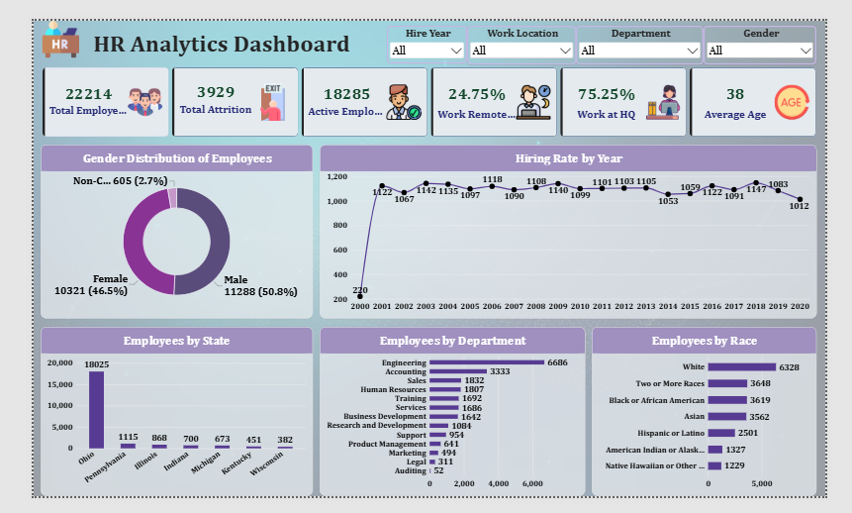
Dashboard
Power BI – Dashboard and chart visualization
Total Attrition
HR Analytics — PRDA-03 Capstone
3

Slide 5
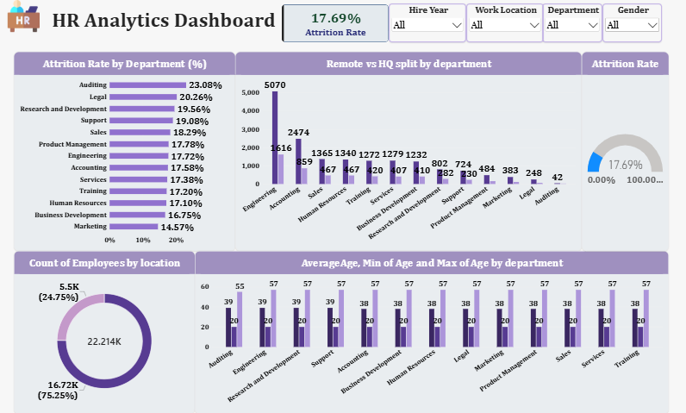
Dashboard
Power BI – Dashboard and chart visualization
Total Attrition
HR Analytics — PRDA-03 Capstone
3

Slide 6
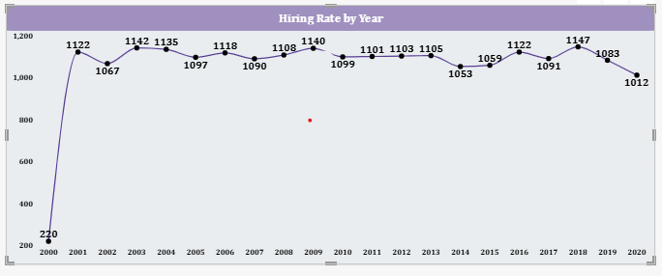
CHART 1 · LINE CHART
Hiring Rate by Year
[ Paste Hiring Rate by Year screenshot here ]
INSIGHT
Steady hiring for two decades
Hiring was minimal in 2000 (220 hires – likely a partial first year), then stabilized to roughly 1,050–1,150 hires/year from 2001–2019. Peak year: 2018 (1,147). 2020 dipped slightly to 1,012.
HR Analytics — PRDA-03 Capstone
4

Slide 7
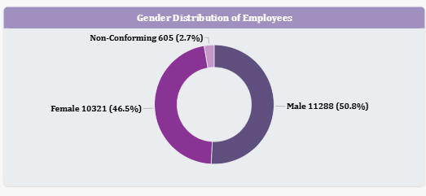
CHART 2 · DONUT CHART
Gender Distribution
[ Paste Gender Distribution screenshot here ]
INSIGHT
Workforce is well balanced by gender
Male: 50.8% (11,288)
Female: 46.5% (10,321)
Non-Conforming: 2.7% (605)
No significant company-wide gender imbalance.
HR Analytics — PRDA-03 Capstone
5

Slide 8
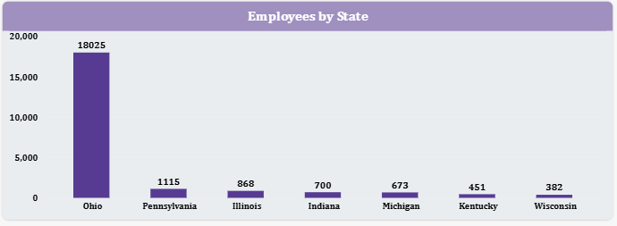
CHART 3 · BAR CHART
Employees by State
[ Paste Employees by State screenshot here ]
INSIGHT
Heavy geographic concentration in Ohio
Ohio: 18,025 employees (≈ 81% of the workforce). All other states are minor: Pennsylvania (1,115), Illinois (868), Indiana (700), Michigan (673), Kentucky (451), Wisconsin (382).
HR Analytics — PRDA-03 Capstone
6

Slide 9
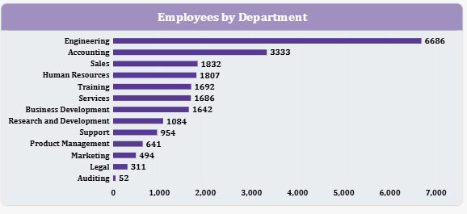
CHART 4 · BAR CHART
Employees by Department
[ Paste Employees by Department screenshot here ]
INSIGHT
Engineering & Accounting dominate headcount
Engineering: 6,686 (30.1%) – the largest team. Accounting: 3,333 (15%). Together they hold 45% of all staff. Auditing is smallest at 52 employees.
HR Analytics — PRDA-03 Capstone
7

Slide 10
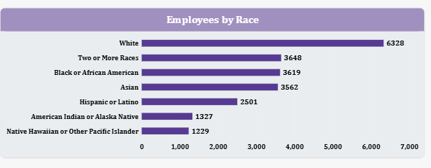
CHART 5 · BAR CHART
Employees by Race
[ Paste Employees by Race screenshot here ]
INSIGHT
Reasonably diverse company-wide
White: 6,328 (28.5%) · Two or More Races: 3,648 · Black or African American: 3,619 · Asian: 3,562 · Hispanic or Latino: 2,501 · Amer. Indian/Alaska Native: 1,327 · Native Hawaiian/Other: 1,229. No single group holds a large majority.
HR Analytics — PRDA-03 Capstone
8

Slide 11
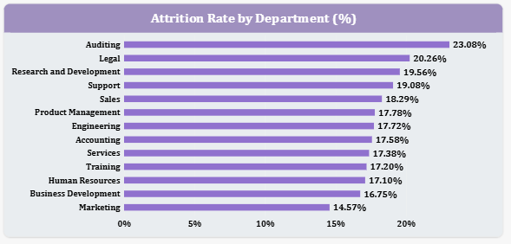
EXTRA INSIGHT · BAR CHART
Attrition Rate by Department
[ Paste Attrition Rate by Department screenshot here ]
INSIGHT
Legal & R&D need retention attention
Auditing: 23.1%* · Legal: 20.3% · R&D: 19.6% · Support: 19.1% · Sales: 18.3% — all above the 17.69% company average. Marketing is lowest at 14.6%.
*Auditing has only 52 employees, so its rate reflects a very small sample.
HR Analytics — PRDA-03 Capstone
9

Slide 12
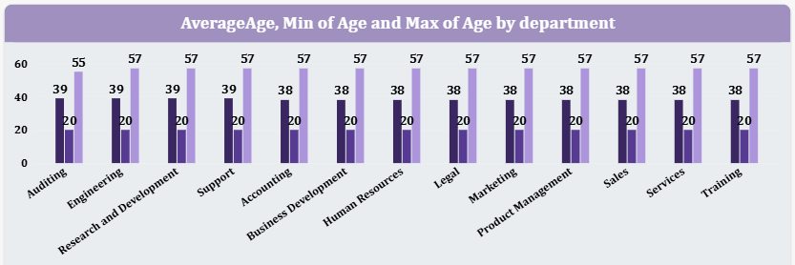
EXTRA INSIGHT · BAR CHART
Average / Min / Max Age by Department
[ Paste Average / Min / Max Age by Department screenshot here ]
INSIGHT
Age is evenly distributed — no localized retirement risk
Average age holds narrowly between 38–39 years across every department, with min/max (20–57) also consistent company-wide. Succession planning should be a company-wide initiative, not department-specific.
HR Analytics — PRDA-03 Capstone
10

Slide 13
FINDINGS
Insights Summary
Workforce
Age Mix
82.3% active, 17.7% attrition; 75.25% HQ vs 24.75% Remote.
Average age 38, consistent (38–39) across every department — no localized retirement risk.
Hiring
Gender
Stable at 1,050–1,150 hires/year since 2001; no aggressive growth or freeze pattern.
Balanced company-wide: 50.8% Male / 46.5% Female / 2.7% Non-Conforming.
Geography
Departments
81% of staff based in Ohio — significant single-location concentration.
Engineering + Accounting = 45% of headcount; Auditing smallest at 0.2%.
Diversity
Attrition
No racial group exceeds 29% of workforce — reasonably diverse overall.
17.69% overall; Legal (20.3%) & R&D (19.6%) run above average.
HR Analytics — PRDA-03 Capstone
11

Slide 14
ACTION PLAN
Recommendations
1
Review retention in Auditing (23.1%), Legal (20.3%) and R&D (19.6%) — all three run meaningfully above the 17.69% company attrition average. Start with exit interviews and a workload/compensation review.
2
Address Ohio concentration risk — 81% of staff are based in one state. Evaluate expanded remote hiring or a second regional hub.
3
Expand remote-work eligibility — only 24.75% currently work remotely; widening this could diversify the talent pool beyond Ohio.
4
Confirm Engineering & Accounting headcount (45% combined) aligns with strategic staffing plans rather than historical drift.
5
Add department-level slicers for gender and race — company-wide diversity is healthy; verify it holds within each team.
HR Analytics — PRDA-03 Capstone
12

Slide 15
CONCLUSION
A large, demographically balanced workforce (22,214 employees) with steady hiring over two decades and 17.69% overall attrition.
The two highest-priority findings for HR leadership: heavy geographic concentration in Ohio (81% of staff), and elevated attrition in Legal and Research & Development. Addressing these represents the clearest path to reducing risk and improving retention.
Thank you

