Slide 1
FoodHub Data Analysis
Project Python Foundations
POST GRADUATE PROGRAM IN AI & MACHINE LEARNING: BUSINESS APPLICATIONS
Saroj Ekka
Aug 24th 2025

Slide 2
Contents / Agenda
Executive Summary
Business Problem Overview and Solution Approach
Data Overview
EDA - Univariate Analysis
EDA - Multivariate Analysis
Appendix

Slide 3
Executive Summary
📊 Key Conclusions (based on FoodHub csv data)
Order Volume & Restaurants
  Dataset covers 1,898 orders across 178 restaurants.
  Average order cost is ~$16.5.
Ratings
  Many customers did not provide ratings (736 “Not given” ≈ 39%).
  Among those who rated:
    5 stars → 588 orders
    4 stars → 386 orders
    3 stars → 188 orders
  Ratings are skewed positively but feedback coverage is low.
Operational Times
  Average preparation time ≈ 27 minutes.
  Average delivery time ≈ 24 minutes.
  Only 10.5% of orders take longer than 60 minutes total (prep + delivery).
Note: You can use more than one slide if needed
Weekday vs Weekend
  Weekdays: Mean delivery time ≈ 28 minutes.
  Weekends: Mean delivery time ≈ 22 minutes.
    Faster deliveries on weekends.
Revenue
  Net revenue (commission model) is ~$6,166.
  Orders above $20 contribute more significantly due to the 25% commission.
Promotional Offers
  Only 4 restaurants qualify for the “high engagement + high rating” promotion:
    The Meatball Shop, Blue Ribbon Fried Chicken, Shake Shack, Blue Ribbon Sushi.

Slide 4
Executive Summary
🎯 Actionable Insights
Ratings & Feedback
  Nearly 40% of customers did not provide ratings. Lack of feedback is limiting insights into quality.
  Restaurants with >50 reviews and avg rating >4 are strong brand ambassadors.
Delivery Efficiency
  Weekend deliveries are ~20% faster than weekdays, likely due to traffic/staffing factors.
  Only 1 in 10 orders exceed 60 minutes, showing good operational performance.
Revenue Drivers
  Majority of revenue is coming from orders > $20 due to higher commission.
  Smaller orders ($5–20) are frequent but less profitable.
Restaurant Engagement
  Only a handful of restaurants are consistently high-rated and high-volume.
  Long-tail restaurants may need quality improvements or visibility boosts.

Slide 5
Executive Summary
✅ Recommendations
Boost Customer Ratings
  Encourage ratings with small discounts or reward points for feedback.
  This reduces “Not given” cases and helps identify issues more clearly.
Improve Weekday Delivery
  Partner with delivery providers to handle weekday traffic better.
  Consider dynamic delivery fee discounts to spread orders more evenly across time slots.
Revenue Optimization
  Highlight premium combo offers above $20 in the app → drives higher commission revenue.
  For smaller orders, push “add-on items” (desserts, drinks) to bump order value above $20.
Promotional Campaigns
  Promote the top 4 high-rated restaurants in ads.
  Create a “FoodHub Certified Best Rated” badge to attract more customers.
Support for Underperforming Restaurants
  Provide insights/training to restaurants with avg ratings ≤3.5.
  Offer them app-based promotions to increase order volume and engagement.

Slide 6
Executive Summary - Q17
(Conclusion based on cuisine type and feedback ratings)
📊 Conclusions
Spanish and Thai cuisines have the highest average ratings (>4.6), but with very low order counts
  underexposed but well-loved.
Indian, Mexican, Japanese, Italian, and Chinese cuisines have both high ratings (~4.3–4.5) and strong order counts,
  showing they are the core demand drivers.
American cuisine has the largest order count (584 orders) but only an average rating of ~4.3
  indicating room for quality improvement.
✅ Recommendations
Promote Niche High-rated Cuisines
  Increase visibility of Spanish and Thai restaurants through promotions and app highlights → convert customer satisfaction into higher order volume.
Strengthen Core Cuisines
  Focus on Indian, Mexican, Japanese, Italian, and Chinese cuisines with combo deals and targeted ads → maximize revenue from already popular, high-rated cuisines.
Improve American Cuisine Quality
  Since American cuisine has the largest volume but lower relative rating, work with these restaurants on quality upgrades (taste, service consistency). Even a small rating improvement will significantly impact overall customer satisfaction.

Slide 7
Business Problem Overview and Solution Approach
Overview
FoodHub, an online food aggregator, wants to analyze customer orders and restaurant performance to gain insights that can improve customer experience and optimize business decisions.
Key challenges include:
Identifying which restaurants and cuisines are most in demand.
Understanding the patterns of customer orders (weekday vs weekend).
Analyzing food preparation time and delivery time to measure efficiency.
Studying customer satisfaction through ratings and its relationship with order cost, preparation, and delivery times.
Helping FoodHub strategically improve partnerships with restaurants and allocate delivery resources better.
The business goal is to analyze the data to get a fair idea about the demand of different restaurants which will help them in enhancing their customer experience. In short
Enhance customer satisfaction.
Improve delivery efficiency.
Support restaurant selection & promotion strategies.
Ultimately, increase revenue through better service and operational efficiency.
Note: You can use more than one slide if needed

Slide 8
Business Problem Overview and Solution Approach
Solution Approach / Methodology
The problem can be solved through Exploratory Data Analysis (EDA), statistical insights, and visualization techniques:
Step 1: Data Understanding & Cleaning
Load and explore dataset structure.
Handle missing values (e.g., ratings not provided).
Remove duplicates and validate data consistency.
Convert categorical variables (weekday/weekend, cuisine type, etc.) if needed.
Step 2: Univariate Analysis
Distribution of order cost.
Most popular restaurants and cuisines.
Distribution of ratings.
Typical food preparation time and delivery time.
Step 3: Bivariate / Multivariate Analysis
Relationship between order cost and rating.
Effect of food preparation time and delivery time on customer rating.
Order demand weekday vs weekend.
Correlation between restaurant popularity and average rating.
Comparison of different cuisines in terms of cost, preparation time, and ratings.
Step 4: Key Insights Extraction
Identify top-performing restaurants (high demand + high ratings + low prep/delivery time).
Find bottlenecks (restaurants with high preparation/delivery times leading to lower ratings).
Determine cuisine preferences across customers.
Recommend strategies for better delivery resource allocation (weekend spikes, peak-hour orders).
Step 5: Business Recommendations
Promote restaurants with high customer satisfaction.
Support restaurants with high prep times by suggesting process improvements
Optimize delivery logistics to reduce delivery times.
Launch marketing campaigns based on cuisine and order patterns.

Slide 9
Data Overview - FoodHub Dataset
Dataset Summary
Total Records: 1898
Total Datafields: 9
Fields Description
order_id → Unique identifier for each order
customer_id → Unique identifier for each customer
restaurant_name → Name of the restaurant
cuisine_type → Cuisine ordered (e.g., Italian, Chinese, Indian)
cost_of_the_order → Cost (in $) of the order
day_of_the_week → Weekday or Weekend order
rating → Rating given by the customer (1–5, may have missing values)
food_preparation_time → Time (minutes) taken by restaurant to prepare food
delivery_time → Time (minutes) taken by delivery person to deliver order
Key Points
Covers order lifecycle from placement → preparation → delivery → customer feedback
Mix of categorical, numerical, and ID variables
Useful for analyzing:
✅ Customer demand patterns
✅ Restaurant efficiency
✅ Delivery performance
✅ Customer satisfaction

Slide 10
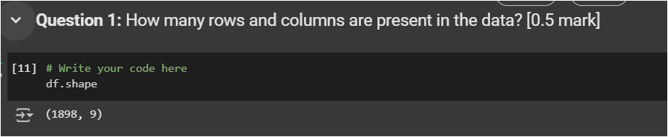
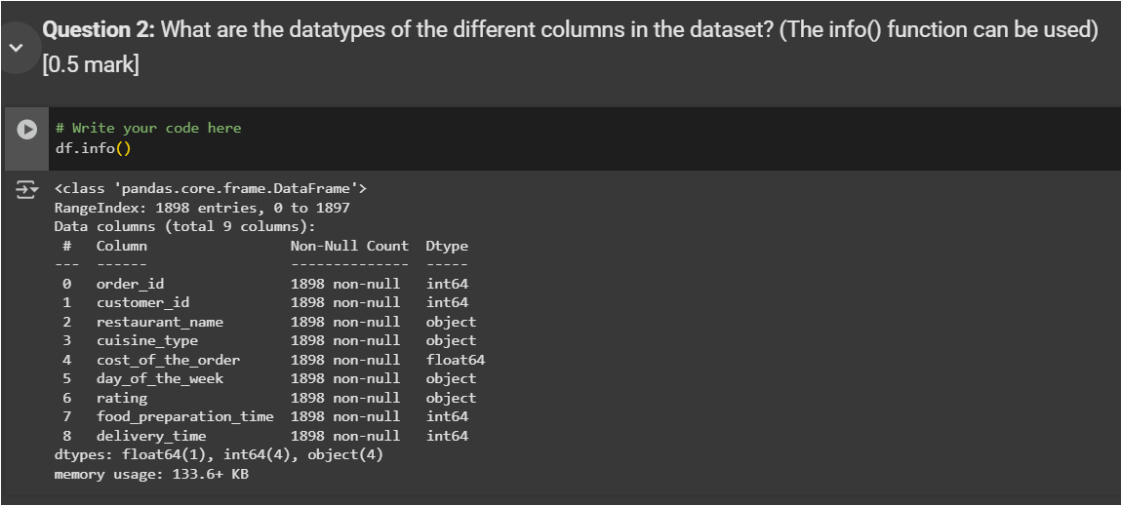
Data Questions 1 - 2

Slide 11
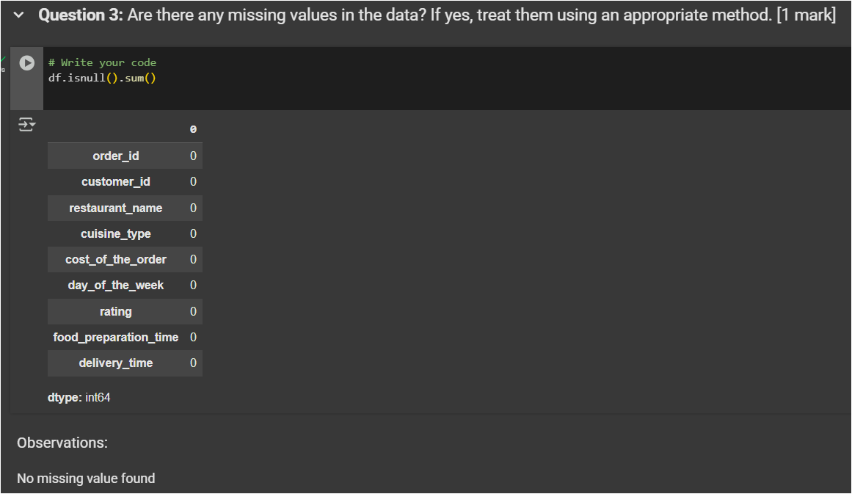
Data Questions 3

Slide 12
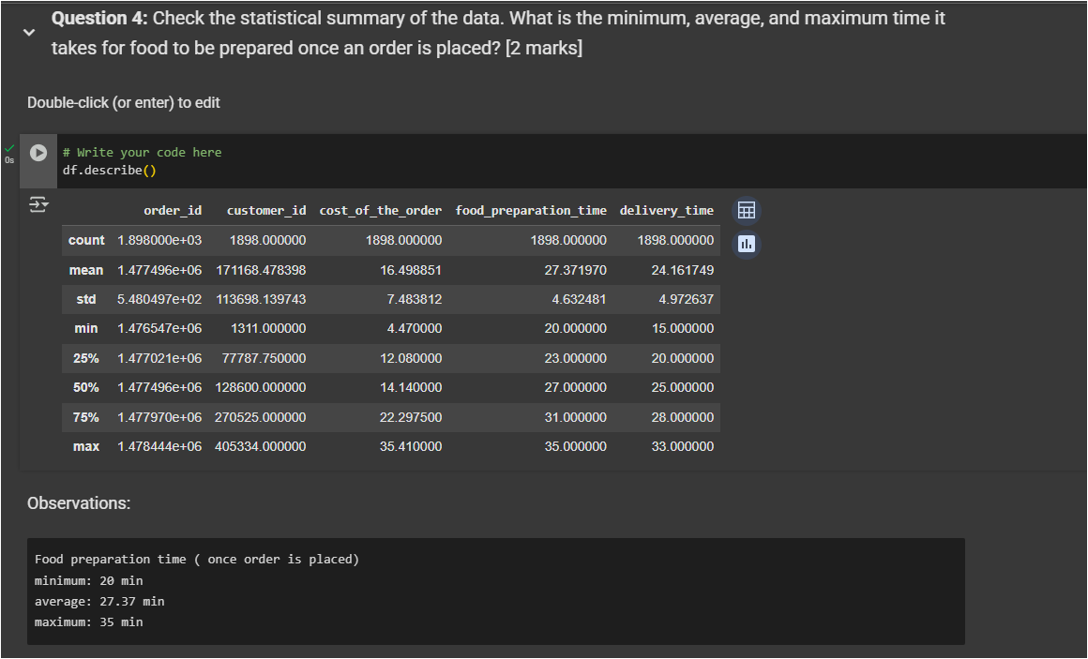
Data Questions 4

Slide 13
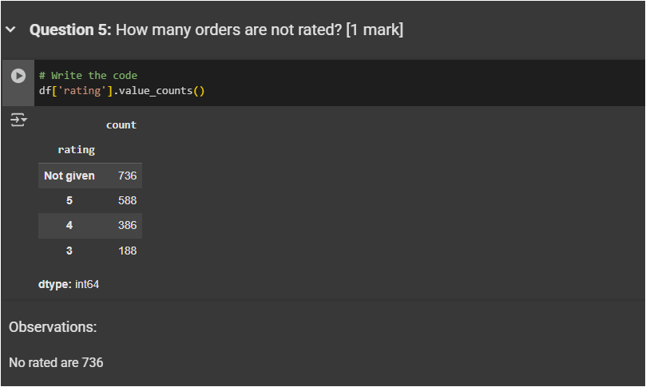
Data Questions 5

Slide 14
Univariate Analysis
Summary
Categorical columns
  IDs, restaurant_name, cuisine_type, day_of_the_week
  Use countplots/frequency tables.
Numerical columns
  cost_of_the_order, rating, food_preparation_time, delivery_time)
  Use histograms, boxplots, and descriptive statistics.
ID variables: Not meaningful for univariate analysis, except customer_id for frequency of repeat orders.

Slide 15
Univariate Analysis ( column wise)
1. Order_id
Type: Categorical (ID variable, unique).
Analysis: Not meaningful for univariate statistics since it’s just an identifier.
2. customer_id
Type: Categorical (ID variable, can repeat).
Analysis:
  Countplot can show how many orders each customer placed.
  Most customers likely have few orders, while some may be frequent users.
3. restaurant_name
Type: Categorical.
Analysis:
  Frequency distribution of orders per restaurant.
  Identify top restaurants with the highest demand.
  Long-tail distribution likely (few very popular restaurants, many with fewer orders).
4. cuisine_type
Type: Categorical.
Analysis:
  Countplot / bar chart to show most popular cuisines.
  Helps identify customer preferences (e.g., Indian vs Italian vs Chinese).
5. cost_of_the_order
Type: Numerical (continuous).
Analysis:
  Histogram / boxplot to see spending pattern.
  Summary statistics (min, mean, median, max).
  Check for outliers (very high-cost orders).
6. day_of_the_week
Type: Categorical (Weekday / Weekend).
Analysis:
  Countplot to compare order frequency on weekdays vs weekends.
  Insight: Higher demand expected on weekends.

Slide 16
Univariate Analysis ( column wise)
7. rating
Type: Numerical (discrete, 1–5).
Analysis:
  Histogram to check rating distribution.
  Summary stats (average rating).
  Check how many customers didn’t give a rating (missing values).
8. food_preparation_time
Type: Numerical (continuous).
Analysis:
  Histogram / boxplot to check distribution.
  Summary stats (min, mean, max).
  Outliers: Some restaurants may take unusually long.
9. delivery_time
Type: Numerical (continuous).
Analysis:
  Histogram to understand delivery speed distribution.
  Summary stats (min, mean, max).
  Outliers may indicate traffic/weather issues.

Slide 17
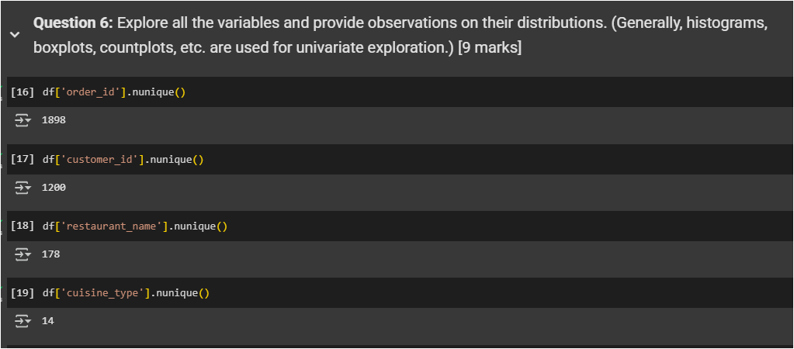
Univariate Analysis - Questions 6

Slide 18
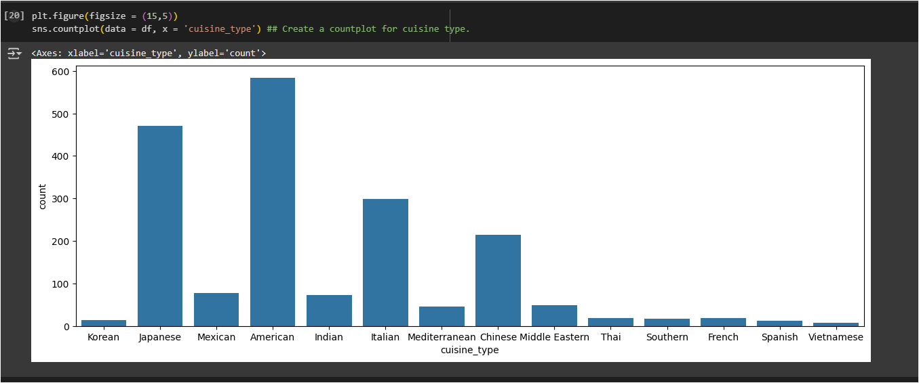
Univariate Analysis - Questions 6

Slide 19
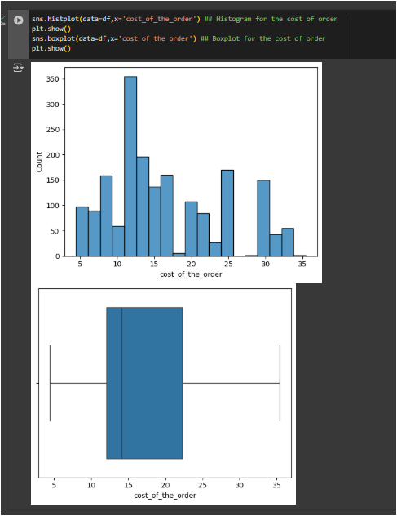
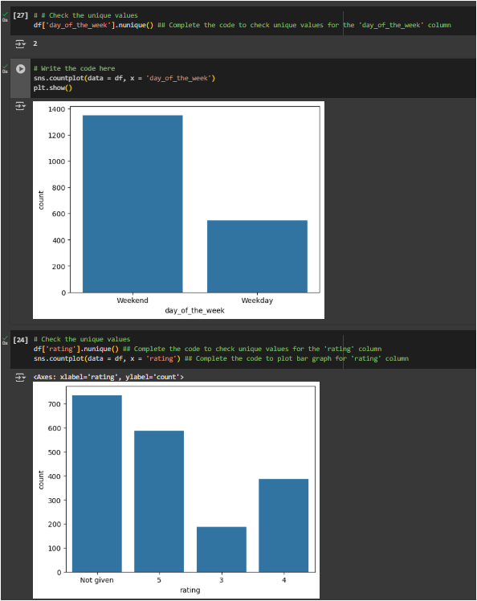
Univariate Analysis - Questions 6

Slide 20
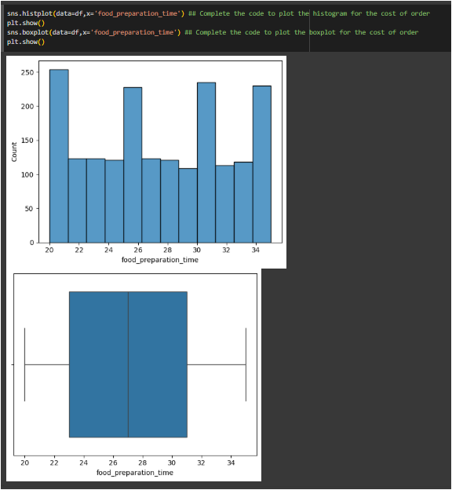
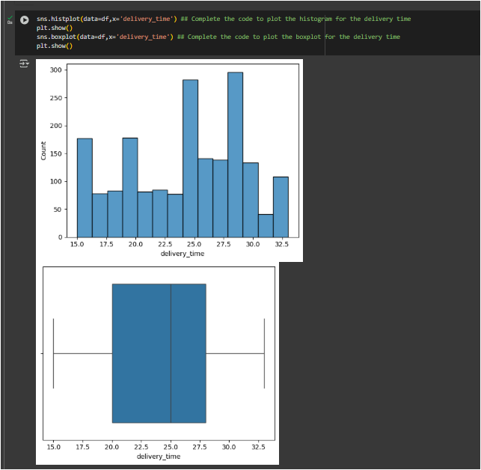
Univariate Analysis - Questions 6

Slide 21
Univariate Analysis - Questions 6

Slide 22
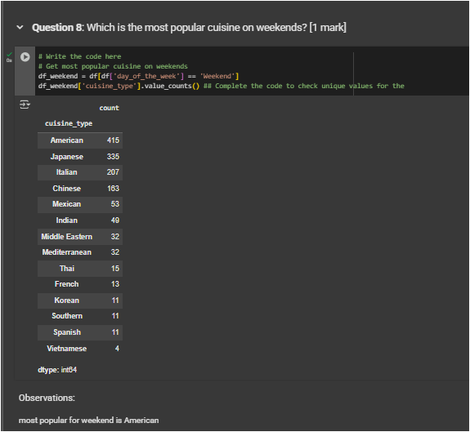
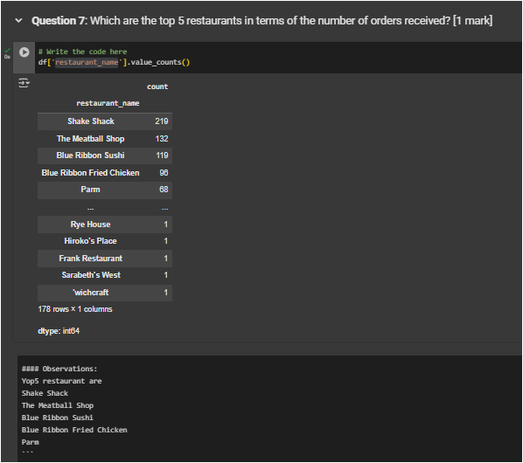
Univariate Analysis - Questions 7 -8

Slide 23
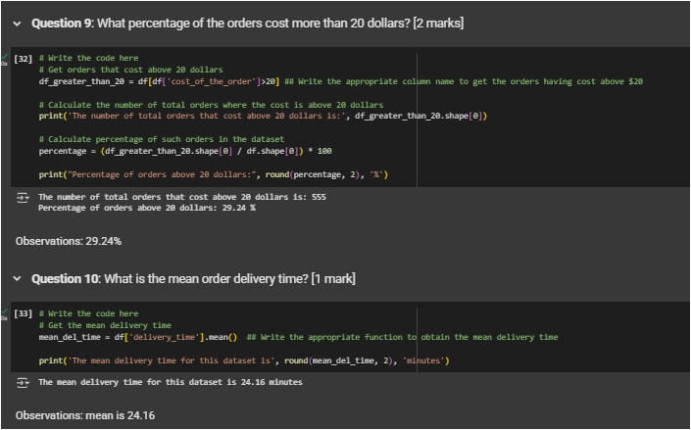
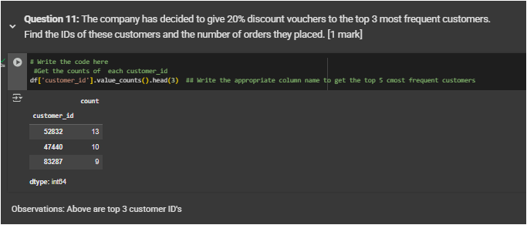
Univariate Analysis - Questions 9-11

Slide 24
Multivariate Analysis
Summary
  Numerical × Numerical → scatter plots, correlation heatmaps.
  Categorical × Numerical → boxplots, grouped bar charts.
  Categorical × Categorical → stacked bar charts, heatmaps.

Slide 25
Multivariate Analysis - Column relationships
Restaurant Demand vs. Cuisine Type
Columns: restaurant_name × cuisine_type
Analysis:
  Which cuisines are served by which restaurants?
  Do certain restaurants specialize in one cuisine or offer multiple?
  Visualization: Grouped bar chart or heatmap.
2. Order Cost vs. Rating
Columns: cost_of_the_order × rating
Analysis:
  Do higher-cost orders receive better ratings?
  Is there a threshold where very high cost leads to lower ratings?
  Visualization: Boxplot or scatter plot with regression line.
3. Preparation Time vs. Delivery Time vs. Rating
Columns: food_preparation_time × delivery_time × rating
Analysis:
  Do longer preparation/delivery times lead to lower ratings?
  Correlation between prep time and delivery time (are they linked?).
  Visualization: Bubble chart (x=prep time, y=delivery time, size/color = rating).
4. Day of the Week vs. Number of Orders vs. Cost
Columns: day_of_the_week × order count × cost_of_the_order
Analysis:
  Are orders higher on weekends compared to weekdays?
  Do customers spend more on weekends?
  Visualization: Bar chart (avg cost per order by day).

Slide 26
Multivariate Analysis - Column relationships
5. Cuisine Type vs. Average Delivery Time
Columns: cuisine_type × delivery_time
Analysis:
  Does delivery time vary by cuisine? (e.g., fast food vs. full meals).
  Helps optimize delivery expectations.
  Visualization: Boxplot.
6. Restaurant Popularity vs. Customer Ratings
Columns: restaurant_name × rating
Analysis:
  Do popular restaurants always have higher ratings?
  Detect restaurants with high orders but low customer satisfaction.
  Visualization: Scatter plot (x=order count, y=avg rating).
7. Cost vs. Prep Time vs. Delivery Time
Columns: cost_of_the_order × food_preparation_time × delivery_time
Analysis:
  Are expensive meals associated with higher prep times?
  Does delivery time increase with higher-cost orders?
  Visualization: 3D scatter plot or pairplot.

Slide 27
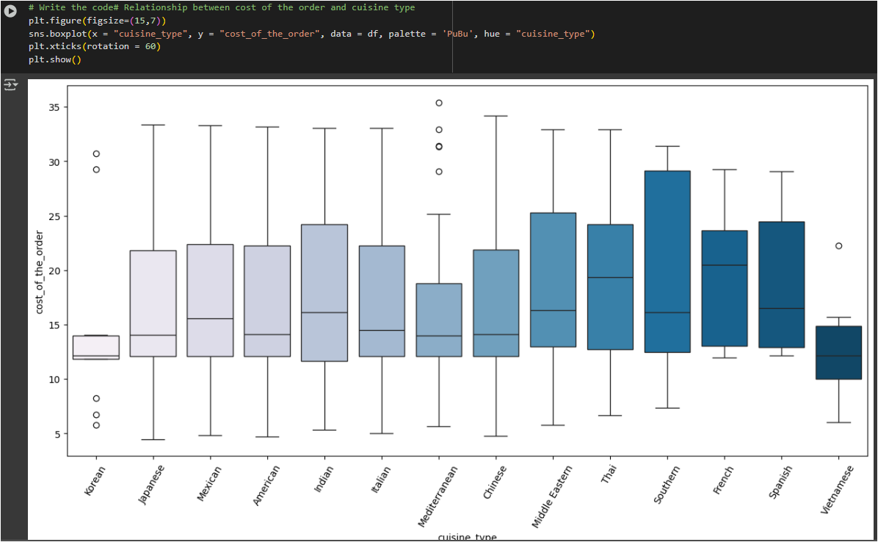
Multivariate Analysis - Questions 12
Based on Cuisine type vs cost
Korean is narrow spread of cost whereas southern has most wide spread
Vietnamese has also less expensive on average vs French has more expensive
Mediterranean has more outliner means more premium dishes
3 Budget friendly cuisines are Vietnamese, Korean, Mediterranean
3 Premium cuisines are French, Spanish & Thai
4 Most wide spread range cuisines as per cost are Southern, Italian, Middle Eastern & Spanish

Slide 28
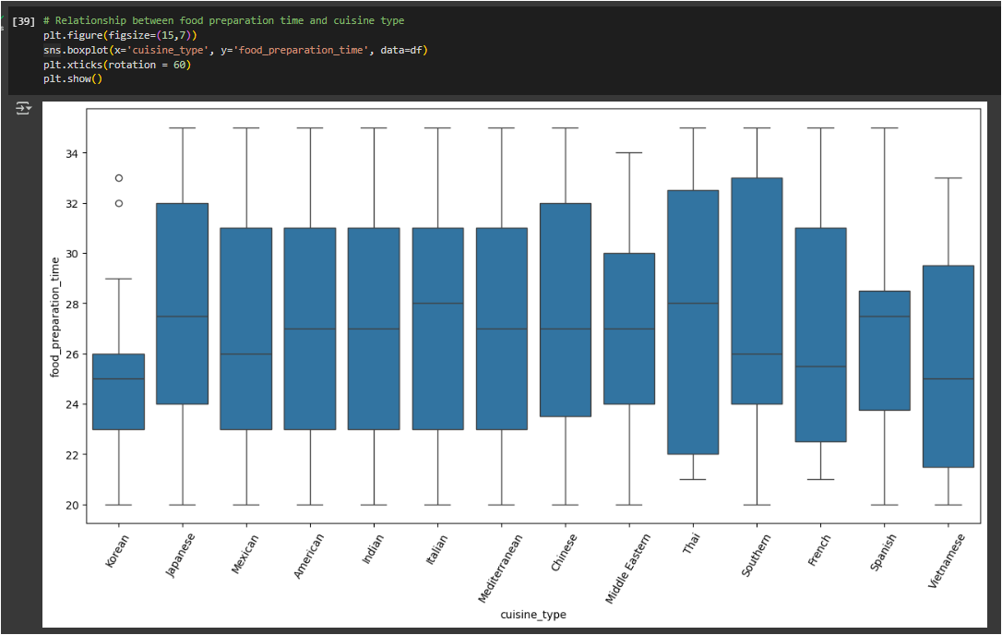
Multivariate Analysis - Questions 12
Based on food preparation time and cuisine type
Vietnamese/Korean are the fastest preparation time
Italian/Thai takes longer
Only Korean has some outlier means some dishes takes longer
Cuisines with wider boxes (e.g., thai → inconsistent preparation times across restaurants.
Narrower boxes (e.g., Korean) → consistent preparation times.
Average time for most of is close to 27 min :
  Italian, Thai,Spanish
  Japanese,Chinese,
  American,Mediterranean
  ,Indian,Middle Eastern , Southern

Slide 29
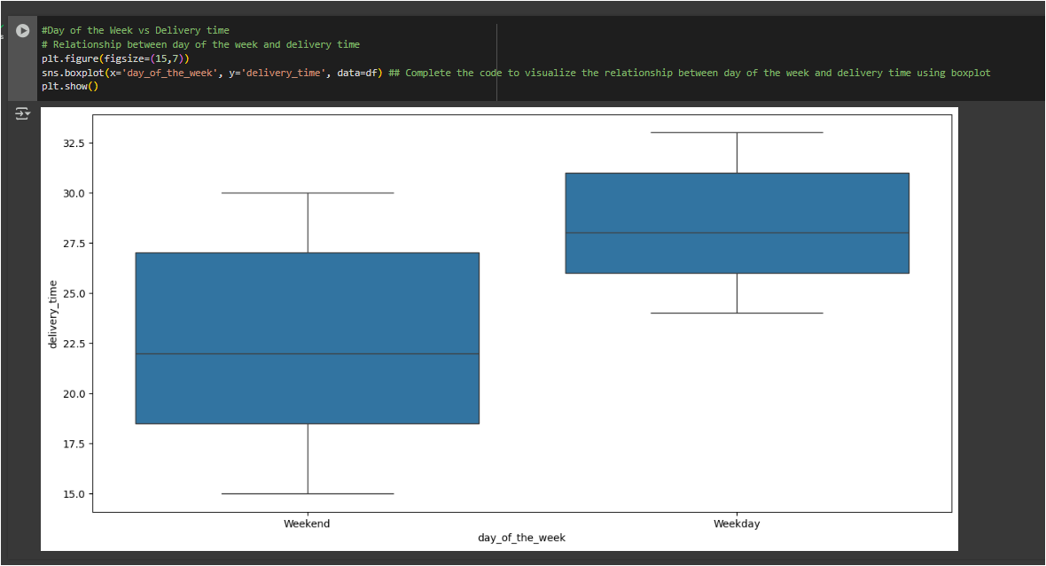
Multivariate Analysis - Questions 12
Based on day of the week and delivery time
Weekend delivery is faster than weekdays
Weekend deliveries are faster (avg ~22.5 mins) compared to weekdays (avg ~28.3 mins).
Weekdays also have a narrower time range (24–33 mins), while weekends show more flexibility (15–30 mins).

Slide 30
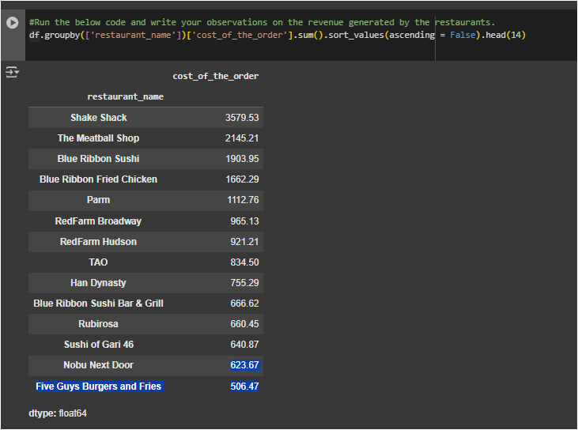
Multivariate Analysis - Questions 12
Based on revenue generated by the restaurants.
Top most revenue generation restaurant is Shake Shack
Least revenue is coming from Five Guys Burgers and Fries
Top three to focus to main revenue are Shake Shack, The Meatball Shop , Blue Ribbon Sushi
Least 3 to focus on improving/study root cause are Sushi of Gari, Nobu Next Door, Five Guys Burgers and Fries

Slide 31
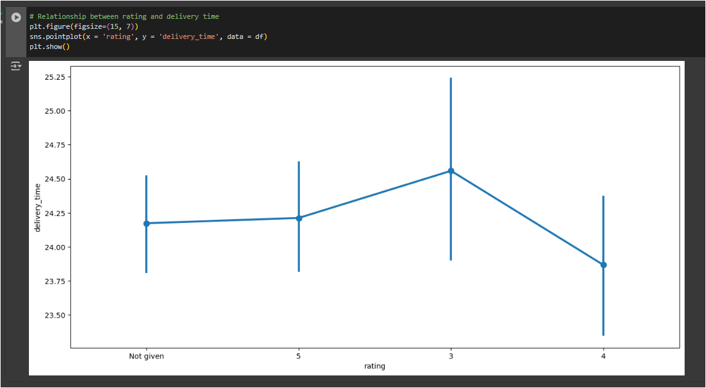
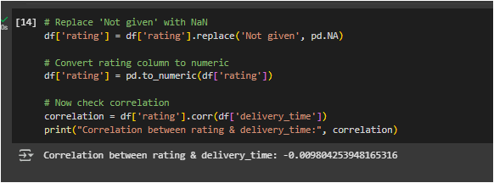
Multivariate Analysis - Questions 12
Based on rating vs delivery time
Don’t see any strong correlation between rating and delivery time

Slide 32
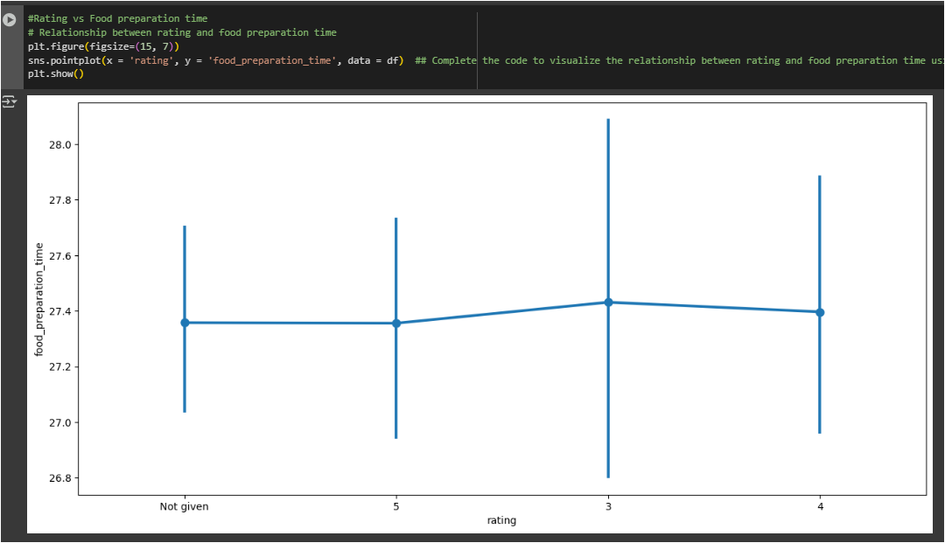
Multivariate Analysis - Questions 12
Based on Rating vs Food preparation time
Average food preparation time is very similar across ratings:
  Rating 3 → ~27.43 minutes
  Rating 4 → ~27.40 minutes
  Rating 5 → ~27.36 minutes
There is no significant correlation between ratings and food preparation time.

Slide 33
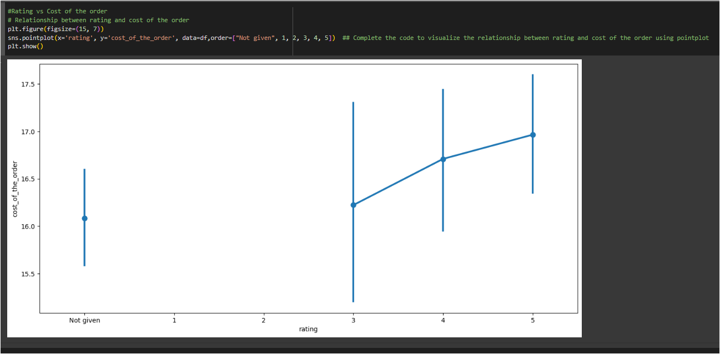
Multivariate Analysis - Questions 12
Based on Rating vs Cost of the order
Apart from not given rating , Average order cost by rating:
  Rating 3 → ~$16.22
  Rating 4 → ~$16.71
  Rating 5 → ~$16.97
There is a slight upward trend: higher-rated orders tend to have marginally higher costs.
However, the difference is small (only ~$0.7 between rating 3 and 5).
This suggests that order cost has minimal influence on customer ratings — other factors (taste, service, delivery) are likely more impactful.

Slide 34
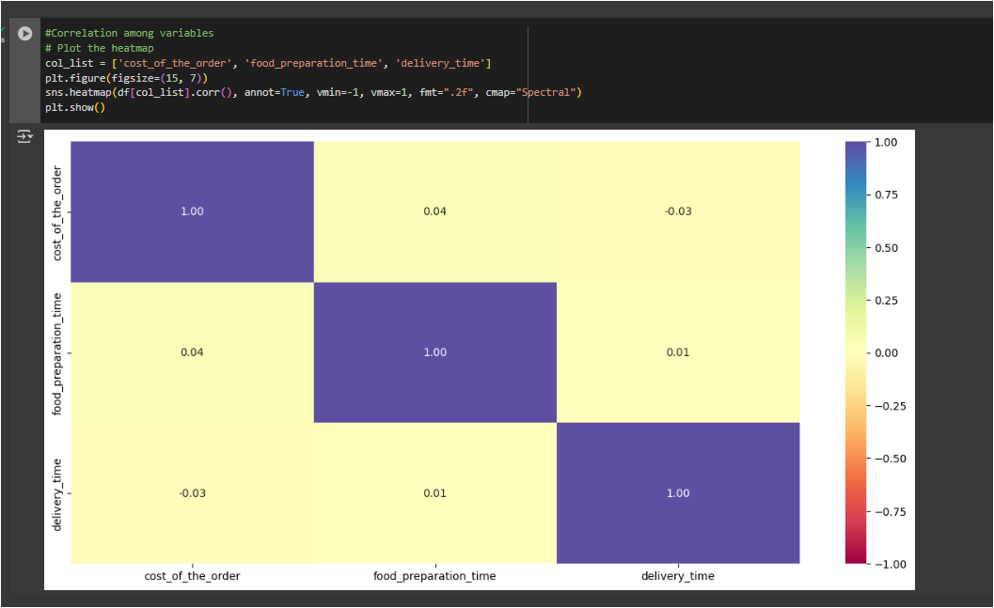
Multivariate Analysis - Questions 12
Based on Correlation among order cost vs Food prep time vs delivery time
Cost of the order vs Food preparation time
  0.04 (very weak positive correlation)
Cost of the order vs Delivery time
  -0.03 (very weak negative correlation)
Food preparation time vs Delivery time
  0.01 (almost no correlation)
None of the variables show any meaningful correlation with each other.
Order cost, preparation time, and delivery time are essentially independent in this dataset.
This suggests that operational times (prep & delivery) are not strongly linked to how much an order costs.

Slide 35
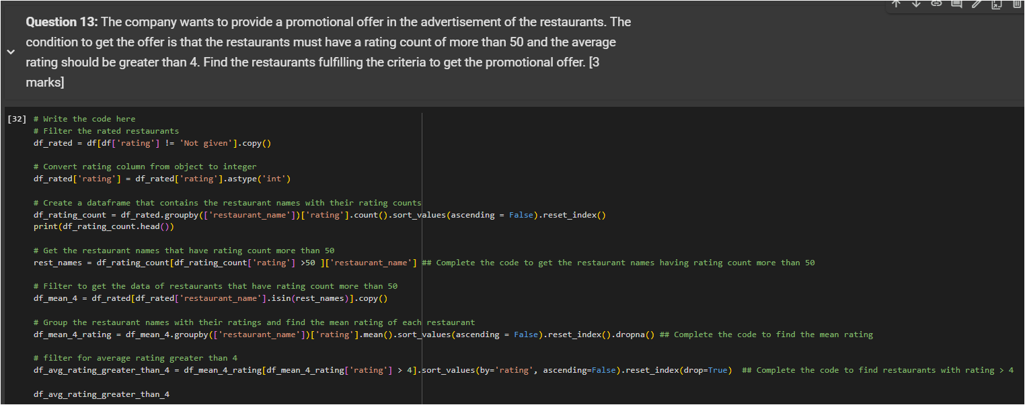
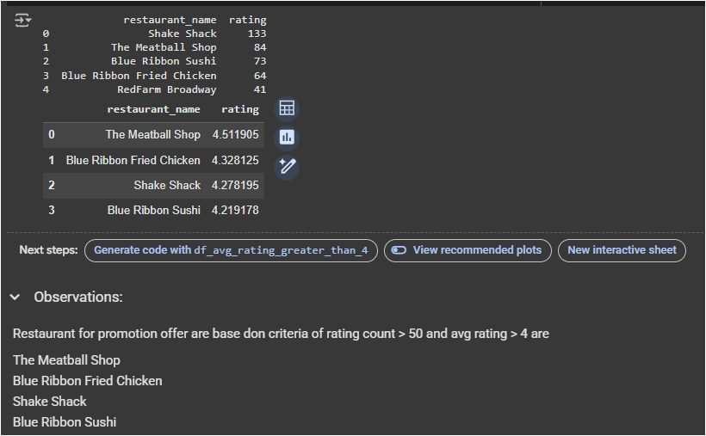
Multivariate Analysis - Questions 13

Slide 36
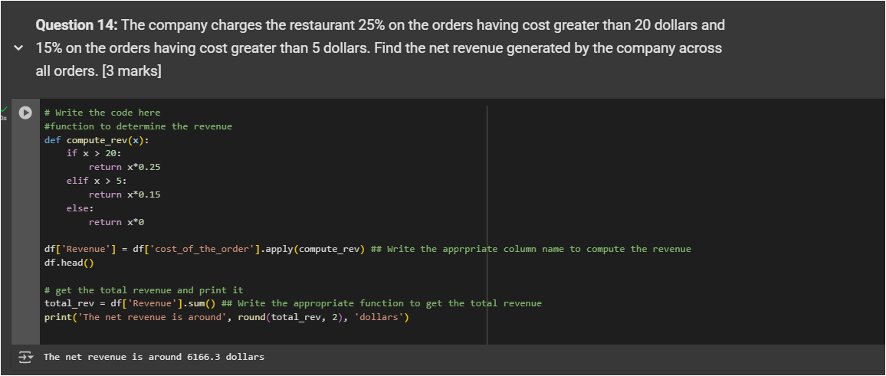
Multivariate Analysis - Questions 14

Slide 37
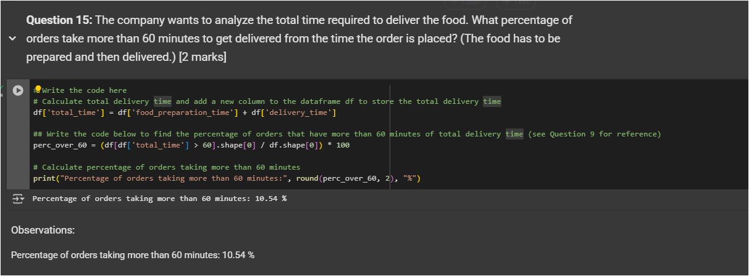
Multivariate Analysis - Questions 15

Slide 38
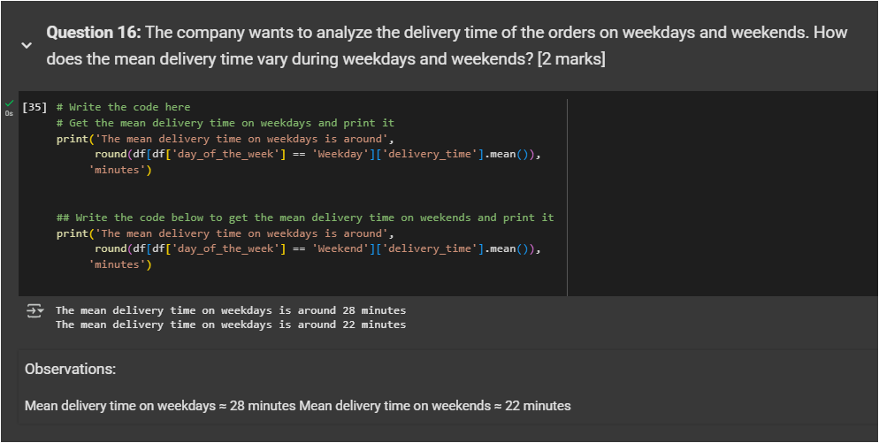
Multivariate Analysis - Questions 16

Slide 39
APPENDIX

Slide 40
NOTE:
Added my notebook as slides in appendix ( 19 slide after this).
Conversion to ipynb → html → has disturbed the formatting but ideas is to attach my whole work here

Slide 41
Project Python Foundations: FoodHub Data Analysis
Context
The number of restaurants in New York is increasing day by day. Lots of students and busy professionals rely on those restaurants due to their hectic lifestyles. Online food delivery service is a great option for them. It provides them with good food from their favorite restaurants. A food aggregator company FoodHub offers access to multiple restaurants through a single smartphone app.
The app allows the restaurants to receive a direct online order from a customer. The app assigns a delivery person from the company to pick up the order after it is confirmed by the restaurant. The delivery person then uses the map to reach the restaurant and waits for the food package. Once the food package is handed over to the delivery person, he/she confirms the pick-up in the app and travels to the customer's location to deliver the food. The delivery person confirms the drop-off in the app after delivering the food package to the customer. The customer can rate the order in the app. The food aggregator earns money by collecting a fixed margin of the delivery order from the restaurants.
Objective
The food aggregator company has stored the data of the different orders made by the registered customers in their online portal. They want to analyze the data to get a fair idea about the demand of different restaurants which will help them in enhancing their customer experience. Suppose you are hired as a Data Scientist in this company and the Data Science team has shared some of the key questions that need to be answered. Perform the data analysis to find answers to these questions that will help the company to improve the business.
Data Description
The data contains the different data related to a food order. The detailed data dictionary is given below.
Data Dictionary
• order_id: Unique ID of the order
• customer_id: ID of the customer who ordered the food
• restaurant_name: Name of the restaurant
• cuisine_type: Cuisine ordered by the customer
• cost_of_the_order: Cost of the order
• day_of_the_week: Indicates whether the order is placed on a weekday or weekend (The weekday is from Monday to Friday and the weekend is Saturday and Sunday)
• rating: Rating given by the customer out of 5
• food_preparation_time: Time (in minutes) taken by the restaurant to prepare the food. This is calculated by taking the difference between the timestamps of the restaurant's order confirmation and the delivery person's pick-up confirmation.
• delivery_time: Time (in minutes) taken by the delivery person to deliver the food package. This is calculated by taking the difference between the timestamps of the delivery person's pick-up confirmation and drop-off information
Let us start by importing the required libraries
In [1]:
# Installing the libraries with the specified version.
!pip install numpy==1.25.2 pandas==1.5.3 matplotlib==3.7.1 seaborn==0.13.1 -q --user
-10.8/10.8 MB 60.0 MB/s eta 0:00:00
Installing build dependencies ... done error: subprocess-exited-with-error
x Getting requirements to build wheel did not run successfully.
| exit code: 1
—> See above for output.
note: This error originates from a subprocess, and is likely not a problem with pip.
Getting requirements to build wheel ... error error: subprocess-exited-with-error
x Getting requirements to build wheel did not run successfully.
| exit code: 1
—> See above for output.
note: This error originates from a subprocess, and is likely not a problem with pip.
Note:
• After running the above cell, kindly restart the runtime (for Google Colab) or notebook kernel (for Jupyter Notebook), and run all cells sequentially from the next cell.
• On executing the above line of code, you might see a warning regarding package dependencies. This error message can be ignored as the above code ensures that all necessary libraries and their dependencies are maintained to successfully execute the code in this notebook.
In [2]:

Slide 42
# import libraries for data manipulation import numpy as np
import pandas as pd
# import libraries for data visualization import matplotlib.pyplot as plt import seaborn as sns
Understanding the structure of the data
In [9]:
# uncomment and run the below code snippets if the dataset is present in the Google Drive from google.colab import drive
drive.mount('/content/drive')
Mounted at /content/drive In [5]:
from google.colab import drive drive.mount('/content/drive')
Mounted at /content/drive In [16]:
# Write your code here to read the data
df = pd.read_csv('/content/drive/MyDrive/Colab Notebooks/PYF-FoodHub Data Analysis/foodhub_order.csv') In [17]:
# Write your code here to view the first 5 rows df.head()
Out[17]:
 | order_id | customer_id | restaurant_name | cuisine_type | cost_of_the_order | day_of_the_week | rating food_preparation
0 | 1477147 | 337525 | Hangawi | Korean | 30.75 | Weekend | Not given
1 | 1477685 | 358141 | Blue Ribbon Sushi Izakaya | Japanese | 12.08 | Weekend | Not given
2 | 1477070 | 66393 | Cafe Habana | Mexican | 12.23 | Weekday | 5
3 | 1477334 | 106968 | Blue Ribbon Fried Chicken | American | 29.20 | Weekend | 3
4 | 1478249 | 76942 | Dirty Bird to Go | American | 11.59 | Weekday | 4
Question 1: How many rows and columns are present in the data? [0.5 mark]
In [11]:
# Write your code here df.shape
Out[11 ]:
(1898, 9)
# This is formatted as code Observations:
Total Rows: 1898 Total fields/columns: 9
Question 2: What are the datatypes of the different columns in the dataset? (The info() function can be used) [0.5 mark]
In [12]:
# Write your code here df.info()

Slide 43
<class 'pandas.core.frame.DataFrame'> RangeIndex: 1898 entries, 0 to 1897 Data columns (total 9 columns):
# Column Non-Null Count Dtype
0 order_id 1898 non-null int64
1 customer_id 1898 non-null int64
2 restaurant_name 1898 non-null object
3 cuisine_type 1898 non-null object
4 cost_of_the_order 1898 non-null float64
5 day_of_the_week 1898 non-null object
6 rating 1898 non-null object
7 food_preparation_time 1898 non-null int64
8 delivery_time 1898 non-null int64
dtypes: float64(1), int64(4), object(4) memory usage: 133.6+ KB
Observations:
# This is formatted as code
Data types are float64(1), int64(4), object(4)
Question 3: Are there any missing values in the data? If yes, treat them using an appropriate method. [1 mark]
In [13]:
# Write your code df.isnull().sum()
Out[13]:
0
order_id 0 customer_id 0 restaurant_name 0 cuisine_type 0 cost_of_the_order 0 day_of_the_week 0 rating 0 food_preparation_time 0 delivery_time 0
dtype: int64 Observations:
No missing value found
Question 4: Check the statistical summary of the data. What is the minimum, average, and maximum time it takes for food to be prepared once an order is placed? [2 marks]
In [14]:
# Write your code here df.describe()

Slide 44
Out[14]:
 | order_id | customer_id | cost_of_the_order | food_preparation_time | delivery_time
count | 1.898000e+03 | 1898.000000 | 1898.000000 | 1898.000000 | 1898.000000
mean | 1.477496e+06 | 171168.478398 | 16.498851 | 27.371970 | 24.161749
std | 5.480497e+02 | 113698.139743 | 7.483812 | 4.632481 | 4.972637
min | 1.476547e+06 | 1311.000000 | 4.470000 | 20.000000 | 15.000000
25% | 1.477021e+06 | 77787.750000 | 12.080000 | 23.000000 | 20.000000
50% | 1.477496e+06 | 128600.000000 | 14.140000 | 27.000000 | 25.000000
75% | 1.477970e+06 | 270525.000000 | 22.297500 | 31.000000 | 28.000000
max | 1.478444e+06 | 405334.000000 | 35.410000 | 35.000000 | 33.000000
Observations:
Food preparation time ( once order is placed) minimum: 20 min average: 27.37 min maximum: 35 min
Question 5: How many orders are not rated? [1 mark]
In [15]:
# Write the code df['rating'].value_counts()
Out[15]:
count
rating
Not given 736
5 588
4 386
3 188
dtype: int64 Observations:
No rated are 736
Exploratory Data Analysis (EDA)
Univariate Analysis
Question 6: Explore all the variables and provide observations on their distributions. (Generally, histograms, boxplots, countplots, etc. are used for univariate exploration.) [9 marks]
In [16]:
df['order_id'].nunique()
Out[16]:
1898 In [17]:
df['customer_id'].nunique()
Out[17]:
1200 In [18]:
df['restaurant_name'].nunique()
Out[18]:
178
In [19]:

Slide 45
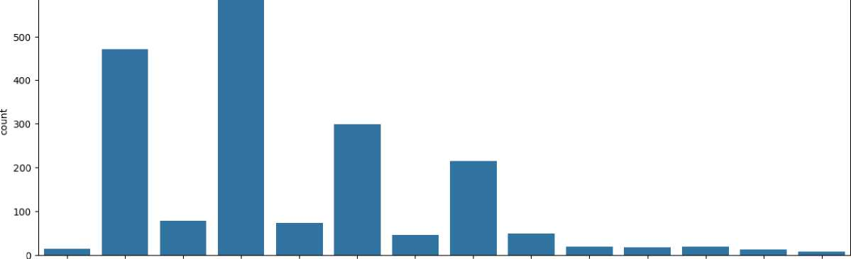
df['cuisine_type'].nuniqueO
Out[19]:
14
In [20]:
plt.figure(figsize = (15,5))
sns.countplot(data = df, x = 'cuisine_type') ## Create a countplot for cuisine type. Out[20]:
<Axes: xlabel='cuisine_type', ylabel='count'>
600
Korean Japanese Mexican American Indian Italian Mediterranean Chinese Middle Eastern Thai Southern French Spanish Vietnamese
cuisine_type
In [21]:
sns.histplot(data=df,x='cost_of_the_order') ## Histogram for the cost of order plt.show()
sns.boxplot(data=df,x='cost_of_the_order') ## Boxplot for the cost of order plt.show()

Slide 46
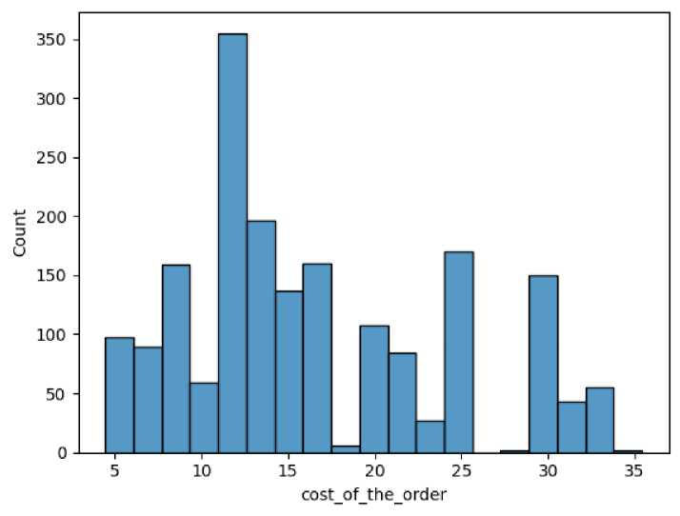
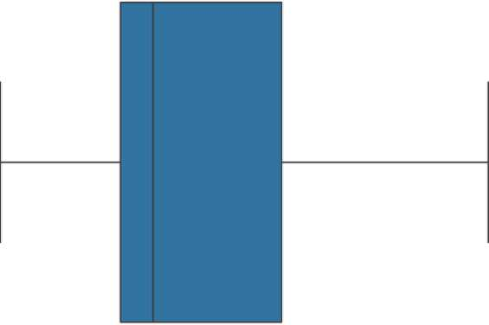
-1-1-1-1-1-1-1-
5 10 15 20 25 30 35
cost_of_the_order
In [27]:
# # Check the unique values
df['day_of_the_week'].nunique() ## Complete the code to check unique values for the 'day_of_the_week' column
Out[27]:
2
In [28]:
# Write the code here
sns.countplot(data = df, x = 'day_of_the_week') plt.show()

Slide 47
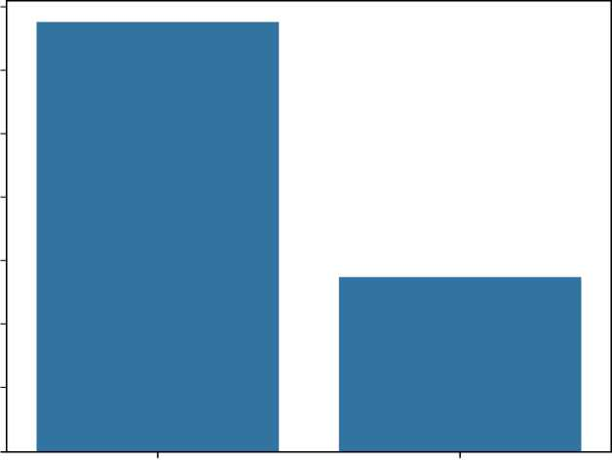
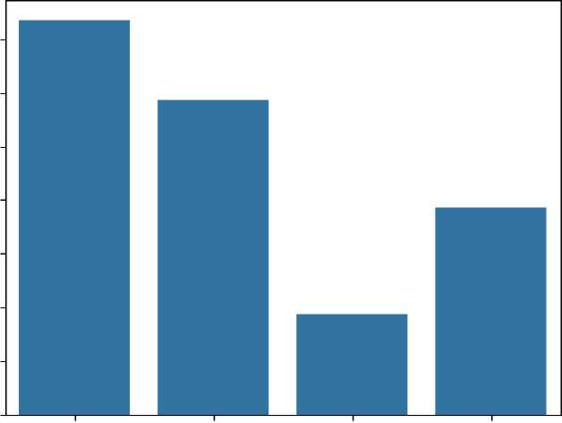
1400
1200
1000
BOO
-M
c
s
600
400
200
0
Weekend Weekday
dayoftheweek
In [24]:
# Check the unique values
df['rating'].nunique() ## Complete the code to check unique values for the 'rating' column sns.countplot(data = df, x = 'rating') ## Complete the code to plot bar graph for 'rating' column Out[24]:
<Axes: xlabel='rating', ylabel='count'>
700 600 500 {= 400
S
300 200 100 0
Not given 5 3 4
rating
In [29]:
sns.histplot(data=df,x='food_preparation_time') ## Complete the code to plot the histogram for the cost of order plt.show()
sns.boxplot(data=df,x='food_preparation_time') ## Complete the code to plot the boxplot for the cost of order plt.show()

Slide 48
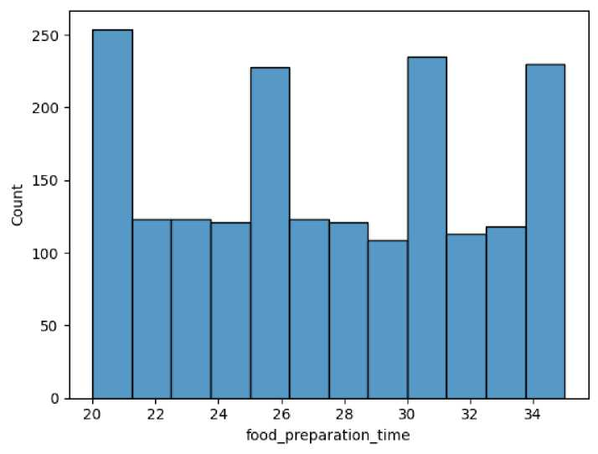
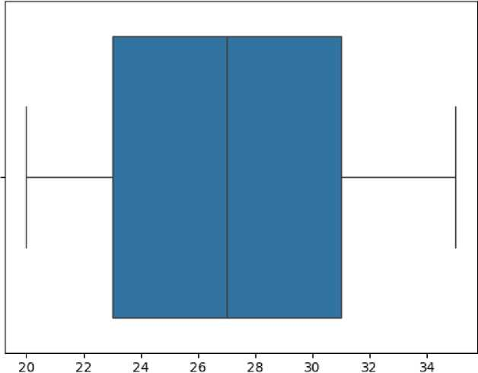
food_preparation_time
In [26]:
sns.histplot(data=df,x='delivery_time') ## Complete the code to plot the histogram for the delivery time plt.show()
sns.boxplot(data=df,x='delivery_time') ## Complete the code to plot the boxplot for the delivery time plt.show()

Slide 49
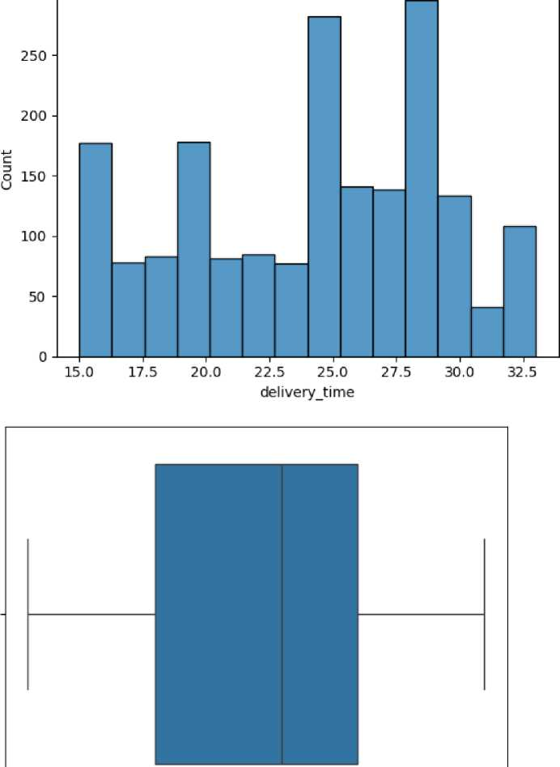
300
15.0 17.5 20.0 22.5 25.0 27.5 30.0 32.5
delivery_time
Question 7: Which are the top 5 restaurants in terms of the number of orders received? [1 mark]
In [30]:
# Write the code here df['restaurant_name'].value_counts()

Slide 50
Out[30]:
count
restaurant_name
Shake Shack 219
The Meatball Shop 132
Blue Ribbon Sushi 119
Blue Ribbon Fried 96
Chicken
Parm 68
Rye House 1
Hiroko's Place 1
Frank Restaurant 1
Sarabeth's West 1
'wichcraft 1
178 rows x 1 columns
dtype: int64
#### Observations:
Yop5 restaurant are Shake Shack The Meatball Shop Blue Ribbon Sushi Blue Ribbon Fried Chicken Parm
Question 8: Which is the most popular cuisine on weekends? [1 mark]
In [31]:
# Write the code here
# Get most popular cuisine on weekends df_weekend = df[df['day_of_the_week'] == 'Weekend']
df_weekend['cuisine_type'].value_counts() ## Complete the code to check unique values for the

Slide 51
Out[31]:
count
cuisine_type
American | 415
Japanese | 335
Italian | 207
Chinese | 163
Mexican | 53
Indian | 49
Middle Eastern | 32
Mediterranean | 32
Thai | 15
French | 13
Korean | 11
Southern | 11
Spanish | 11
Vietnamese | 4
dtype: int64 Observations:
most popular for weekend is American
Question 9: What percentage of the orders cost more than 20 dollars? [2 marks]
In [32]:
# Write the code here
# Get orders that cost above 20 dollars
df_greater_than_20 = df[df['cost_of_the_order']>20] ## Write the appropriate column name to get the orders having cost above $20
# Calculate the number of total orders where the cost is above 20 dollars
print('The number of total orders that cost above 20 dollars is:', df_greater_than_20.shape[0])
# Calculate percentage of such orders in the dataset percentage = (df_greater_than_20.shape[0] / df.shape[0]) * 100
print(''Percentage of orders above 20 dollars:", round(percentage, 2), '%')
The number of total orders that cost above 20 dollars is: 555 Percentage of orders above 20 dollars: 29.24 %
Observations: 29.24%
Question 10: What is the mean order delivery time? [1 mark]
In [33]:
# Write the code here
# Get the mean delivery time
mean_del_time = df['delivery_time'].mean() ## Write the appropriate function to obtain the mean delivery time
print('The mean delivery time for this dataset is', round(mean_del_time, 2), 'minutes')
The mean delivery time for this dataset is 24.16 minutes
Observations: mean is 24.16
Question 11: The company has decided to give 20% discount vouchers to the top 3 most frequent customers. Find the IDs of these customers and the number of orders they placed. [1 mark]

Slide 52
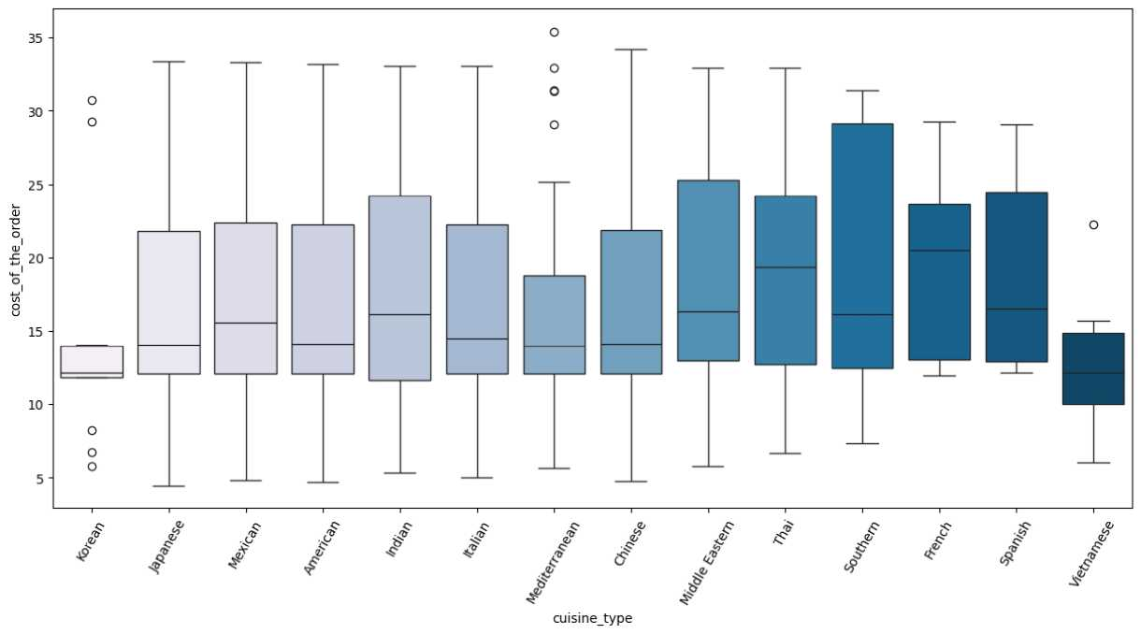
In [35]:
# Write the code here
#Get the counts of each customer_id
df['customer_id'].value_counts().head(3) ## Write the appropriate column name to get the top 5 cmost frequent customers Out[35]:
 | count
customer_id
52832 | 13
47440 | 10
83287 | 9
dtype: int64
Observations: Above are top 3 customer ID's
Multivariate Analysis
Question 12: Perform a multivariate analysis to explore relationships between the important variables in the dataset. (It is a good idea to explore relations between numerical variables as well as relations between numerical and categorical variables) [10 marks]
In [6]:
# Write the code# Relationship between cost of the order and cuisine type plt.figure(figsize=(15,7))
sns.boxplot(x = "cuisine_type", y = "cost_of_the_order", data = df, palette = 'PuBu', hue = "cuisine_type")
plt.xticks(rotation = 60)
plt.show()
In [7]:

Slide 53
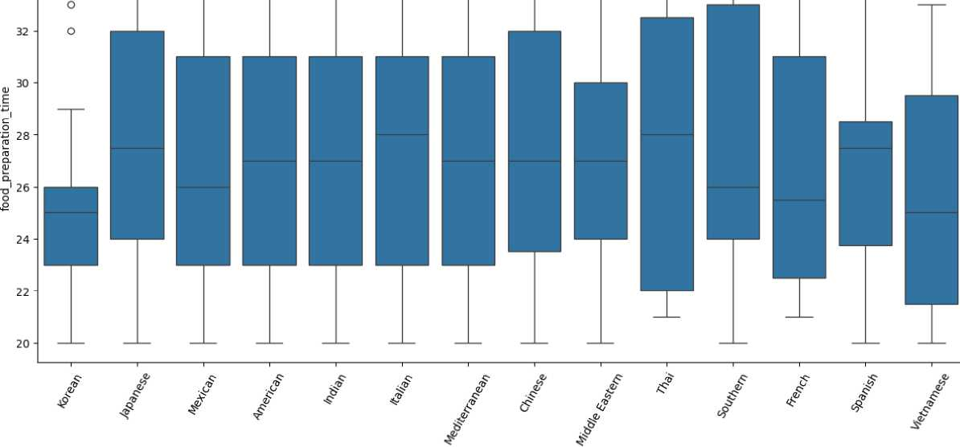
# Group by cuisine type and calculate average order cost
avg_cost_by_cuisine = df.groupby('cuisine_type')['cost_of_the_order'].meanO-sort_values(ascending=False) printfAverage cost per cuisineAn", avg_cost_by_cuisine)
# Find the most expensive and cheapest cuisines most_expensive = avg_cost_by_cuisine.head(1) cheapest = avg_cost_by_cuisine.tail(1)
print('’\nMost Expensive CuisineAn", most_expensive) print('’\nCheapest CuisineAn", cheapest)
Average cost per cuisine: cuisine_type
French 19.793889
Southern 19.300588
Thai 19.207895
Spanish 18.994167
Middle Eastern 18.820612
Mexican 16.933117
Indian 16.919726
Italian 16.418691
American 16.319829
Chinese 16.305209
Japanese 16.304532
Mediterranean 15.474783
Korean 14.001538
Vietnamese 12.882857
Name: cost_of_the_order, dtype: float64
Most Expensive Cuisine: cuisine_type French 19.793889
Name: cost_of_the_order, dtype: float64
Cheapest Cuisine: cuisine_type
Vietnamese 12.882857
Name: cost_of_the_order, dtype: float64
In [39]:
# Relationship between food preparation time and cuisine type plt.figure(figsize=(15,7))
sns.boxplot(x='cuisine_type', y='food_preparation_time', data=df)
plt.xticks(rotation = 60)
plt.show()
34
In [11]:
cuisine type

Slide 54

# Group by cuisine and calculate min, avg, max preparation time prep_time_stats = df.groupby('cuisine_type')['food_preparation_time'].agg( min_time='min', avg_time='mean', median='median', max_time='max'
).sort_values(by='median', ascending=False)
print(prep_time_stats)
min_time avg_time median max_time
cuisine_type
Italian | 20 27.483221 28.0 |  | 35
Thai | 21 27.315789 28.0 |  | 35
Spanish | 20 26.916667 | 27.5 | 35
Japanese | 20 27.510638 | 27.5 | 35
Chinese | 20 27.511628 | 27.0 | 35
American | 20 27.440068 | 27.0 | 35
Mediterranean | 20 27.000000 27.0 |  | 35
Indian | 20 27.109589 | 27.0 | 35
Middle Eastern | 20 26.673469 27.0 |  | 34
Southern | 20 27.588235 | 26.0 | 35
Mexican | 20 26.727273 | 26.0 | 35
French | 21 26.888889 | 25.5 | 35
Korean | 20 25.461538 | 25.0 | 33
Vietnamese | 20 25.714286 25.0 |  | 33
In [7]:
#Day of the Week vs Delivery time
# Relationship between day of the week and delivery time
plt.figure(figsize=(15,7))
sns.boxplot(x='day_of_the_week', y='delivery_time', data=df) ## Complete the code to visualize the relationship between day of the week a plt.show()
32.5 -
30.0 -
27.5 -
<u
.1 25.0-£7
CD
>
1 22.5-
20.0 -
17.5 -
15.0 - --
weekend weekday
day_of_the_week
In [8]:
# Group by day_of_the_week and calculate min, avg, max delivery time delivery_time_stats = df.groupby('day_of_the_week')['delivery_time'].agg( min_time='min', avg_time='mean', max_time='max'
⁾
print(delivery_time_stats)
min_time avg_time max_time day_of_the_week
Weekday 24 28.340037 33
Weekend 15 22.470022 30
In [9]:
#Run the below code and write your observations on thec
df.groupby(['restaurant_name'])['cost_of_the_order'].sum0.sort_values(ascending = False).head(14)

Slide 55
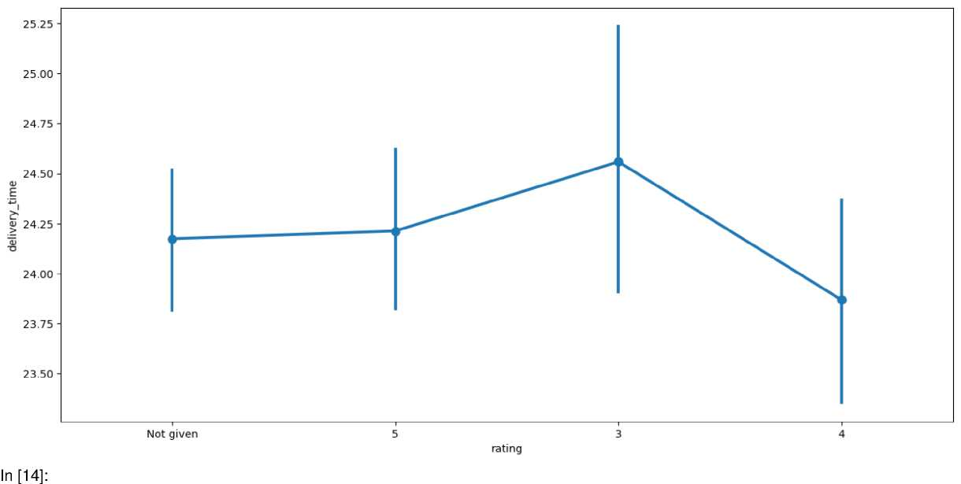
Out[9]:
cost of the order
restaurant_name
Shake Shack | 3579.53
The Meatball Shop | 2145.21
Blue Ribbon Sushi | 1903.95
Blue Ribbon Fried Chicken | 1662.29
Parm | 1112.76
RedFarm Broadway | 965.13
RedFarm Hudson | 921.21
TAO | 834.50
Han Dynasty | 755.29
Blue Ribbon Sushi Bar & Grill | 666.62
Rubirosa | 660.45
Sushi of Gari 46 | 640.87
Nobu Next Door | 623.67
Five Guys Burgers and Fries | 506.47
dtype: float64 In [10]:
# Relationship between rating and delivery time plt.figure(figsize=(15, 7))
sns.pointplot(x = 'rating', y = 'delivery_time', data = df) plt.show()
# Replace 'Notgiven' with NaN
df['rating'] = df['rating'].replace('Not given', pd.NA)
# Convert rating column to numeric df['rating'] = pd.to_numeric(df['rating'])
# Now check correlation
correlation = df['rating'].corr(df['delivery_time']) print("Correlation between rating & delivery_time:", correlation)

Slide 56
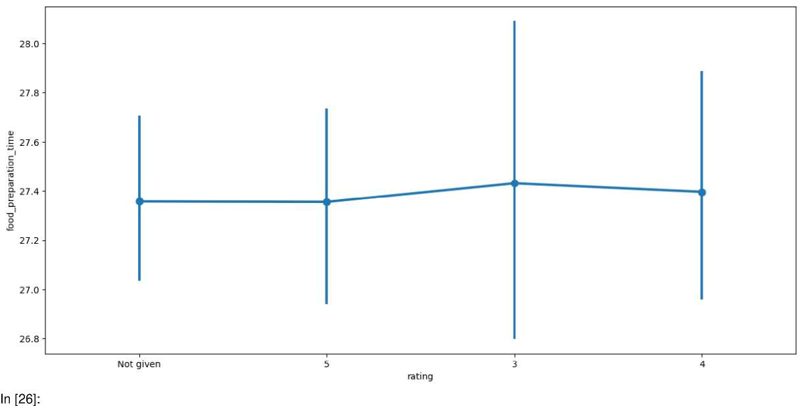
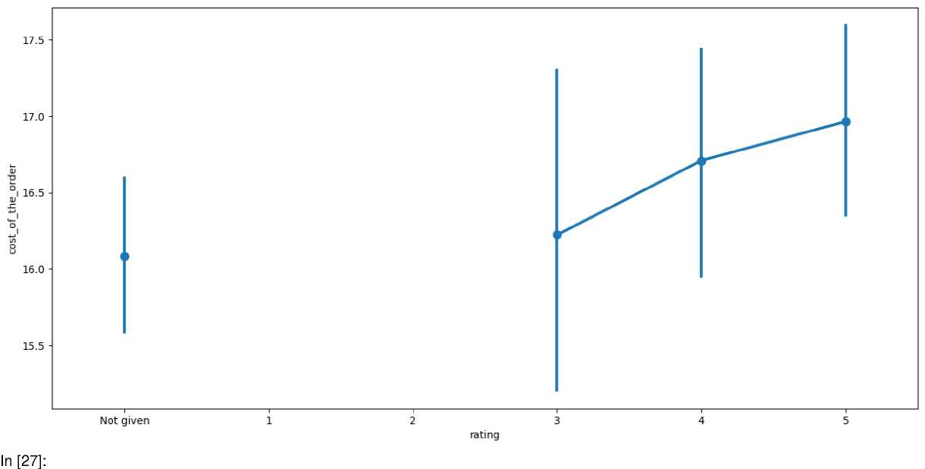
Correlation between rating & delivery_time: -0.009804253948165316
In [19]:
#Rating vs Food preparation time # Relationship between rating and food preparation time plt.figure(figsize=(15, 7))
sns.pointplot(x = 'rating', y = 'food_preparation_time', data = df) ## Complete the code to visualize the relationship between rating and food plt.show()
#Rating vs Cost of the order # Relationship between rating and cost of the order plt.figure(figsize=(15, 7))
sns.pointplot(x='rating', y='cost_of_the_order', data=df,order=["Not given", 1,2, 3, 4, 5]) ## Complete the code to visualize the relationship b plt.show()
#Correlation among variables # Plot the heatmap
col_list = ['cost_of_the_order', 'food_preparation_time', 'delivery_time'] plt.figure(figsize=(15, 7))
sns.heatmap(df[col_list].corr(), annot=True, vmin=-1, vmax=1, fmt=".2f", cmap="Spectral") plt.show()

Slide 57
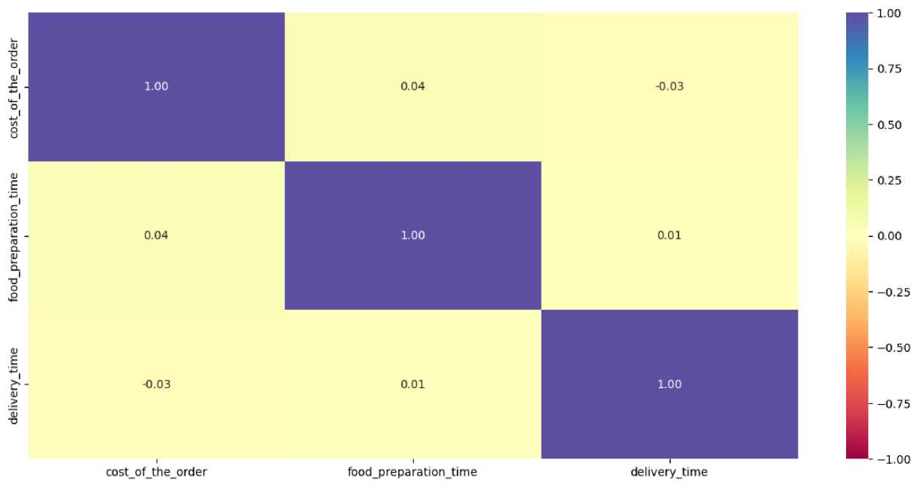
Question 13: The company wants to provide a promotional offer in the advertisement of the restaurants.
The condition to get the offer is that the restaurants must have a rating count of more than 50 and the average rating should be greater than 4. Find the restaurants fulfilling the criteria to get the promotional offer. [3 marks]
In [32]:
# Write the code here
# Filter the rated restaurants
df_rated = df[df['rating'] != 'Not given'].copy()
# Convert rating column from object to integer df_rated['rating'] = df_rated['rating'].astype('int')
# Create a dataframe that contains the restaurant names with their rating counts
df_rating_count = df_rated.groupby(['restaurant_name'])['rating'].count().sort_values(ascending = False).resetJndexO print(df_rating_count.head())
# Get the restaurant names that have rating count more than 50
rest_names = df_rating_count[df_rating_count['rating'] >50 ]['restaurant_name'] ## Complete the code to get the restaurant names having r
# Filter to get the data of restaurants that have rating count more than 50 df_mean_4 = df_rated[df_rated['restaurant_name'].isin(rest_names)].copy()
# Group the restaurant names with their ratings and find the mean rating of each restaurant
df_mean_4_rating = df_mean_4.groupby(['restaurant_name'])['rating'].mean().sort_values(ascending = False).resetJndex().dropnaO ## Co
# filter for average rating greater than 4
df_avg_rating_greater_than_4 = df_mean_4_rating[df_mean_4_rating['rating'] > 4].sort_values(by='rating', ascending=False).reset_index(d df_avg_rating_greater_than_4

Slide 58
restaurant_name rating
0 Shake Shack 133
1 The Meatball Shop 84
2 Blue Ribbon Sushi 73
3 Blue Ribbon Fried Chicken 64
4 RedFarm Broadway 41
Out[32]:
 | restaurant_name | rating
0 | The Meatball Shop | 4.511905
1 | Blue Ribbon Fried Chicken | 4.328125
2 | Shake Shack | 4.278195
3 | Blue Ribbon Sushi | 4.219178
Observations:
Restaurant for promotion offer are base don criteria of rating count > 50 and avg rating > 4 are The Meatball Shop Blue Ribbon Fried Chicken Shake Shack Blue Ribbon Sushi
Question 14: The company charges the restaurant 25% on the orders having cost greater than 20 dollars and 15% on the orders having cost greater than 5 dollars. Find the net revenue generated by the company across all orders. [3 marks]
In [33]:
# Write the code here #function to determine the revenue def compute_rev(x):
if x > 20:
return x*0.25 elif x > 5: return x*0.15 else:
return x*0
df['Revenue'] = df['cost_of_the_order'].apply(compute_rev) ## Write the apprpriate column name to compute the revenue df.head()
# get the total revenue and print it
total_rev = df['Revenue'].sum() ## Write the appropriate function to get the total revenue print('The net revenue is around', round(total_rev, 2), 'dollars')
The net revenue is around 6166.3 dollars
Observations:
Question 15: The company wants to analyze the total time required to deliver the food. What percentage of orders take more than 60 minutes to get delivered from the time the order is placed? (The food has to be prepared and then delivered.) [2 marks]
In [34]:
# Write the code here
# Calculate total delivery time and add a new column to the dataframe df to store the total delivery time df['total_time'] = df['food_preparation_time'] + df['delivery_time']
## Write the code below to find the percentage of orders that have more than 60 minutes of total delivery time (see Question 9 for referenc perc_over_60 = (df[df['total_time'] > 60].shape[0] / df.shape[0]) * 100
# Calculate percentage of orders taking more than 60 minutes print("Percentage of orders taking more than 60 minutes:", round(perc_over_60, 2), "%")
Percentage of orders taking more than 60 minutes: 10.54 %
Observations:
Percentage of orders taking more than 60 minutes: 10.54 %

Slide 59
Question 16: The company wants to analyze the delivery time of the orders on weekdays and weekends. How does the mean delivery time vary during weekdays and weekends? [2 marks]
In [35]:
# Write the code here
# Get the mean delivery time on weekdays and print it print('The mean delivery time on weekdays is around',
round(df[df['day_of_the_week'] == 'Weekday']['delivery_time'].mean()),
'minutes')
## Write the code below to get the mean delivery time on weekends and print it print('The mean delivery time on weekdays is around',
round(df[df['day_of_the_week'] == 'Weekend']['delivery_time'].mean()),
'minutes')
The mean delivery time on weekdays is around 28 minutes The mean delivery time on weekdays is around 22 minutes
Observations:
Mean delivery time on weekdays » 28 minutes Mean delivery time on weekends » 22 minutes
Conclusion and Recommendations
Question 17: What are your conclusions from the analysis? What recommendations would you like to share to help improve the business? (You can use cuisine type and feedback ratings to drive your business recommendations.) [6 marks]
Conclusions:
Recommendations:

