Slide 1
WEB SCRAPPINNG
WITH VISUALIZATION

Slide 2
WEB SCRAPPINNG WITH VISUALIZATION
Web Scrapping
This process is divided into two parts as given below,
Web Scrapping
Data processing
Data
Processing
Data
Modelling
Data
Visualization

Slide 3
What is web scrapping? And its purpose?
Web scrapping is web data extraction, it’s a process of collecting structured web data in an automated fashion.
People who wants to make smarter decisions or analyze data, vast amount of publicly available web data is extracted.

Slide 4
Why web scrapping? Different ways of data extraction?
An automated method which helps to extract large amount of data from websites
Collects unstructured data available on websites and stores by converting into structured form.
There are different ways to scrape websites such as,
Online Services,
APIs or writing your own code.

Slide 5
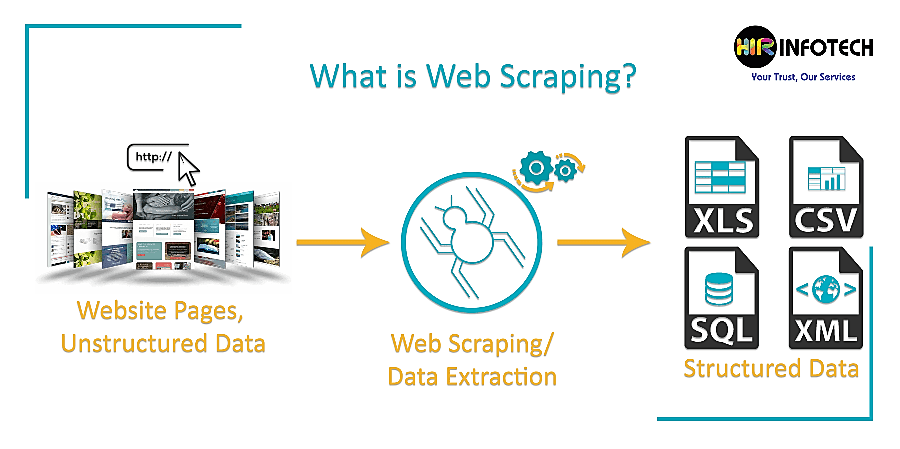

Slide 6
How web scrapping works?
URL of the website which is supposed to scrape given to the scrapper.
It loads the HTML code of these web pages and extracts the data needed, such as prices or customer reviews.
The scraper then outputs the data in a readable format.

Slide 7
Different ways of web scrapping
Human copy-and-paste
Text pattern matching
HTTP programming
HTML parsing
DOM parsing
Vertical aggregation
Semantic annotation recognizing
Computer vision web-page analysis

Slide 8
Data processing
Extracting required data from the data set
Data cleaning

Slide 9
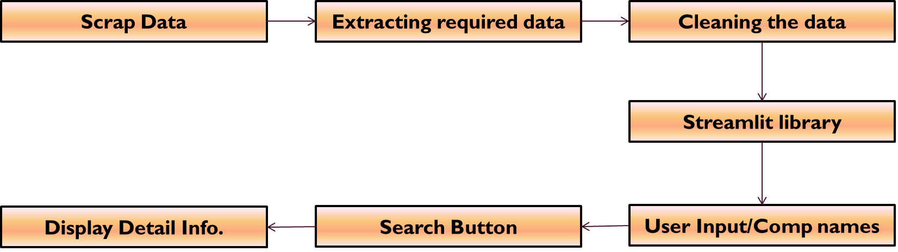
Flow of DATA PROCESSING

Slide 10
DATA VISUALIZATION
Using streamlit library, accepting company name as user input.
It’ll display all the details of company.

Slide 11
Thank You..

