Slide 1

Music Recommendation App
Members
Bishal Banstola
Saroj Bhattarai

Slide 2
Problem Statement
Everyone has their taste in music. While some prefer to listen to pop hits, others may listen to genres like rock and hip-hop.
Nonetheless, people want to listen to songs similar to what they are listening to.
Music Recommendation App will examine users' music preferences and recommend new similar music based on their interests.

Slide 3
Features and Functions
Web-based application
Users can look up a song and play it in an embedded external player.
Users are presented with similar songs based on what they listen to.
Users can listen to recommended songs and get further recommendations.

Slide 4
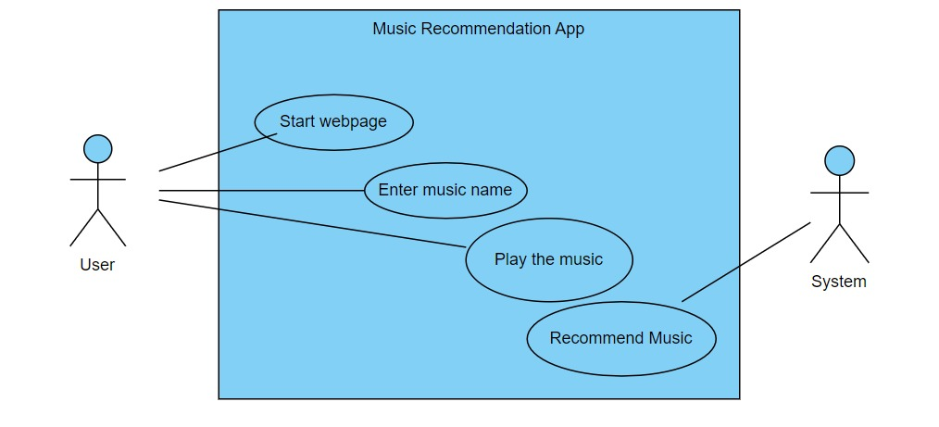
Use Case

Slide 5
Technology Used
Python
JavaScript
GitHub

