Slide 1
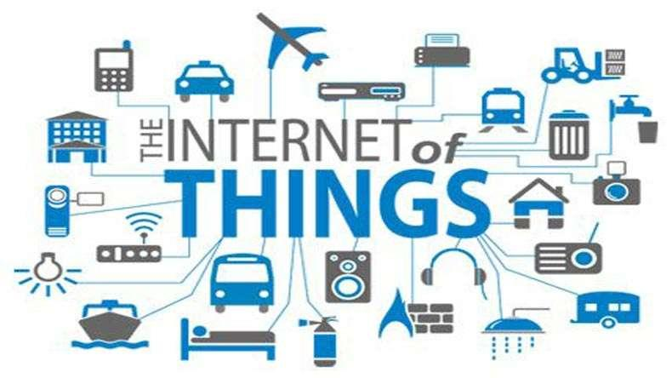
Internet of Things (IOT)
-by Er. Saroj Shakya
Notes:
British entrepreneur Kevin Ashton first coined the term in 1999

Slide 2


Slide 3
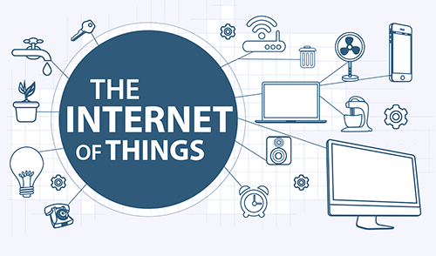
What is IOT?

Slide 4
What is IOT?
Network of physical objects (things) embedded with electronics, software, sensors, and network connectivity that are connected to the internet allowing them to send, receive and exchange data.
Internet of Things sometimes called Internet of Everything

Slide 5
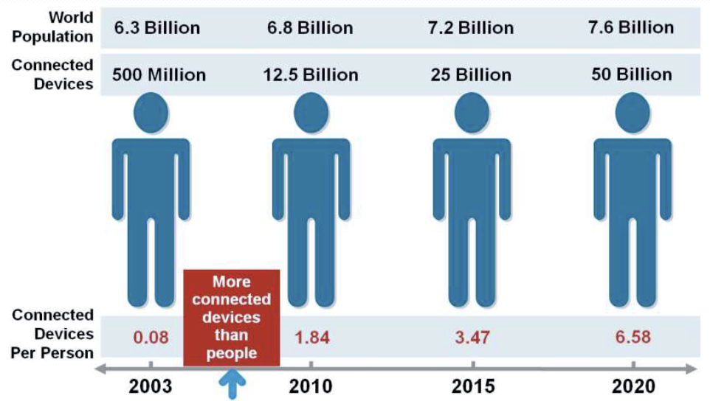
Current status & future prospect of Iot

Slide 6
Brief History of iot
IOT got its name in 1999
Kevin Ashton coined the term “Internet of Things” and established MIT’s Auto-ID Center, a global research network of academic laboratories focused on RFID and the IOT.

Slide 7
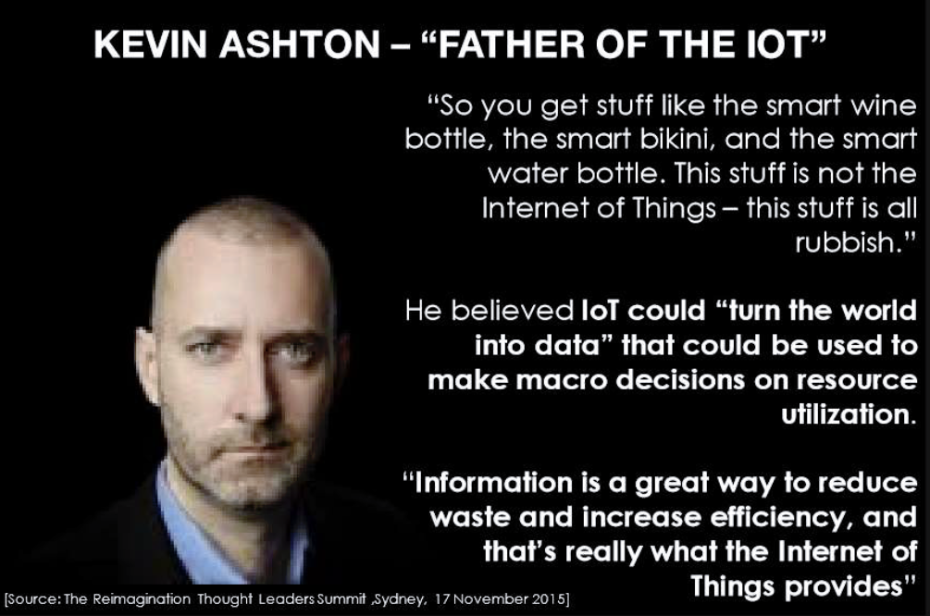
Brief History of iot

Slide 8
How it works?
IOT consists of all the web-enabled devices that collect, send and act on data they acquire from surroundings environments.
Uses sensors, processor and communication hardware. (“smart” devices) to collect the information
Machine to Machine(M2M) communication
Machine to Human Communication
Analyze the collected data
Act based on the conclusion of analysis

Slide 9
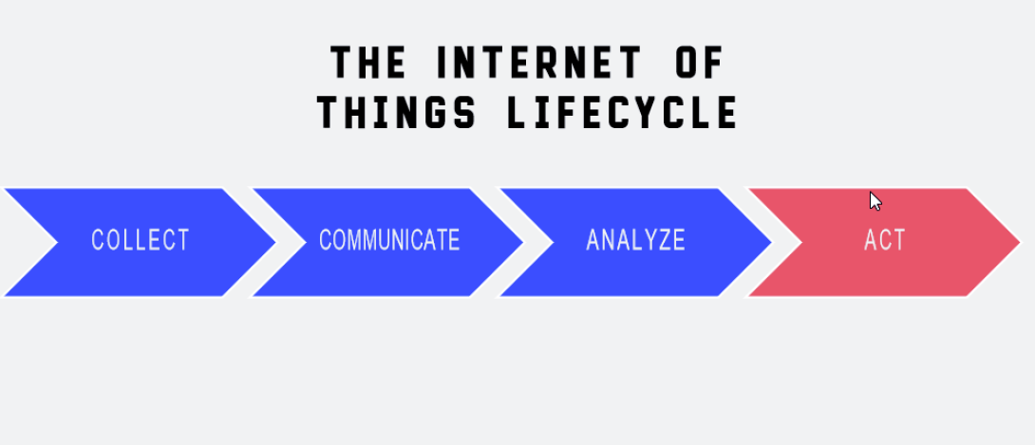
IOT Life Cycle

Slide 10
Collection
Devices and Sensors are collecting data everywhere.
At your home
At your university
At public vehicles
At office
At factories

Slide 11
Communication
Sending data and events through networks to some destination
A cloud platform
Private data center
Home network

Slide 12
Analysis
Creating information from the data
Visualizing the data
Building reports
Filtering data

Slide 13
Action
Taking action based on the information and data
Communicate with another machine (m2m)
Send notification (sms, email etc.)
Talk to another system

Slide 14
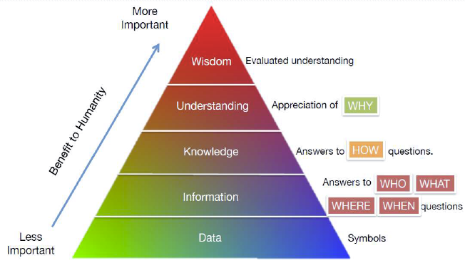
Hierarchy
The more data that is created, the better understanding and wisdom people can obtain

Slide 15
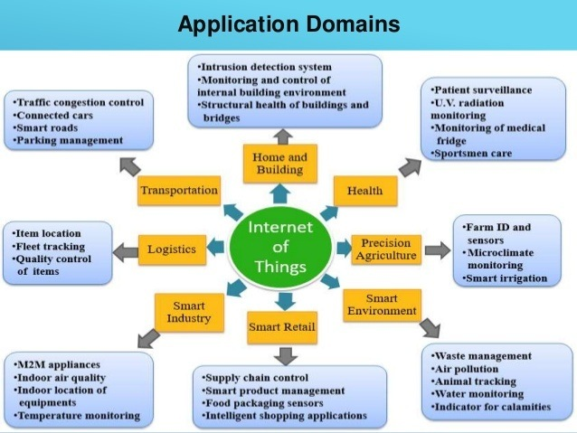
Application of Iot

Slide 16
Application of Iot
The ultimate goal of IOT us to automate human life.
Few applications are
Building and Home automation
Manufacturing
Medical and Healthcare systems
Media
Environmental monitoring
Infrastructure management
Energy management
Transportation
Better quality of life for elderly
... ... ...
You name it, and you will have it in IOT!

Slide 17
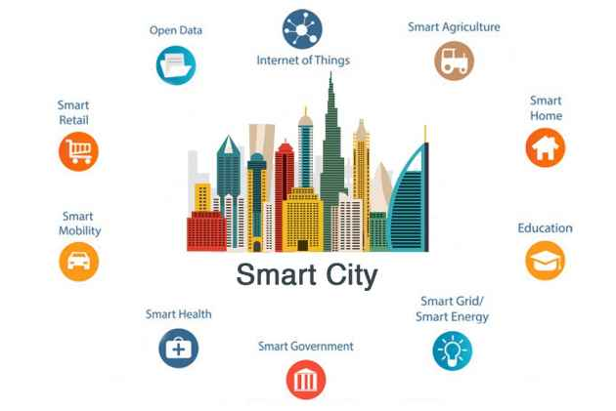
Smart City

Slide 18
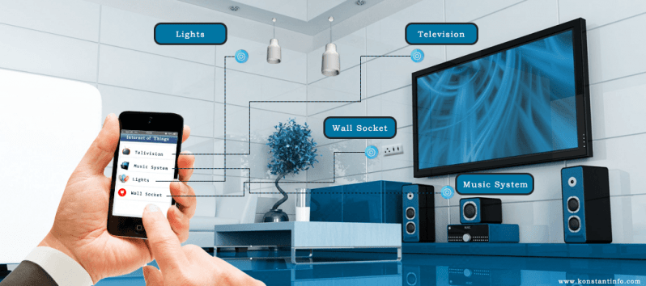
Smart Home
Many of you already know what the smart home is.

Slide 19
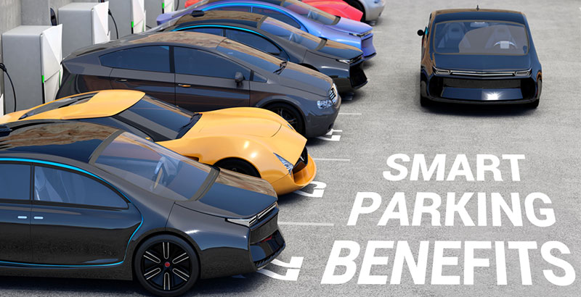
Smart Parking
Resident can identify the closest available space.

Slide 20
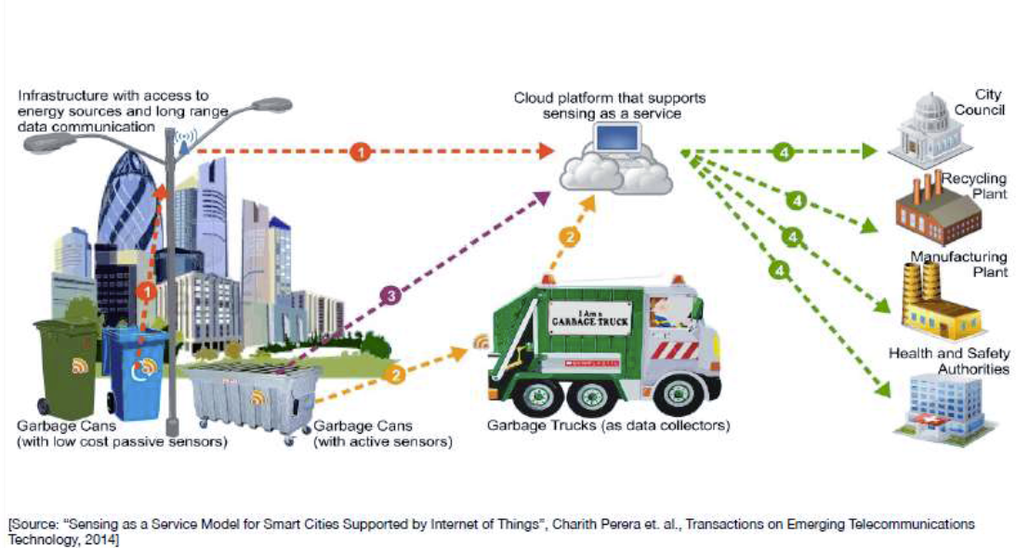
Waste Management In smart cities

Slide 21
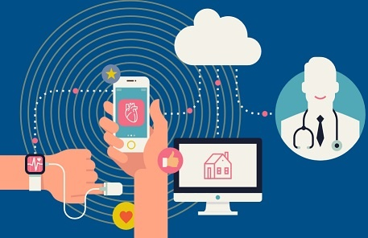
HealthCare
Notes:
Patients Surveillance, monitoring disabled people

Slide 22
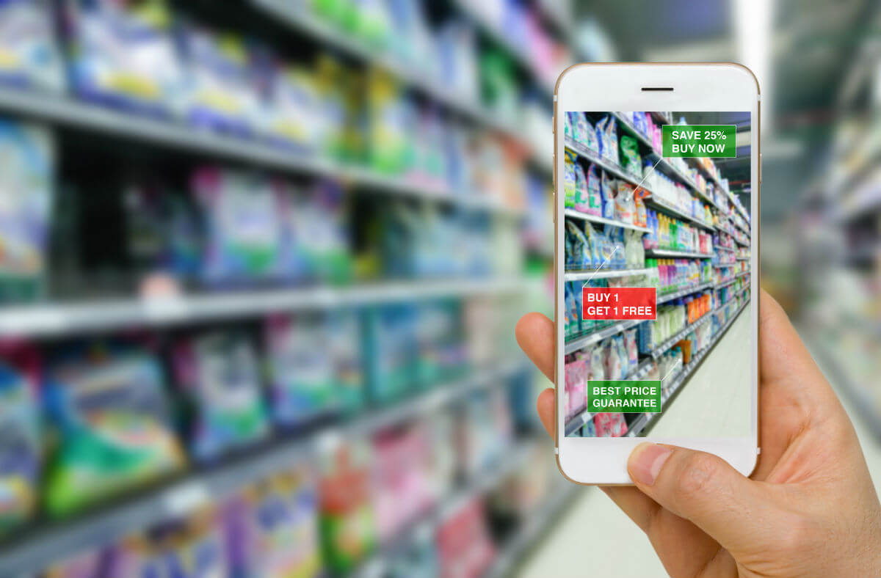
Retail market

Slide 23
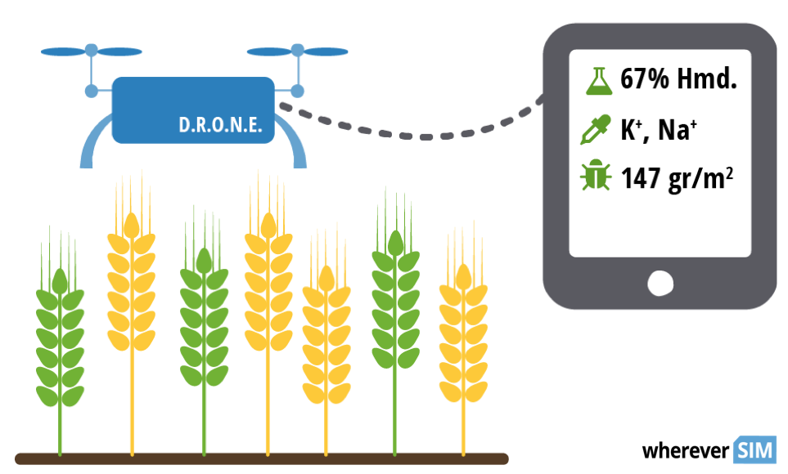
Agriculture

Slide 24
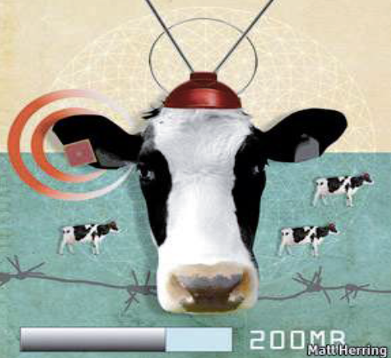
Sensors In even the holy cow
To monitor cow’s health and track their movements, ensuring healthier.

Slide 25
Can IOT help us to know more about ourselves?
Where you are going?
Who you are interacted with?
How long you have spoken to friends?
How long it takes to get to work?
The amount you text, tweet
How much exercise you are getting
How much you get distracted?
IOT helps you in life logging.

Slide 26
Challenges
Security
Connectivity
Technological Standardization
Data Volume
Compatibility and Longevity
Privacy

Slide 27
We have golden future in IOT.

Slide 28
Thank You!

