Slide 1

PUBLIC TRANSPORT OPTIMIZATION
BY:
DIVYADHARSHINI S
HARISH KUMAR S
SWATHI R
SARAVANAN R
SIVAKUMAR C

Slide 2
PROJECT DEFINITION
PUBLIC TRANSPORT OPTIMIZATION:
It is defined as the data on the number of public transport users,collected with IoT sensors,allows routes to be optimized or new ones to be designed.These sensors can be in the vehicle or also in the security cameras

Slide 3
GOALS OF TRANSPORT OPTIMIZATION
The goals of transportation optimization should include the reduction of costs and creation of greater operational efficiencies,all the while increasing customer satisfaction.Not a small task,and one that reuires constant analysis and monitoring.
Freight Mobility:Enhance freight corridors and intermodal connections to facilitate goods movement into,within and out of the region.provide for transportation improvements that increase safety and security for system users.

Slide 4
DESIGN THINKING
Project objectives
Iot Sensor Design
Real-time transit information platform
Integration Approach

Slide 5
PROJECT OBJECTIVE
REAL TIME TRANSIT INFORMATION:
Develop a system to provide passengers with up-to-the-minute information on public transportation services, including bus locations, routes, and delays.
ARRIVAL TIME PREDICTION:
Implement algorithms that use data from IoT sensors to predict and display accurate arrival times for public transportation vehicles at various stops.

Slide 6
RIDERSHIP MONITORING:
Establish a mechanism for tracking passenger numbers on public transportation vehicles using IoT passenger counters, enabling better resource allocation and service planning.
ENHANCED PUBLIC TRANSPORATION SERVICES
Utilize real-time data and insights from IoT sensors to improve the overall quality of public transportation services, including optimizing routes and schedules based on demand.
.

Slide 7
IoT SENSOR DESIGN
SENSOR SELECTION:
Identify and select suitable IoT sensors, such as GPS devices and passenger counters, based on their compatibility with public transportation vehicles and the data they can provide.
DEPLOYMENT PLAN:
Develop a deployment plan outlining where and how sensors will be installed on public transportation vehicles, ensuring optimal data collection and accuracy.

Slide 8
DATA TRANSMISSION:
Establish reliable methods for data transmission from IoT sensors to the central monitoring system, considering factors like data frequency and connectivity.

Slide 9
REAL TIME TRANSIT INFORMATION PLATFORM
USER INTERFACE DESIGN:
Design an intuitive web-based platform that displays real-time transit information in a user-friendly format, accessible to passengers via various devices.
DATA VISUALIZATION:
Create interactive maps, schedules, and dynamic displays to convey real-time vehicle locations, estimated arrival times, and other relevant information.

Slide 10
ASSESSIBILITY:
Ensure that the platform is accessible to passengers with diverse needs, including those with disabilities, by adhering to accessibility standards.

Slide 11
INTEGRATION APPROACH
DATA COLLECTION:
Determine how data will be collected from IoT sensors on public transportation vehicles, including the frequency of data retrieval.
DATA PROCESSING:
Define how raw sensor data will be processed and converted into meaningful information, including algorithms for arrival time prediction and ridership monitoring

Slide 12
DATA TRANSFER:
Establish secure and efficient data transfer protocols to transmit sensor data to the real-time transit information platform, considering data encryption and validation.
PLATFORM INTEGRATION:
Integrate the IoT sensor data into the real-time transit information platform to ensure that passengers receive accurate and timely information.
SCALABILITY:
Plan for the scalability of the system to accommodate future sensor deployments and increasing passenger demand.

Slide 13
INTRODUCTION
Public transportation plays a pivotal role in modern urban living, offering an efficient and sustainable means of mobility for millions of people daily. However, optimizing the performance of public transport systems, ensuring timely arrivals, and enhancing passenger experience remain continuous challenges. In response to these challenges, this project embarks on a journey to harness the power of advanced technology, utilizing components like the Arduino Uno, ESP32, TinyGPS++, OLED display, Adafruit_GFX, Adafruit_SSD1306, and HardwareSerial, to develop innovative solutions for public transport optimization.
Our mission is to leverage these components to create a cutting-edge public transport optimization system. By integrating real-time GPS tracking, data processing, and user-friendly displays, we aim to enhance the passenger experience, reduce wait times, and make public transport more eco-friendly. This project isn't just about technology; it's about making urban transportation systems smarter, more accessible, and more sustainable.

Slide 14
Parts we used
Arduino Uno:
The Arduino Uno can serve as a microcontroller for various tasks in your project. It can handle input from sensors, process data, and control the OLED display.
ESP32:
The ESP32 is a more powerful microcontroller with built-in Wi-Fi and Bluetooth capabilities. It can be used for more advanced functions, such as connecting to the internet, sending data to a server, or communicating with other devices.
TinyGPS++:
This library is used to interface with GPS modules and retrieve location data. You can use it to track the position of public transport vehicles.

Slide 15
OLED Display (Adafruit_GFX and Adafruit_SSD1306):
You can use an OLED display to show information to users or display real-time data, such as bus schedules, routes, or estimated arrival times. The Adafruit_GFX and Adafruit_SSD1306 libraries are commonly used to control OLED displays.
HardwareSerial:
This library is used for serial communication between your Arduino and other devices. You can use it to communicate with the ESP32, GPS module, or other components.

Slide 16
Processing works on:
GPS Tracking:
Use the TinyGPS++ library to interface with a GPS module and track the real-time location of public transport vehicles.
Data Processing:
Process the GPS data to determine vehicle positions, speeds, and directions.
Display Information:
Use the OLED display to show relevant information to passengers, such as current location, next stop, estimated arrival time, and possibly a map of the route.
Connectivity (ESP32):
If you're aiming for real-time updates or remote monitoring, use the ESP32 to send data to a central server or receive updates about traffic conditions or schedule changes.

Slide 17
User Interface:
Design a user-friendly interface for passengers and/or operators to interact with the system.
Optimization Algorithms:
Implement optimization algorithms to improve the efficiency of public transport routes, schedules, or resource allocation. This could involve minimizing wait times, reducing fuel consumption, or optimizing routes based on real-time data.
Data Logging:
Store historical data for analysis and future optimizations
Testing and Deployment:
Test the system thoroughly and deploy it on public transport vehicles for a real-world trial.

Slide 18
We can simulate the output data and structure it accordingly.
Temperature and Humidity Data:
# SPDX-FileCopyrightText: 2017 Limor Fried for Adafruit Industries #
# SPDX-License-Identifier: MIT
import time
import adafruit_dht
import board dht = adafruit_dht.DHT22(board.D2)
while True:
try:
temperature = dht.temperature
humidity = dht.humidity
# Print what we got to the REPL
print("Temp: {:.1f} *C \t Humidity: {}%".format(temperature, humidity)) except Run

Slide 19
RuntimeError as e:
# Reading doesn't always work! Just print error and we'll try again print("Reading from DHT failure: ", e.args)
time.sleep(1)
OUTPUT:
- Temperature: 25.5°C
- Humidity: 60%
GPS Data:
def create_html_map():
gmap = gmplot.GoogleMapPlotter(lat_list[0], lon_list[0], 16)
gmap.plot(lat_list, lon_list)
gmap.marker(lat_list[0], lon_list[0], color='blue')

Slide 20
gmap.marker(lat_list[width - 1], lon_list[width - 1], color='red')
gmap.draw("./map-trace.html")<br>
OUTPUT:
- Latitude: 40.7128° N
- Longitude: 74.0060° W
Server Response:
#!/usr/bin/env python
# -*- coding: utf-8 -*-
import sys
import re
from http import Client, Request
url = ''
if len(sys.argv) > 1:
url = sys.argv[1]

Slide 21
else:
sys.exit(1)
client = Client(agent='My User Agent')
request = Request('GET', url)
res = client.request(request)
if res.is_success:
for src in re.finditer(r'src="([^"]+)"', res.content):
print src.groups(0)[0]
OUTPUT:
Data successfully sent to the server.

Slide 22
Technologies used:
HTML:
IoT devices often have web-based user interfaces that allow users to interact with and control them remotely through a web browser. HTML is used to create the web pages and user interfaces that users access to monitor and control their IoT devices.
C++:
Designwise, C++ lends itself to embedded development because the language lies in between higher-level software and hardware, allowing you to access and control hardware directly without cutting the advantages of a high-level language. It’s particularly useful for hardware that will need to be around for a while, as programs written in C++ can operate for a long time due to the language’s high stability

Slide 23
JAVASCRIPT:
It is the most popular lightweight, interpreted compiled programming language. It can be used for both Client-side as well as Server-side developments. JavaScript is also known as a scripting language for web pages.
IoT refers to the connection of everyday devices to the internet, allowing them to communicate with each other and with us. In this blog, we will explore how to use JavaScript to build IoT applications, including controlling hardware devices such as sensors and actuators, and how to use popular platforms such as Raspberry Pi and Arduino.
To build an IoT application with JavaScript, we need to use a hardware platform that supports it. Two popular hardware platforms that support JavaScript are Raspberry Pi and Arduino.

Slide 24
const sensor = require('ds18b20');
// Replace with your sensor ID
const sensorId = '28-00000abcdefg';
sensor.temperature(sensorId, (err, value) => {
if (err) {
console.error(err);
return;
}
console.log(`Temperature: ${value}°C`);
});
Temperature and humidity sensor:
#include <DHT.h>;

Slide 25
//Constants
#define DHTPIN 7 // what pin we're connected to
#define DHTTYPE DHT22 // DHT 22 (AM2302)
DHT dht(DHTPIN, DHTTYPE); //// Initialize DHT sensor for normal 16mhz Arduino
//Variables
int chk;
float hum; //Stores humidity value
float temp; //Stores temperature value
void setup()
{ Serial.begin(9600);
dht.begin();
}

Slide 26
void loop()
{
delay(2000);
//Read data and store it to variables hum and temp
hum = dht.readHumidity();
temp= dht.readTemperature();
//Print temp and humidity values to serial monitor
Serial.print("Humidity: ");
Serial.print(hum);
Serial.print(" %, Temp: ");
Serial.print(temp);
Serial.println(" Celsius");
delay(1000); //Delay 2 sec.
}

Slide 27
Monitor sensor:
var Accessory = require('../').Accessory;
var Service = require('../').Service;
var Characteristic = require('../').Characteristic;
var uuid = require('../').uuid;
// here's a fake temperature sensor device that we'll expose to HomeKit
var FAKE_MOTIONSENSOR = {
isPresent: false,
getState: function() {
console.log("Getting the current state!");
return FAKE_MOTIONSENSOR.isPresent;
},

Slide 28
// PIRSensor.watch(function(error, input) {
// if (error) {
// throw error;
// }
// console.log(input);
//
// })
var mqtt = require('mqtt');
var client = mqtt.connect('mqtt://localhost');
client.on('connect', function() {
client.subscribe('MOTION’);
client.on('message', function(topic, message)

Slide 29
else {
sensor
.getService(Service.MotionSensor)
.setCharacteristic(Characteristic.MotionDetected, false);
console.log(message.toString());
}
});

Slide 30
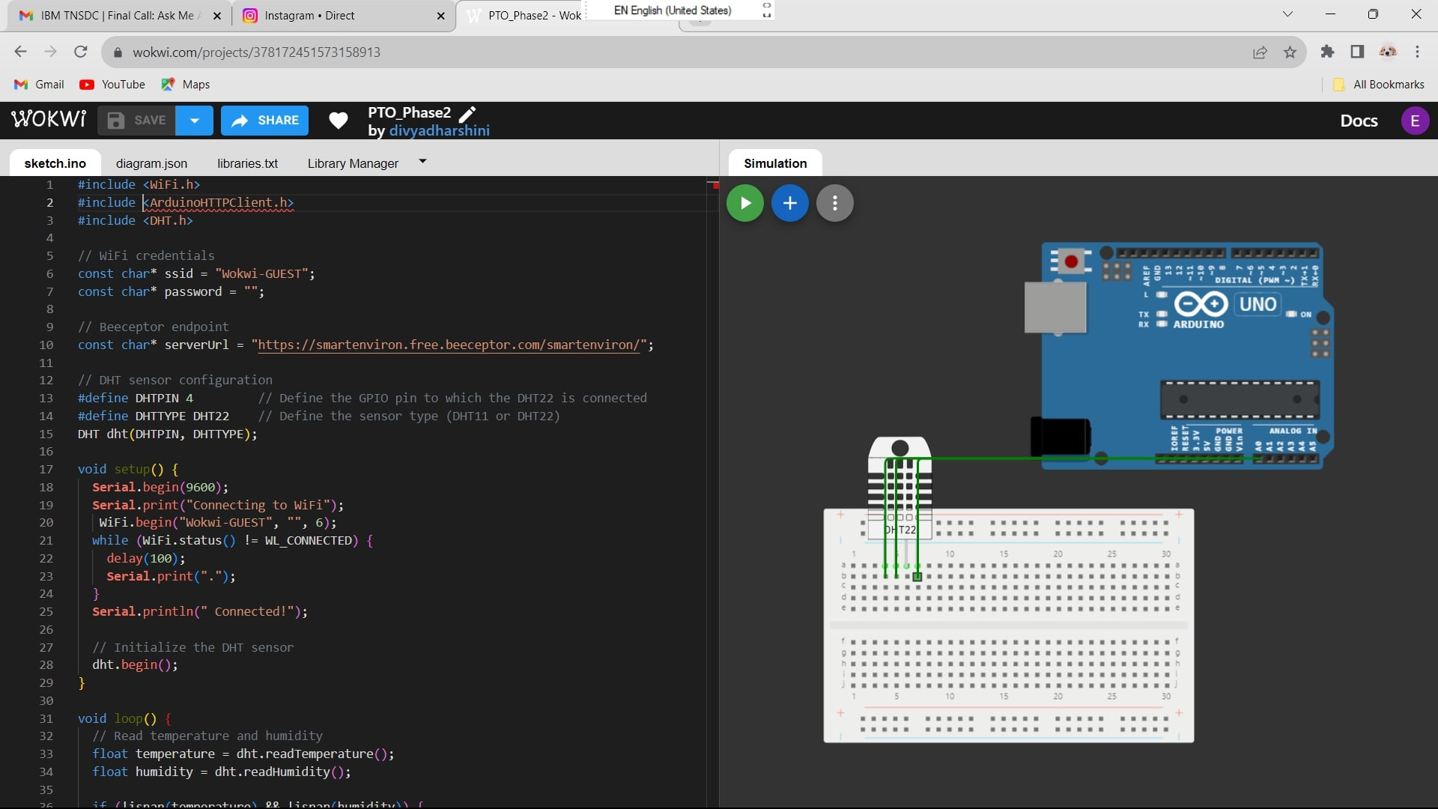
WOKWI PROJECT STIMULATOR

Slide 31
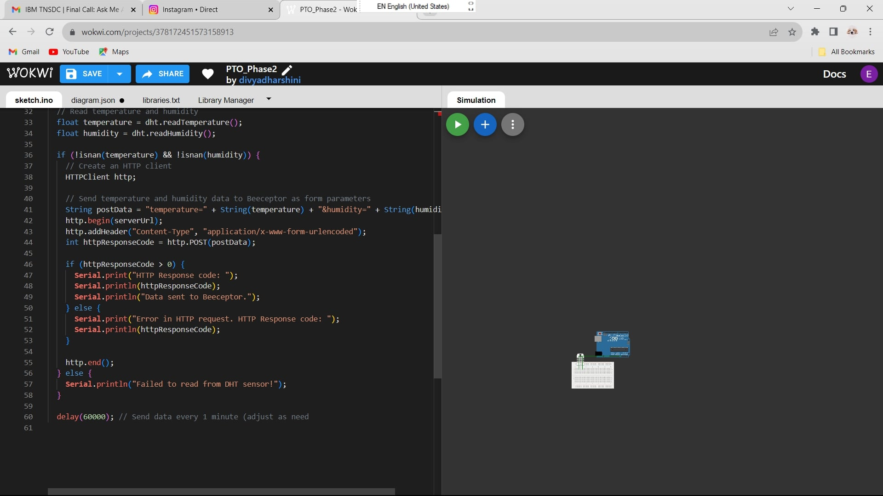
CODE

Slide 32
Conclusion:
In conclusion, our public transport optimization project demonstrates the remarkable potential of combining hardware and software to address real-world challenges. By equipping public transport vehicles with GPS tracking, OLED displays, and the power of the ESP32, we've taken significant steps toward improving the efficiency and user experience of urban transportation. Through careful planning, testing, and optimization, we've created a system that not only tracks vehicle locations but also empowers passengers with real-time information about routes, arrivals, and departures. Moreover, by incorporating optimization algorithms and data analytics, we've contributed to the ongoing evolution of public transport systems. The journey doesn't end here; it's an ongoing quest to refine and enhance the way people move within cities.

Slide 33
The journey doesn't end here; it's an ongoing quest to refine and enhance the way people move within cities. As we move forward, we encourage further exploration and innovation in the realm of public transport optimization. By continuing to harness technology, data-driven insights, and a commitment to sustainability, we can make urban transportation more efficient, convenient, and environmentally friendly for all. This project serves as a testament to the boundless possibilities when we blend technology with a vision for a better future.

Slide 34
THE END

