Slide 1

DEPARTMENT OF ELECTRICAL ENGINEERING
PAKISTAN INSTITUTE OF ENGINEERING AND APPLIED SCIENCES
Hands on Algorithm Acceleration using
Heterogeneous Computing Systems
FINAL YEAR PROJECT PRESENTATION
PRESENTED BY:
Mahgul Adnan (02-3-1-025-2019)
Soroush Javed Sulehri (02-3-1-070-2019)
01

Slide 2

PAKISTAN INSTITUTE OF ENGINEERING AND APPLIED SCIENCES | 02
Overview
01.
Introduction
06.
CPU Implementation
02.
Motivation
07.
Results and Discussion
03.
Theory and Background
08.
Conclusion
04.
Literature Review
09.
Future Recommendation
05.
Methodology

Slide 3
PAKISTAN INSTITUTE OF ENGINEERING AND APPLIED SCIENCES | 03
Introduction
PROBLEM STATEMENT
Accelerating Genome Sequencing Sneaky Snake Pre-alignment filtering algorithm using Heterogeneous Computing Systems
OBJECTIVES
  Understanding Heterogeneous Computing Systems
  Understanding the basics of Genome Sequencing and Pre-alignment Filtering Algorithm
  Implementation of Sneaky Snake Algorithm in a multi threaded fashion on a multi core processor (CPU)
  Analyzing the performance of the implementation on CPU
01. Introduction

Slide 4

PAKISTAN INSTITUTE OF ENGINEERING AND APPLIED SCIENCES | 04
Motivation
  Increasing need of better and faster computing platforms
  Moore's Law Reaching its Limit
  Heterogeneous Computing is the tomorrow
WHY BIOINFORMATICS/GENOME SEQUENCING
Recent Pandemic advocated the need of:
  Faster Diagnosis
  Accelerated Research
  Better understanding of Human at its core
  Advancement in Bioinformatics is needed
  Genome Sequencing is in need of better and faster computing platforms
02. Motivation

Slide 5


Background and
Theory
01 | Heterogeneous Computing Systems
02 | Genome Sequencing and Pre-alignment Filtering
03 | Sneaky Snake Algorithm

Slide 6
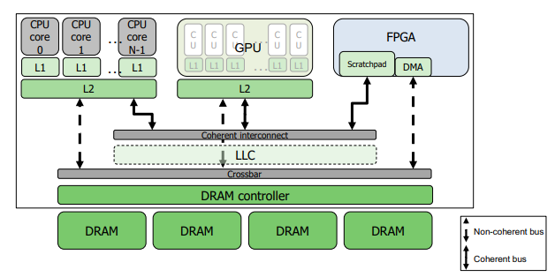
PAKISTAN INSTITUTE OF ENGINEERING AND APPLIED SCIENCES | 06
Heterogeneous Computing Systems
Composed of different types of processors
Different computing nodes are available
Workload is divided between processors according to their capability
Parallel systems
Thus, depending on the application use any of the four levels of parallelism
    Single Instruction stream-Single Data Stream (SISD)
    Single Instruction Stream-Multiple Data Stream (SIMD)
    Multiple Instruction Stream-Single Data Stream (MISD)
    Multiple Instruction Stream-Multiple Data Stream (MIMD)
03. Background & Theory

Slide 7
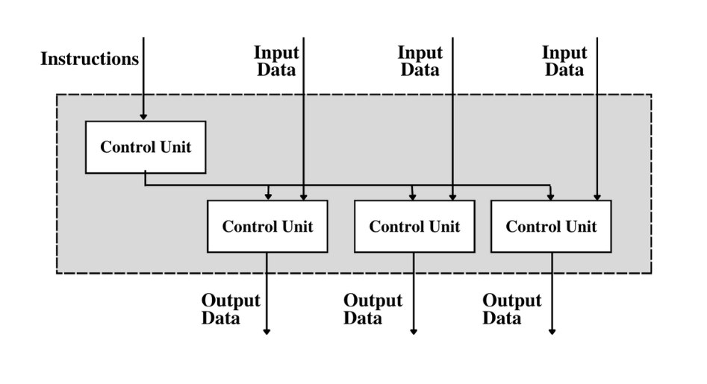
PAKISTAN INSTITUTE OF ENGINEERING AND APPLIED SCIENCES | 07
Single Instruction Multiple Data
Only one instruction is available with all the processors
Each processor has its own data on which it executes instructions
Used for vector operation processing and digital signal processing
Primary goal: Maximize performance while using the least amount of power
03. Background & Theory

Slide 8
PAKISTAN INSTITUTE OF ENGINEERING AND APPLIED SCIENCES | 08
Different Processors Combinations
CPU and ASIC
Simplest and low-power consuming architecture
CPU and GPU
Increases the throughput of data and the number of concurrent calculations within an application
CPU and FPGA
Can execute ASM algorithm much more quickly than a CPU
Advantages of Heterogenous Systems
Parallel task division technology
Increases the computation speed but also play their role in reducing the power consumption
Paved way for the introduction of data communication technology between Heterogeneous Processors
03. Background & Theory

Slide 9
PAKISTAN INSTITUTE OF ENGINEERING AND APPLIED SCIENCES | 09
Genome Sequencing
What is Human Genome?
  Complete set of all nucleic acid sequences for homo sapiens, encoded as DNA within 23 chromosomes
  Consists of three billion base pairs, forming one long polymer
  Classified as coding and non-coding DNA
Genome Sequencing Process
  Determining the genome of an organism in its entirety or near to that
  Helps determines the intricacies hidden behind the coded sequence that living cells contain
  This process can be divided into the following steps:
  Obtaining reads from sequencer
  Taking reads from the sequencer and mapping them onto the reference genome (Read Mapping)
  Read mapping is further divided into
    Indexing and Querying
    Pre-alignment filtering
    Sequence Alignment
03. Background & Theory

Slide 10
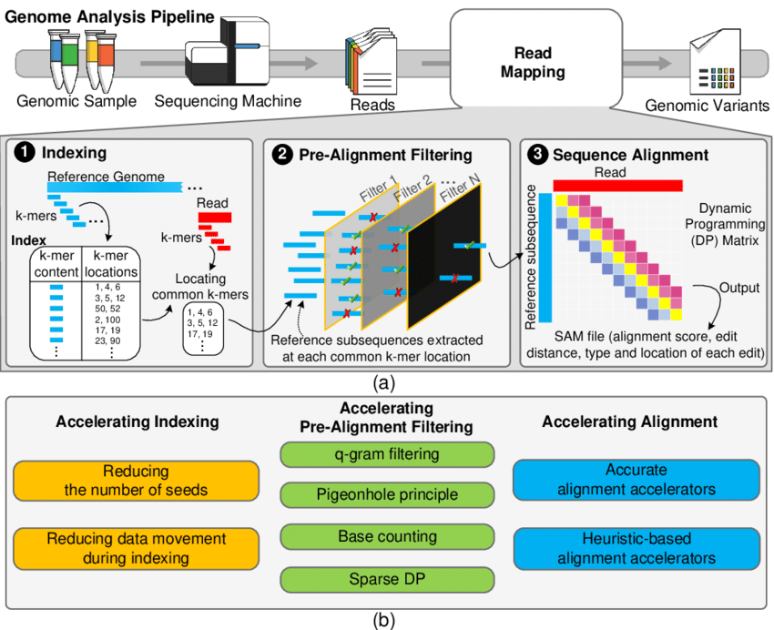
PAKISTAN INSTITUTE OF ENGINEERING AND APPLIED SCIENCES | 10
Genome Sequencing
Pre-Alignment Filtering
A technique used to accelerate the process of genome sequencing
Reduces the need for DP algorithm used by the sequence alignment technique
Types of Pre-Alignment Filtering algorithm
  Shifted Hamming Distance
  Gatekeeper Algorithm
  MAGNET
  Shouji
  Sneaky Snake Algorithm
03. Background & Theory

Slide 11
PAKISTAN INSTITUTE OF ENGINEERING AND APPLIED SCIENCES | 11
Literature Review
ALGORITHM | DESCRIPTION
SHD | Limited by the capability of SIMD machines Can only take 128 bit input read at a time Is slower as compared to other algorithms due to sequential comparison
Gatekeeper | Inaccurate after a certain edit distance threshold
Sneaky Snake | Improves the accuracy of pre-alignment filtering by 4 times as compared to other algorithms Can be implemented on CPUs, GPUs, FPGAs Only algorithm which can be implemented on different processors
03. Background & Theory

Slide 12
PAKISTAN INSTITUTE OF ENGINEERING AND APPLIED SCIENCES | 12
Sneaky Snake Algorithm
Highly accurate and highly parallel pre-alignment filter that reduced computations
Focuses on reducing the Approximate String Matching (ASM) problem to single net routing (SNR)
Works by eliminating sequences with edits greater than a certain edit distance threshold
  Edit Distance Threshold is defined as the minimum number of edits needed to convert one sequence into the other
  Single Net Routing Problem
Refers to the problem of optimally interconnecting two terminals on a grid graph while respecting constraints
The main objective of this problem is to find the optimal signal net
03. Background & Theory

Slide 13
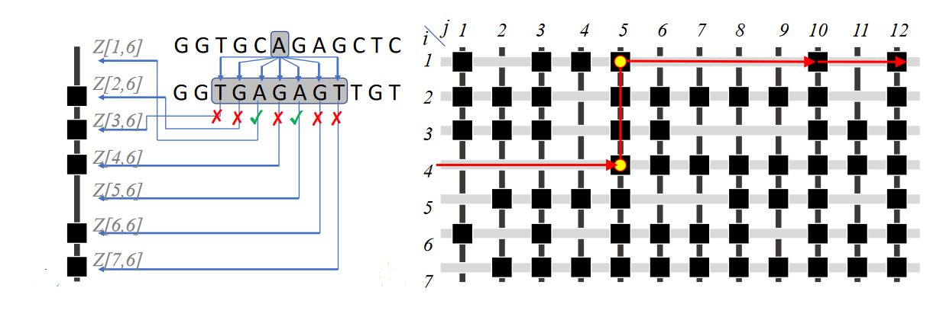
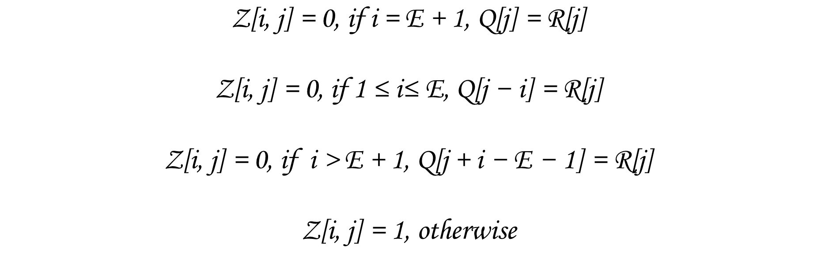
PAKISTAN INSTITUTE OF ENGINEERING AND APPLIED SCIENCES | 13
$$\text{Z}\text{[}\text{i}\text{, }\text{j}\text{] = 0, }\text{if} \text{i}\text{ = }\text{E}\text{ + 1, }\text{Q}\text{[}\text{j}\text{] = }\text{R}\text{[}\text{j}\text{]}$$
$$\text{Z}\text{[}\text{i}\text{, }\text{j}\text{] = 0, }\text{if}\text{ 1 ≤ }\text{i}\text{≤} \text{E}\text{, }\text{Q}\text{[}\text{j}\text{ − }\text{i}\text{] = }\text{R}\text{[}\text{j}\text{]}$$
$$\text{Z}\text{[}\text{i}\text{, }\text{j}\text{] = 0, }\text{if} \text{i}\text{ > }\text{E}\text{ + 1, }\text{Q}\text{[}\text{j}\text{ + }\text{i}\text{ − }\text{E}\text{ − 1] = }\text{R}\text{[}\text{j}\text{]}$$
$$\text{Z}\text{[}\text{i}\text{, }\text{j}\text{] = 1, }\text{otherwise}$$
Figure 3: SNR Problem
03. Background & Theory

Slide 14
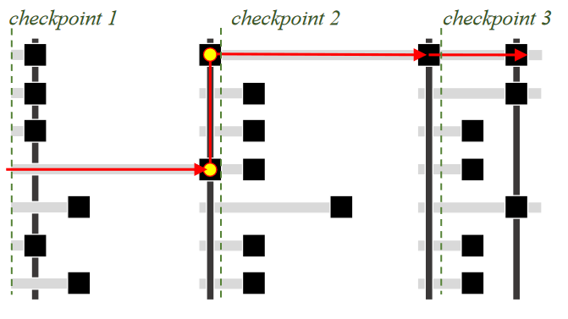
PAKISTAN INSTITUTE OF ENGINEERING AND APPLIED SCIENCES | 14
Solving Single Net Routing
AIM: Finding the optimal Signal Net by solving SNR Problem
The problem is solved insix steps
  Calculating the chip maze on the fly using the equations given in the previous slide.
  The first column is taken to be the first checkpoint.
  The Sneaky Snake algorithm always chooses the longest escape segment at each subsequent checkpoint, enabling the signal to go as far as possible before hitting an obstruction
  IV. A new checkpoint is created after the longest escape segment.
  V. Step 2 and 3 are repeated to find whether the signal net has reached its destination
  VI. Decisions are made, and the reads are accepted or rejected
03. Background & Theory

Slide 15
Methodology
01 | Performance
02 | Datasets
03 | Procedure

Slide 16
PAKISTAN INSTITUTE OF ENGINEERING AND APPLIED SCIENCES | 16
PERFORMANCE OF SNEAKY SNAKE ALGORITHM
Execution Time (s)
  In Code High Resolution Clock
Memory Utilization (bytes)
  Visual Studio Performance Profiler.
CPU Utilization (percent)
  Visual Studio Performance Profiler
Accuracy
  Compared with previous Results
04. Methodology

Slide 17
PAKISTAN INSTITUTE OF ENGINEERING AND APPLIED SCIENCES | 17
DATA SETS
Data Set Name | Source | Read Length | Sample Pairs | Edit Distance Threshold
100_bp_1 | https://www.ebi.ac.uk/ena/data/view/ERR240727 | 100 | 30000 | 2
100_bp_2 | https://www.ebi.ac.uk/ena/data/view/ERR240727 | 100 | 3000000 | 2
100_bp_3 | https://www.ebi.ac.uk/ena/data/view/ERR240727 | 100 | 30000 | 40
100_bp_4 | https://www.ebi.ac.uk/ena/data/view/ERR240727 | 100 | 3000000 | 40
250_bp_1 | https://www.ebi.ac.uk/ena/data/view/SRR826471 | 250 | 30000 | 8
250_bp_2 | https://www.ebi.ac.uk/ena/data/view/SRR826471 | 250 | 3000000 | 8
250_bp_3 | https://www.ebi.ac.uk/ena/data/view/SRR826471 | 250 | 30000 | 40
250_bp_4 | https://www.ebi.ac.uk/ena/data/view/SRR826471 | 250 | 3000000 | 40
10K_bp | Alser et al. | 10000 | 10 | Default Error Count
Real Data Sets
100_bp_1 to 250_bp_4
Simulated Data Sets
10K_bp (long_1) Alser et al.
04. Methodology

Slide 18
PAKISTAN INSTITUTE OF ENGINEERING AND APPLIED SCIENCES | 18
PROCEDURE
  Choose a data set
  Provide Inputs
  Measure Execution Time
  Measure CPU Utilization
  Measure Memory Utilization
  Observations Recorded
  Repeated for different Edit Distance Threshold
  Repeated for different number of threads
  Whole Process Repeated for different data sets
Data Set | Iteration No
 | 1 | 2 | 3 | 4 | 5
100_bp_1 | E = 0 | E = 2 | E = 5 | E = 10 | E = 20
100_bp_2 | E = 0 | E = 10 | E = 20 | E = 40 | E = 100
250_bp_1 | E = 0 | E = 4 | E = 8 | E = 10 | E = 20
250_bp_2 | E = 0 | E = 20 | E = 40 | E = 50 | E = 100
10K_bp | E = 0 | E = 100 | E = 1000 | E = 2000 | E = 5000
ANALYSIS
The collected data was organized and plotted to make conclusions about the effect of varying parameters
04. Methodology
Notes:
Integration with Visual Studio Enterprise
Choose a data sets and adjust Edit Distance Threshold, Read Length, Number of Threads and Number of Reads
Executed to measure the execution time in Debug Mode
Executed with CPU and Memory Profiler
Observations Recorded
Repeated for different Edit Distance Threshold
Repeated for different number of threads
Whole Process Repeated for different data sets

Slide 19
CPU Implementation
01 | Functional Hierarchy
02 | Pseudo Code
03 | Multi-threading via OpenMP
04 | Hardware Used
05 | Software Requirement

Slide 20
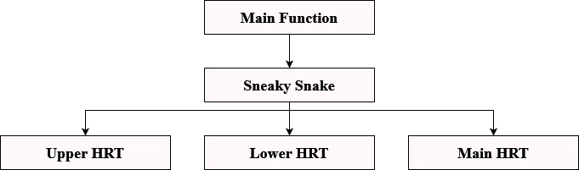
PAKISTAN INSTITUTE OF ENGINEERING AND APPLIED SCIENCES | 20
Functional Hierarchy
05. CPU Implementation

Slide 21
PAKISTAN INSTITUTE OF ENGINEERING AND APPLIED SCIENCES | 21
Pseudo Code
Inputs and Outputs
Variable Name | Datatype | Input/Output | Contains
readfile | fstream | Input | The read data is contained within this data structure
N | int | Input | Total bases present in a read (read length)
E | int | Input | Edit Distance Threshold
threads | int | Input | No of threads to be used
lines | int | Input | Total number of reads
accepted_sum | int | Output | Total number of reads accepted
rejected_sum | int | Output | Total number of reads rejected
05. CPU Implementation

Slide 22
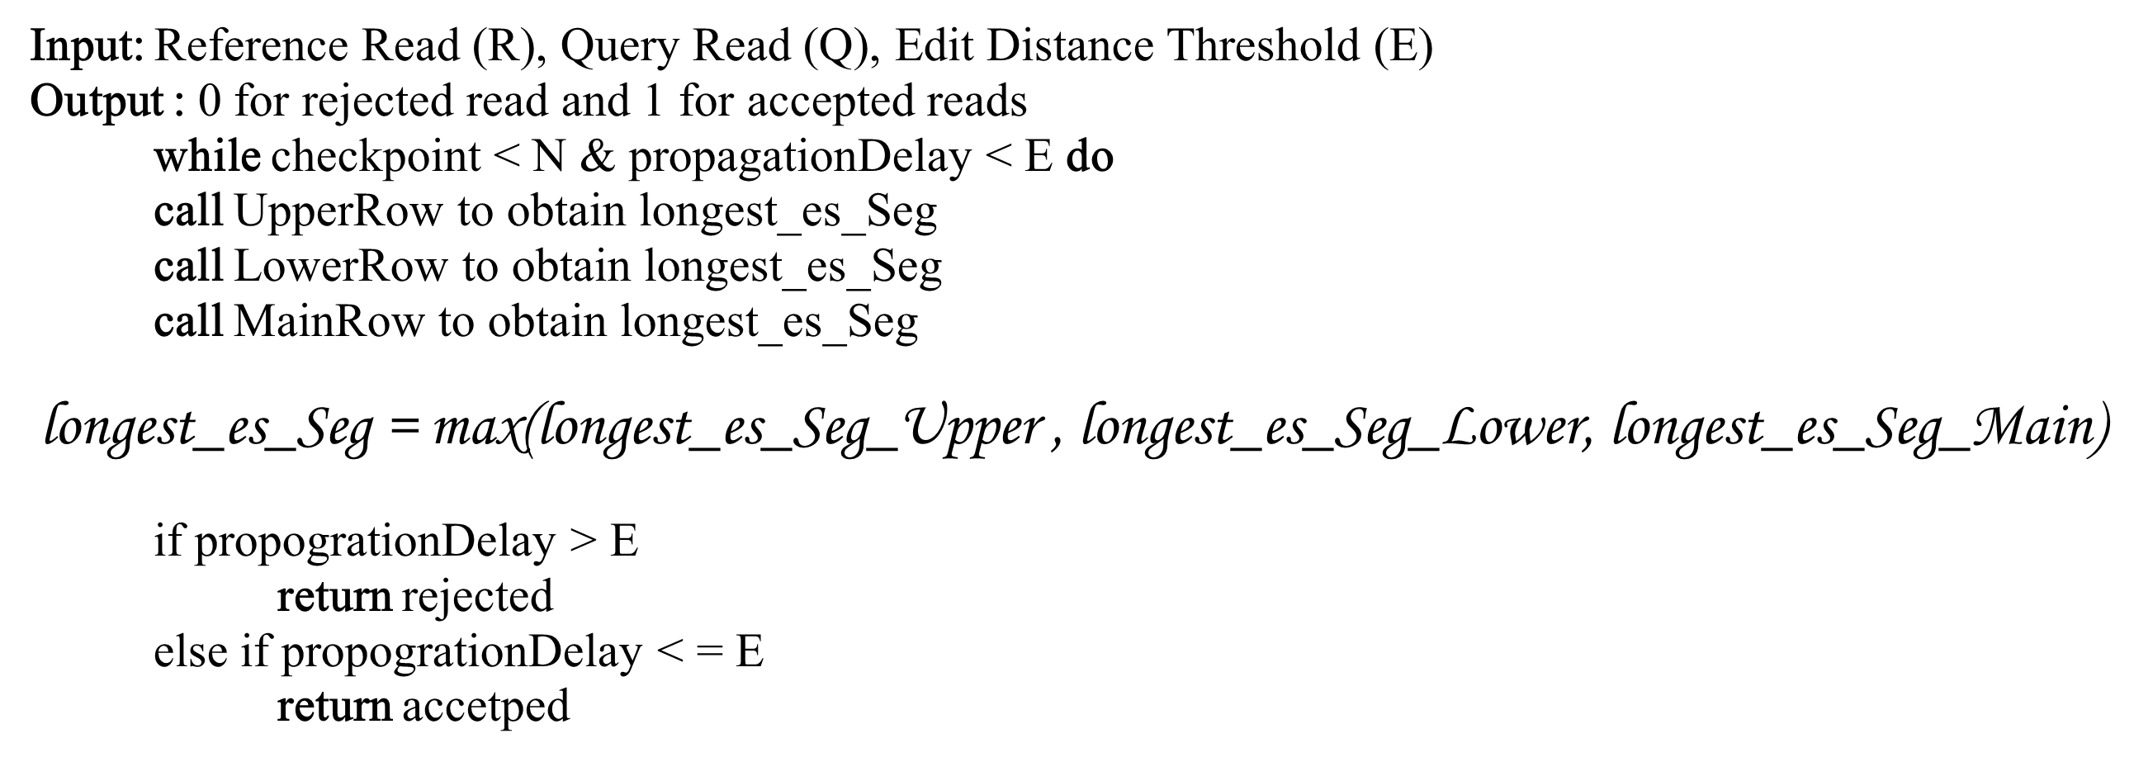
PAKISTAN INSTITUTE OF ENGINEERING AND APPLIED SCIENCES | 22
Algorithm 1 : Sneaky Snake
Input: Reference Read (R), Query Read (Q), Edit Distance Threshold (E)
Output : 0 for rejected read and 1 for accepted reads
while checkpoint < N & propagationDelay < E do
call UpperRow to obtain longest_es_Seg
call LowerRow to obtain longest_es_Seg
call MainRow to obtain longest_es_Seg
$$\text{longest}\text{_}\text{es}\text{_}\text{Seg}\text{ = }\text{max}\text{(}\text{longest}\text{_}\text{es}\text{_}\text{Seg}\text{_}\text{Upper}\text{ , }\text{longest}\text{_}\text{es}\text{_}\text{Seg}\text{_}\text{Lower}\text{, }\text{longest}\text{_}\text{es}\text{_}\text{Seg}\text{_}\text{Main}\text{)}$$
if propogrationDelay > E
return rejected
else if propogrationDelay < = E
return accetped
05. CPU Implementation

Slide 23
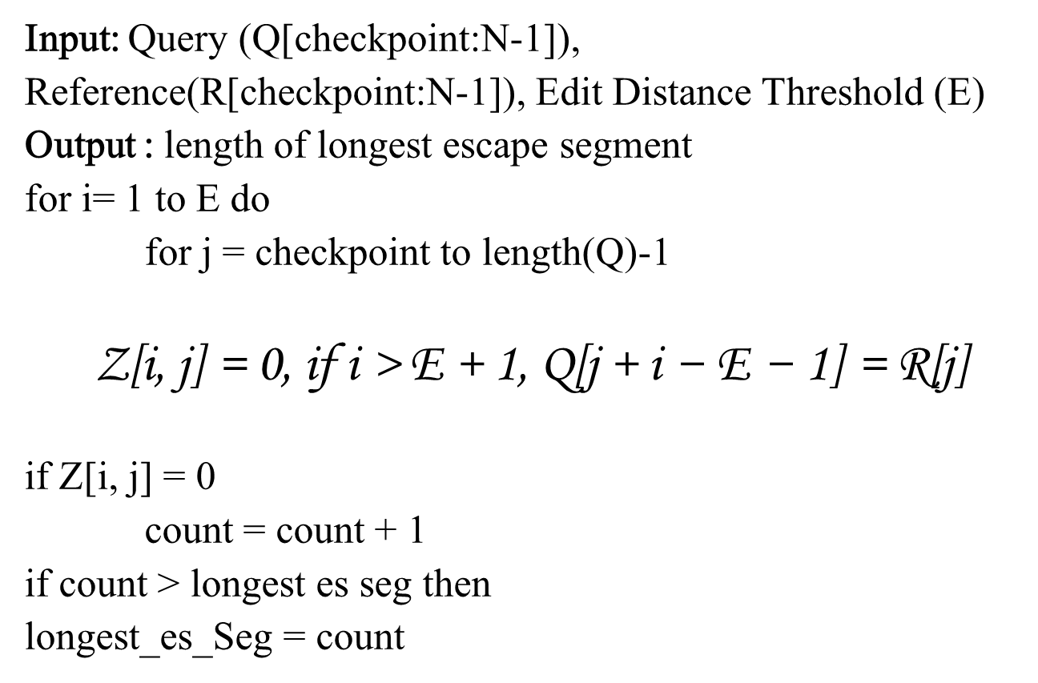
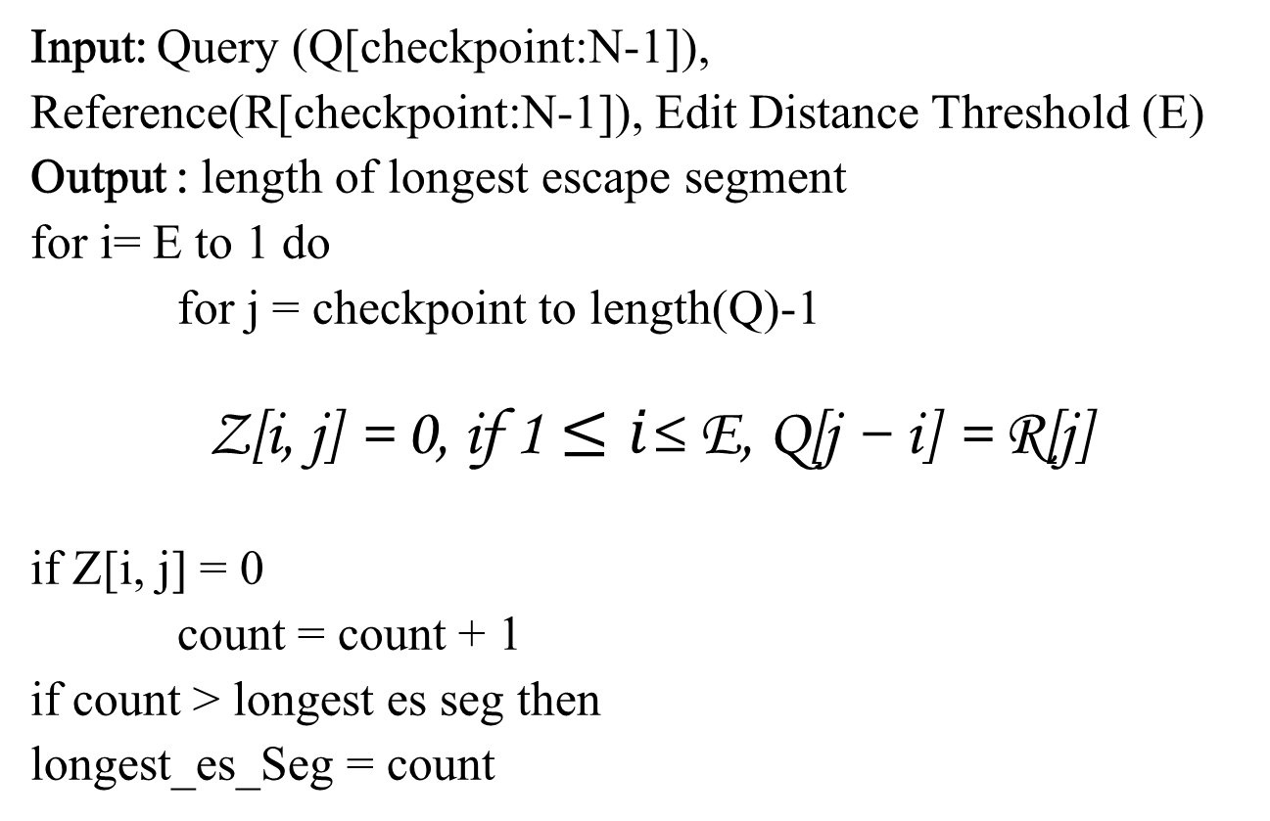
PAKISTAN INSTITUTE OF ENGINEERING AND APPLIED SCIENCES | 23
Algorithm 2 : Upper HRT
Algorithm 3: Lower HRT
Input: Query (Q[checkpoint:N-1]), Reference(R[checkpoint:N-1]), Edit Distance Threshold (E)
Output : length of longest escape segment
for i= E to 1 do
for j = checkpoint to length(Q)-1
$$\text{Z}\text{[}\text{i}\text{, }\text{j}\text{] = 0, }\text{if}\text{ 1}≤i\text{≤ }\text{E}\text{, }\text{Q}\text{[}\text{j}\text{ − }\text{i}\text{] = }\text{R}\text{[}\text{j}\text{]}$$
if $\text{Z}\text{[}\text{i}\text{, }\text{j}\text{] = 0}$
count = count + 1
if count > longest es seg then
longest_es_Seg = count
Input: Query (Q[checkpoint:N-1]), Reference(R[checkpoint:N-1]), Edit Distance Threshold (E)
Output : length of longest escape segment
for i= 1 to E do
for j = checkpoint to length(Q)-1
$$\text{Z}\text{[}\text{i}\text{, }\text{j}\text{] = 0, }\text{if} \text{i}\text{ > }\text{E}\text{ + 1, }\text{Q}\text{[}\text{j}\text{ + }\text{i}\text{ − }\text{E}\text{ − 1] = }\text{R}\text{[}\text{j}\text{]}$$
if $\text{Z}\text{[}\text{i}\text{, }\text{j}\text{] = 0}$
count = count + 1
if count > longest es seg then
longest_es_Seg = count
05. CPU Implementation

Slide 24
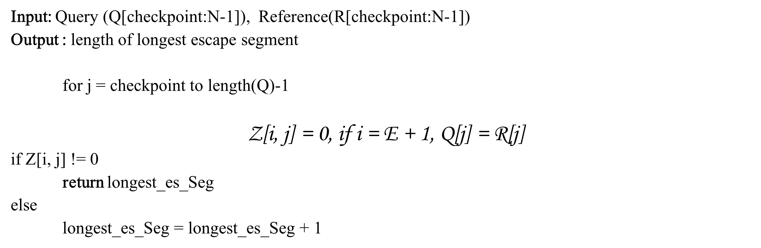
PAKISTAN INSTITUTE OF ENGINEERING AND APPLIED SCIENCES | 24
Algorithm 4: Main HRT
Input: Query (Q[checkpoint:N-1]), Reference(R[checkpoint:N-1])
Output : length of longest escape segment
for j = checkpoint to length(Q)-1
$$\text{Z}\text{[}\text{i}\text{, }\text{j}\text{] = 0, }\text{if} \text{i}\text{ = }\text{E}\text{ + 1, }\text{Q}\text{[}\text{j}\text{] = }\text{R}\text{[}\text{j}\text{]}$$
if $\text{Z}\text{[}\text{i}\text{, }\text{j}\text{] != 0}$
return longest_es_Seg
else
longest_es_Seg = longest_es_Seg + 1
05. CPU Implementation

Slide 25
PAKISTAN INSTITUTE OF ENGINEERING AND APPLIED SCIENCES | 25
PARALLELISM
  Bottleneck
  Algorithm and Parallelism
    Independent Reads
    Independent Rows
  OpenMP
  SIMD Model
  limitations
05. CPU Implementation

Slide 26
PAKISTAN INSTITUTE OF ENGINEERING AND APPLIED SCIENCES | 26
Hardware Used
intel(R) Core(TM) i5-10210U
Characteristic | Specification
Cores | 4
Logical Processors | 8
Maximum Turbo Frequency | 4.20 GHz
Base Frequency | 1.60 GHz
Cache | 6MB Intel Smart Cache
Software Requirements
  Visual Studio Enterprise Edition
  C++ 14
  OpenMP
05. CPU Implementation

Slide 27
Results and Discussion

Slide 28
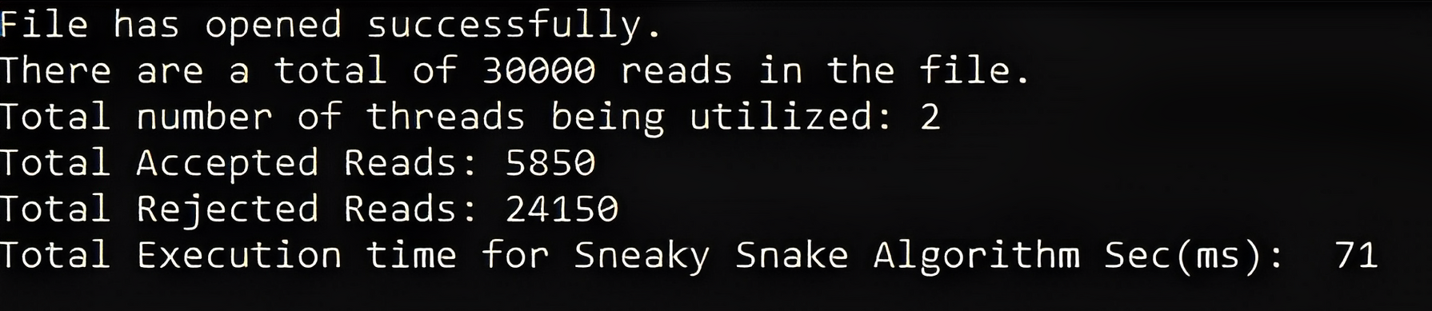
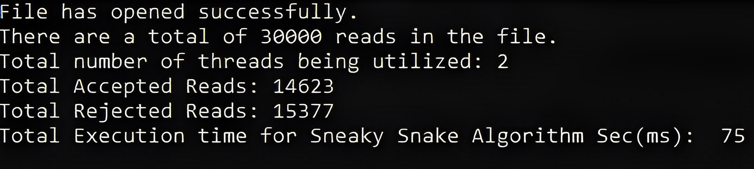
PAKISTAN INSTITUTE OF ENGINEERING AND APPLIED SCIENCES | 28
Functioning and Output
06. Results and Discussion

Slide 29
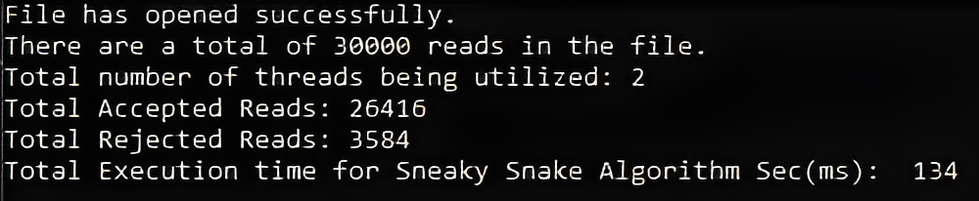
PAKISTAN INSTITUTE OF ENGINEERING AND APPLIED SCIENCES | 29
Functioning and Output
06. Results and Discussion

Slide 30
PAKISTAN INSTITUTE OF ENGINEERING AND APPLIED SCIENCES | 30
Accuracy
Data Set: 100_bp_1
Edit Distance | No of Threads | Accepted Experimental | Accepted Original | Rejected Experimental | Rejected Original
0 | 2 | 243 | 243 | 29757 | 29757
2 | 2 | 1578 | 1578 | 28422 | 28422
5 | 4 | 5850 | 5850 | 24150 | 24150
10 | 6 | 14623 | 14623 | 15377 | 15377
20 | 8 | 26416 | 26416 | 3584 | 3584
03. Background & Theory

Slide 31
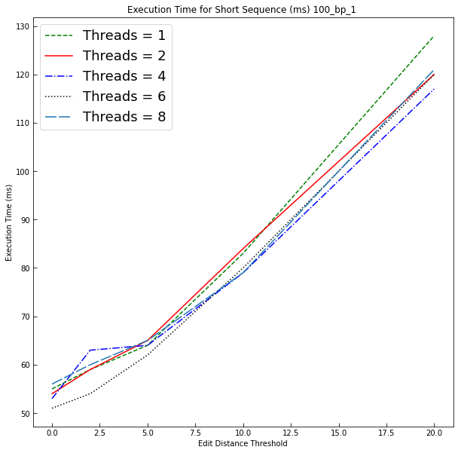
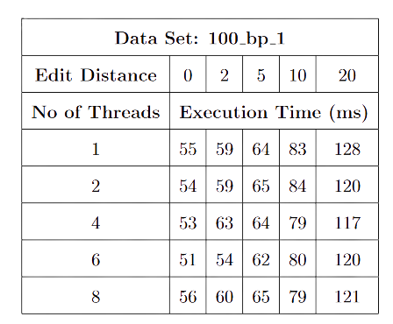
PAKISTAN INSTITUTE OF ENGINEERING AND APPLIED SCIENCES | 31
Execution Time
06. Results and Discussion

Slide 32
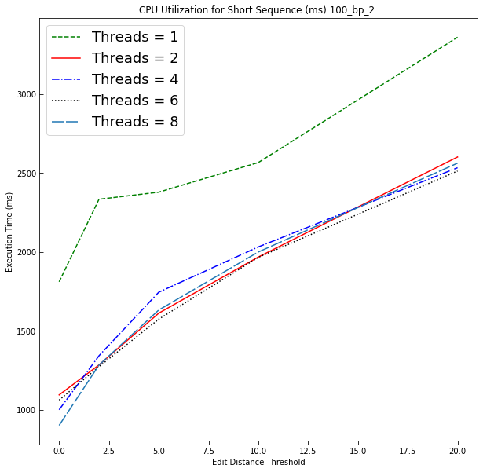
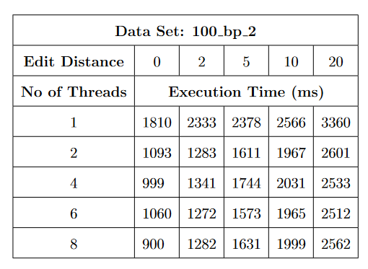
PAKISTAN INSTITUTE OF ENGINEERING AND APPLIED SCIENCES | 32
Execution Time
06. Results and Discussion

Slide 33
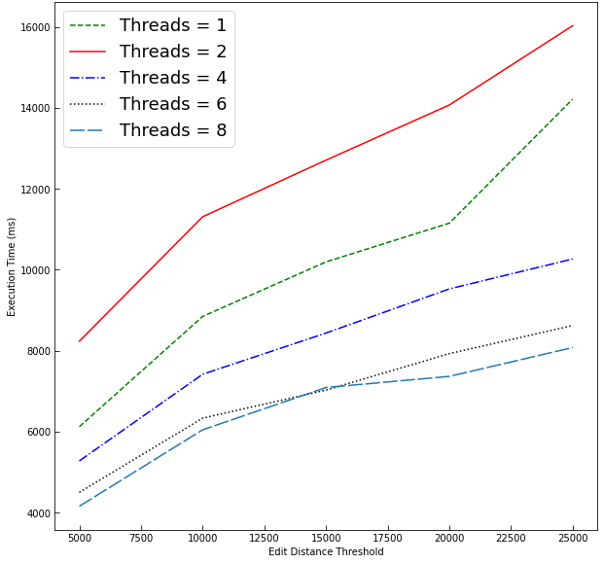
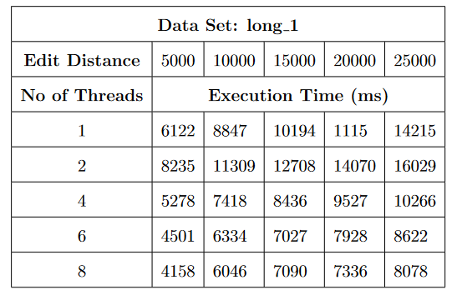
PAKISTAN INSTITUTE OF ENGINEERING AND APPLIED SCIENCES | 33
Execution Time
06. Results and Discussion

Slide 34
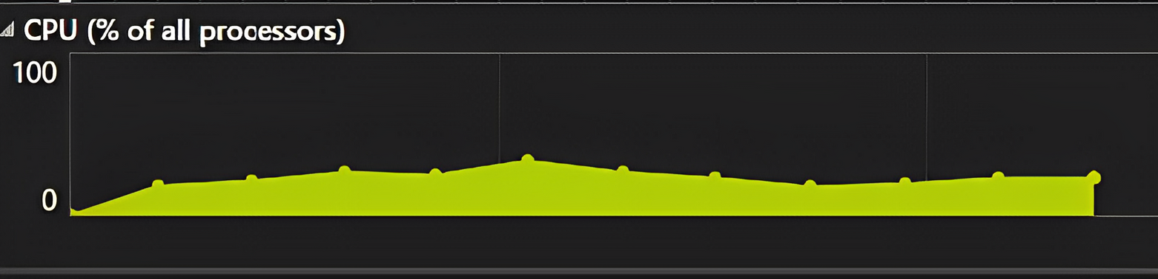
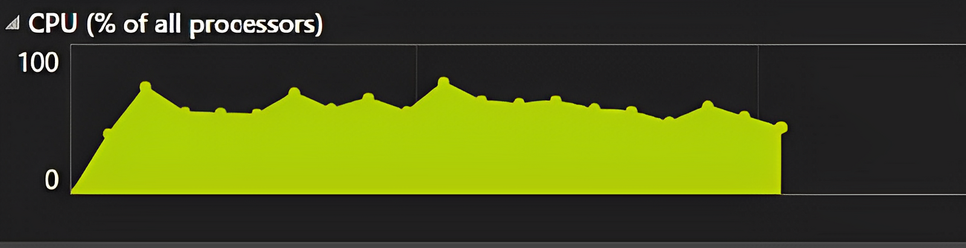
PAKISTAN INSTITUTE OF ENGINEERING AND APPLIED SCIENCES | 34
CPU Utilization
Execution Time (s)
Execution Time (s)
06. Results and Discussion

Slide 35
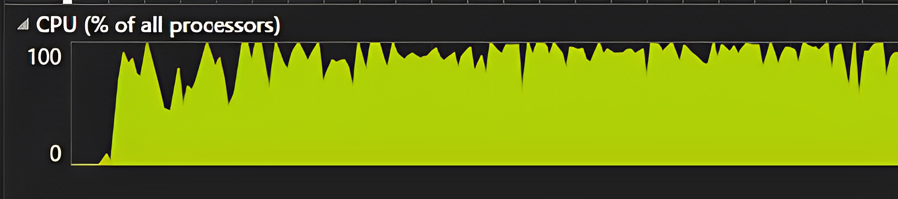
PAKISTAN INSTITUTE OF ENGINEERING AND APPLIED SCIENCES | 35
CPU Utilization
Execution Time (s)
Execution Time (s)
06. Results and Discussion

Slide 36
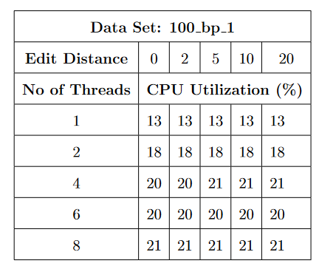
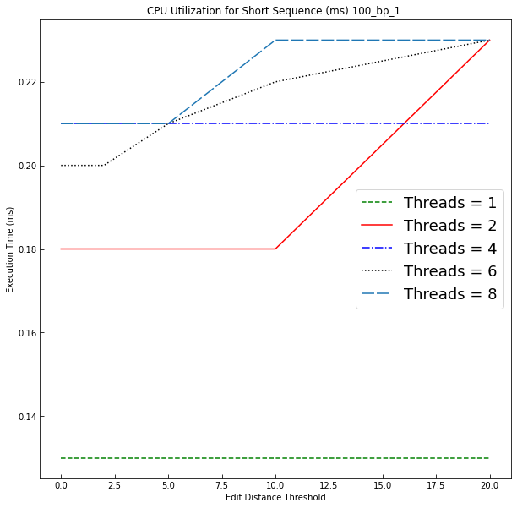
PAKISTAN INSTITUTE OF ENGINEERING AND APPLIED SCIENCES | 36
CPU Utilization
Execution Time (s)
21
06. Results and Discussion

Slide 37
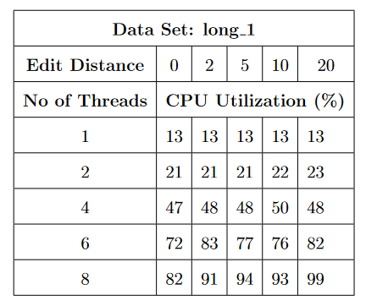
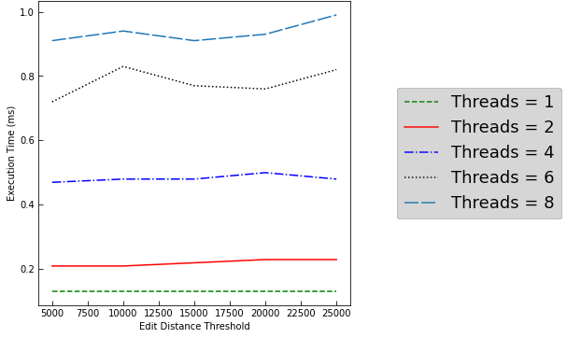
PAKISTAN INSTITUTE OF ENGINEERING AND APPLIED SCIENCES | 37
CPU Utilization
Execution Time (s)
03. Background & Theory

Slide 38
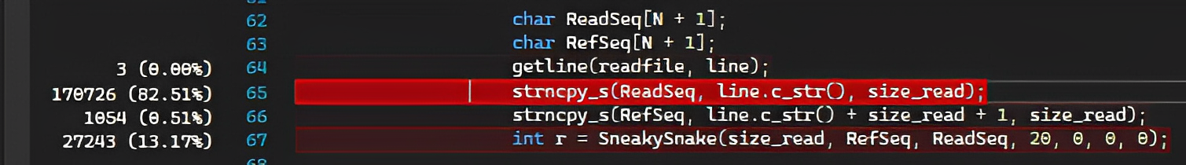
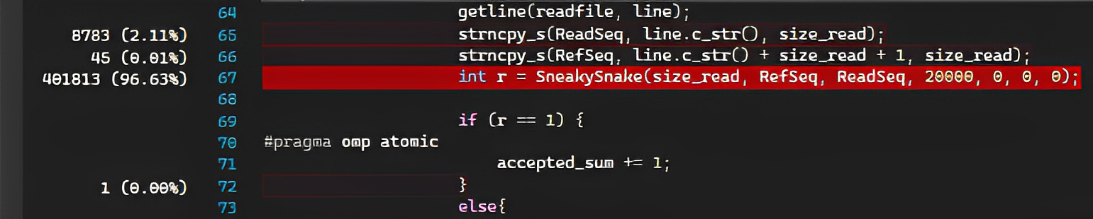
PAKISTAN INSTITUTE OF ENGINEERING AND APPLIED SCIENCES | 38
Bottleneck and Problems
06. Results and Discussion

Slide 39
Conclusion

Slide 40
PAKISTAN INSTITUTE OF ENGINEERING AND APPLIED SCIENCES | 40
Conclusion
The project aimed to implement the Sneaky Snake algorithm on the CPU. The implemented algorithm worked accurately, achieving results that coincided with the previously tested algorithm’s results. The algorithm’s performance was analyzed to conclude that with increasing cores, the algorithm performed better for most data sets. The results indicated that a multi-threaded approach towards the implementation was superior to single-threaded implementation unless the multi-threading overhead cost exceeded the speed provided by it.
Future work
  Sneaky Snake algorithm can be moved onto other processing hardware such as FPGAs and GPU
  Moving the implementation onto cloud computing platforms can optimize the speed and resource utilization much better due to the availability of better resources and support

Slide 41
PAKISTAN INSTITUTE OF ENGINEERING AND APPLIED SCIENCES | 41
Future Project Timeline
  1. Testing the CPU implementation for more data and finding optimal performing conditions
2. Cloud based CPU Implementation and Analysis
3.Implementation on Xilinx Virtex 7 vc707 FPGA
5. Cloud based implementation of Nvidia A100 GPU
4. Cloud Based FPGA Implementation and Analysis
6. Development of Command Line Interface
03. Background & Theory

Slide 42

Thank You

