Slide 1

Hello and welcome to our Presentation!

Slide 2
SUBMITTED BY
Mohammad Shah Alam
201015075
Most. Akhi Khatun
201015018
Dept. of CSE
Green University of Bangladesh
SUBMITTED TO
Md Riyad Hassan
Lecturer
Dept. of CSE
Green University of Bangladesh

Slide 3
Project Title
Contact Management System

Slide 4

Contents
Project Description
Tools & Technologies
Sample UI

Slide 5
How we develop the project
We created a system for managing contacts by using shell script.
In this project users can add contact, view contact, search contact, and also delete the contact.
We made this system easier for all.
Users can store contact for future uses.

Slide 6
Tools & Technologies
Operating System
Linux (Ubuntu)
Programming Language
Shell
Code Editor
Sublime Text 3

Slide 7
How much portion of the project is done
We just created user interface what user can see when project will run.

Slide 8
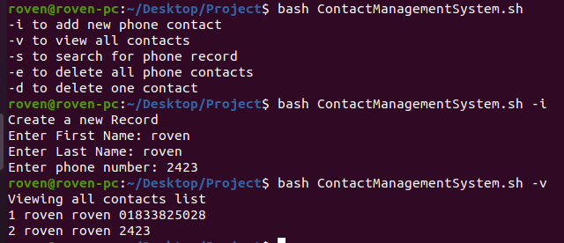
Sample UI

Slide 9
Thank You!

