Slide 1
Version Control System (VCS)
DevOps Batch – 13
Module - 02

Slide 2
Version Control System (VCS)
A Version Control System (VCS) is a tool/software that helps you track changes made to files (usually source code), collaborate with others, and revert to previous versions when needed. It keeps a history of every change, who made it, when, and why. Think of it like a time machine for your code.
Track Changes Over Time
Collaboration
Backup & Safety
Experiment Safely
Review & Accountability
Deployment Automation

Slide 3
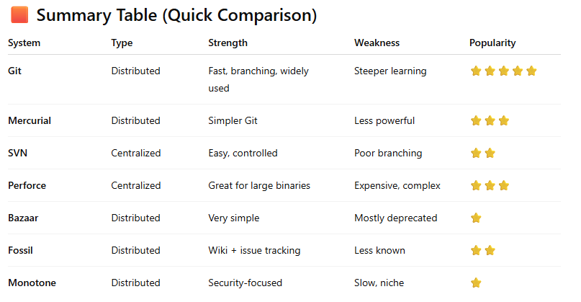
Other Version Control Systems
Version Control Systems fall into two main categories:
Distributed VCS → (Git, Mercurial)
Centralized VCS → (Subversion, Perforce)
Git is distributed, fast, and the most widely used

Slide 4

Why GiT
Very fast
Best branching model
Used by millions
Supported by GitHub, GitLab, Bitbucket
Works offline
Highly flexible

Slide 5
Top Features of Git
Distributed Version Control: Everyone has a full copy of the repository (history + files). Works offline, Faster operations, Safer backups
Lightning-Fast Performance: Git is optimized for speed. Operations like commit, diff, and log are extremely fast because they run locally.
Branching & Merging (Best in the industry): Git makes branching: EasyCheapFastSafeYou can create new features, test ideas, or fix bugs without touching the main code. Merging branches is also very smooth.
Staging Area (Index): Before committing, you can select exactly which changes should go into a commit. This allows: Partial commits, Cleaner commit history, Better control

Slide 6
Top Features of Git
Data Integrity (SHA-1): Every file and commit is check summed with SHA-1.Git ensures your data cannot be changed silently or corrupted.
Distributed Collaboration: Git makes collaboration easy using platforms like: GitHub, GitLab, Bitbucket. Everyone works on their own branches → merges → reviews.
Powerful History Tracking: Who change what? When was it changed? Why was it changed? - (git log, git blame, git show)
Lightweight
Open Source & Free
Flexibility

Slide 7
Learning goals
Use Git confidently: init, stage, commit, branch, rebase, merge, bisect, stash, cherry-pick.
Fork a public repository, contribute via branches and PRs, keep your fork in sync.
Configure branch protection and recover from force-push mistakes.
Prepare a repo to run on Heroku and Render; deploy and troubleshoot.
Create CI pipeline to deploy from Git.

Slide 8
Git Branching
Work on Features Without Breaking Main Code (git checkout -b feature/login-system)
Multiple Developers Can Work in Parallel (Dev A: feature/payment-api | Dev B: feature/dashboard-ui | Dev C: bugfix/order-summary)
Easier Bug Fixing (git checkout -b hotfix/critical-db-error)
Better Code Review and Collaboration (Create branch → feature/cart-module, git push -u origin feature/cart-module, Open Pull Request → teammates review, Approve → merge to main)
Helps Maintain Different Versions
Easy Rollback If Something Goes Wrong
Helps with CI/CD Pipelines

Slide 9

Practical

