Slide 1

Mawlana Bhashani Science and Technology University
Santosh, Tangail- 1902.
Department of Computer Science and Engineering
Course Title: Software Development Project- II and Industrial Tour
Course Code: CSE 3116
Created By
Golam Sarowar(CE21007)
Jonayet Hossain(CE21008)
Alamgir Hosain(CE21012)
3rd Year 2nd Semester
Supervised By
Dr. Mohammad Motiur Rahman
Professor
Department of CSE,MBSTU

Slide 2
Presentation on
Learning Management System
Efficient Course Management for Teachers, Students, and Admins

Slide 3
Content
1. Introduction
2. objective and scope
3. Architecture
4. Implementation
5. Video
6.Challenge
7. Future Scope
8. Conclusion

Slide 4
Introduction
The Learning Management System (LMS) is a web-based platform designed to facilitate educational interactions between administrators, teachers, and students. Developed using modern web technologies.

Slide 5
Objective
This project focuses on the-
Easy Resource Sharing.
Centralized Learning Platform.
Anytime, Anywhere Learning.
Streamlined Educational Processes.
Enhanced User Interaction.
User-friendly interfaces.
Design a secure system with user roles and authentication.

Slide 6
Scope
This project contains three modules-
Admin
Teacher
Student
User verification
Handles course creation
Routine management.
Classroom creation,
Routine management,
Content upload (topic lists, course materials),
Announcement posting.
Join Course
View Course materials
Check announcement

Slide 7
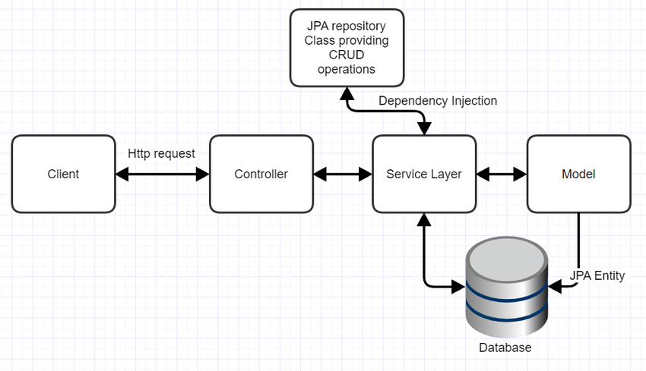
Architecture
Spring MVC Framework follows the Model-View-Controller architectural design pattern.

Slide 8
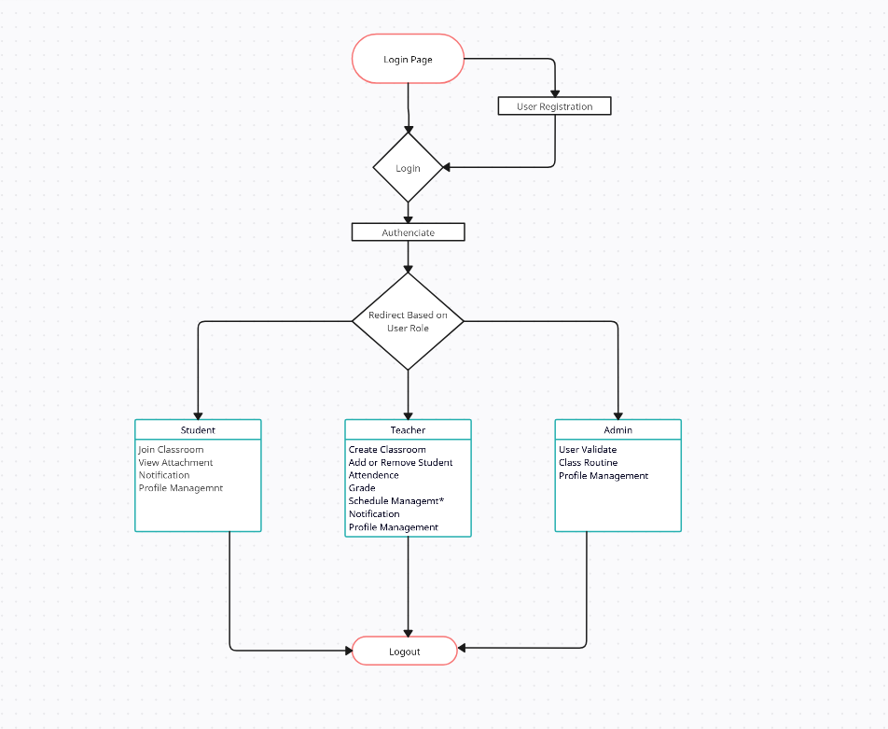
Workflow Diagram

Slide 9
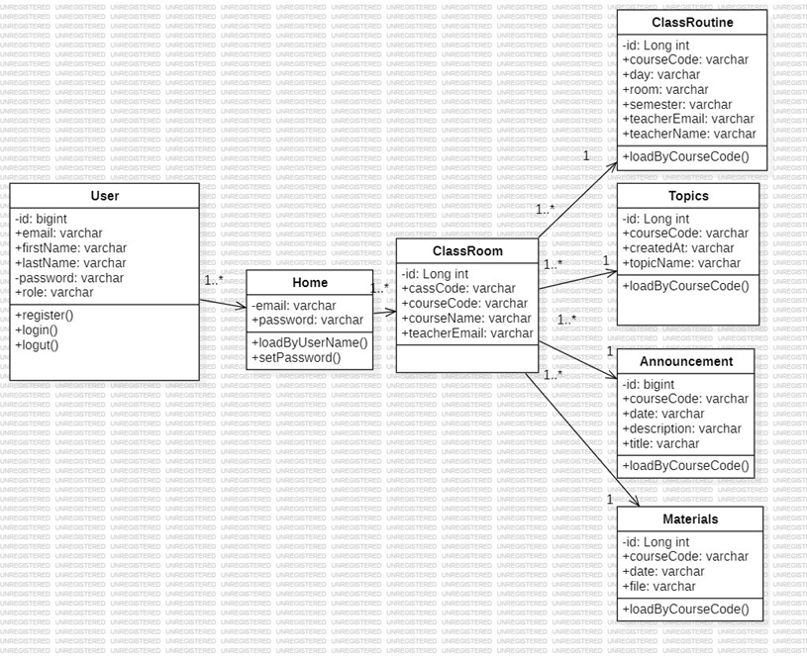
Class Diagram

Slide 10
Implementation
Frontend
Backend
Database
HTML
CSS
JavaScript
Bootstrap
Spring Boot
RESTful API
Secure Authentication
MySQL

Slide 11
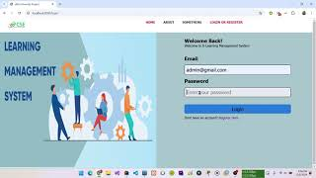
Video

Slide 12
Challenge
Challenges Faced During the Project-
Complex Authentication.
Slow Data Retrieval.
Work on Github.

Slide 13
Future Scope
Future Scope of the Project-
Mobile Application.
Real-time communication (e.g., chat).
Integration with video conferencing tools.
Advanced Dashboard.
Develop a progress tracking system for students.

Slide 14
Conclusion
The Learning Management System project demonstrates a comprehensive, scalable educational platform integrating modern web technologies.Future advancements can further enhance the functionalities and user experience.

Slide 15
Thank You

