Slide 1
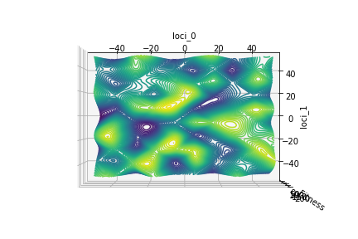
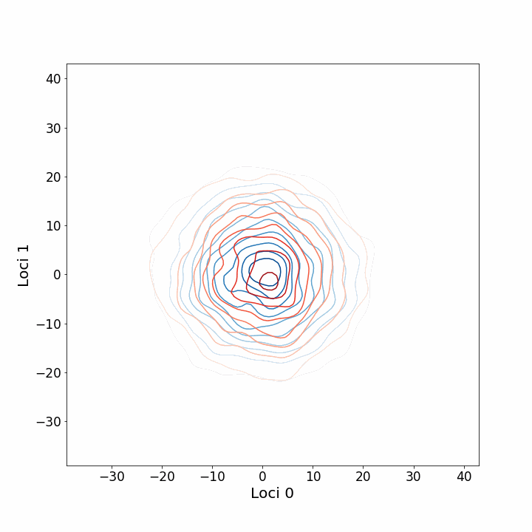
General Landscape

Slide 2
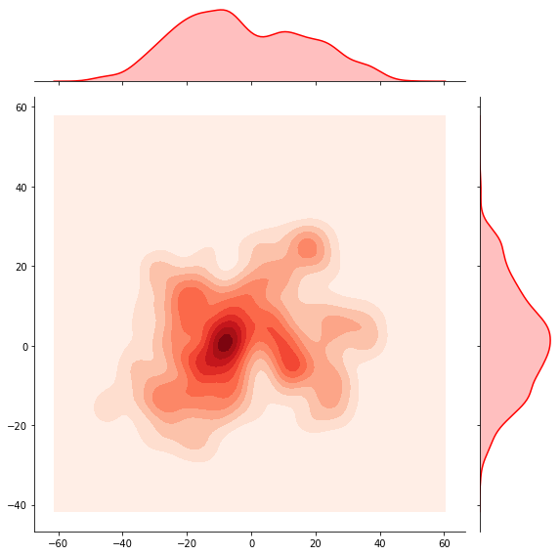
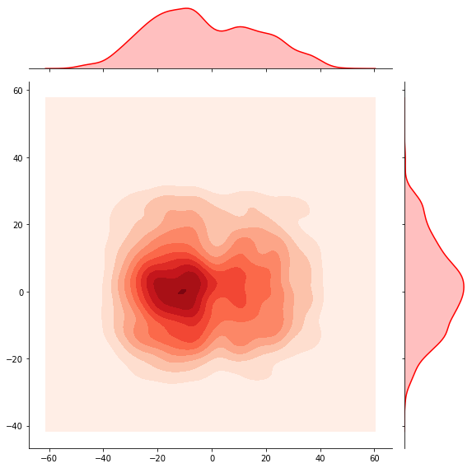
The essence of super-recombination

Slide 3
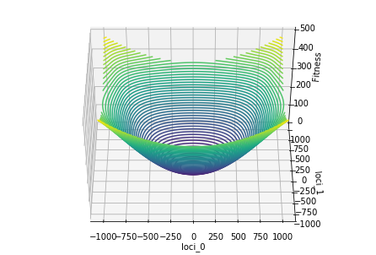
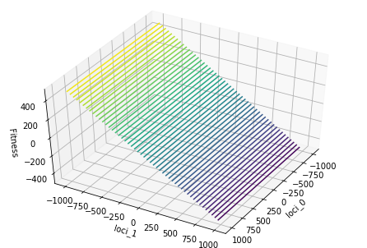
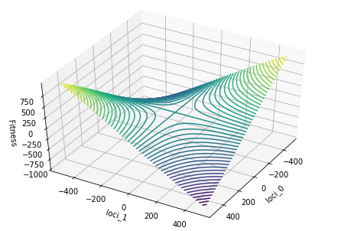
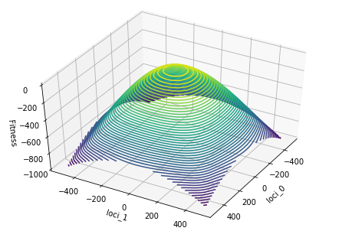
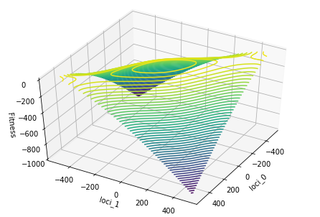
Hence I focus on “local” landscapes:
With atmost 1 zero gradient point..
(or a line of zero gradient)
Etc...

Slide 4
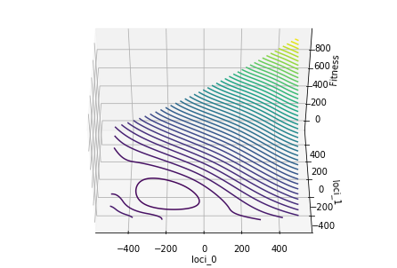
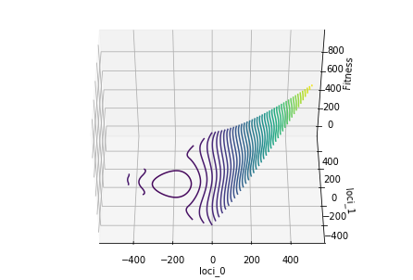
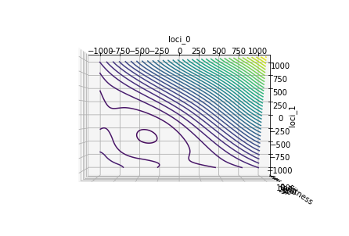
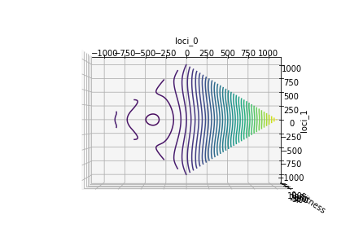
Diagonality and Recombination

Slide 5
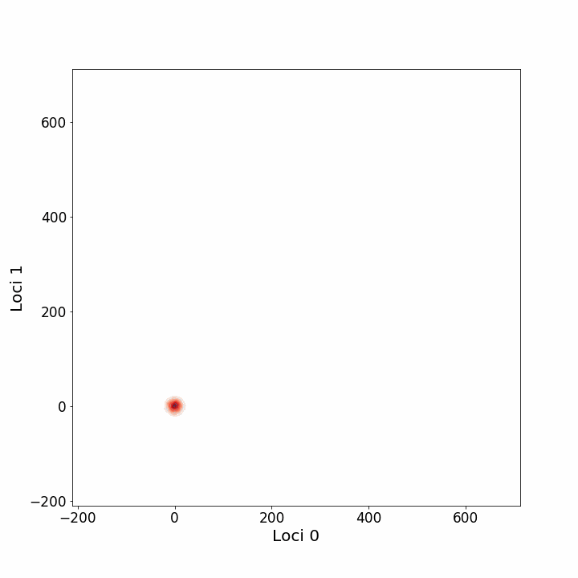
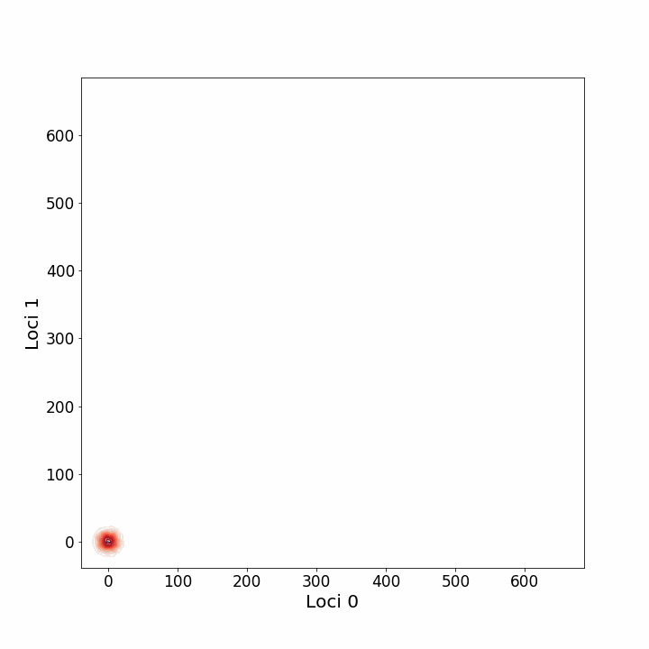
Diagonality and Recombination

Slide 6
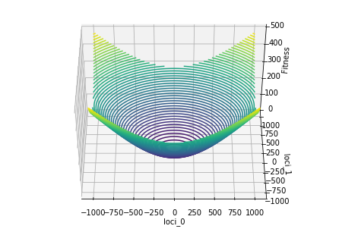
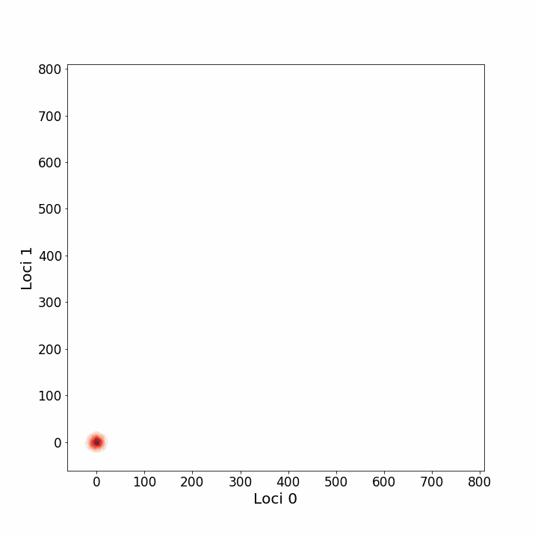
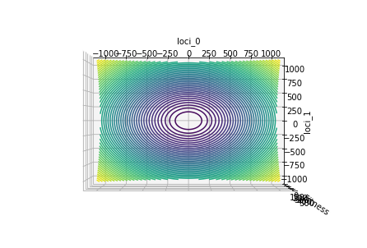
This may be a general diagonal advantage:

Slide 7
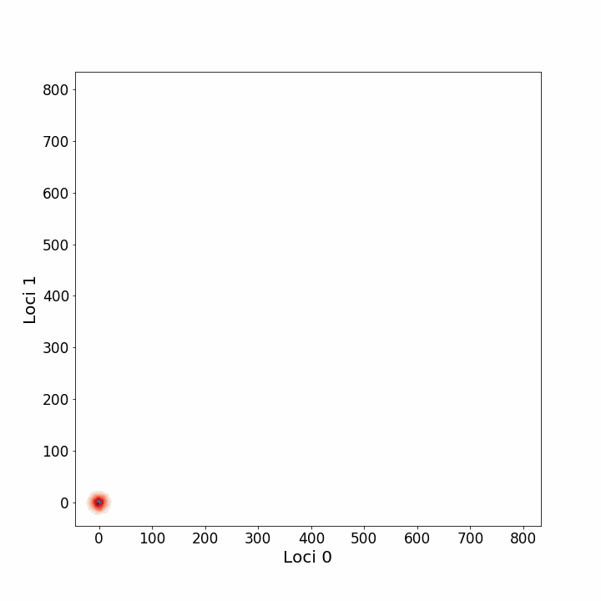
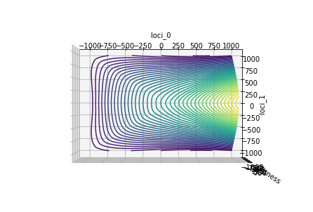
With seemigly no disadvantage:

Slide 8
Approaches to analysing the ‘simple’ local landscapes
Before I get stuck into going of and learning way more probability etc. It would be useful to have a good grasp of literature research directions – as in key works or just words and language to google (e.g. Genetic Algorithms was a useful direction).
Analysing Mean Fitness:
  Cubic or quadratic n dimensional polynomials approximations, with only one zero grad point. Then intergration over population distribution.
  Extreme cases: where diagonal movement contributes no more than up/down.
Stochastic stopping and extinction probability
….

