Slide 1

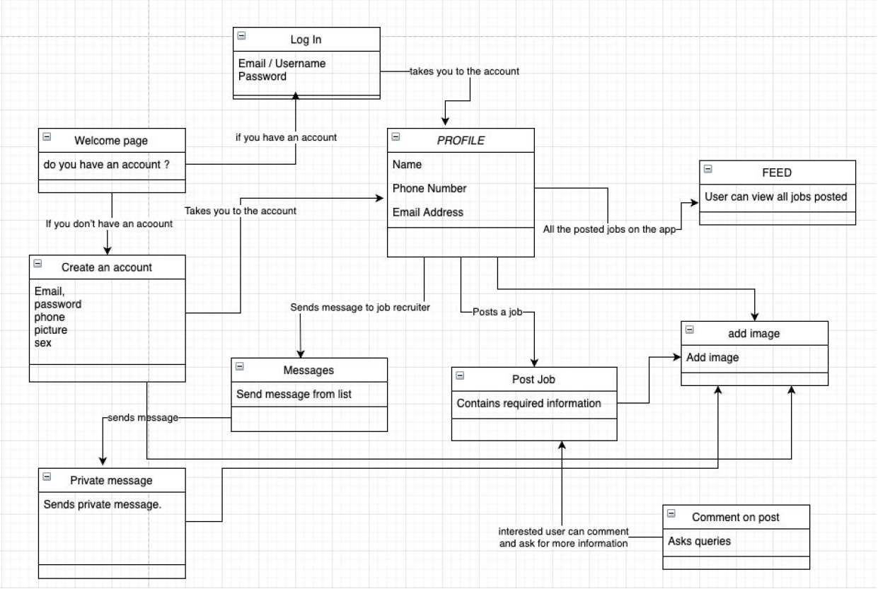
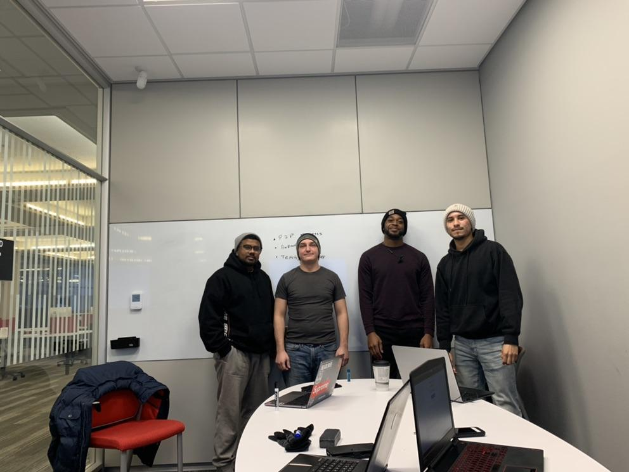
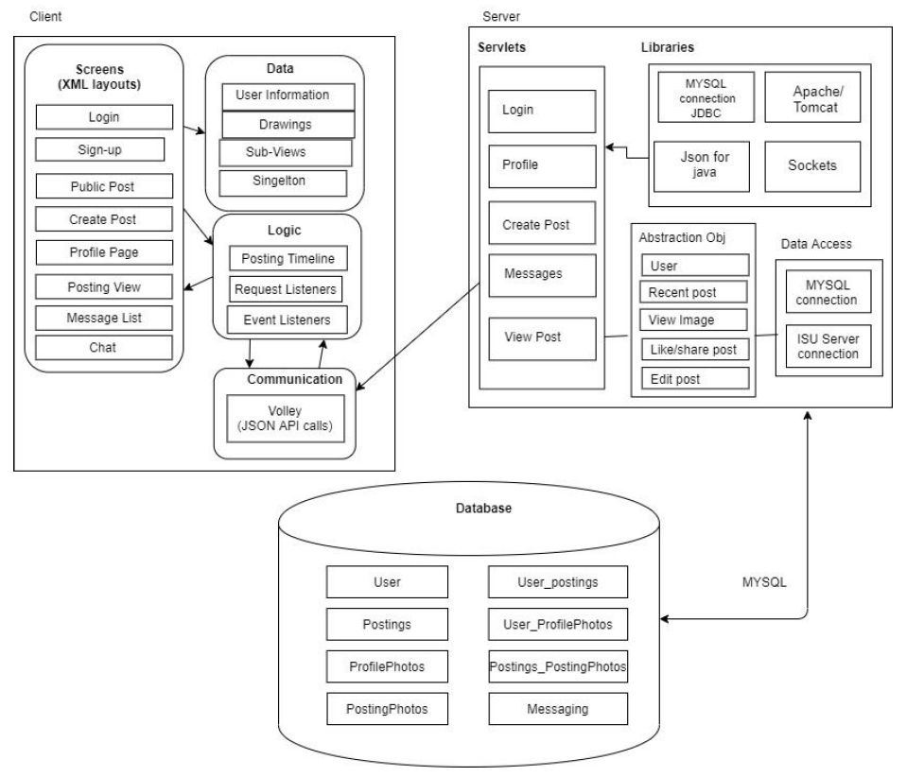
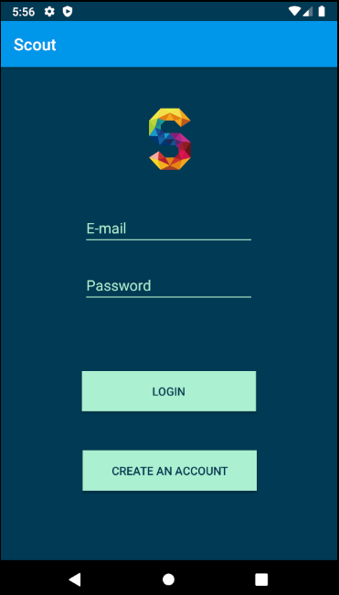
What went wrong
COVID19
Schedules
Proper Delegation Of Tasks
Communication
Image Uploads and Messaging
Welcome To Scout!
What went right
Individual Work/Tasks
Login Page/Creating Account
Posting Interface
Communication Prior to COVID
COM S 309 Spring 2020
Front End Ismael Duran Cody Federicks
Back End Kenyon Thomas Mohit Saroye
Actors and Functionality
1. System Administrator
a. Admin Can Access All Locations of the Application.
b. Controls and Oversees User’s Posting
c. Supervising Everyone’s Account
d. Ability to Block Posting
e. Deactivate Accounts
2. Job Seeker
a. User can create a profile and browse job feeds posted by other user/recruiters.
b. View Public Postings
c. Control their own public profile by editing, adding, and deleting
d. Search postings to filter out uninterested posting
e. Able to configure setting to their liking
f. View recruiters' profiles
g. Can also interact with job posting via commenting or sending a personal message.
3. Job Recruiter
a. Recruiter can create a profile to post a job. This actor is looking for an
applicant based on the requirements posted on the job description.
b. Ability to receive messages from potential clients
c. Edit their own posts as well as deleting
d. Should be able to send messages
e. View seekers profile for recruiting
f. Allowed to search for job seekers to filter out people with specific skills
g. Configure setting to their liking
h. Create their own profile to give credibility to job seekers
Lessons Learned
Integrate Essential Modules Early
Communication is Key
Remote Working
Understand Timing And Scheduling

Slide 2
Module Interface description:
GUI Essential Method Calls for Postings
public String addNewPost(String projectname, String projectdescription, String neededroles, String compensation, String thumbnailDescription, String userid)
Method is used to place a new post into a repository
public List<Map<String, String>> getAllPosts()
Returns all postings from the repository
public void deletePost(Integer id)
Searches the repository and deletes the post designated by the given ID
GUI Essential Method Calls for Users
public String addNewUser (String firstName, String lastName, String email, String password, String phone)
Used in conjunction with create account to place the new user’s information into the repository
public LoginObject login(String email, String password)
Function used to check the repository for account information and login if found (major security flaw)
public Optional<Postings> getPost(Integer id)
Iterates through the repository to find the specified post from the given ID
Design Decisions:
Develop a Public Posting Page
Adding a Person-to-Person Messaging feature
Favorite Button
Respond to Specific Postings
Create Account/Login Page

