Slide 1
HTML , CSS & JAVASCRIPT
sarojhumagain16@gmail.com

Slide 2
Introduction to HTML
HTML stands for Hyper Text Markup Language
Hypertext refers to the way in which Web pages (HTML documents) are linked together. Thus, the link available on a webpage is called Hypertext.
As its name suggests, HTML is a Markup Language which means we use HTML to simply "mark-up" a text document with tags that tell a Web browser how to structure it to display.
● HTML is not a programming language
● HTML was created by Tim Berners-Lee in late 1991
● HTML was developed with the intent of defining the structure of documents
HTML is being widely used to format web pages with
the help of different tags

Slide 3
HTML contd..
HTML tags are keywords surrounded by angle brackets like <html>
HTML tags normally come in pairs like <b> and </b>
The first tag in a pair is the start tag (opening tags), the second tag is the
end tag(closing tags)
For example <body> is a opening tag and </body> is a closing tag.

Slide 4
Simple code
<!DOCTYPE html>
<html>
<head>
<title>Landing page</title>
</head>
<body>
<h1>I am h1 tag.</h1>
</body>
</html>
<!DOCTYPE html> declaration defines this document to be HTML5
<html> .... </html> describes the web page
<body> ..... </body> is the visible page content
<h1>............</h1> is a heading tag.

Slide 5
HTML Headings
HTML headings are defined with the <h1> to <h6> tags.
<h1> defines the most important heading. <h6> defines the least important heading: Example
<h1>This is heading 1</h1> This is heading 1
<h2>This is heading 2</h2> This is heading 2
<h3>This is heading 3</h3> This is heading 3

Slide 6
Empty HTML elements
HTML elements with no content are called empty elements.
<br> is an empty element without a closing tag (the <br> tag defines a line break).
Empty elements can be "closed" in the opening tag like this: <br />.
HTML5 does not require empty elements to be closed. But if you want stricter validation, or if you need to make your document readable by XML parsers, you must close all HTML elements properly.

Slide 7
More Tags
Italic tag => <i> Rabin </i>
Underline => <u> Rabin </u>
Bold => <b> Rabin </b>
Preserve formating => <pre> function(){
                print(“Hello world”);
                }</pre>

Slide 8
HTML Attributes
All HTML elements can have attributes
Attributes provide additional information about an element
Attributes are always specified in the start tag
Attributes usually come in name/value pairs like: name="value"
Example: <a href="https://www.w3schools.com">This is a link</a> ,
<img src="image.jpg"> ,
<img src="img.jpg" width="500px" height="600px">

Slide 9
HTML Tables
The HTML tables allow web authors to arrange data like text, images, links, other tables, etc. into rows and columns of cells.
The HTML tables are created using the <table> tag in which the <tr> tag is used to create table rows and <td> tag is used to create data cells. The elements under <td> are regular and left aligned by default

Slide 11
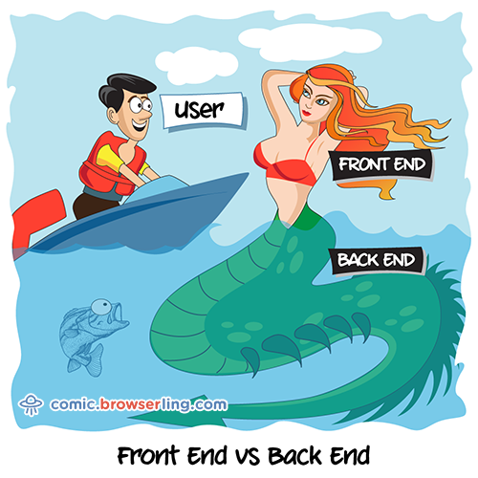
Frontend vs Backend
The front-end is everything involved with what the user sees,
including design and some languages like HTML and CSS.
The back-end, or the "server-side", is basically how the site works
updates and changes. This refers to everything the user can't
see in the browser, like databases and servers.

Slide 12
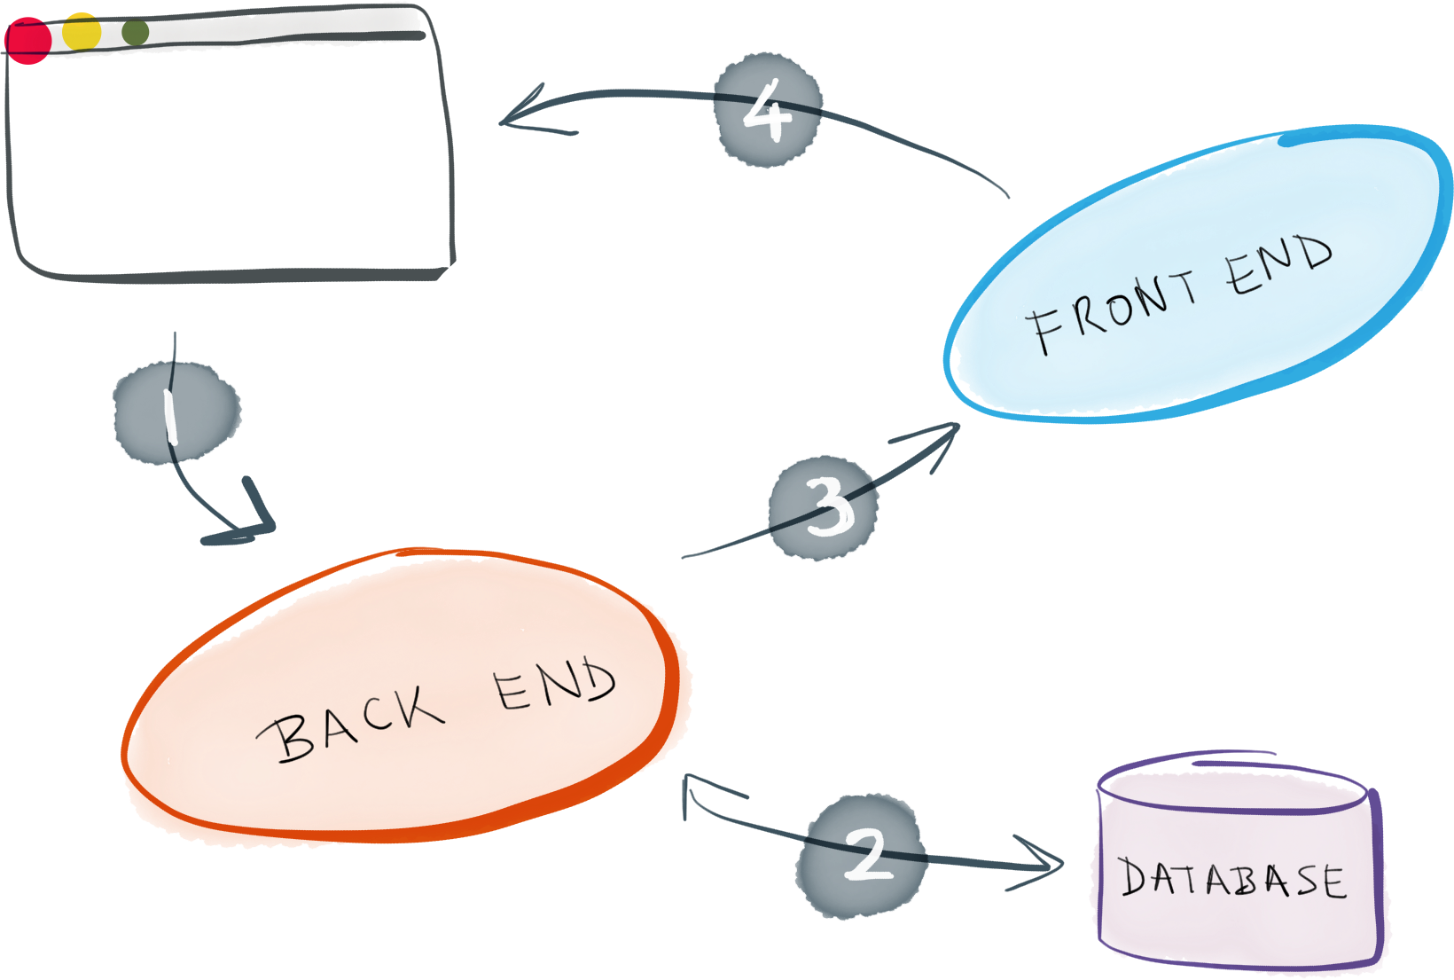
Database
A database is a collection of information that is organized so that it can be easily accessed, managed and updated.

Slide 13
HTML list
Unordered list
An unordered list starts with the <ul> tag. Each list item starts with the <li> tag.
The list items will be marked with bullets (small black circles) by default:
example:
<ul>
<li>Game of thrones</li>
<li>Vikings</li>
<li>Stranger things</li>
</ul>
<ul style="list-style-type:disc"> , replace disc by circle, square or none.

Slide 14
HTML list
Ordered list
An ordered list starts with the <ol> tag. Each list item starts with the <li> tag.
The list items will be marked with numbers by default:
<ol>
<li>Game of thrones</li>
<li>Vikings</li>
<li>Stranger things</li>
</ol>
<ol type="1">, replace 1 by A, a, i I.

Slide 15
HTML links
You can click on a link and jump to another document.
When you move the mouse over a link, the mouse arrow will turn into a little hand.
In HTML, links are defined with the <a> tag:
<a href="https://github.com/">Github</a>
<a href=”index.htm”> Home</a>
<a href="https://github.com/" target="_blank">Github!</a>
_blank opens the linked document in a new window or tab

Slide 16
HTML links-attributes
_blank - Opens the linked document in a new window or tab.
_self - Opens the linked document in the same window/tab as it was clicked (this is default).
_top - Opens the linked document in the full body of the window.
Create a Bookmark
<p><a href="#C2">Jump to Chapter </a></p>
<h2>Chapter 1</h2>
<p>This chapter explains ba bla bla</p>
<h2>Chapter 2</h2>
<p>This chapter explains ba bla bla</p>
<h2>Chapter 3</h2>
<p>This chapter explains ba bla bla</p>

Slide 17

HTML Tables
The HTML tables allow web authors to arrange data like text, images, links, other tables, etc. into rows and columns of cells.
The HTML tables are created using the <table> tag in which the <tr> tag is used to create table rows and <td> tag is used to create data cells. The elements under <td> are regular and left aligned by default.
<body>
<table border = "1">
<tr>
<td>Row 1, Column 1</td>
<td>Row 1, Column 2</td>
</tr>
<tr>
<td>Row 2, Column 1</td>
<td>Row 2, Column 2</td>
</tr>
</table>
</body>
Here, the border is an attribute of <table> tag and it is used to put a border across all the cells.

Slide 18

HTML Tables
Table Heading:
Table heading can be defined using <th> tag. This tag will be put to replace <td> tag, which is used to represent actual data cell. Normally we will put our top row as table heading as shown below, otherwise we can use <th> element in any row. Heading, which are defined in <th> tag are centered and bold by default.
<body>
<table border = "1">
<tr>
<th>Name</th>
<th>Salary</th>
</tr>
<tr>
<td>Ramesh Raman</td>
<td>5000</td>
</tr>
<tr>
<td>Shabbir Hussein</td>
<td>7000</td>
</tr>
</table>
</body>

Slide 19
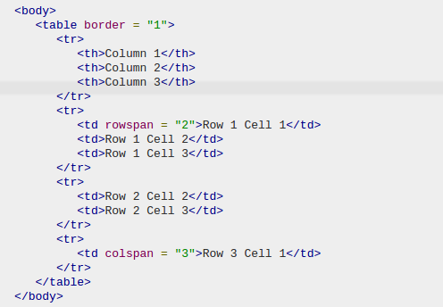
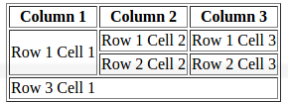
HTML Tables
Colspan and Rowspan Attributes:
You will use colspan attribute if you want to merge two or more columns into a single column. Similar way you will use rowspan if you want to merge two or more rows.

Slide 20
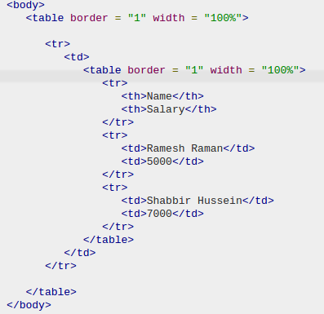

Nested Tables
We can user table inside another table. Not only tables we can use almost all the tag inside table data tag <td> .
Following is the example of using another able and the other tags inside a table cell

Slide 21
Tables background
You can set table background using one of the following two ways −
bgcolor attribute − You can set background color for whole table or just for one cell.
background attribute − You can set background image for whole table or just for one cell.
You can also set border color also using bordercolor attribute.
<table bgcolor=”green”>

