Slide 1

Exploratory Data Analysis
<G2M Case Study>
<21.03.2023>

Slide 2

Agenda
Executive Summary
Problem Statement
Approach
EDA
EDA Summary
Recommendations

Slide 3
Overview
XYZ is a private equity firm in the US. Due to remarkable growth in the Cab Industry in last few years and multiple key players in the market, it is planning for an investment in the Cab industry.
Objective of the Project is to provide actionable insights to help XYZ firm in identifying the right company for making an investment.
The analysis can be examined under 3 headlines:
- Understanding Data
- Choicing important features and extracting meaningful results
- Results and recommendations

Slide 4
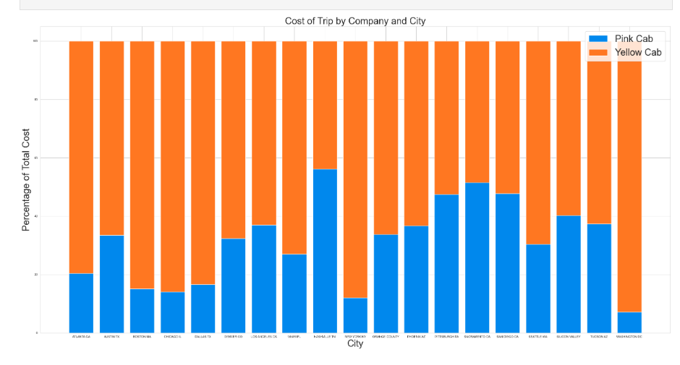
Cost of Trip by Company and City

Slide 5
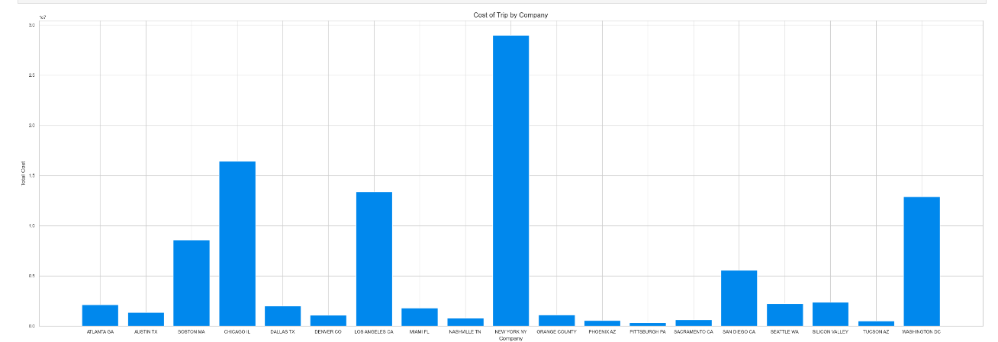
Cost of Trip by Company

Slide 6
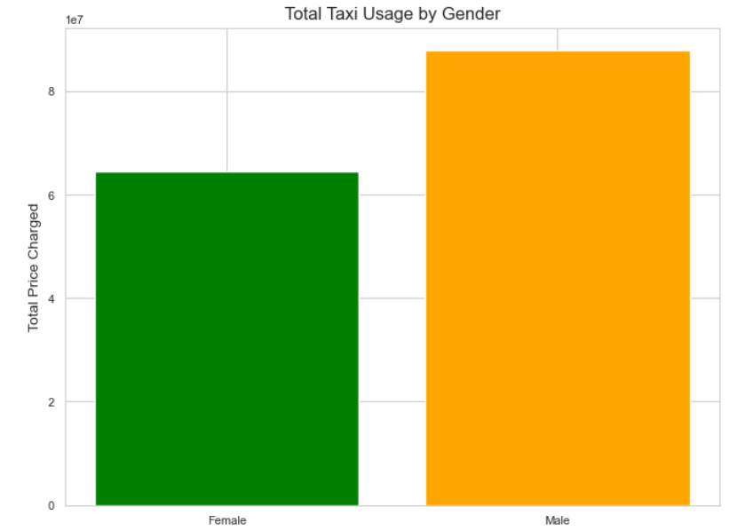
Total Taxi Usage by Gender
XY

Slide 7
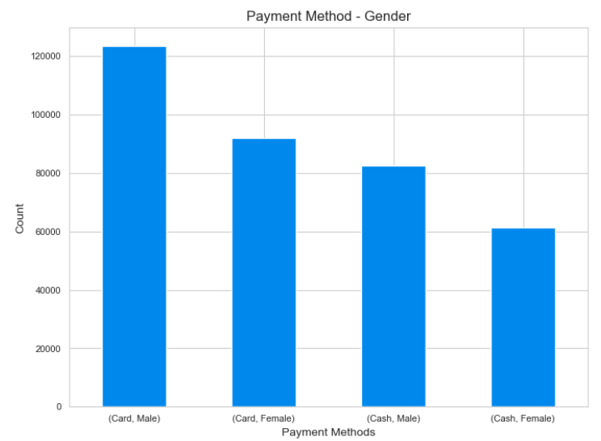
Payment Metod - Gender

Slide 8
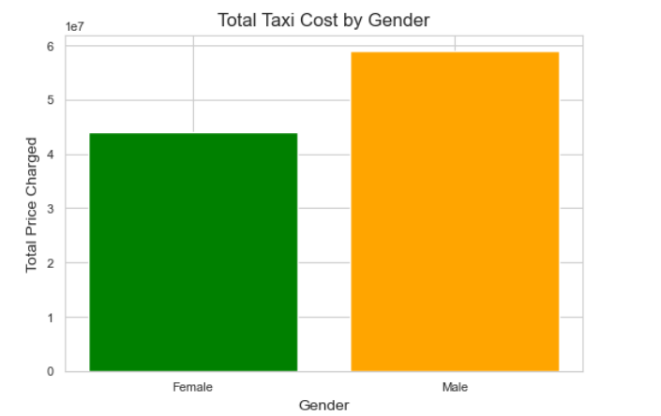
Total taxi cost by Gender

Slide 9

EDA SUMMARY and RECOMMENDATIONS
From these graphs we understand that :
Yellow Cab makes more profit
Cab industry earns the most in new York
Men travel by taxi more than women
People pay by card rather than cash
Men pay more for taxis than women

Slide 10
Thank You
Emirhan Sarp

