Slide 1

Processes
By Sarpreet Singh Buttar, Phillip Lunyov, Jusuf Omerovic, Robin Reijo & Weibin Yu

Slide 2
Process Concept
What is a process?
Attributes of a process
Program under execution
Reside in main memory
java HelloWorld.class
Also known as job
2 types of processes w.r.t. to execution time
CPU bound processes
I/O bound processes
Program state
Program counter
CPU registers
CPU scheduling information
Memory management information
Account information
I/O status information
max
Process Control Block (PCB)
process id | priority
program counter | process state
L.O.F. | G.P.R.
0

Slide 3
Process States
New
Non-pre-emptive
p4
Pre-emptive
Interrupt/ time slice
Admitted
p1 p2
p3
Ready*
Running
Scheduler dispatch
Exit
Terminated
I/O or event
completion
Waiting*
I/O or event

Slide 4
Process Scheduling
What is process scheduler?
Transfer process to CPU
Part of multiprogramming
What are scheduling queues?
Job queue
Ready queue
Device queue
Job queue
Ready queue
CPU
I/O
I/O queue
I/O request
Time slice expired
Child executes
Fork a child
Interrupt occurs
Wait for an interrupt

Slide 5
Types of Schedulers
Suspended Ready
Terminated
MTS
Swap in
Swap out
Interrupt/ time slice
MTS
Exit
New
Admitted
Ready*
STS
Running
LTS
Scheduler dispatch
I/O or event
completion
Long term scheduler (LTS) or Job scheduler
Short term scheduler (STS) or CPU scheduler
Medium term scheduler (MTS) or Swapper
Waiting*
I/O or event
MTS
Swap in
MTS
Swap out
SuspendedWait

Slide 6
p1
p3
p4
Degree of Multiprogramming
No. of processes in the main memory
Controls by LTS
Context Switch
Saving the context of one process and
loading context of other process
Need at least 2 processes
Overhead for the system
Multitasking in Mobile Systems
ios:
Limits because of battery life and memory use
On display -> foreground
On background -> background
Android
Use service -> a separate component
p2
= 4
Context switching time
p1
p2
p1
CTS

Slide 7
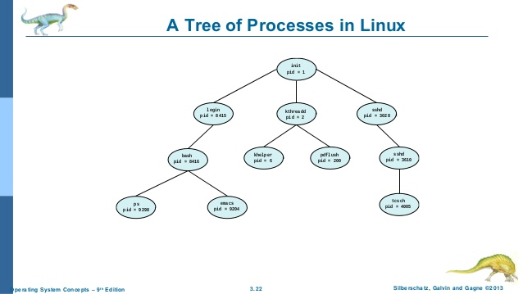
Process Creation
Parent processes
Child processes
Tree-like formed chain of processes
Identified through IDs
Uses that index to allocate system resources
Process uses CPU time, memory, files and I/O devices
Get resources directly from operating system or constrained to a subset of the resources of the parent process
Parent share resources among children or partition resources(files ex)
Restricting a child process to a subset of the parent’s resources prevents any process from overloading the system by creating too many child processes. Also the parent process must provide an initialization data for child process.

Slide 8
Process Creation
When Parent process creates a child process, two ways of executions might be:
Parent process continues to execute concurrently with its children
Parent process waits until child processes finish their tasks

Slide 9
Process Termination
process terminates when it finishes executing its final statement and asks the operating system to delete it by using the exit() system call
the process may return a status value (typically an integer) to its parent process (via the wait() system call).
All the resources of the process—including physical and virtual memory, open files, and I/O buffers—are deallocated by the operating system (termination can occur in other circumstances as well).

Slide 10
Process termination
Reason to terminate the execution of the child processes:
The child has exceeded its usage of some of the resources that it has been allocated. (To determine whether this has occurred, the parent must have a mechanism to inspect the state of its children.)
The task assigned to the child is no longer required.
The parent is exiting, and the operating system does not allow a child to continue if its parent terminates.
So we might get:
Cascading termination

Slide 11
Process termination
Zombie process
Orphan process

Slide 12
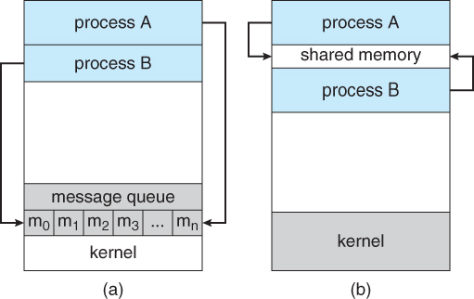
Interprocess Communication
cooperating process
Shared memory - Shared memory means that processes has established a shared area for the data and information they share
Message passing means that the processes communicate through sending messages to each other.
independent process is when a process cant be affected by other processes, for example if the process doesn't share any data with any other processes then it is independent.
When is cooperating processes beneficial?
Sharing information
Faster computations of tasks
Break down the system in modular
Convenient

Slide 13
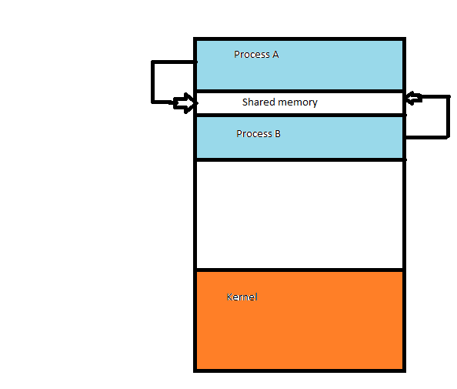
Interprocess communication – Shared memory
Example: A producer produces meat. Then we have a Consumer that eats/takes that meat. Inbetween we have buffer class that keeps the produced meat in wait for consumer and vice versa

Slide 14
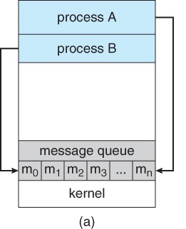
Message Passing
Establish Link
Sender receiver
Direct -> Send(P, message) – Send a message to Process P
receive(Q, message)—Receive a message from process Q. Uses Symmetry scheme.
Indirect communication -> Send and recieve from mailboxes or ports
send(A, message) - Send a message to mailbox A. receive(A, message) - Receive a message from mailbox A.
naming
sync or async communication
Automatic or explicit buffering

Slide 15
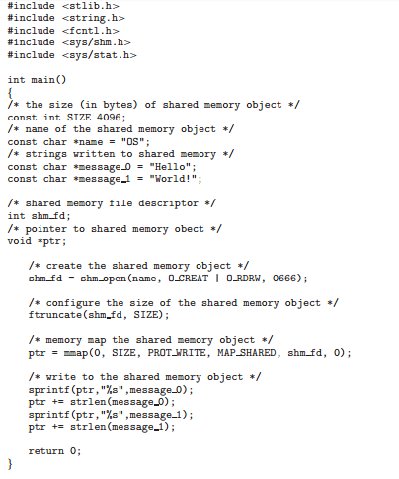
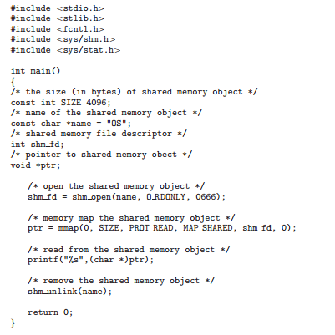
POSIX Shared Memory
Use memory mapped files to organize shared memory
Producer
Consumer

Slide 16
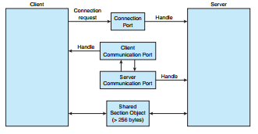
Mach Message passing
Port
Port_allocate()
Own
Order of message
Messages
Header
Variable lenght data portion
If port is full
Windows Combination
ALPC
Port
Channel
Section object

Slide 17
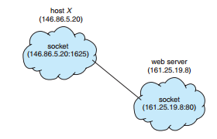
Communication in Client–Server Systems
Sockets
Socket
Server
Client
low-level form of
communication

Slide 18
Remote Procedure Calls
Design
no longer just packets of data
message
daemon
Issues
Differences in data representation
Semantics of a call
The binding problem

Slide 19
Pipes
Pipe
Ordinary Pipes
Producer-consumer fashion
Only accessable inside creater(need parent/child relation)
Windows
exist only while the processes are communicating
Named Pipes
bidirectional,don't need relation
Exist even communication finished
Unix
FIFOs/Half duplex
Only on same machine or use sockets
byte-oriented data
Windows
Full-duplex
byte- or message-oriented data

Slide 20
Conclusion
A process is a program in execution.
Schedulers helps the modern system to get maximum CPU utilization
Processes are identified with a unique ID and terminated using it.
Processes uses shared memory and message passing to communicate
IPC systems use either shared memory, Message passing or a combination of both mechanism.
There are three ways to preform communication in Client-Server system. Sockets , RPC and Pipes

