Slide 1
Parallel Programming
By – Sarpreet Singh Buttar

Slide 2
Task 1
Made a method which calculate PI and return the execution time
Inside, used #pragma command for doing the calculation in parallel
Also done reduction on shared variables for getting correct result
Made another method which calculate and print average time
Used nested loops to run the program with all inputs automatically
Used GCC compiler for compiling the code

Slide 3
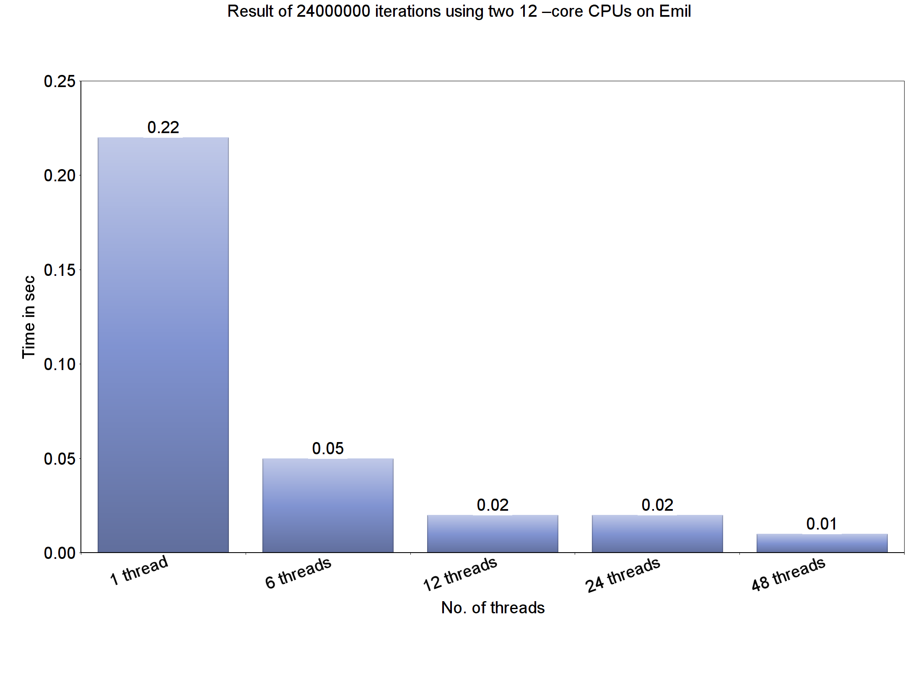
Task 1 - Results

Slide 4
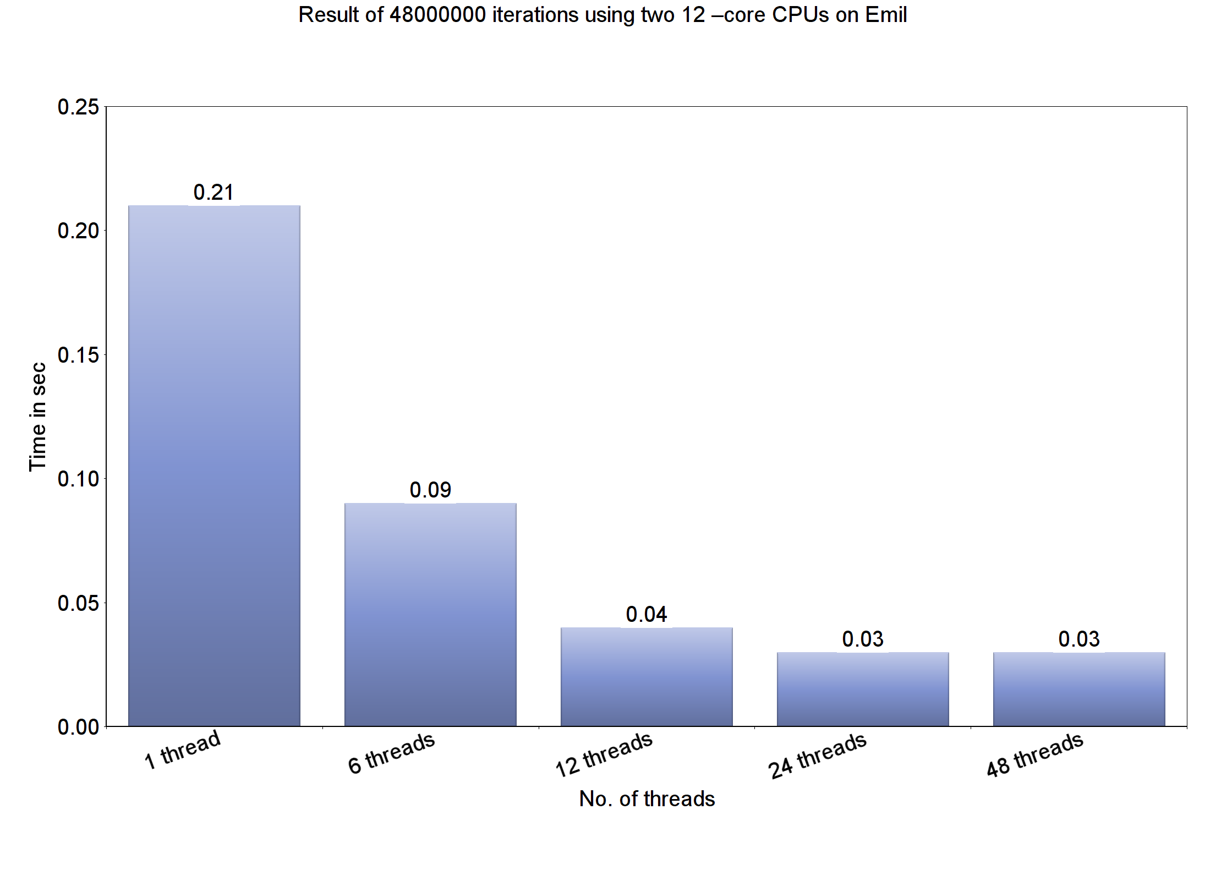
Task 1 - Results

Slide 5
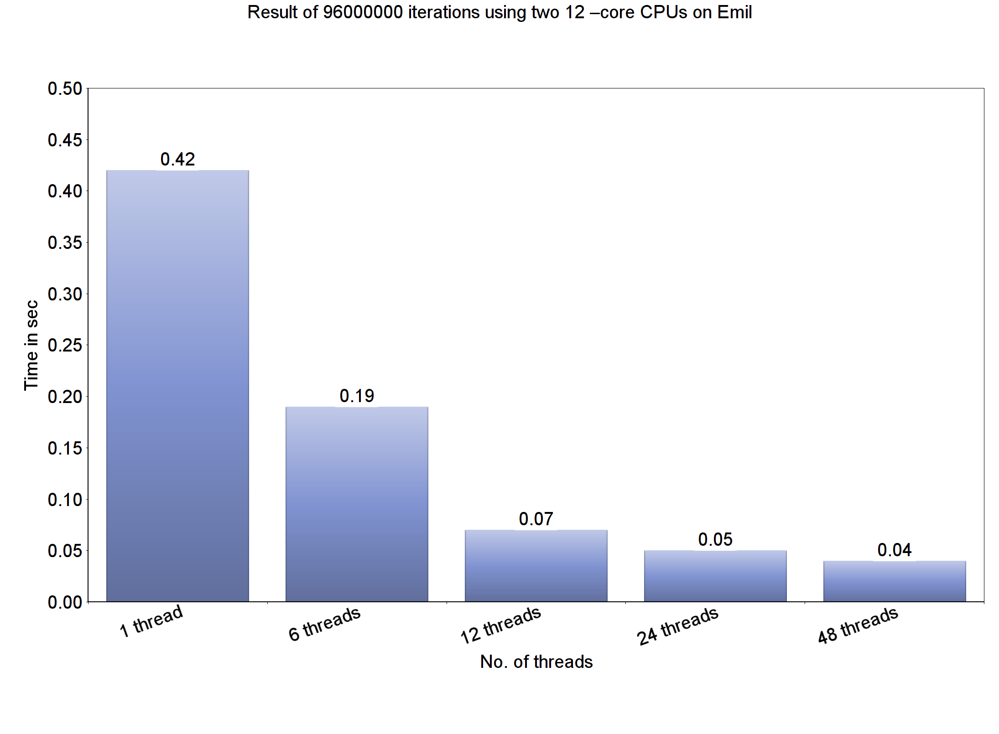
Task 1 - Results

Slide 6
Task 2
Same code works as Task 1
Only need to change number of threads
Used native programming mode
Poor single thread performance
Used ICC compiler for compiling the code

Slide 7
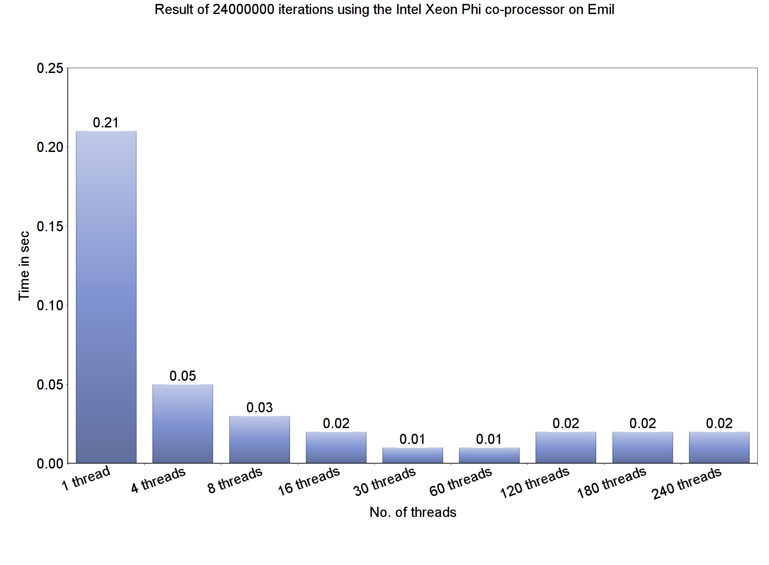
Task 2 - Results

Slide 8
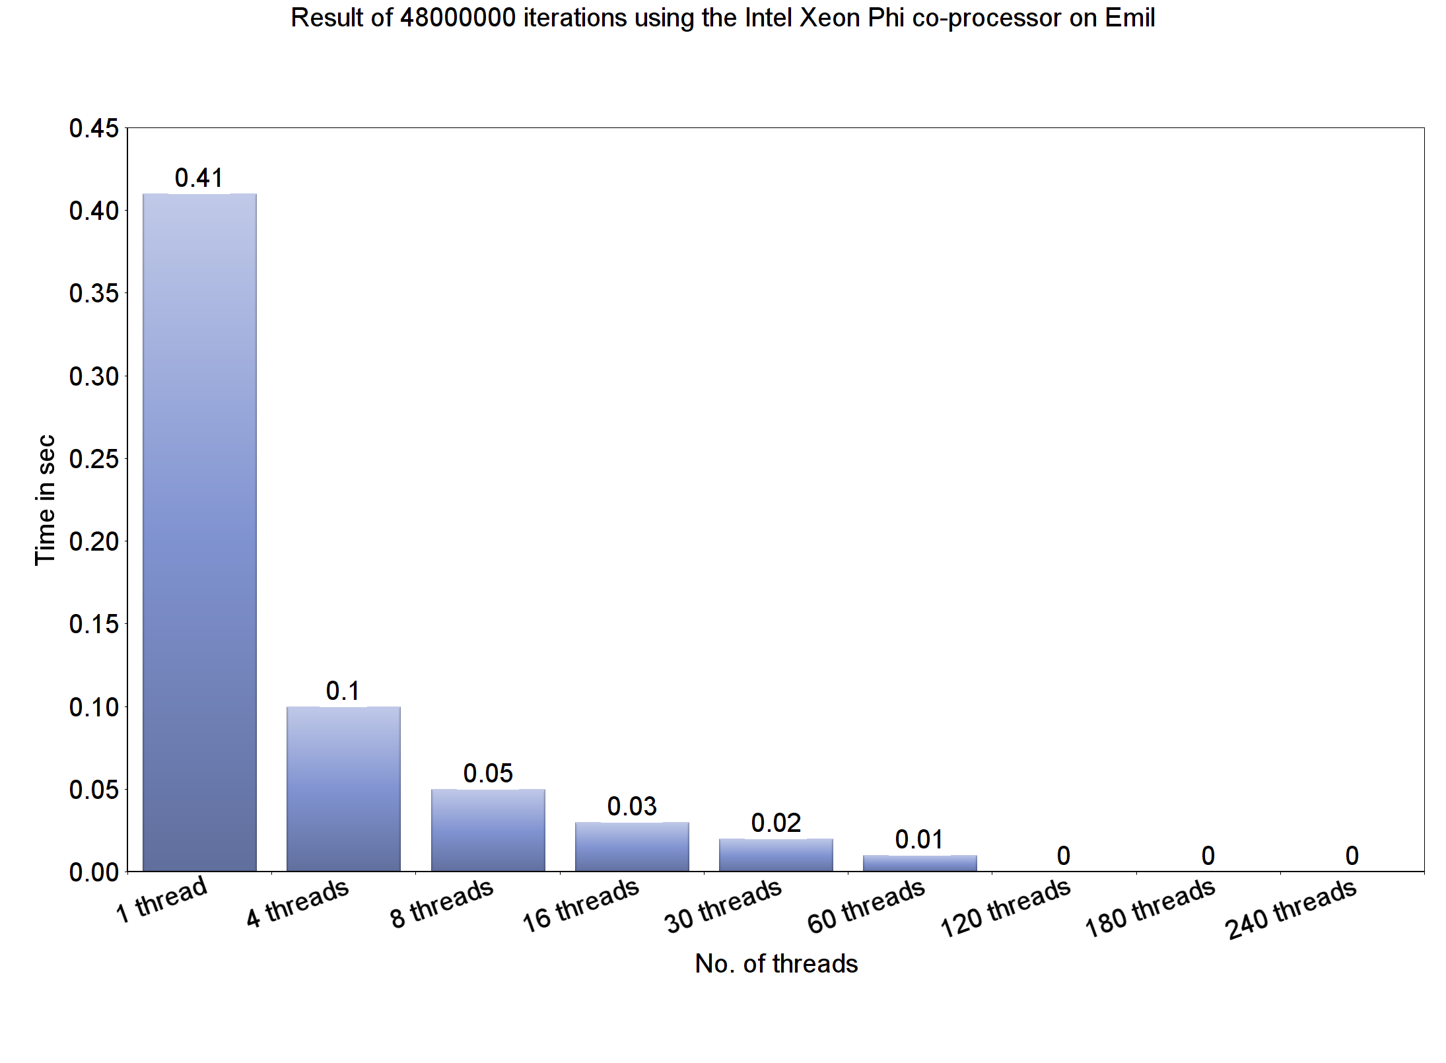
Task 2 - Results

Slide 9
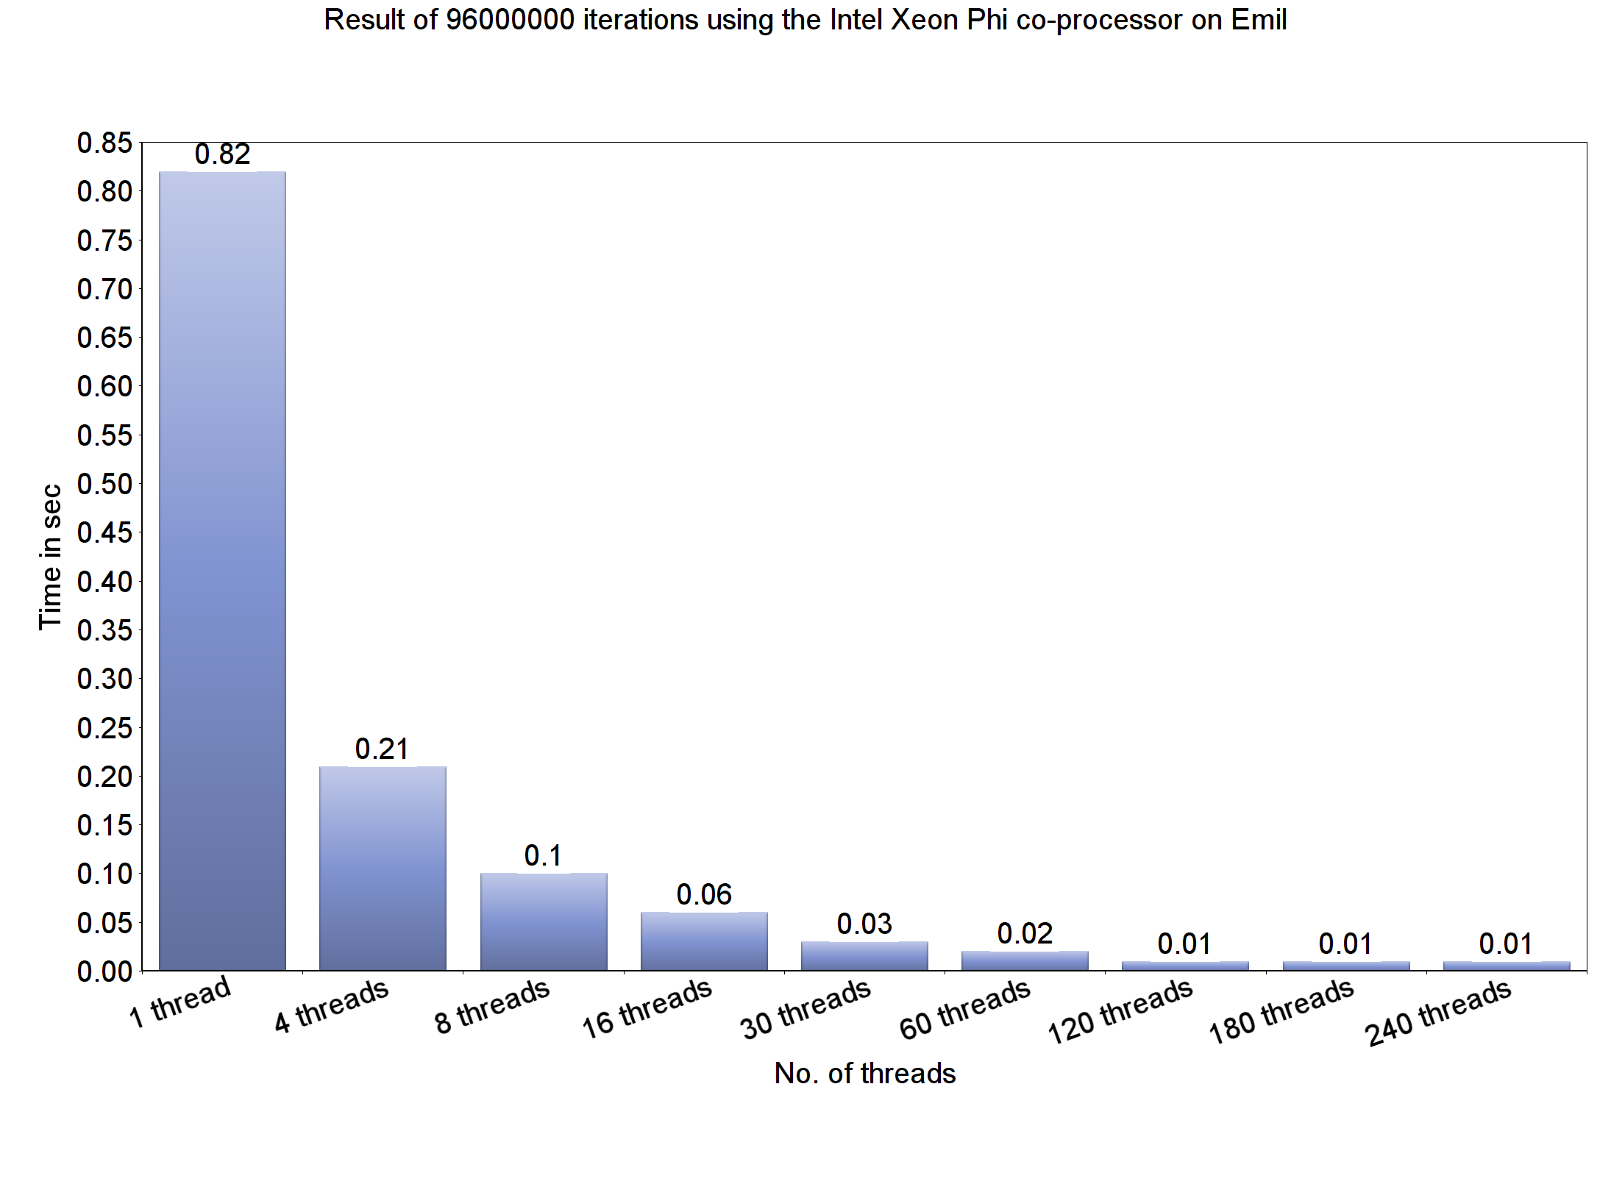
Task 2 - Results

