Slide 1
User & Cart Microservices
By - Sarpreet Singh Buttar

Slide 2
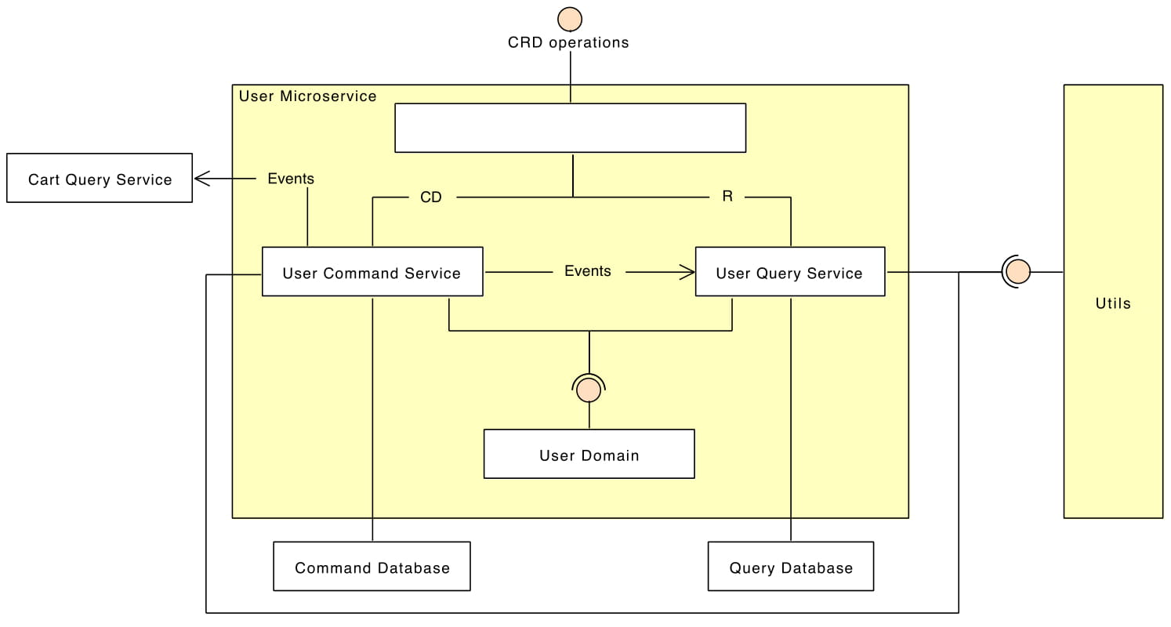
Architecture of User Microservice

Slide 3
Public API’s of User Service
Create a user
Retrieve a user
Retrieve users
Delete a user

Slide 4
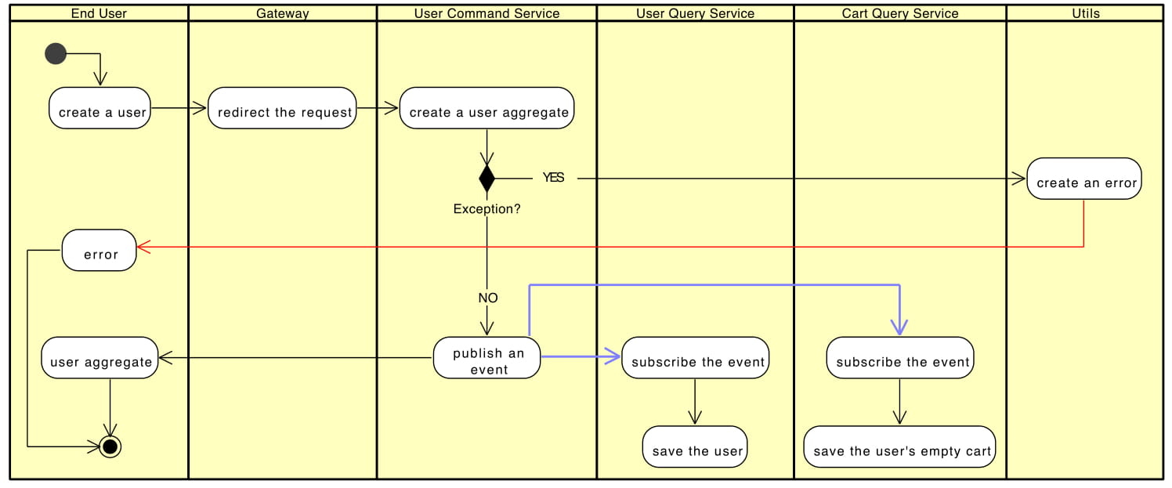
Create a User

Slide 5
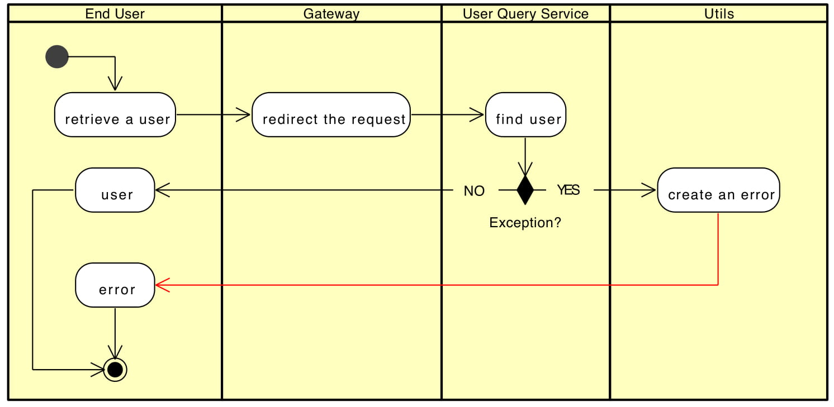
Retrieve a User

Slide 6
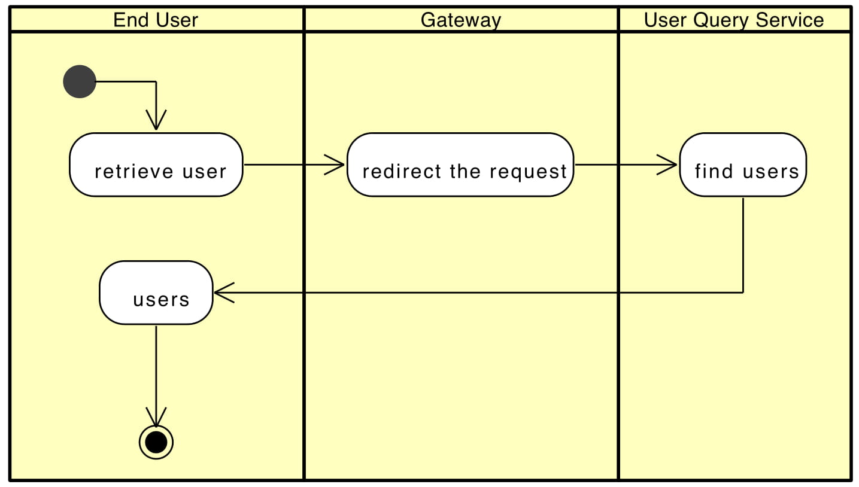
Retrieve Users

Slide 7
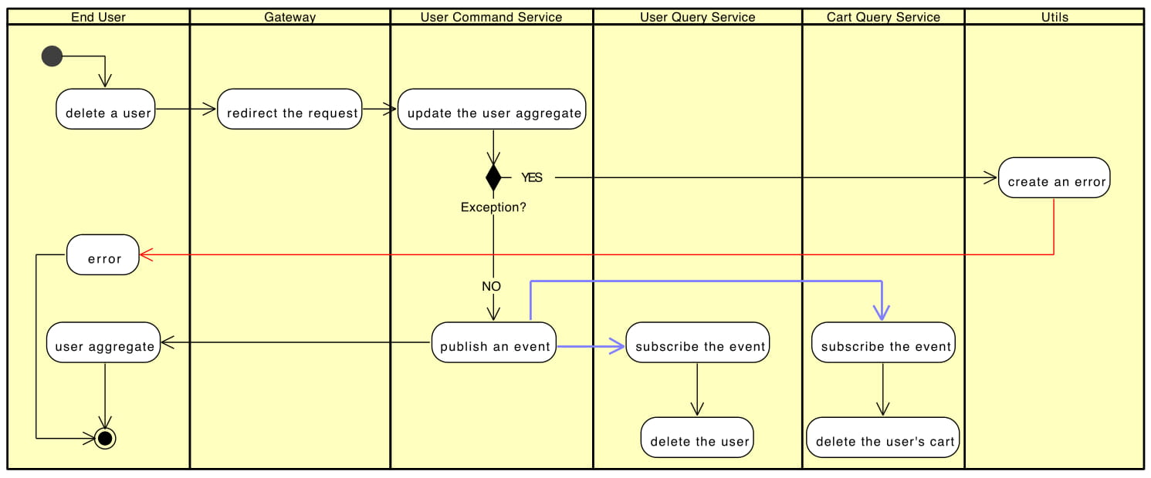
Delete a User

Slide 8
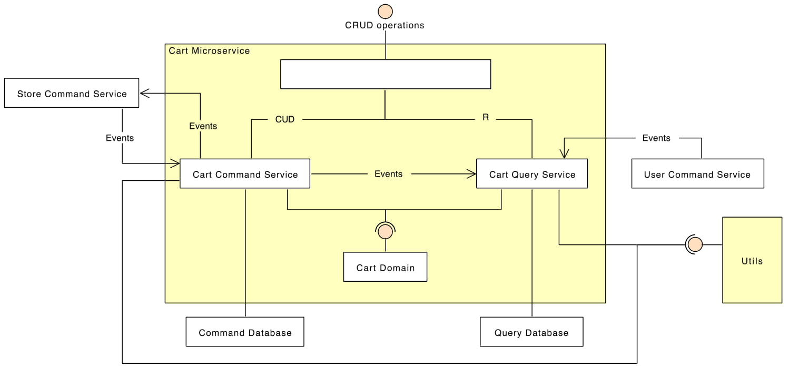
Architecture of Cart Microservice

Slide 9
Public API’s of Cart Service
Add product in cart
Update product quantity in cart
Delete product from cart
Sort cart by stores distance
Sort cart by products price

Slide 10
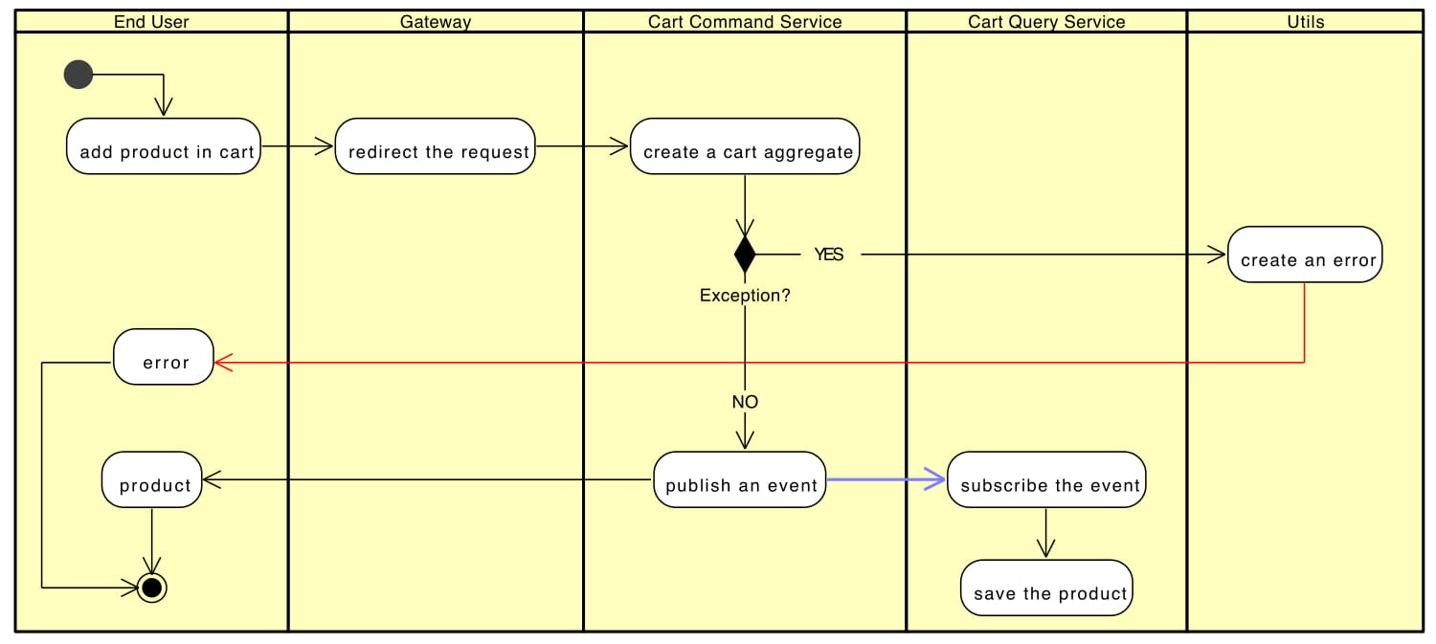
Add Product in Cart

Slide 11
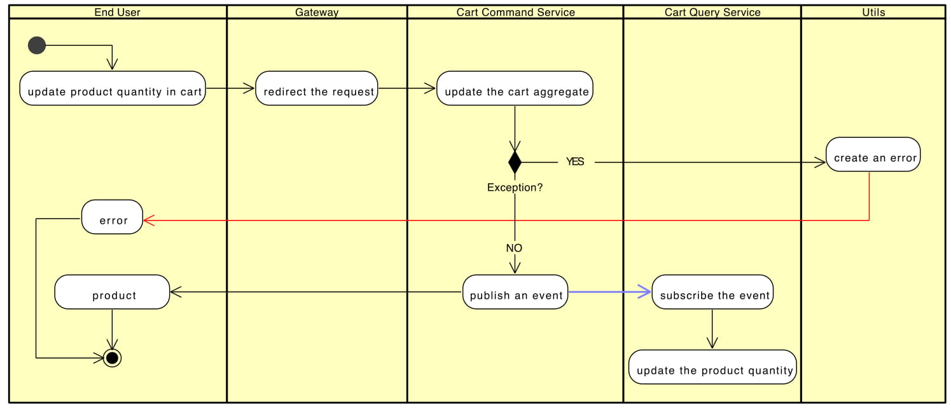
Update Product Quantity in Cart

Slide 12
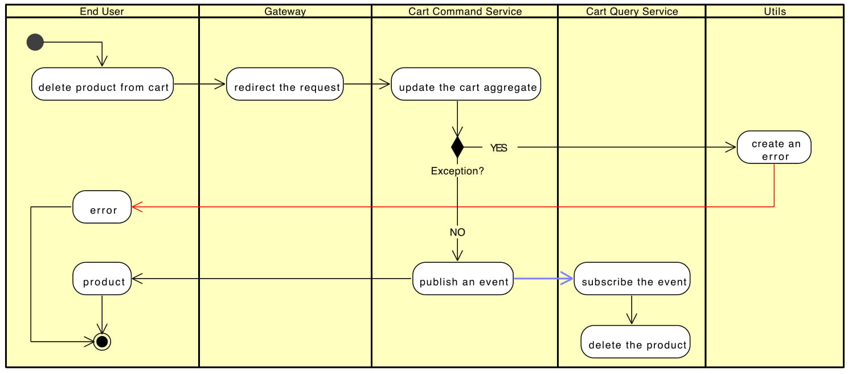
Delete Product from Cart

Slide 13
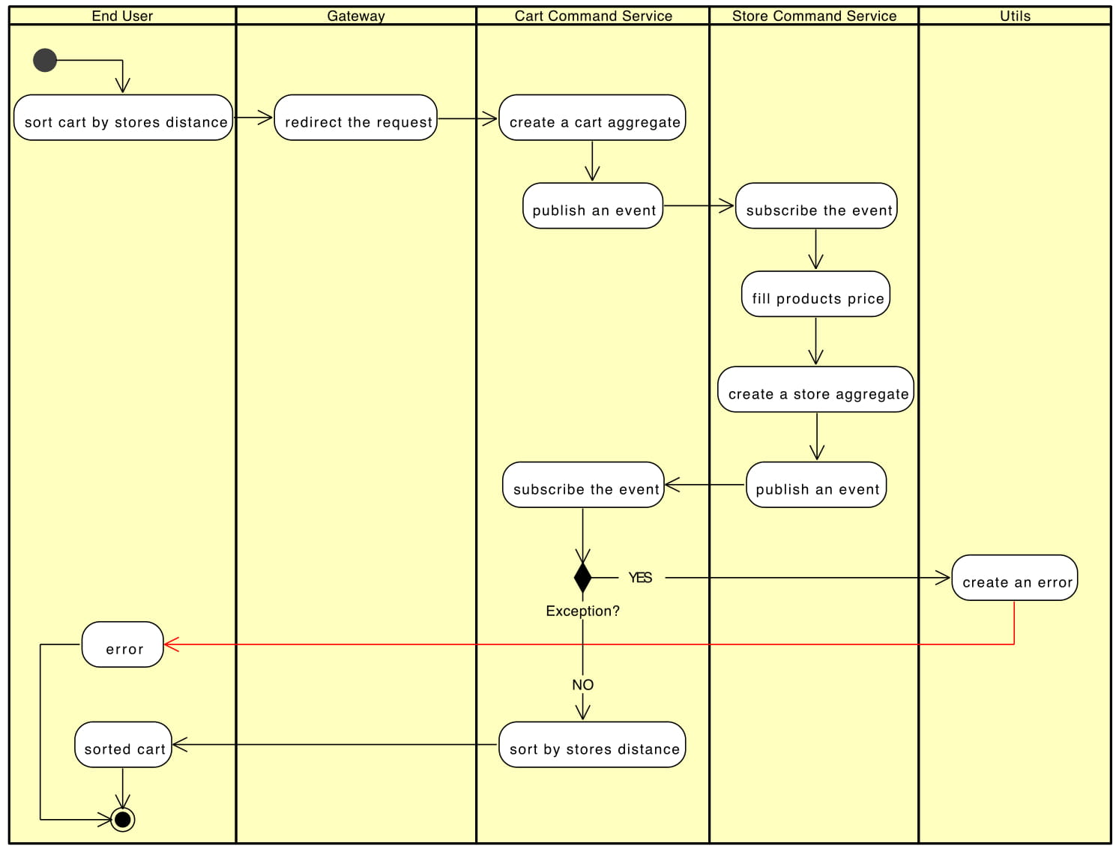
Sort Cart by Stores Distance

Slide 14
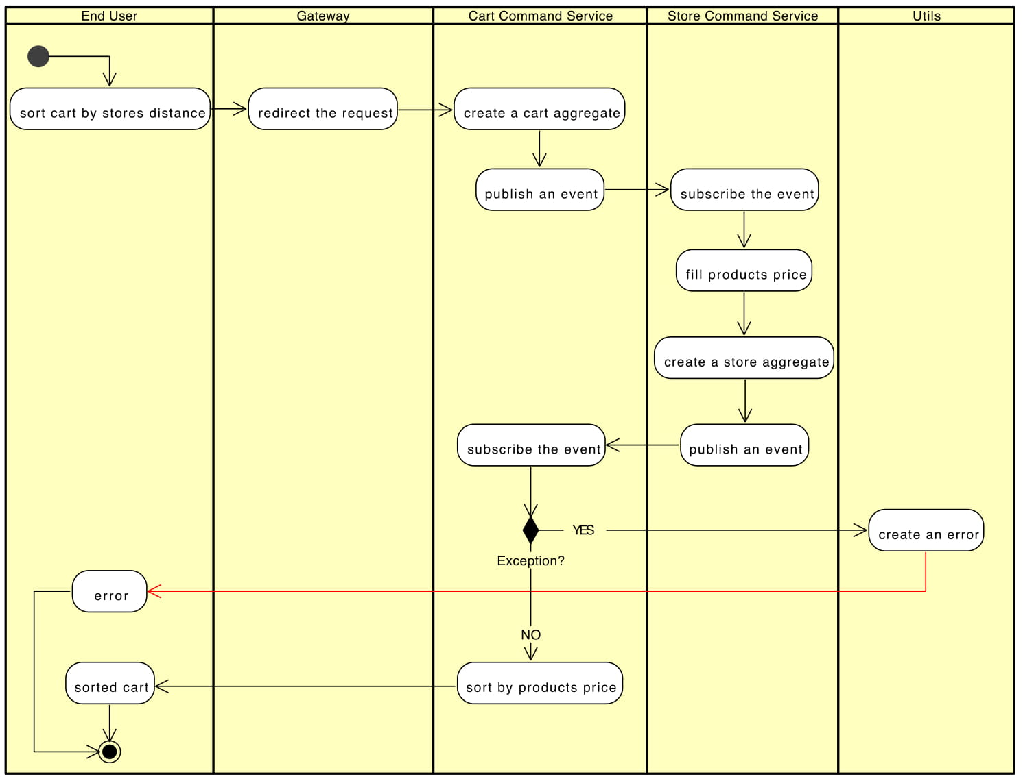
Sort Cart by Products Price

