Slide 1
Lending Club Case Study EPGML C55 July 2023 Group Members: Syed Abdul Rahim Leena Orpe

Slide 2
Introduction
Lending Club is a consumer finance company which specializes in lending various types of loans to urban customers. When the company receives a loan application, the company has to make a decision for loan approval based on the applicant’s profile. Two types of risks are associated with the bank’s decision:
If the applicant is likely to repay the loan, then not approving the loan results in a loss of business to the company
If the applicant is not likely to repay the loan, i.e. he/she is likely to default, then approving the loan may lead to a financial loss for the company
The data we are analyzing here contains information about past loan applicants and whether they ‘defaulted’ or not. The aim is to identify patterns which indicate if a person is likely to default, which may be used for taking actions such as denying the loan, reducing the amount of loan, lending (to risky applicants) at a higher interest rate, etc.

Slide 3
Objective:
To uncover critical insights into loan default risk factors, we will use Exploratory Data Analysis (EDA) to understand how consumer attributes and loan attributes influence the tendency to default.
Along side exploring the key drivers behind loan defaults, evaluating historical borrower behaviors, and identifying actionable strategies for risk assessment and portfolio management, through data-driven visualizations and in-depth exploration. And to empower financial professionals with the knowledge needed to make informed decisions and reduce credit losses, for both Rejectable and Approvable Loans.

Slide 4
Project analysis slide 2
Analysis Methodology
8. Analysis Observations
1. Data Understanding
with Dictionary
LENDING CLUB CASE STUDY
7. Multivariate Analysis
2. Data Cleaning
3. Columns Selection
4. Deriving New Columns
6. Bivariate Analysis
5. Univariate Analysis

Slide 5
Project analysis slide 3
Analysis Steps
DATA UNDERSTANDING
DATA CLEANING
DERIVING COLUMNS
EDA - VARIATE ANALYSIS
ANALYSIS OBSERVATIONS
Going through the Data Dictionary and understand the columns and expected values in them, gives us a broader view of which columns to choose for this analysis
Dropping columns with unique values
Dropping Rows with 30% threshold for NA or NULL values
Filling columns with mode or mean or 0 for NA or NULL
Deriving Year / Month from Date Columns
Binning certain columns for Graded Analysis
Univariate Analysis on Continuous & Categorical Columns
Bivariate Analysis on combination
Multivariate Analysis with cross combination
Result of all insights pooled into an observation for the client as an answer to this business problem

Slide 6
Data Understanding
Understanding the structure and meaning of each column is paramount in conducting meaningful analysis. To aid us in this endeavor, we have been provided with metadata, which includes column names, data types, and brief descriptions, to better understand the columns and the expected data in it. In particular we can deduce the business aspect of the data and its importance for the EDA which need to perform. Which is the starting point for any analysis, as too much data or unnecessary scope can ruin the analysis.
Identifying columns which are required primarily for the analysis. Stressing more on data cleaning activity for these columns.
Identifying columns which can be straightaway dropped, like Id, Member Id, etc, which have no impact on analysis.
Identifying columns which needs to be derived before using, like Year and Month from Issue Date, stripping % from Interest Rate, etc.
Identifying null valued columns with certain threshold to be dropped
Identifying null valued rows with certain threshold to be dropped
Identifying columns which have similar values, which needs a correlation, to see if a primary column identified from above can replace the presence of other columns, like Funded Amount and Funded Amount by Investor can be dropped and Loan Amount can be used in that place.

Slide 7
Data Cleaning
Find columns with null values more than 30% and drop
Find rows with null values more than 30% and drop
Find Columns with Unique values and drop
Replace Employment Length missing values with mode value
With box plot identify outliers and drop rows where the values is greater than (75th Quantile + (1.5 x 75th Quantile - 25th Quantile), Example: Annual Income
Mark columns as required basing on Data Dictionary pertaining to this case and drop all else columns

Slide 8
Deriving Columns
Derive columns to make them numeric, appropriate for analysis:
Interest rate column from existing one by stripping % from it
Revolving line utilization rate column from existing one by stripping % from it
Issued Year from Issue Date column
Issued Month from Issue Date column
Finally dropping the column which are remanent because of derivation
Convert following column to numeric 'loan_amnt','int_rate','installment','annual_inc','dti','delinq_2yrs','open_acc', 'pub_rec', 'revol_util', 'total_acc', 'issue_d_year’
Binning columns for proper segmented analysis, example: interest rate

Slide 9
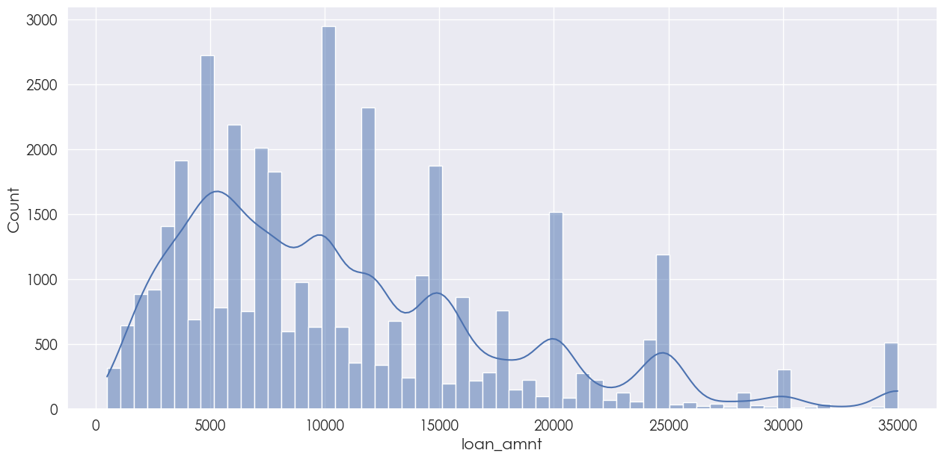
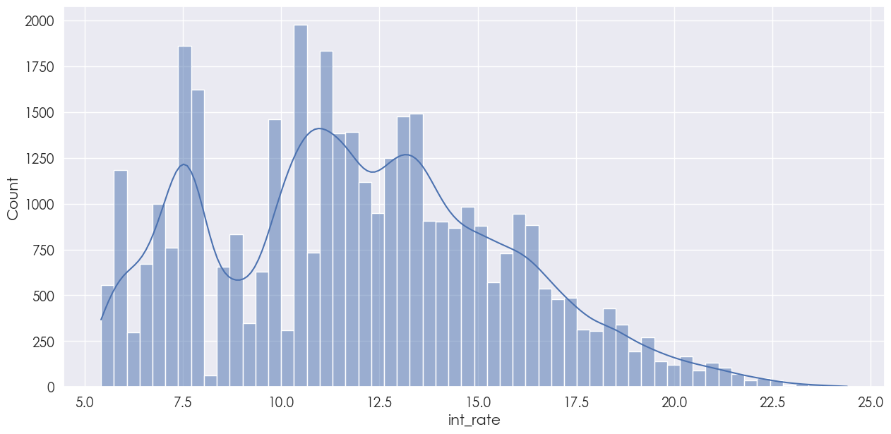
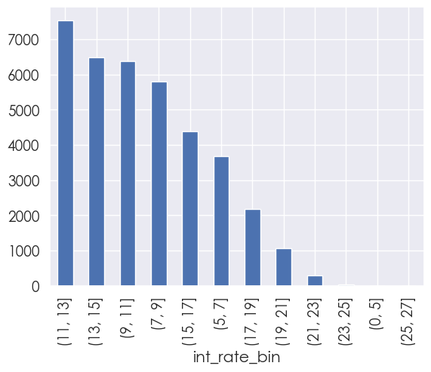
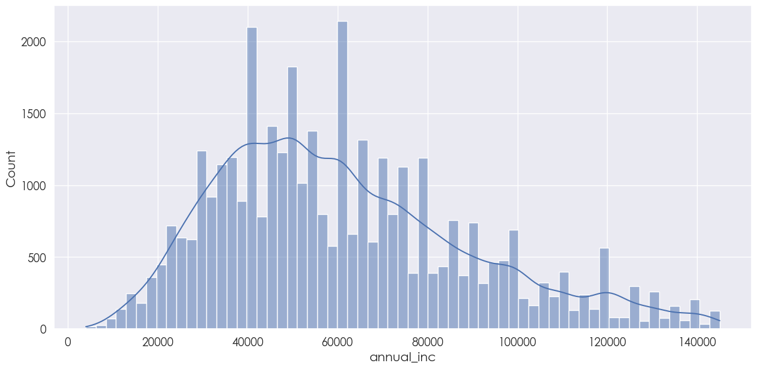
Univariate Analysis – 1/2
loan_amnt vs count: Most of the loans range from 4000 - 20000
int_rate or int_rate_bin vs count:
Most of the interest rates are distributed between 5% to 17%
annual_inc vs count: Most of the applications income lies between 30000 to 80000

Slide 10
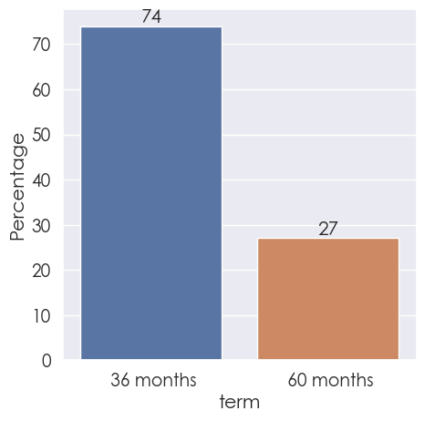
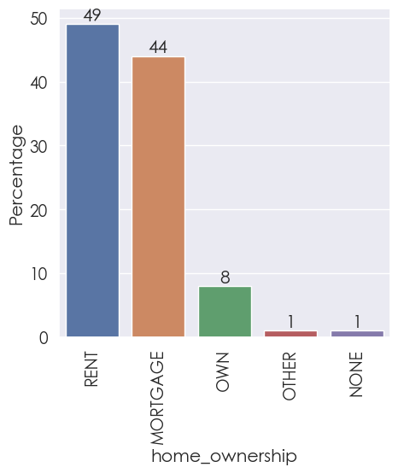
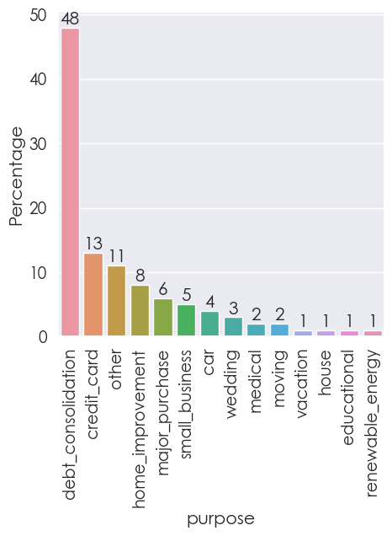
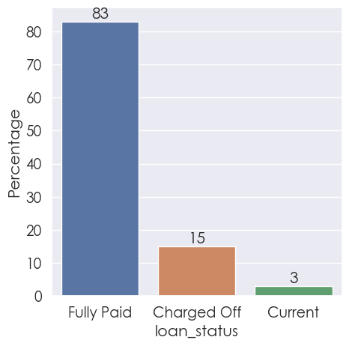
Univariate Analysis – 2/2
purpose by percentage: 61% applied for paying other loans, i.e., debit consolidation (48%) / credit card (13%)
loan_status by percentage: Fully Paid: 83%, Charged Off: 15%, Current: 3%
term by percentage: Most of the loans are issued for 36 months (74%)
home_ownership by percentage: Most of the owners are either on Rent (49%) or Mortgage (44%)

Slide 11
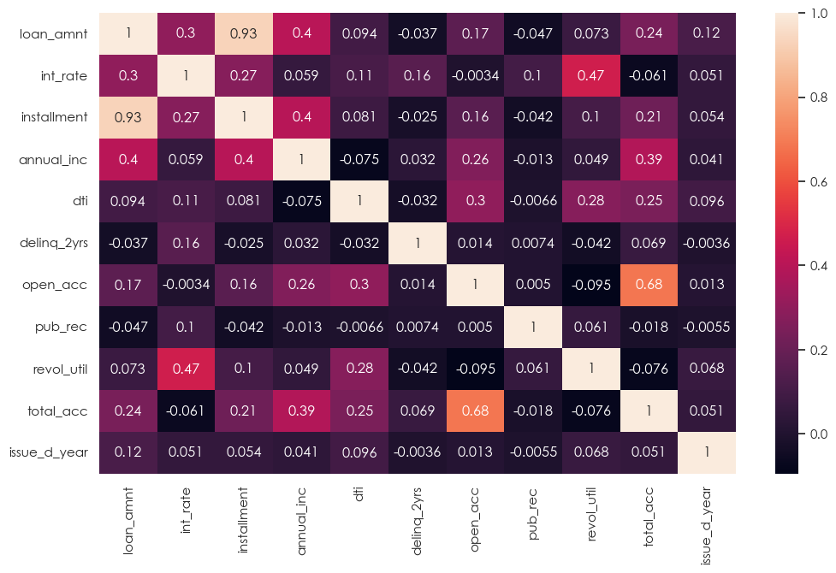
Bivariate Analysis – 1/4
Continuous Columns Correlation:
Interest rate has positive correlation with loan amount
Loan amount is highly correlated with installment
Annual income has negative correlation with DTI
DTI has small positive correlation with loan amount and installment
Annual income has positive correlation with installment, loan amount
Annual income has negative correlation with DTI

Slide 12
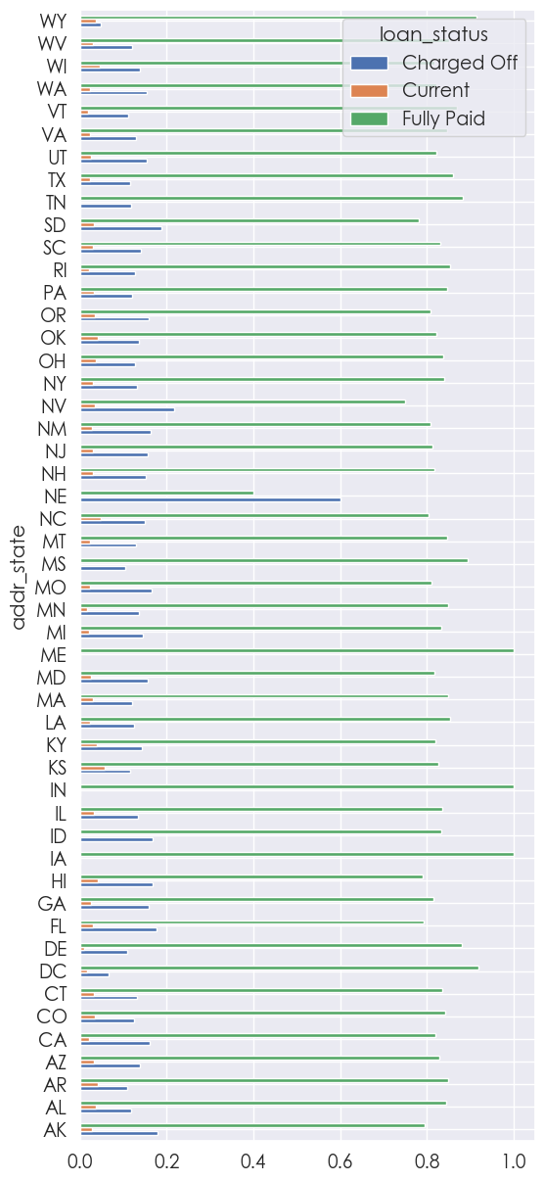
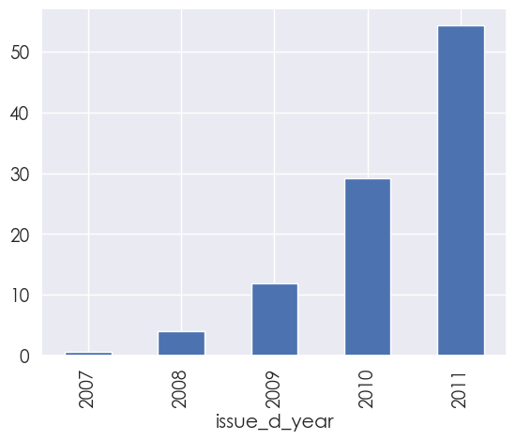
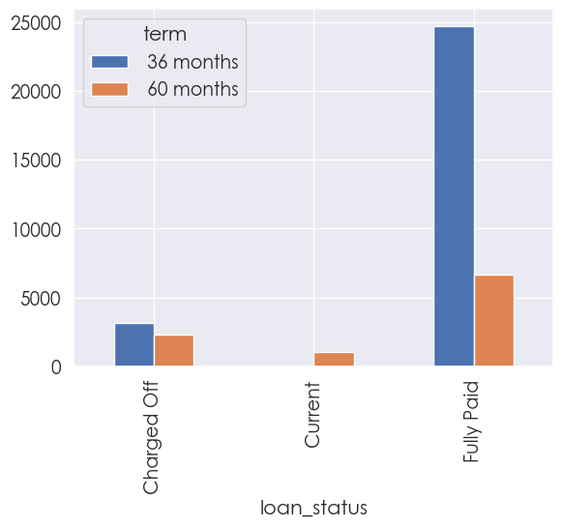
Bivariate Analysis – 2/4
loan_status by term: Charged Off is slightly more for 36 months vs 60 months tenure
But the counter argument is significantly high too, as Fully Paid is much higher for 36 month term
issue_d_year by year: Loan applicants increases year after year, reaching over 55% in 2011
addr_state by loan_status: State NE (Nebraska) stands out as the highest

Slide 13
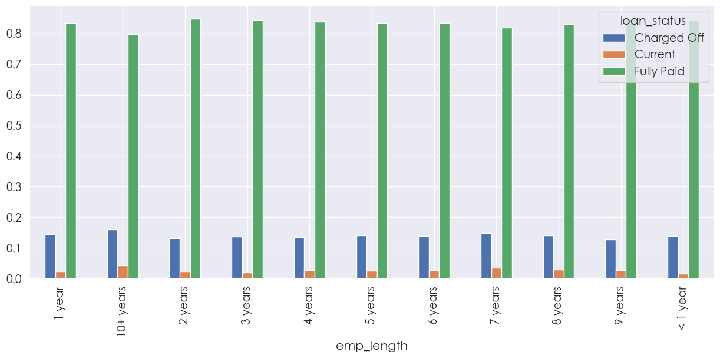
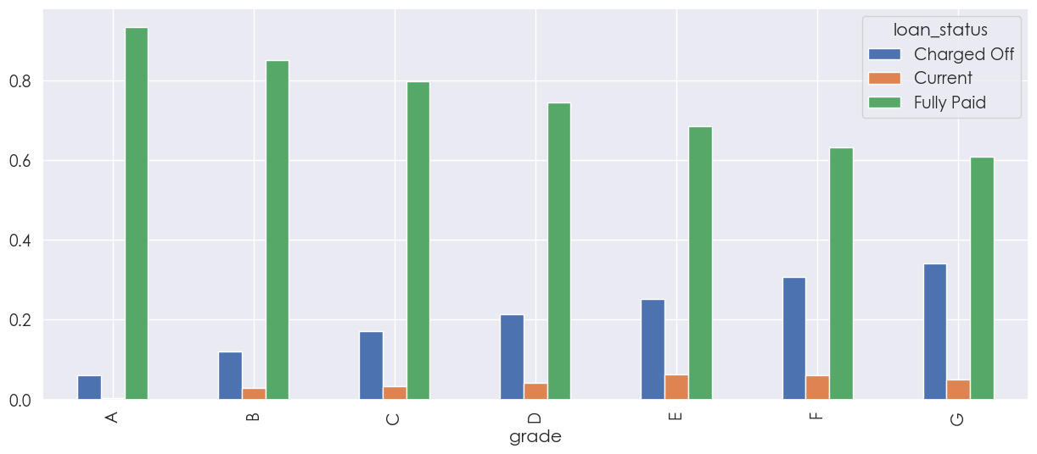
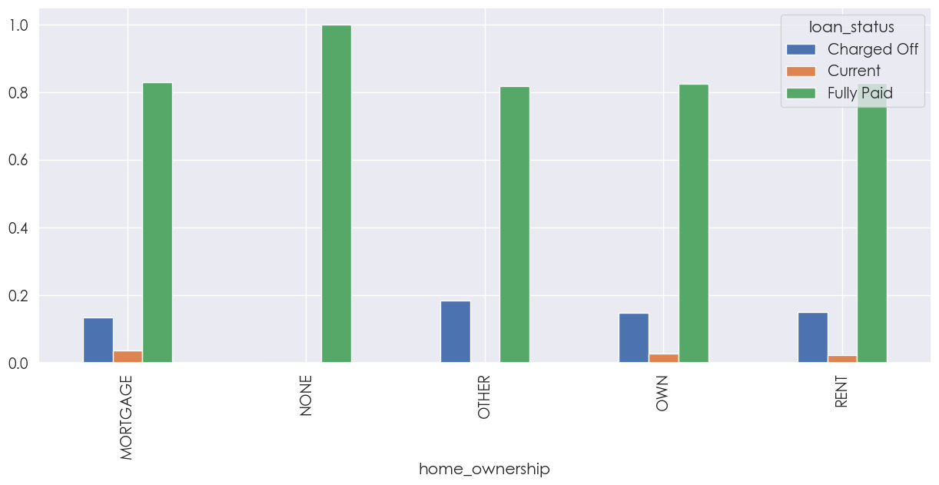
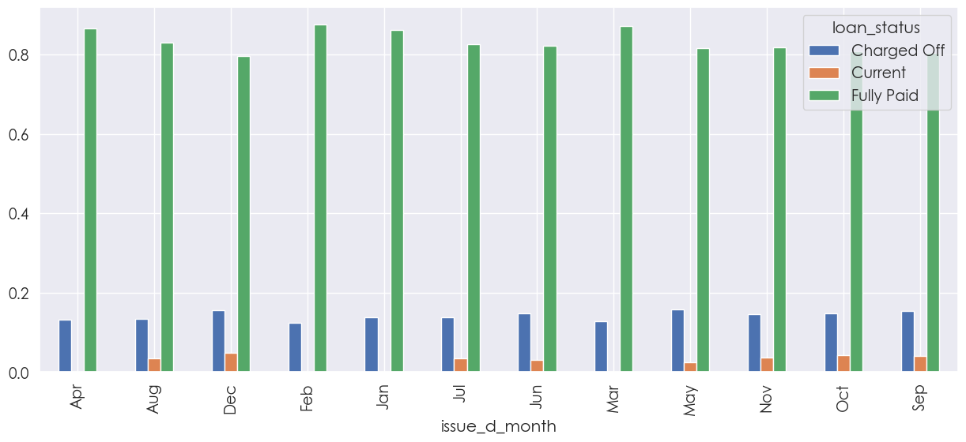
Bivariate Analysis – 3/4
emp_length by loan_status: Employment length doesnot seem to have an influence
grade by loan_status: 'Charged Off' increases as grades go from A to G
home_ownership by loan_status: Except for none, all other categories have similar rate
issue_d_month by loan_status: Occasionally a bit higher for some months, but not significantly different

Slide 14
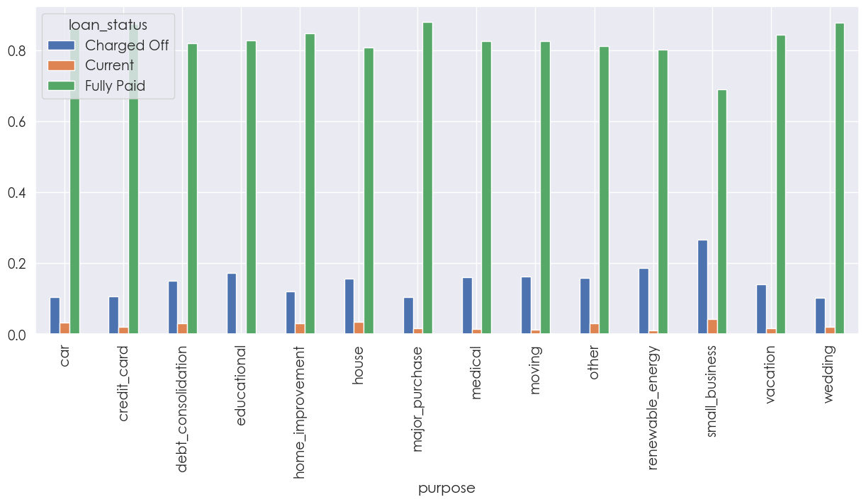
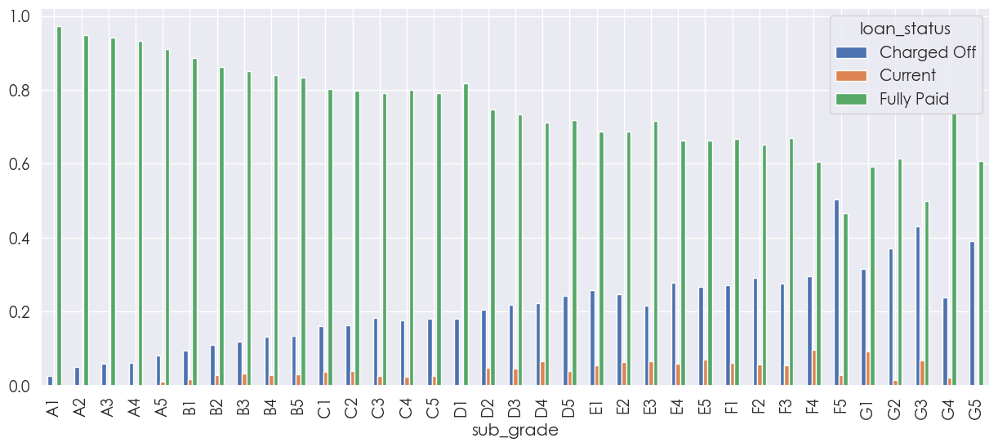
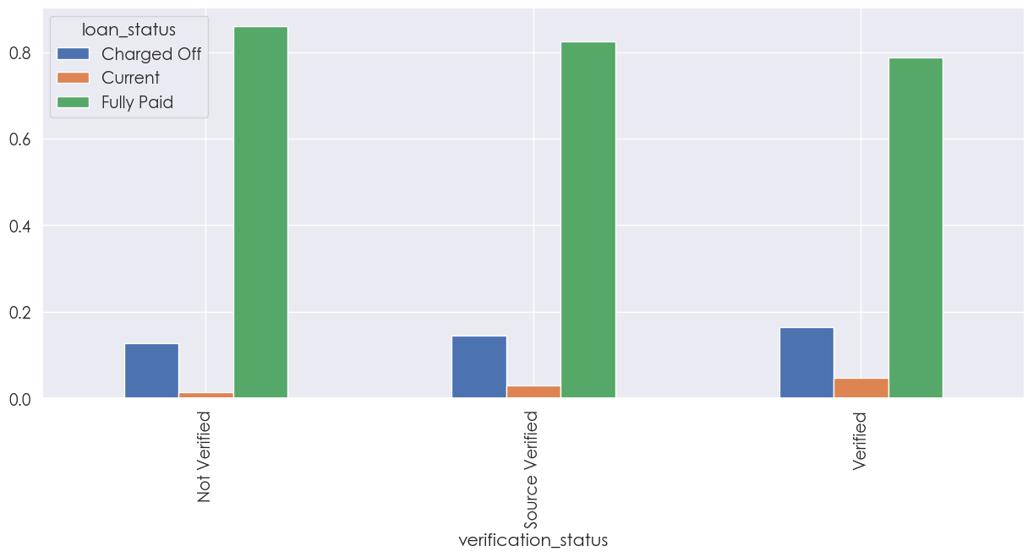
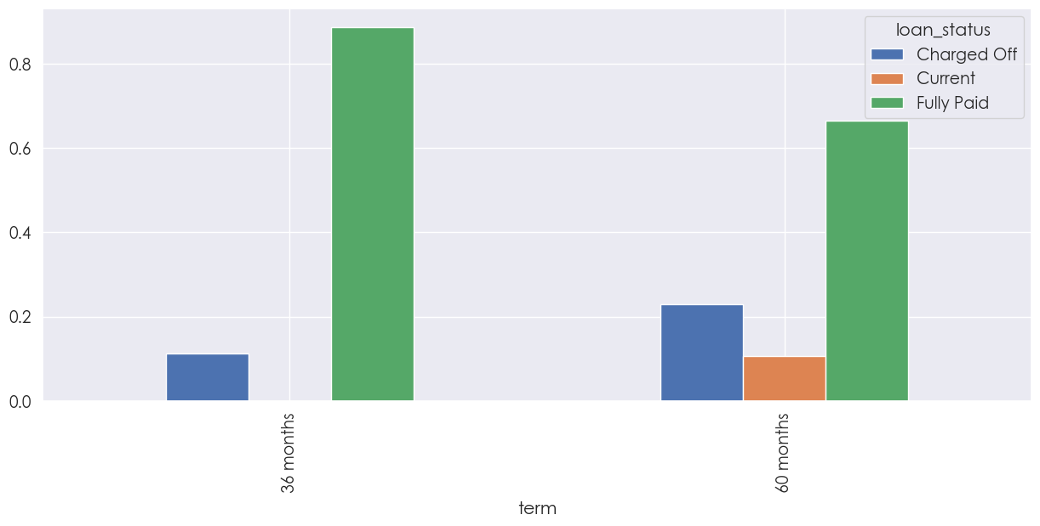
Bivariate Analysis – 4/4
sub_grade by loan_status: Incremental trend moving from A to G, but significant for F5
purpose by loan_status: Charged Off has significant increase for small_business
term by loan_status: Charged Off is higher for 60 months compared with 30 months
verification_status by loan_status: Ironically Verified has higher than Not Verified for Charged Off

Slide 15
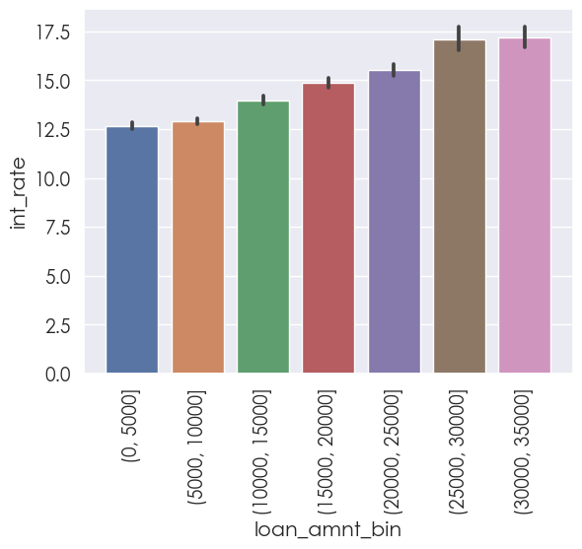
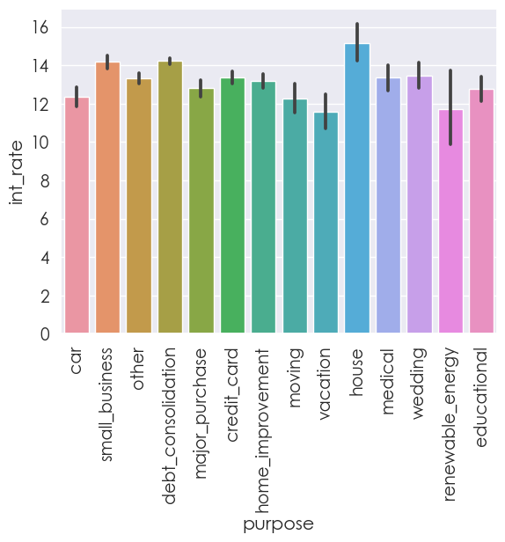
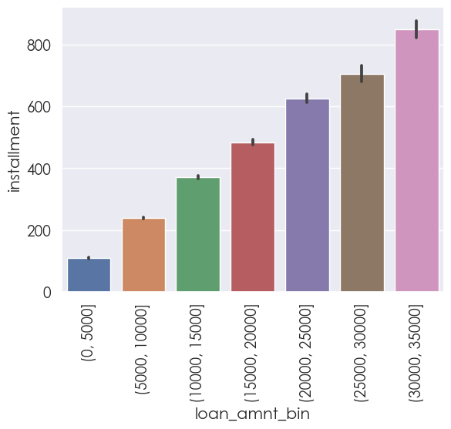
Multivariate Analysis – 1/2
loan_amnt_bin vs installment:
[data filtered on Charged Off]
Loans above 30000 and installment above 800 have higher chance for Charged Off
loan_amnt_bin vs int_rate:
[data filtered on Charged Off]
Loans above 25000 and interest rate more than 15% have higher chance for Charged Off
purpose vs int_rate:
[data filtered on Charged Off]
Loans applied for 'house' with Interest rate above 15% have higher chance for Charged Off

Slide 16
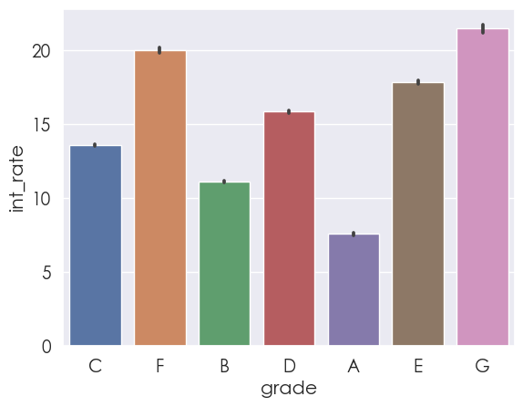
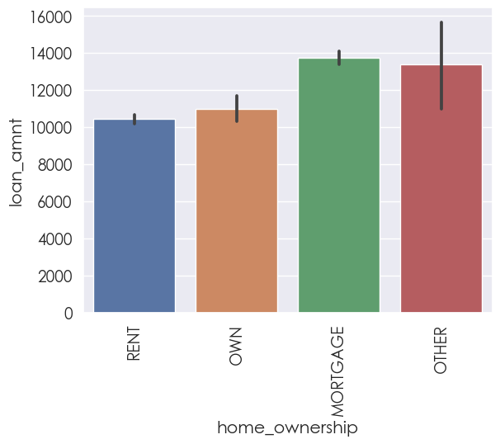
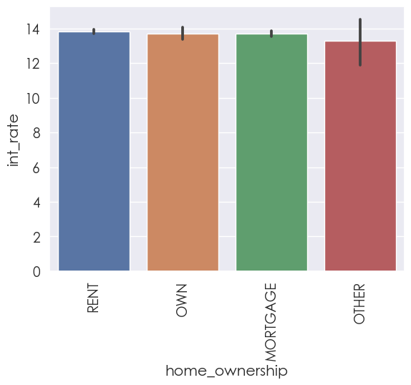
Multivariate Analysis – 2/2
home_ownership vs int_rate:
[data filtered on Charged Off]
No significant impact basing on home ownership for Charged Off
grade vs int_rate:
[data filtered on Charged Off]
Loans under grade 'G' with Interest rate above 20% have higher chance for Charged Off
home_ownership vs loan_amnt:
[data filtered on Charged Off]
Applicants on 'Mortgage' home and loan above 13000 have higher chance for Charged Off

Slide 17
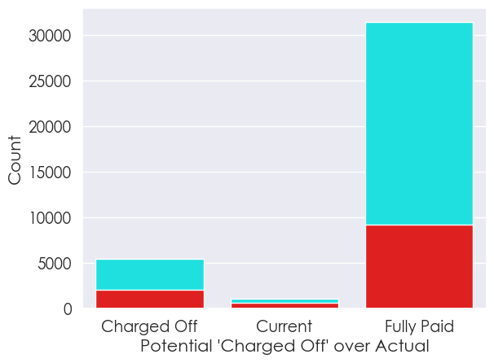
Analysis Observations
Rejectable Loans:
Loans above 25000 and interest rate more than 15% have higher chance for Charged Off
Loans above 30000 and installment above 800 have higher chance for Charged Off
Loans applied for 'house' with Interest rate above 15% have higher chance for Charged Off
Loans under grade 'G' with Interest rate above 20% have higher chance for Charged Off
Applicants on 'Mortgage' home and loan above 13000 have higher chance for Charged Off
Approvable Loans:
Loans below 25000, interest rate below 15% and not for 'house’
Loans below grade 'G' and interest rate below 20%
Loans below 13000 and not under 'Mortgage'
loan_status vs count:
overlayed potential 'Charged Off' on top of the actual values
Additional Observation: ‘Current’ has the potential of ‘Charged Off’ cases basing on the findings

Slide 18
Thank You

