Slide 1
Predicting Stock-Market Crashes
with a Temporal Fusion Transformer
— and an honest test of what actually helps
Dense Drawdown Supervision for Equity Crisis Early Warning
Hüseyin Sarp Vulaş · MSc Computational Finance · King's College London
Supervisor: Dr Bart de Keijzer

Slide 2
WHAT & WHY
The problem: an early-warning system for crashes
• Bear markets are expensive: you're fully invested right at the top, and credit dries up exactly when you need it.
• Goal — one yes/no question, asked every day:
• "Will a crash begin within the next 3 months (63 trading days)?"
• If you can see it coming, you can de-risk in time.
• This is a binary classification problem on time-series data.
🔑 Analogy: It's a weather forecast for the market. We don't predict the exact rainfall — we raise a flag when storm clouds are gathering.
Input → Output
In: 252 days of market history (returns, volatility, VIX, credit spreads…)
Out: probability of a crash in the next 63 days
1

Slide 3
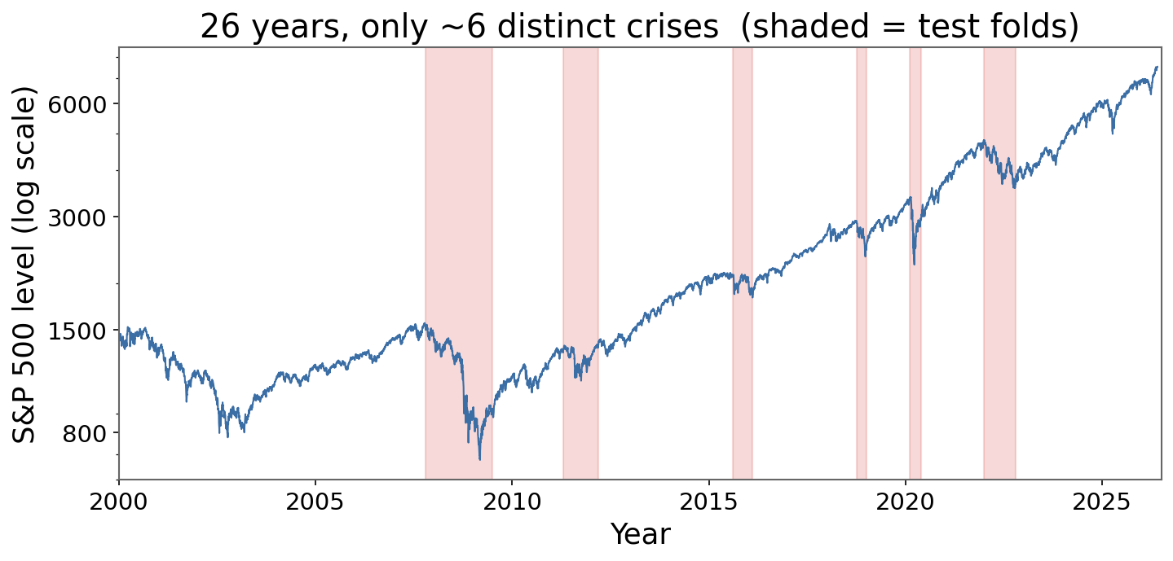
THE CORE DIFFICULTY
The catch: real crashes are RARE
• 26 years of the S&P 500…
• …produce only ~5-6 distinct crises.
• That is almost no examples to learn from.
• A big neural network has millions of dials but only a handful of real lessons to tune them on.
🔑 Analogy: Like training a smoke detector when your house has only caught fire 6 times in 26 years — you barely have enough fires to learn what smoke looks like.
2

Slide 4
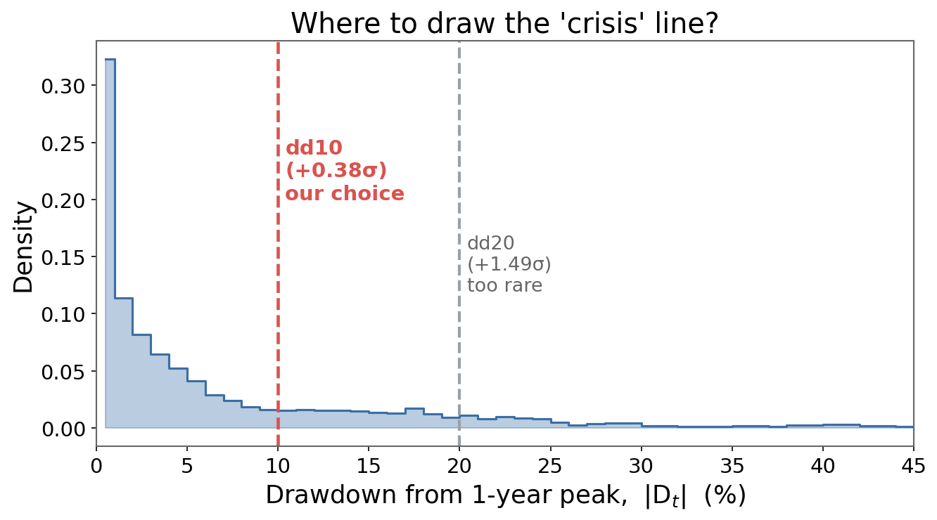
METHODOLOGY
Defining a "crisis": the dd10 rule
Drawdown = how far below the 1-year peak we are:
Dt = price / 1-yr peak − 1
Crisis = drawdown of 10% or more → "dd10"
• Why 10%? Chosen from the data, not gut feeling.
• 5% = just noise (happens 36% of days).
• 20% = textbook-clean, but only ~5 events in 26 yrs — too few to test.
• 10% sits just above average: enough events (~11) to evaluate honestly.
🔑 Analogy: Where you set the alarm's sensitivity: too low = beeps constantly; too high = never warns.
3

Slide 5
THE FORK IN THE ROAD
Two competing ideas to beat the data shortage
IDEA A — be smarter
IDEA B — feed it more
"Regime awareness"
Teach the model to figure out on its own whether the market is calm, stressed, or in crisis — and behave differently in each mood.
The intuition we started with.
The "AF recipe"
Don't change the brain. Give it an easier second homework task + a training trick that focuses on the hard cases.
The boring idea that actually worked.
Spoiler: Idea A did nothing. Idea B helped. The thesis is honest about both.
4

Slide 6
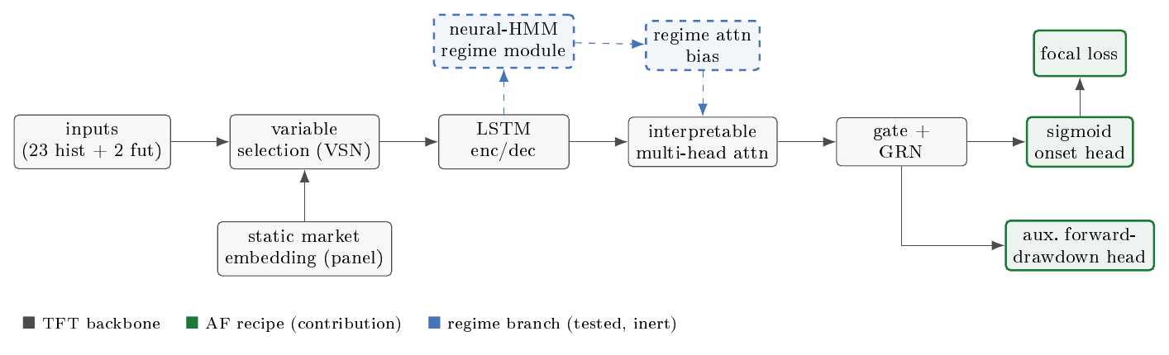
THE MODEL
The backbone: Temporal Fusion Transformer (TFT)
• Black = the standard TFT (Lim et al., 2021): picks useful inputs, an LSTM reads the sequence, attention links distant days.
• Green = our contribution (the AF recipe). Blue dashed = the regime idea we tested and rejected.
• We swapped the forecasting head for a sigmoid that outputs a crash probability.
5

Slide 7
WHAT WE TRIED
Idea A: Regime awareness (the one that failed)
• A built-in module tries to label each day as calm / stressed / crisis (a neural Hidden Markov Model).
• It then nudges the model's attention based on that mood.
• Reasonable hypothesis: a model that 'knows' it's in a storm should read history differently.
• Result: statistically identical to the plain model (0.460 vs 0.458). It added dials, not knowledge.
🔑 Analogy: Asking a student to guess the exam topic from the same few past papers they're already stuck on. Guessing the mood doesn't add new information — it recycles the scarce labels.
Why more runs can't save it:
Power is limited by the number of independent crises (~6), not by how many times we re-run.
6

Slide 8
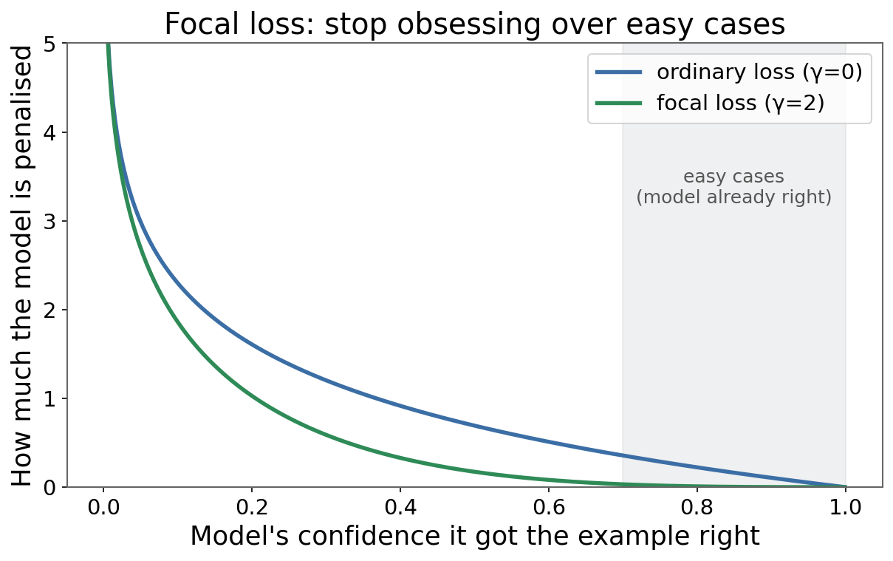
OUR CONTRIBUTION
Idea B: The AF recipe (the one that worked)
A = Auxiliary task (extra homework)
Besides the rare yes/no crisis label, also predict "how far will the market fall?" — a number available EVERY day, not just on rare crisis days.
F = Focal loss (focus on hard cases)
Lfocal = −(1−pt)γ · log pt
The (1−pt)γ term shrinks the penalty for easy days, so the model concentrates on the rare, hard crises.
🔑 Analogy: Studying for the few hard questions instead of re-reading the easy ones you already ace — and getting denser practice from a related side-subject.
7

Slide 9
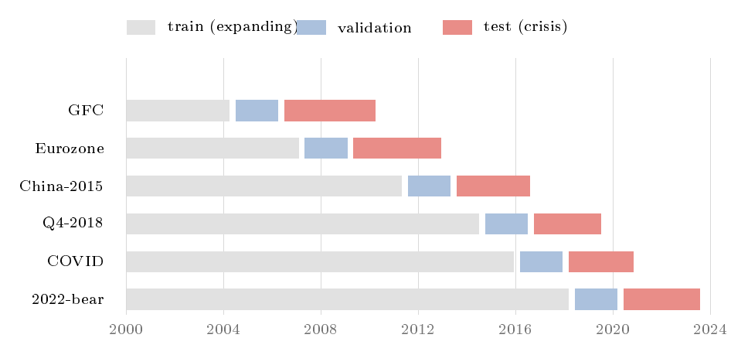
METHODOLOGY — THE REAL CONTRIBUTION
Testing honestly: no peeking at the future
• Walk-forward: train on the past, test on a LATER crisis — never the reverse.
• 63-day embargo: throw away the days right before each test so the model can't 'see' the answer.
• Tuned the XGBoost baseline properly — no straw man.
🔑 Analogy: It's a closed-book exam on next year's material. An earlier sloppy version let the model peek — and 'regime awareness' looked like a winner. Once we sealed the leaks, that win vanished. How you test can manufacture conclusions.
8

Slide 10
HOW WE MEASURE SUCCESS
The scorecards, in plain English
PR-AUC
Brier score
Prevalence π ≈ 0.34
How well it ranks true crisis days above calm ones. Stays meaningful when crises are rare. Read it vs the 0.34 'random' floor.
Are the probabilities HONEST? If it says '30% chance', does a crash really happen ~30% of the time? (calibration)
The 'do-nothing' baseline. ~34% of test days are crisis days, so blind guessing scores ~0.34. Beat this = real skill.
↑ higher = better
↓ lower = better
= the floor to beat
🔑 Analogy: PR-AUC = how well a doctor RANKS who is sick. Brier = whether 'I'm 70% sure' is actually right 70% of the time. A 0.48 PR-AUC against a 0.34 floor is genuine skill — not near-perfect, but real.
9

Slide 11
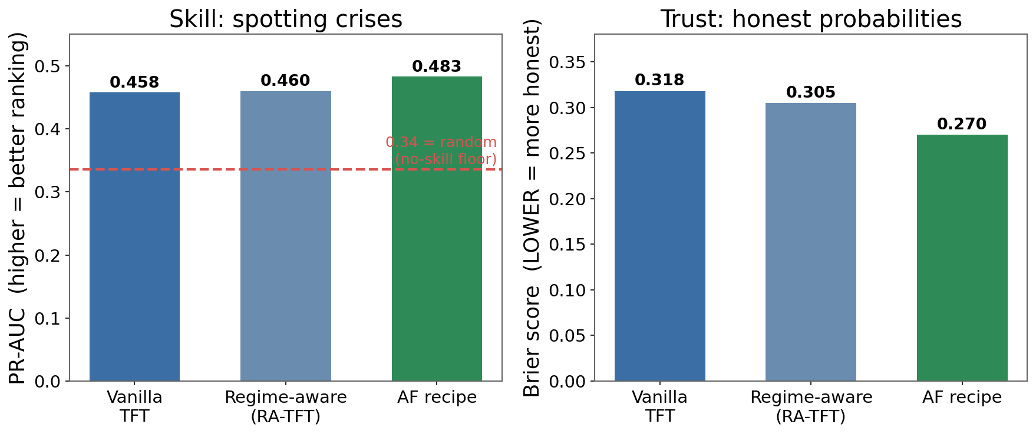
FINDINGS
Result 1: Regime awareness is inert
• Regime-aware (middle) ≈ plain model (left).
• 0.460 vs 0.458 — a rounding error (p = 0.43).
• The 'smart' idea added complexity but no skill.
• AF (green) is the one that pulls ahead — on both charts.
10

Slide 12
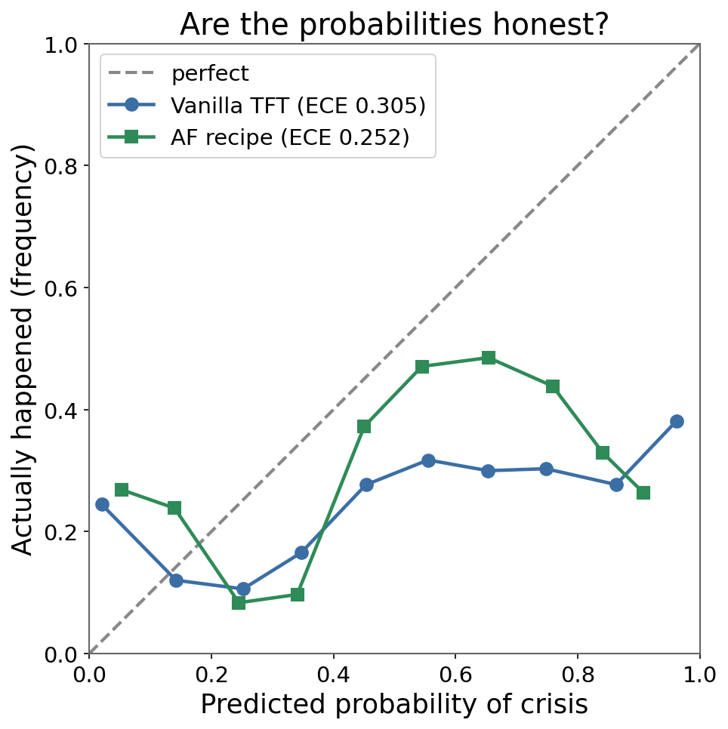
FINDINGS — THE MOST RELIABLE WIN
Result 2: AF gives more HONEST probabilities
• Closer to the dashed line = more honest probabilities.
• AF (green) hugs the diagonal better than vanilla (blue).
• AF lowered the Brier score in ALL SIX crises — every time, not just on average.
• For a tool that feeds real risk decisions, trustworthy probabilities matter more than a tiny ranking gain.
11

Slide 13
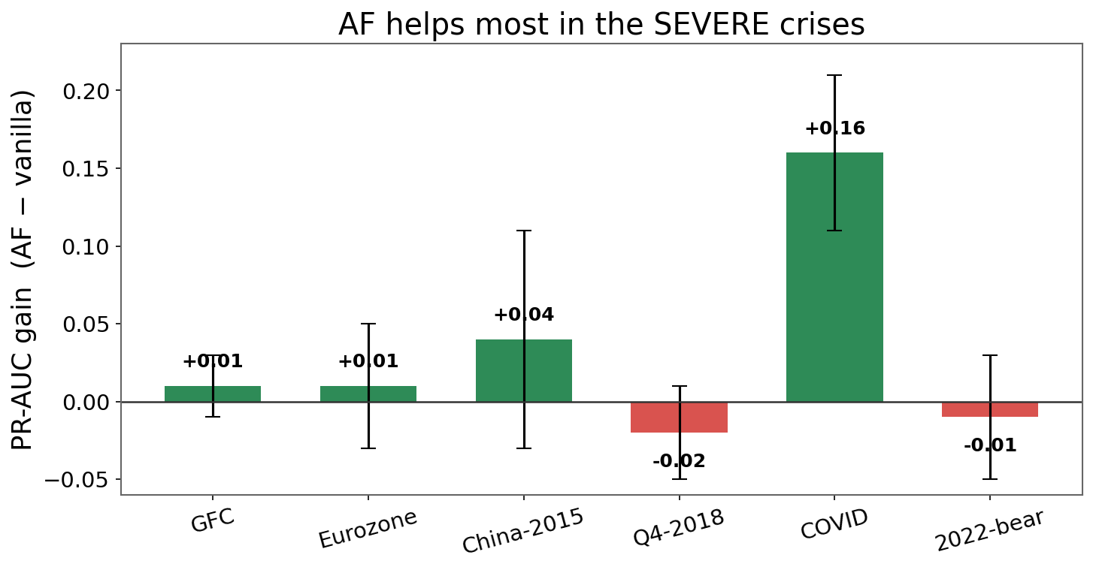
FINDINGS — BE HONEST ABOUT LIMITS
Where AF helps: the severe crises
• Big wins in the violent crashes: COVID +0.16, China +0.04.
• Flat/slightly negative on the mild wobbles.
• With only 6 crises, this gain isn't statistically 'proven' (CI just touches zero).
• So we claim a consistent improvement where it matters — not a proven one.
12

Slide 14
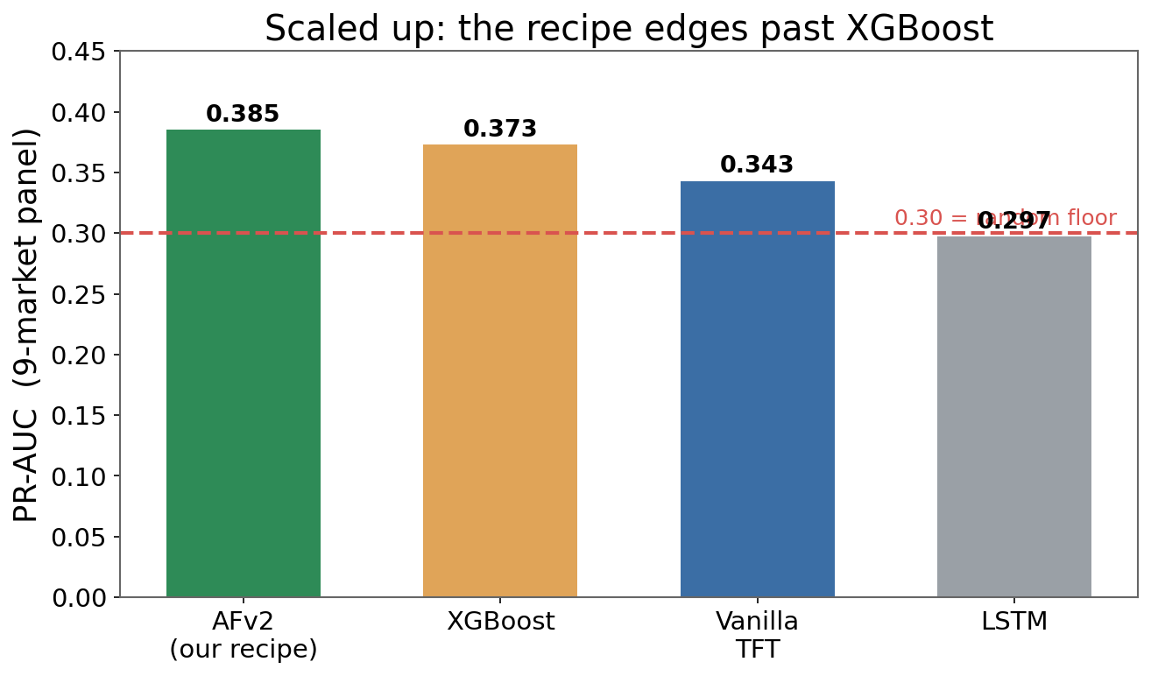
FINDINGS — THE PANEL
Result 3: scale up → it beats XGBoost
• Pool 9 markets → ~110 crisis onsets instead of ~6.
• More examples let the deep model finally shine.
• The tuned recipe (AFv2) edges XGBoost — the simple model the textbooks said you can't beat.
• Margins are small & honest: 0.385 vs 0.373. Not a blowout, but a real, careful win.
13

Slide 15
THE LESSON
Why one idea failed and the other won
Regime module ✗
Had to GUESS hidden moods from the same scarce labels that already bottleneck the task.
→ added capacity, no new information.
Auxiliary head ✓
Supplied a NEW, dense signal (drawdown is defined every single day).
→ added information, exactly what a scarce-label problem needs.
When examples are scarce, feed the model more information — not more parameters.
14

Slide 16
CONCLUSION
Takeaways
• Regime awareness — the clever idea — did NOT help. We report it honestly.
• The AF recipe (dense drawdown side-task + focal loss) gives better-calibrated warnings in every crisis, and bigger ranking gains in the severe ones.
• Scaled to 9 markets, the tuned recipe edges XGBoost and transfers back to the single market unchanged — one universal recipe.
• The biggest contribution is the honest, leak-free protocol: it's what makes the modest gains believable.
• Lesson: in low-data problems, more signal beats more model.
🔑 Analogy: A careful referee matters as much as a clever player: the strict testing is what separated a real improvement from a plausible illusion.
15

Slide 17
Thank you
Questions?
Hüseyin Sarp Vulaş · MSc Computational Finance · King's College London

