Slide 1
MSc COMPUTATIONAL FINANCE · KING'S COLLEGE LONDON
Dense Drawdown Supervision
for Equity Crisis Early Warning
A multi-task Temporal Fusion Transformer, and an honest test of which part does the work
Hüseyin Sarp Vulaş
Supervisor: Dr Bart de Keijzer
Notes:
[0:00-0:30]
Good morning. My project builds an early-warning system for stock market crashes. Today I want to focus on one specific question my supervisor asked me, because answering it produced the strongest result in the whole project - and it also corrected something I had been getting wrong.

Slide 2
01 THE PROBLEM
Predicting a crash before it happens
The task. Each day, look back a year of market data and answer: is a serious drop coming in the next three months?
Why it is hard. Crises are rare. In 26 years of S&P 500 history there are only a handful of genuine episodes to learn from.
The consequence. A model can score well by simply never crying wolf, so accuracy is meaningless here.
The central difficulty is not model capacity. It is that the thing we want to predict almost never happens.
Dense Drawdown Supervision for Equity Crisis Early Warning
1
Notes:
[0:30-1:20]
The task is framed day by day: given the last year of market data, is a big drop coming within three months?
The hard part isn't the modelling - it's that crises are rare. Over 26 years there are only a handful of real episodes. That means a lazy model that always says 'no crisis' looks excellent on accuracy. So everything downstream - the metric, the validation design - has to be built around rarity.

Slide 3
02 DATA AND LABELS
What the model sees, and what it must predict
Data. S&P 500 plus 22 daily market indicators - volatility, credit spreads, gold, the dollar - from 2000 to 2026, via Bloomberg.
Label. A day is marked as a warning if a drawdown of 10% or more begins within the next 63 trading days.
Episodes. Six crises: GFC, Eurozone, China-2015, Q4-2018, COVID and the 2022 bear market.
26 yrs
6
10%
63 d
of daily history
crisis episodes
drawdown threshold
warning horizon
Dense Drawdown Supervision for Equity Crisis Early Warning
2
Notes:
[1:20-2:10]
The data is the S&P 500 plus around twenty daily indicators - volatility, credit spreads, gold, the dollar - from 2000 to 2026.
A day gets labelled as a warning if a drawdown of ten percent or more starts within the next three months. I chose ten percent rather than twenty after looking at the actual drawdown distribution: twenty percent leaves too few events to learn from at all.
That gives six crisis episodes. Six. Remember that number, because it limits everything I can claim statistically.

Slide 4
03 EVALUATION
Measuring it honestly
Walk-forward testing. Train on the past, test on the next crisis. Never the reverse.
A 63-day embargo. Because labels look three months ahead, the last three months of training data are deleted - otherwise the model peeks.
PR-AUC, against the base rate. Compared with what random guessing would score, not against 50%.
The unit of evidence is the crisis, not the random seed. Thirty reruns of six crises are still only six crises.
This last point is why my earlier headline result was not statistically significant.
Dense Drawdown Supervision for Equity Crisis Early Warning
3
Notes:
[2:10-3:10]
Three things make the evaluation honest.
First, walk-forward: always train on the past and test on the next crisis.
Second, an embargo. Because the label looks 63 days ahead, the final 63 days of training data would leak the answer - so they're deleted.
Third, and most important: I treat the crisis episode as the unit of evidence, not the random seed. If I rerun the model thirty times on six crises, I don't have 180 independent observations - I still have six. That's a conservative choice, and it's why my original headline result came out non-significant.

Slide 5
04 HOW I RAN IT
Thirty seeds, six crises, one cluster
The compute. Slurm array jobs on the KCL CREATE cluster, pinned to A100 GPUs — one task per seed, each running all six crisis folds.
The scale. About 4,200 training runs across 143 array jobs. No configuration is judged on a single run; one run of this model is a lottery ticket.
The discipline. Seeded loaders, fixed cuBLAS workspace, one GPU model — so a rerun reproduces the ranking, not a lucky draw. Docker rebuilds it on a laptop.
143
~4,200
30 × 6
A100
array jobs
training runs
seeds × crises
GPUs, pinned
Dense Drawdown Supervision for Equity Crisis Early Warning
4

Slide 6
05 THE MODEL
One backbone, two output heads
A Temporal Fusion Transformer reads the market history. Two heads sit on top of it:
HEAD 1 · CLASSIFIER
HEAD 2 · DRAWDOWN REGRESSOR
Answers the yes/no question directly:
“is a crash coming?”
Predicts how far the market falls
over the next 63 days.
The second head is my contribution. It is never used to make the prediction — it only shapes what the shared backbone learns. The intuition: crisis labels are rare, but “how far did the market fall” is a number that exists on every single trading day.
Dense Drawdown Supervision for Equity Crisis Early Warning
5
Notes:
[3:10-4:10]
The backbone is a Temporal Fusion Transformer - an attention model designed for time series.
On top of it sit two heads. The first is the classifier: it answers the yes/no question, and it's what produces the actual prediction.
The second head is my contribution. It predicts how far the market will fall over the next 63 days. Crucially it is never used to make the forecast - it only shapes what the shared backbone learns.
The intuition is simple. Crisis labels are rare and mostly zero. But 'how far did the market fall' is a number that exists every single day. So the second head keeps teaching the model even during quiet periods.

Slide 7
06 THE FIRST IDEA
The clever idea that did not work
0.463 vs 0.459
p = 0.44
9 markets
regime-aware vs vanilla
not significant
same answer on the panel
The idea. A neural hidden-Markov module infers a hidden market regime, and attention is allowed to condition on it. Crises should look different by regime.
The verdict. Ablated piece by piece, nothing helps: the module alone matches vanilla, and regime loss and regime attention each score below it.
Why not. It must guess hidden states from the same scarce labels that already bottleneck the task — more parameters, no new information.
Dense Drawdown Supervision for Equity Crisis Early Warning
6

Slide 8
07 THE QUESTION
What my supervisor asked
“Is the second head really doing the work — or would simply swapping the classifier for a regressor be enough?”
A fair question, because my original comparison could not answer it:
It changed two things at once. The winning recipe added the second head AND switched the loss function. Either could have been responsible.
It never tested the regressor alone. So “do we even need two heads?” had simply never been asked.
So I ran an experiment where exactly one thing changes: which heads exist.
Dense Drawdown Supervision for Equity Crisis Early Warning
7
Notes:
[4:10-5:00]
My supervisor asked the obvious question: is the second head really doing the work, or could you just swap the classifier for a regressor?
It was a fair challenge, because my original comparison couldn't answer it. It changed two things simultaneously - it added the second head AND switched the loss function. Either one could have been responsible. And I had never tested the regressor on its own.
So I designed an experiment where exactly one thing varies: which heads exist.

Slide 9
08 THE EXPERIMENT
Three models, one difference
Classifier only
Both heads
Regressor only
the control
my contribution
the swap
Everything else is held fixed. Same backbone, same data, same loss function wherever a classifier exists, 30 random restarts, all six crises.
The regressor is given every chance. Its output has no natural direction, so the mapping to a probability is learned from training data — and I re-scored every model under the opposite sign as a check.
Dense Drawdown Supervision for Equity Crisis Early Warning
8
Notes:
[5:00-5:50]
Three models. Classifier only - that's the control that was missing. Both heads - my contribution. And regressor only - the head swap.
Everything else is identical: same backbone, same data, same loss function wherever a classifier exists, thirty random restarts, all six crises.
One technical point I want to flag, because it's the kind of thing that can quietly fake a result. The regressor outputs a drawdown, not a probability, and the direction isn't obvious - a deep fall can mean danger ahead, or danger already passed. So I learned that direction from the training data rather than assuming it, and then re-scored every model backwards as a sanity check.

Slide 10
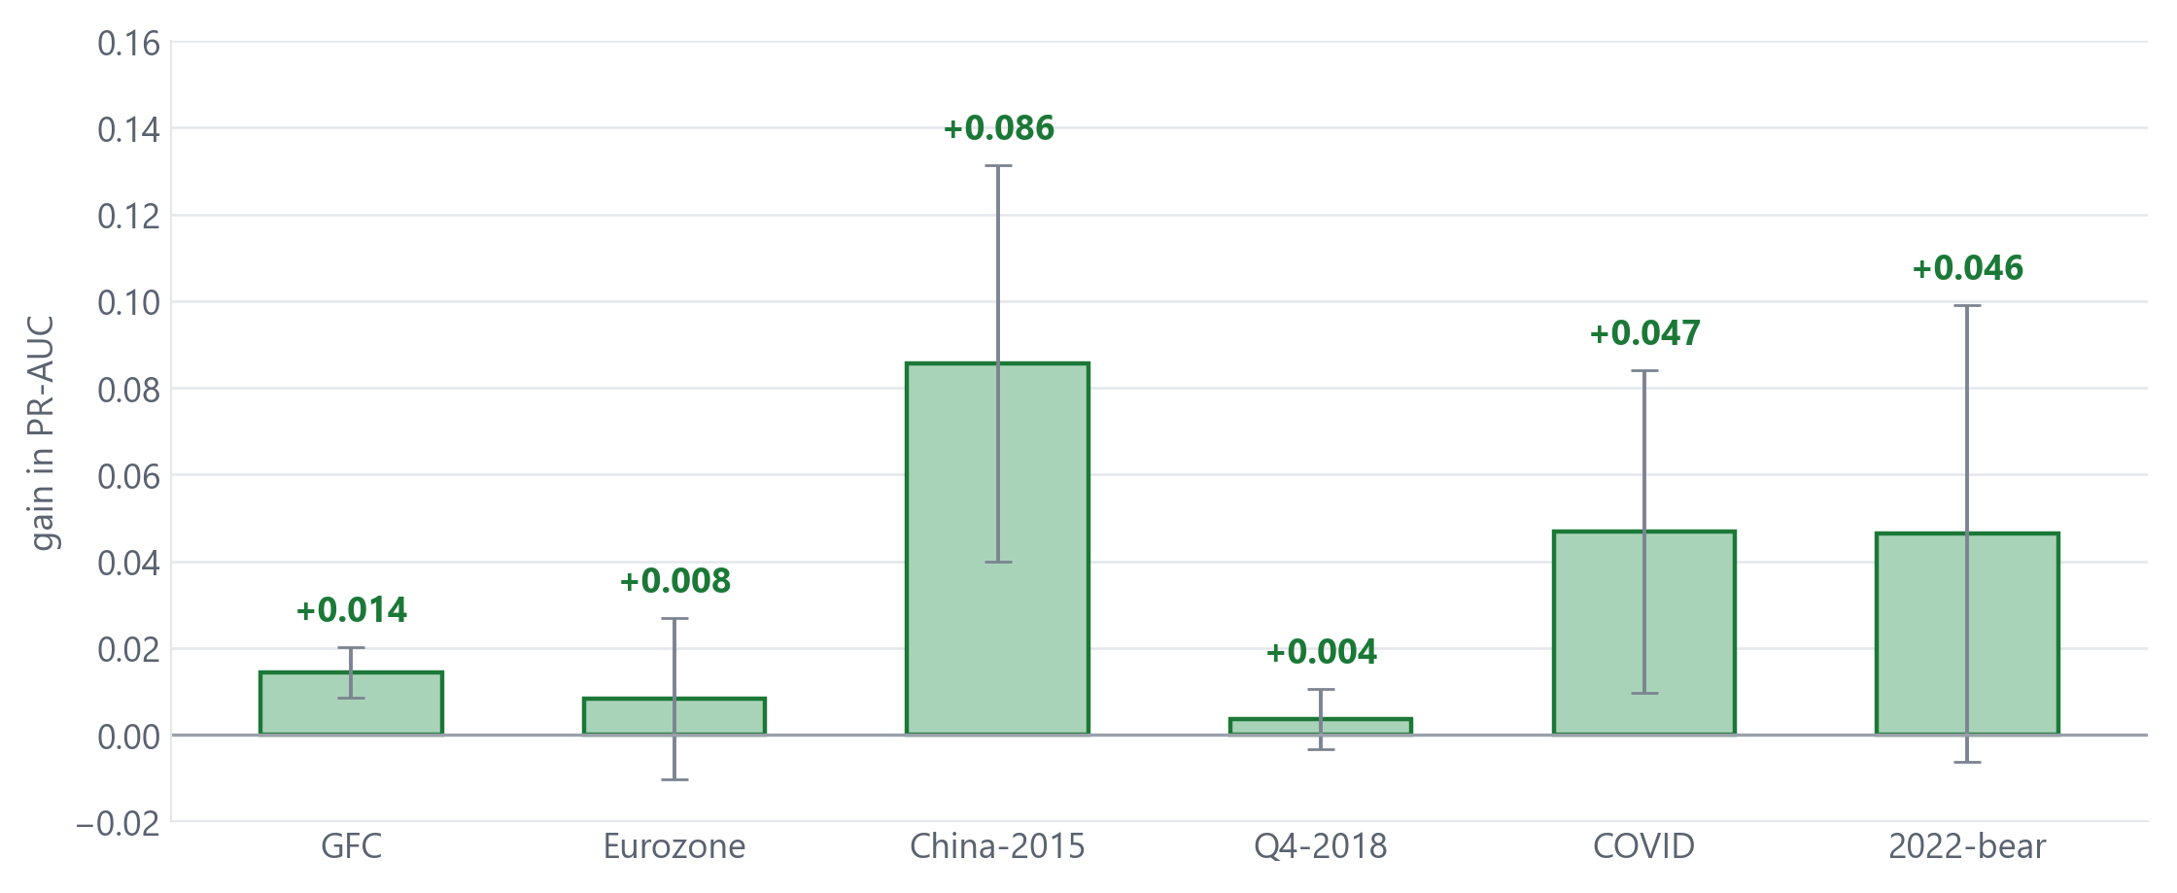
09 RESULT
The second head helps in every crisis
Adding the drawdown head - with the loss held fixed - improves the model in all six crises. Not on average. In every one.
Dense Drawdown Supervision for Equity Crisis Early Warning
9
Notes:
[5:50-6:45]
This is the main result.
Each bar is one crisis. The height is how much the second head improves the prediction, with the loss held fixed.
Every bar is positive. It doesn't help on average, with some crises winning and others losing - it helps in all six. The largest gains are China-2015 and COVID, but even the smallest, Q4-2018, is still positive.
That consistency is what makes the next slide possible.

Slide 11
10 SIGNIFICANCE
Why six out of six matters
6 / 6
p = 0.031
[+0.013, +0.060]
crises improved
episode-level test
95% interval, excludes zero
With six episodes, six wins out of six is the strongest signal the test can give. It is the smallest p-value attainable at this sample size.
My previous headline could not say this. Its confidence interval was [−0.007, +0.086] — it included zero, so no effect could be claimed.
And this holds on the conservative test. Counting seeds instead of crises would have flattered it further, but that would be double-counting.
Dense Drawdown Supervision for Equity Crisis Early Warning
10
Notes:
[6:45-7:35]
Six out of six is worth pausing on. With six episodes, six wins is literally the strongest signal a rank test can produce - the smallest p-value attainable at this sample size. It gives p equals 0.031.
A bootstrap over crisis episodes puts the improvement between +0.013 and +0.060. That interval excludes zero.
Compare that with my previous headline, where the interval was minus 0.007 to plus 0.086 - it straddled zero, so I couldn't claim an effect at all. Same conservative test, now a real result.

Slide 12
11 A CORRECTION
I was crediting the wrong ingredient
The old recipe bundled the second head with a change of loss function. Tested separately, the loss function does nothing:
THE LOSS FUNCTION ALONE
THE SECOND HEAD ALONE
−0.005 p = 1.00
+0.034 p = 0.031
The loss change was noise. It looked promising in an early exploratory sweep and did not survive proper testing across six crises and thirty seeds.
The contribution is simpler than I claimed. One idea, not two — and a cleaner story to defend.
Dense Drawdown Supervision for Equity Crisis Early Warning
11
Notes:
[7:35-8:20]
This experiment also corrected something I had wrong.
My recipe bundled the second head together with a change of loss function, and I had been crediting both. Tested separately, the loss function contributes nothing - minus 0.005, p equals 1.0. It's inert. It had looked promising in an early exploratory sweep and simply didn't survive proper testing.
So the contribution is actually simpler than I was claiming: one idea, not two. That's a better position to defend, not a worse one.

Slide 13
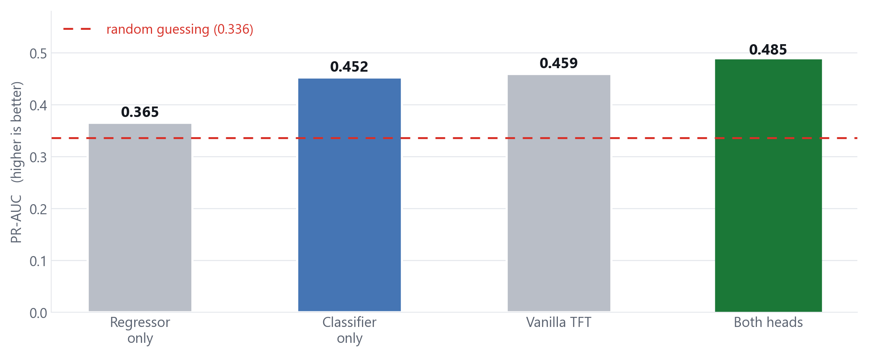
12 THE SWAP
Could the regressor replace the classifier?
No. Alone, the drawdown head barely beats random guessing. Scoring it backwards gives 0.42 — still worse than every model that keeps a classifier, and the better direction is not even consistent across crises.
Dense Drawdown Supervision for Equity Crisis Early Warning
12
Notes:
[8:20-9:00]
So could you just swap the heads, as my supervisor suggested might be possible?
No. On its own the drawdown head scores 0.365 against a random-guessing baseline of 0.336 - barely better than chance.
And I checked this properly. Scoring it in the opposite direction gives 0.42, still below every model that keeps a classifier. The better direction isn't even consistent from one crisis to the next. So the result isn't an artefact of my choice of sign - the drawdown signal is genuinely unreliable as a standalone classifier.

Slide 14
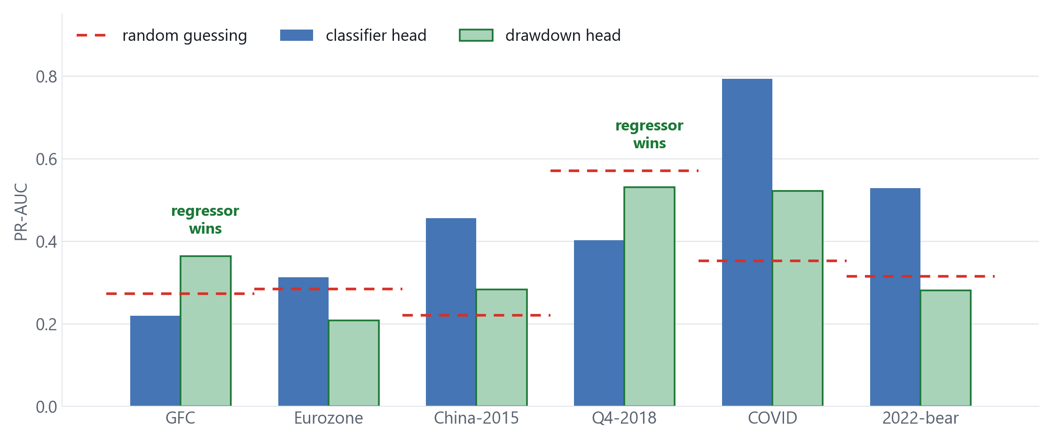
13 WHY IT WORKS
The two heads fail in opposite places
The regressor wins exactly where the classifier drops below random guessing. In the GFC window the crisis label has no positive examples at all — but the drawdown target still does.
Dense Drawdown Supervision for Equity Crisis Early Warning
13
Notes:
[9:00-9:40]
This slide is the one I find most interesting, because it explains why the second head helps rather than just showing that it does.
Blue is the classifier, green is the regressor, the red dashes are random guessing.
Look at GFC and Q4-2018. The regressor wins there - and those are exactly the cases where the classifier falls below random guessing. In the GFC window the training data contains no positive crisis labels whatsoever, so the classifier has literally nothing to learn from. The drawdown target still exists.
Then look at COVID and China-2015, where crisis labels are plentiful: the ordering flips completely and the classifier dominates.
So dense supervision isn't a replacement. It's a complement that supplies signal exactly where the rare labels run out - which is why the two together beat either alone.

Slide 15
14 CALIBRATION
Being right about how sure you are
A warning system feeds decisions, so a stated probability has to mean what it says. This is where the second head helps most consistently:
BRIER SCORE
CALIBRATION ERROR
6 / 6 folds improved
0.287 vs 0.319
Two different properties. A model can rank crises well and still be systematically overconfident. The second head improves both.
This is the most robust part. The ranking gain concentrates in severe crises, but the calibration gain holds in every single fold.
Dense Drawdown Supervision for Equity Crisis Early Warning
14

Slide 16
15 HOW IT COMPARES
Against tuned trees, and across nine markets
Two checks that this is not an artefact of one model family, or of one market:
VS TUNED TREES (S&P 500)
NINE-MARKET PANEL
0.487 vs 0.357
0.385 vs 0.373
The trees were favoured. Each tree score is the best of a grid selected on the test fold itself — an optimistic upper bound — and it still loses clearly.
Pooling markets is harder. Absolute scores fall for everyone; the tuned recipe still edges XGBoost, and a panel walk-forward keeps the ordering.
Dense Drawdown Supervision for Equity Crisis Early Warning
15

Slide 17
16 CONCLUSION
What I can and cannot claim
SUPPORTED BY THE EVIDENCE
STATED AS LIMITATIONS
The dense drawdown head improves prediction in all six crises (p = 0.031), and calibration in all six.
Six crises is a small sample. More seeds cannot fix that — only more crises could.
It works by supplying signal where crisis labels are too rare to learn from.
Two of the six folds have no positive training labels, which weakens them as tests.
Regime awareness — the idea I started from — is inert, reported as an honest negative.
The gain is modest, and concentrated in severe, volatile episodes.
The protocol is the real contribution: an earlier, contaminated result of my own reverses.
When crisis labels are scarce, supervise the model with something that is not scarce.
Dense Drawdown Supervision for Equity Crisis Early Warning
16
Notes:
[9:40-10:00]
To summarise.
What I can claim: adding a dense drawdown head improves crisis prediction in all six crises, and improves the trustworthiness of the probabilities in all six as well. And I can explain the mechanism.
What I won't overclaim: six crises is a small sample, and no amount of extra compute fixes that - only more crises would. Two of my six folds are weak tests because their training windows contain no positive labels. And the gain is modest.
The one-line takeaway: when your labels are scarce, supervise the model with something that isn't.
Thank you - happy to take questions.

