Slide 1

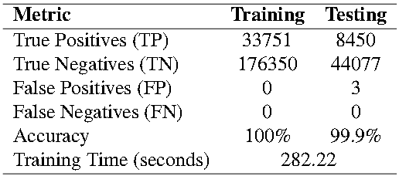
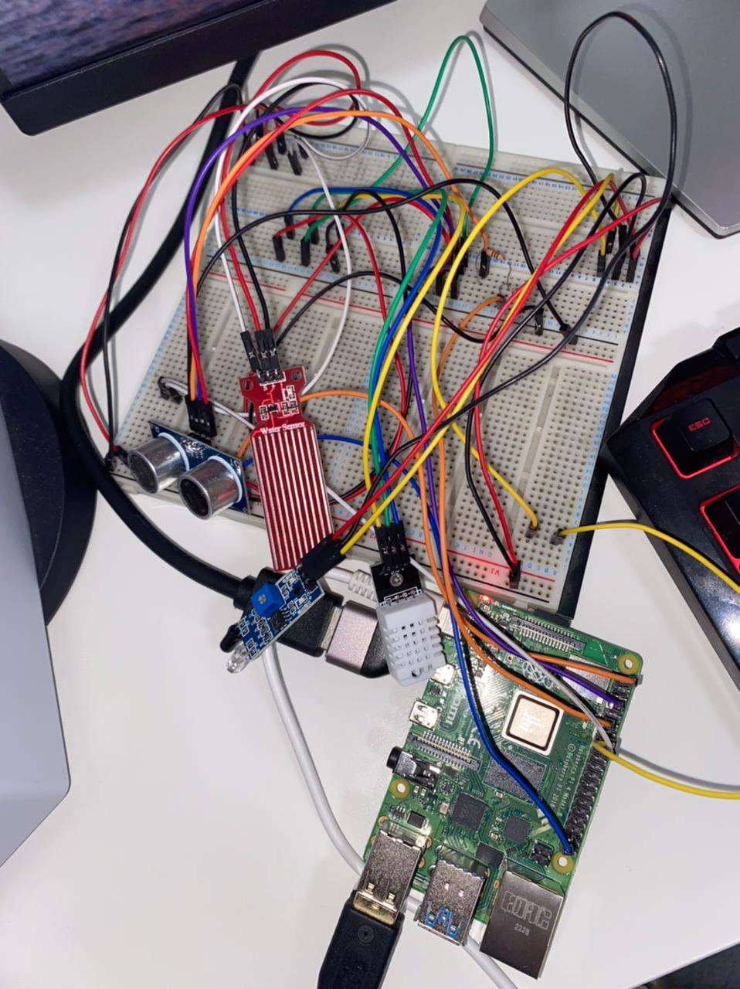
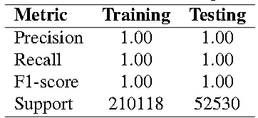
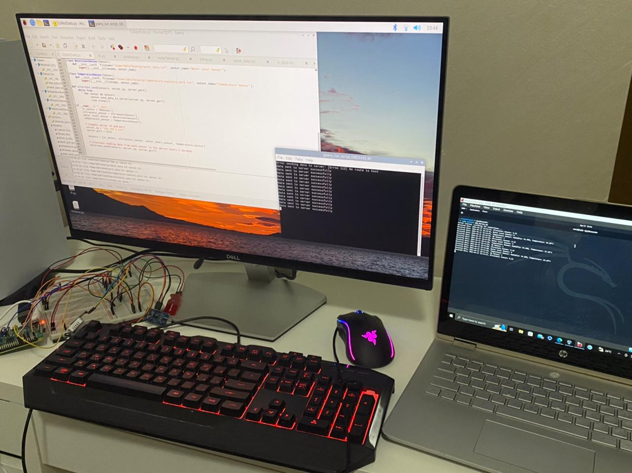
Title: ML Based Intrusion Detection System for IoT Networks
Senior Design Group: Sara Majid, Sarra Ghali, Meera Safar
Supervisor: Dr. Ala’ Altaweel, Mentor: Mohamad Abdallah Mohamad Abdallah
Examination Committee: Prof. Mohamed Saad, Prof. Qassim Nasir
Affiliation: College of Computing and Informatics, Department of Computer Engineering
Problem Statement
THEORY / METHODS
The widespread use of smart devices exposes them to hacking risks, with over 15 billion connected to the internet in 2023 and expected to double soon. Various cyberattacks threaten the security and privacy of users, including DDoS, backdoor access, MiTM interception, SQL injection, and XSS. To address these risks, Intrusion Detection Systems (IDS) enhanced with Machine Learning (ML) are being developed. These systems aim to detect and mitigate attacks by analysing network traffic patterns. Testing in real-world environments will validate their effectiveness.
In the domain of network security for IoT, our approach integrates robust machine learning models to discern between benign traffic and potential threats. The foundation of our methodology is rooted in leveraging a dataset representing a blend of regular IoT device activity and common attack patterns, such as DDoS, MITM, and data breaches. From this data, we meticulously curated features with the potential to reveal malicious intent, focusing on network traffic attributes indicative of anomalous behavior.
The machine learning algorithms of choice, SVM and Random Forest, were meticulously trained with a dataset preprocessed to scale features and eliminate redundancies. The former's capability to handle high-dimensional data and the latter's proficiency in classification through ensemble learning offer a complementary defense mechanism against cyber threats.
SETUP, EXPERIMENTAL
Our experimental setup mimics a real-world IoT environment to validate the efficacy of our intrusion detection system. Utilizing a virtual network sandbox, we simulated IoT device traffic and superimposed a variety of attack scenarios to rigorously test our models' detection capabilities. The SVM and Random Forest classifiers, having been trained on a rich dataset, were then deployed to monitor and analyze the traffic. We leveraged Scapy for packet capturing and feature extraction, while the Socket programming facilitated a testbed for live data traffic handling. Through this setup, we simulated authentic traffic patterns to assess model performance under dynamic conditions.
Technical Background
RESULTS
DISCUSSIONS
Our project utilizes Machine Learning to develop an Intrusion Detection System (IDS) for IoT networks, aiming to enhance security by detecting potential threats quickly and accurately. There are three main types of Machine Learning: Supervised learning, Unsupervised learning, and Reinforcement Learning. Intrusion Detection Systems (IDS) play a crucial role in protecting IoT networks and devices from unauthorized access and interference. Different types of IDS include Protocol-based IDS, Application Protocol-based IDS, and Hybrid IDS, each with specific monitoring capabilities. IDS can detect suspicious activities in various IoT devices. To capture and analyze data packets in a network, Network sniffers are used. They can operate in different modes, such as Promiscuous Mode, Passive Mode, or Active Mode. Packet Capture Sniffers like Wireshark record data packets for analysis, while Wi-Fi Protocol Analyzers diagnose Wi-Fi network issues.
The deployment of our ML-based IDS yielded promising outcomes. In testing, the SVM model emerged with a remarkable precision, showcasing its strength in distinguishing true positive detections from false positives. It exhibited a notably high accuracy rate, corroborating the model's capability to generalize from the training data to real-world traffic. On the other hand, the Random Forest classifier demonstrated superior recall, ensuring that the majority of actual attacks were correctly identified. These results were quantified through precision-recall curves and confusion matrices, illustrating the models' robustness in detecting various attack types in the IoT landscape.
In our discussions, we navigated the delicate balance between sensitivity and specificity of ML models in IDS. SVM's precision stood out, though it occasionally missed true threats, highlighting the complexity of maintaining robust security without hindering network functionality. The challenges in model deployment, particularly feature extraction accuracy, emphasized the necessity of precise model training to reflect real-world conditions. These insights will guide future enhancements, focusing on optimizing model reliability for practical IoT security applications.
SVM Model Training and Testing Result
99.9%
Classification Report
Conclusion
In summary, our project pioneers the integration of Machine Learning into an Intrusion Detection System (IDS) for IoT networks, enhancing security by swiftly identifying and mitigating potential threats. By leveraging advanced algorithms, we aim to safeguard connected devices and systems, contributing to the ongoing evolution of IoT security and fostering trust in connected technologies.

