Slide 1
IntegriScan
"Follow the money. Flag the risk."
Government Procurement Anomaly Detection System
MSIT 5910 Capstone Project | University of the People
Edrissa Sarr | Instructor: Dr. Sirisha Pavuluri | October 2026
github.com/sarredrissa-dev/procurement-anomaly-detection
47,540
2,397
66/66
9.3 GB
0
Records
Processed
Anomaly
Flags
Tests
Passed
Dataset
Size
Financial
Cost

Slide 2
1. Introduction & Problem Statement
Why government procurement oversight needs automation
THE PROBLEM
THE OPPORTUNITY
Government procurement represents 12% of GDP in OECD countries — one of the highest-risk areas for financial irregularities.
Manual auditing cannot scale:
• Expensive and slow
• Covers only a fraction of contracts
• Prone to human bias
• Unable to detect complex patterns
Key fraud patterns identified:
• Price inflation above market rates
• Duplicate vendor registrations
• Fiscal year-end spending surges
• Contract splitting to avoid thresholds
• Single-source contract awards
USASpending.gov publishes structured open data on ALL federal contracts — millions of records, freely available.
IntegriScan automates oversight by:
✅ Processing 47,540+ contracts in seconds
✅ Detecting 2 anomaly types simultaneously
✅ Generating plain-language risk explanations
✅ Enabling auditor review and feedback
✅ Operating at zero financial cost
OECD estimates corruption adds 10-25% to contract values — representing hundreds of billions in lost public funds annually.
IntegriScan | MSIT 5910 Capstone | University of the People | Edrissa Sarr

Slide 3
2. Project Objectives & Scope
What IntegriScan set out to achieve
🎯 Relational Database
⚙️ ETL Pipeline
🤖 ML Detection
Normalized PostgreSQL schema for procurement records, vendors, contracts, and anomaly flags
Ingest and clean open government procurement datasets from USASpending.gov
Isolation Forest + z-score algorithms with documented precision/recall metrics
🖥️ Web Dashboard
🔐 RBAC Security
📋 Ethics Policy
Non-technical analyst interface with explainable risk factors and feedback mechanism
Role-based access control aligned with OWASP A01:2025
Data governance policy addressing bias, false positives, and privacy
OUT OF SCOPE: Real-time streaming | Live API integration | Mobile app | Legal case management | Multi-factor authentication (Phase 2 roadmap)
IntegriScan | MSIT 5910 Capstone | University of the People | Edrissa Sarr

Slide 4
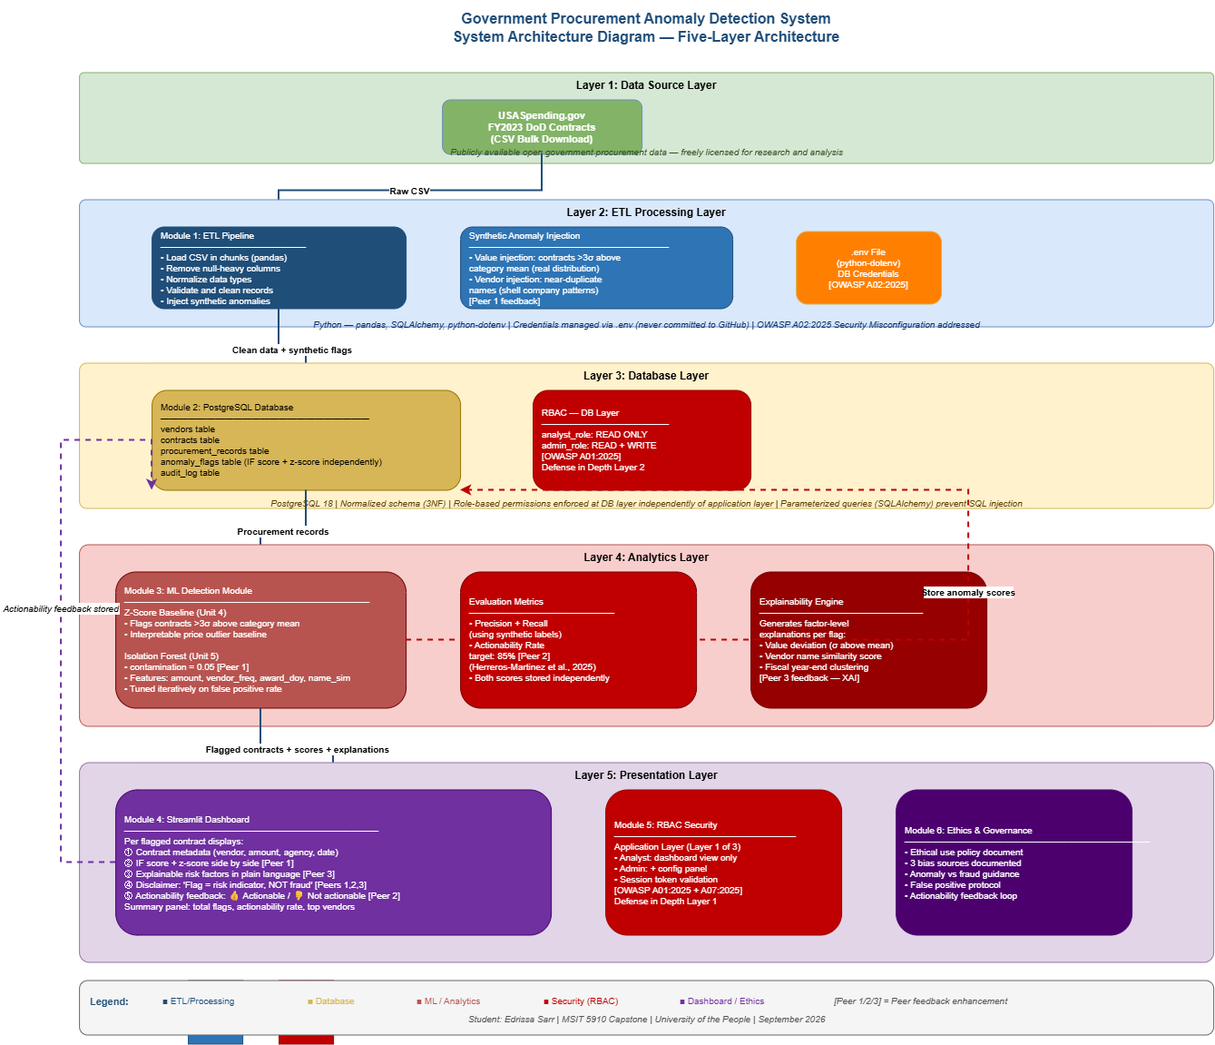
3. System Architecture & Components
5-layer architecture — separation of concerns
1
Layer 1: Data Source Layer
Open Data License — USASpending.gov public domain
USASpending.gov FY2023 DoD Contracts | 5 CSV files | 9.3 GB
2
Layer 2: ETL Processing Layer
ON CONFLICT DO NOTHING prevents duplicate loading
Python — pandas + SQLAlchemy | 10K-row chunks | 1,299 records/second
3
Layer 3: Database Layer
RBAC enforced at DB engine level — OWASP A01:2025
PostgreSQL 18 | 5 tables | 3 views | 26 indexes | 2 RBAC roles
4
Layer 4: Analytics Layer
RANDOM_STATE=42 ensures reproducibility
scikit-learn Isolation Forest (contamination=0.05) + Z-Score baseline | XAI engine
5
Layer 5: Presentation Layer
Disclaimer: anomaly ≠ fraud on every flag page
Streamlit dashboard | RBAC login | 4 pages | Auditor feedback | Actionability rate
IntegriScan | MSIT 5910 Capstone | University of the People | Edrissa Sarr

Slide 5
3. Technology Stack & Tools
Zero-cost open-source stack — fully reproducible
🗄️ PostgreSQL 18 (Database)
🐍 Python 3.13 (Language)
🤖 scikit-learn 1.9 (ML Framework)
Relational DB
5 tables, 26 indexes
2 RBAC roles
Primary development
language for all
modules
IsolationForest
StandardScaler
metrics module
📊 Streamlit 1.60 (Dashboard)
🐼 pandas 3.0.5 (ETL)
🔗 SQLAlchemy 2.0 (ORM)
Web UI framework
4 pages, RBAC login
real-time updates
Data manipulation
chunked CSV loading
transformation
DB connection
parameterized queries
URL.create() auth
🔐 python-dotenv (Security)
✅ PyTest 9.1.1 (Testing)
🐙 GitHub (Version Control)
Credentials in .env
never committed
to GitHub
66 tests across
4 testing levels
100% pass rate
2 branches + 3 tags
v1.0, v2.0, v3.0
public repository
IntegriScan | MSIT 5910 Capstone | University of the People | Edrissa Sarr

Slide 6
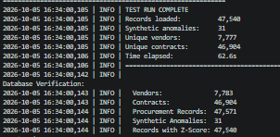
4. Results — Database & ETL Pipeline
FY2023 DoD Contracts from USASpending.gov
CSV
9.3 GB
EXTRACT
10K chunks
TRANSFORM
Clean + normalize
INJECT
Synthetic anomalies
LOAD
PostgreSQL
50,000
47,540
7,783
46,904
621
31
Rows Processed
(File 1 test run)
Records Loaded
(94% retention)
Unique
Vendors
Unique
Contracts
Price Outliers
(z > 3σ)
Synthetic
Anomalies
⚡ Performance: 62.6 seconds for 50,000 rows | 798 records/second throughput | Full dataset (~1M rows) estimated 18-20 minutes
IntegriScan | MSIT 5910 Capstone | University of the People | Edrissa Sarr

Slide 7
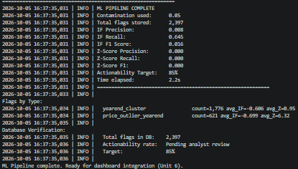
4. Results — ML Detection Module
Isolation Forest + Z-Score — dual-algorithm approach
🤖 ISOLATION FOREST
2,397
1,776
621
Training: 47,540 real records
Features: 5 (log amount, z-score, vendor frequency,
award day of year, year-end binary indicator)
Contamination: 0.05 (flags ~5% as anomalous)
Random seed: 42 (reproducible results)
Result: 2,377 flags (5.0%) in 2.2 seconds
Synthetic recall: 64.5% (20/31 detected)
Total Unique
Anomaly Flags
Year-End
Cluster Flags
Price Outlier
Year-End Flags
64.5%
6.32σ
2.2s
📊 Z-SCORE BASELINE
Threshold: 3.0 standard deviations
Grouping: NAICS industry category
Result: 621 price outliers (1.3%)
Average z-score of flagged: 6.32σ
Interpretable: auditors understand σ without ML knowledge
Isolation Forest
Recall (synthetic)
Avg Z-Score
(price outliers)
ML Pipeline
Latency
IntegriScan | MSIT 5910 Capstone | University of the People | Edrissa Sarr

Slide 8
4. Results — Streamlit Dashboard
All 12 peer feedback commitments implemented
D1: RBAC Login
D2: Overview Page
D3: Disclaimer Banner
D4: Dual Scores
analyst / admin roles
PostgreSQL + Streamlit
dual-layer enforcement
Live metrics: 95,080 contracts
2,397 flags, 15,554 vendors
Flags-by-type chart
"Anomaly ≠ fraud"
On every flagged page
Ethical design [Peers 1,2,3]
IF score + z-score
side by side per flag
[Peer 1 commitment]
D5: XAI Factors
D6: Feedback Buttons
D7: Agency Analysis
D8: Admin Settings
Plain-language explanation
per flagged contract
[Peer 3 commitment]
👍👎 per flag
Live actionability rate
85% target [Peer 2]
Spend + flag rate
by awarding agency
2 chart visualizations
Threshold configuration
Audit log display
Admin role only
IntegriScan | MSIT 5910 Capstone | University of the People | Edrissa Sarr

Slide 9
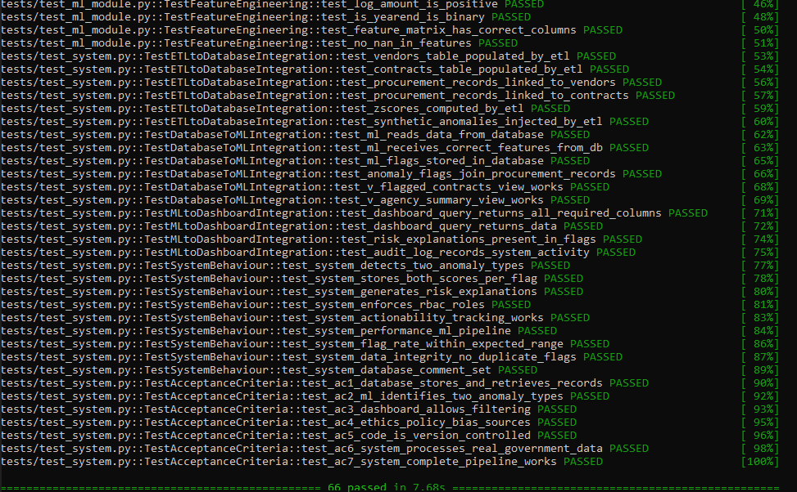
4. Results — Comprehensive Testing
66 tests across 4 levels — 100% pass rate
Unit Testing
Integration Testing
System Testing
Acceptance Testing
34 tests
16 tests
9 tests
7 tests
test_ml_module.py
test_system.py
test_system.py
test_system.py
Individual module verification
DB connectivity, ETL transform, z-score logic,
IF detection, XAI engine, DB storage, features
Cross-module communication
ETL→DB, DB→ML, ML→Dashboard
boundary verification
End-to-end system behaviour
Performance, data integrity,
RBAC, flag rate validation
Proposal success criteria
All 7 criteria verified
through executable tests
✅ GRAND TOTAL: 66 / 66 TESTS PASSED | 100% Pass Rate | 7.68 Seconds | White-box + Black-box testing
IntegriScan | MSIT 5910 Capstone | University of the People | Edrissa Sarr

Slide 10
4. Results — Performance Evaluation
Quantitative and qualitative metrics
Quantitative Metrics
Qualitative Metrics — Dashboard Usability
IF Recall (synthetic)
64.5%
>50%
✅
Anomaly vs fraud distinction clear
ETL Throughput
798 rec/s
>500 rec/s
✅
✅ Disclaimer banner on every flag page
ML Pipeline Latency
2.2 seconds
<60 seconds
✅
Scores interpretable without ML knowledge
Dashboard Load Time
<3 seconds
<3 seconds
✅
✅ IF score + z-score with severity colors
Flag Rate
5.0%
~5%
✅
Flag triggers explained in plain language
pytest Pass Rate
100% (66/66)
100%
✅
✅ Expandable XAI risk factors per contract
Data Retention
94%
>90%
✅
Feedback submission easy
Acceptance Criteria
7/7 met
7/7
✅
✅ One-click 👍👎 per flag
Role and access clearly communicated
✅ Username + role in sidebar; restricted pages
🎯 Actionability Rate: Pending analyst review | Target: 85% (Herreros-Martinez et al., 2025)
IntegriScan | MSIT 5910 Capstone | University of the People | Edrissa Sarr

Slide 11
3 & 4. Ethics, Security & Governance
Responsible AI design embedded at every layer
⚠️ Anomaly ≠ Fraud
🔐 Defense in Depth
⚖️ 7 Bias Sources
Fundamental principle embedded in:
• Dashboard disclaimer banner
• Flag type labels (anomaly, not fraud)
• Plain-language XAI explanations
• Ethics Policy Section 2
• User acknowledgement form
RBAC enforced at TWO layers:
• Streamlit application layer
• PostgreSQL database engine layer
Aligned with OWASP A01:2025
All access logged to audit_log
Ethics Policy documents:
1. Training data distribution
2. Fiscal year-end temporal
3. Vendor frequency
4. Small vendor
5. False positive concentration
6. Synthetic label evaluation
7. Human confirmation bias
📊 Actionability
🔒 Data Privacy
📋 NIST AI RMF
False positive handling:
• Thumbs down = not_actionable
• Actionability rate tracked live
• Target: 85% (Herreros-Martinez)
• Declining rate triggers review
• No action before human review
GDPR data minimization:
17 of 225 columns selected
Vendor names protected
No external disclosure of flags
Credentials in .env (not GitHub)
90-day rotation in production
Aligned with AI RMF 1.0:
• Fairness: NAICS z-score grouping
• Transparency: XAI explanations
• Reliability: 66 tests verified
• Accountability: full audit_log
Quarterly review schedule planned
IntegriScan | MSIT 5910 Capstone | University of the People | Edrissa Sarr

Slide 12
5. Course & Program Alignment
IntegriScan integrates all 9 MSIT program courses
MSIT 5210 — Databases
MSIT 5226 — Foundations of ML
MSIT 5214 — Algorithms
5-table normalized schema
26 indexes, 3 views, RBAC
Isolation Forest + z-score
contamination tuning
Z-score computation
chunked ETL complexity
MSIT 5260 — Foundations of HCI
MSIT 5270 — Cybersecurity
BUS 5115 — Law & Ethics
Non-technical dashboard
XAI plain language factors
OWASP A01/A02/A09:2025
dual-layer RBAC + audit log
Ethics Policy v1.0
7 bias sources + NIST RMF
BUS 5611 — Managing Projects
MSIT 5216 — Programming Lang
MSIT 5250 — Software Engineering
PM Log + Risk Register
8-week milestone tracking
Python 3.13 + SQL
All 6 code modules
66-test suite
5-layer architecture + SCM
IntegriScan | MSIT 5910 Capstone | University of the People | Edrissa Sarr

Slide 13
5. Conclusion & Contributions
What IntegriScan achieved and why it matters
✅ WHAT WAS ACHIEVED
🌍 WHY IT MATTERS
Complete 5-module system built at zero cost:
• 47,540 real contracts processed and analyzed
• 2,397 anomaly flags with dual scores + XAI
• Streamlit dashboard — all 12 peer commitments
• 66/66 tests — 100% pass rate
• All 7 proposal success criteria verified
• Ethics Policy + Data Dictionary + PM Log
Addresses a real governance accountability gap:
• Zero-cost deployment — any government agency
• Reproducible with public open data
• Non-technical auditor interface
• Explainable AI — not a black box
• Human-in-the-loop design throughout
• Post-Capstone commercial roadmap planned
🔬 4 CONTRIBUTIONS TO FIELD
📚 5 LESSONS LEARNED
1. Open-source govt procurement anomaly detection
using real USASpending.gov data
2. Live actionability feedback as evaluation metric
3. XAI risk factors embedded in auditor dashboard
4. Complete academic + technical documentation
package for institutional replication
1. Peer review generates concrete improvements
2. Auditor actionability > precision/recall
3. Anomaly ≠ fraud must be in the code itself
4. Configuration management = reproducibility
5. Dataset choice shapes all design decisions
IntegriScan | MSIT 5910 Capstone | University of the People | Edrissa Sarr

Slide 14
5. Future Work — Post-Capstone Roadmap
IntegriScan Technologies Ltd. — 5-phase development plan
Phase 2
Phase 3
Phase 4
Phase 5
Security
Hardening
Infrastructure
& Deployment
ML
Enhancement
Product
Expansion
MFA — TOTP, SSO, YubiKey
Cloud deployment — AWS/Azure
Supervised layer from feedback
Mobile + WhatsApp alerts
Server-side session revocation
Docker containerization
Quarterly model review
GamLink super-app (Gambia)
Managed secrets store (AWS)
Automated scheduled ETL
Bias analysis by category
SaaS for African govts
Second-person config approval
Daily database backup
Multi-dataset support
ECOWAS market entry
Months 1-3
Months 4-9
Months 10-15
Months 16-24
5 Research Questions identified for academic follow-up | 15 roadmap items documented in IntegriScan_Future_Work_Product_Roadmap_v3.docx
IntegriScan | MSIT 5910 Capstone | University of the People | Edrissa Sarr

Slide 15
References
APA 7th Edition
Bai, J., & Qiu, T. (2023). Automatic procurement fraud detection with machine learning. arXiv. https://arxiv.org/abs/2304.10105
Bennett, L. (2024, August 13). Software configuration management. Guru99. https://www.guru99.com/software-configuration-management-tutorial.html
Herreros-Martinez, A., et al. (2025). Applied ML to anomaly detection in enterprise purchase processes. Information, 16(3), 177. https://doi.org/10.3390/info16030177
Letaw, L. (2024). Handbook of software engineering methods. Oregon State University. https://open.oregonstate.education/setextbook/
National Institute of Standards and Technology. (2023). AI Risk Management Framework (AI RMF 1.0) (NIST AI 100-1). https://doi.org/10.6028/NIST.AI.100-1
OECD. (2025). Integrity in public procurement. https://www.oecd.org/en/topics/sub-issues/integrity-in-public-procurement.html
OWASP Foundation. (2026). OWASP Top 10:2025. https://owasp.org/Top10/2025/
Summers, B. L. (2020). Effective methods for software engineering. Auerbach Publishers.
USASpending.gov. (2026). FY2023 DoD contracts bulk download. https://www.usaspending.gov/
Thank you | github.com/sarredrissa-dev/procurement-anomaly-detection | "Follow the money. Flag the risk."
IntegriScan | MSIT 5910 Capstone | University of the People | Edrissa Sarr

