Slide 1

Split Sensor Communications Network to Monitor Microclimates
The Solution to Understanding and Mitigating Climate Change
New York Department of Environmental Conservation
Sarah Scheps, Irving Becerril, Quotayba Yousif, Katy Cable, and Ahmed Fadlalla
Date: 04/24/2024

Slide 2
Agenda
Problem Statement
System Requirements
Physical Diagrams
Logical Diagrams
Wireframe Model
Live Demonstration
Discussion
Conclusion
Credits
Questions
Extra Slides

Slide 3
Problem Statement
The NYDEC needs to be able to monitor climate change in microclimates to take preventative measures to avoid adverse effects.

Slide 4
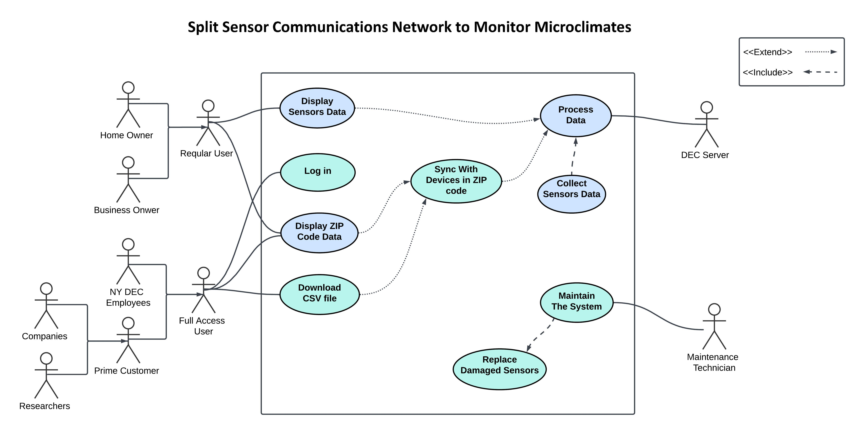
Key System Requirements
Use Case Diagram:

Slide 5
Key System Requirements
Functional:
Data Acquisition
Accuracy
Communication
User Interactive Monitor
Non-Functional:
Cost Efficiency
Usability
Upgradability
Reliability
Maintainability

Slide 6
Key System Requirements
Design Constraints
Budget: $150
Time: 9 weeks

Slide 7
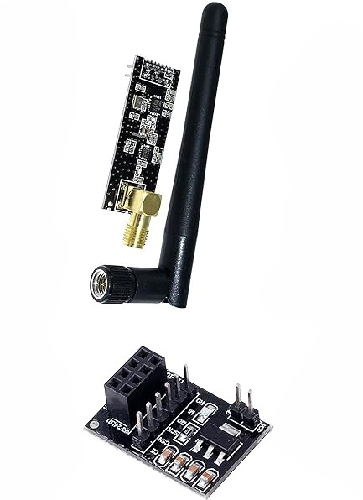
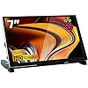
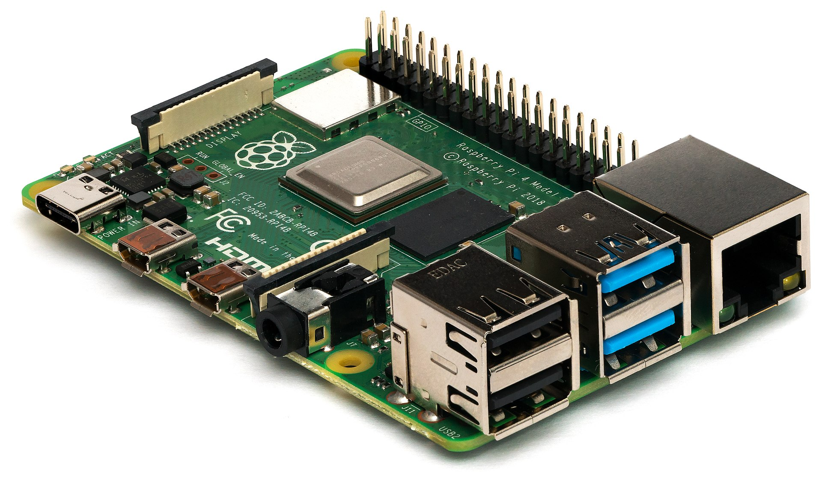
Physical Design
System Components: 7 Inch IPS LCD Touch Screen, RasPi 4B, nRF24L01, Raspbian OS, Python, Qt.
LCD
Ras Pi 4B
nRF24L01

Slide 8
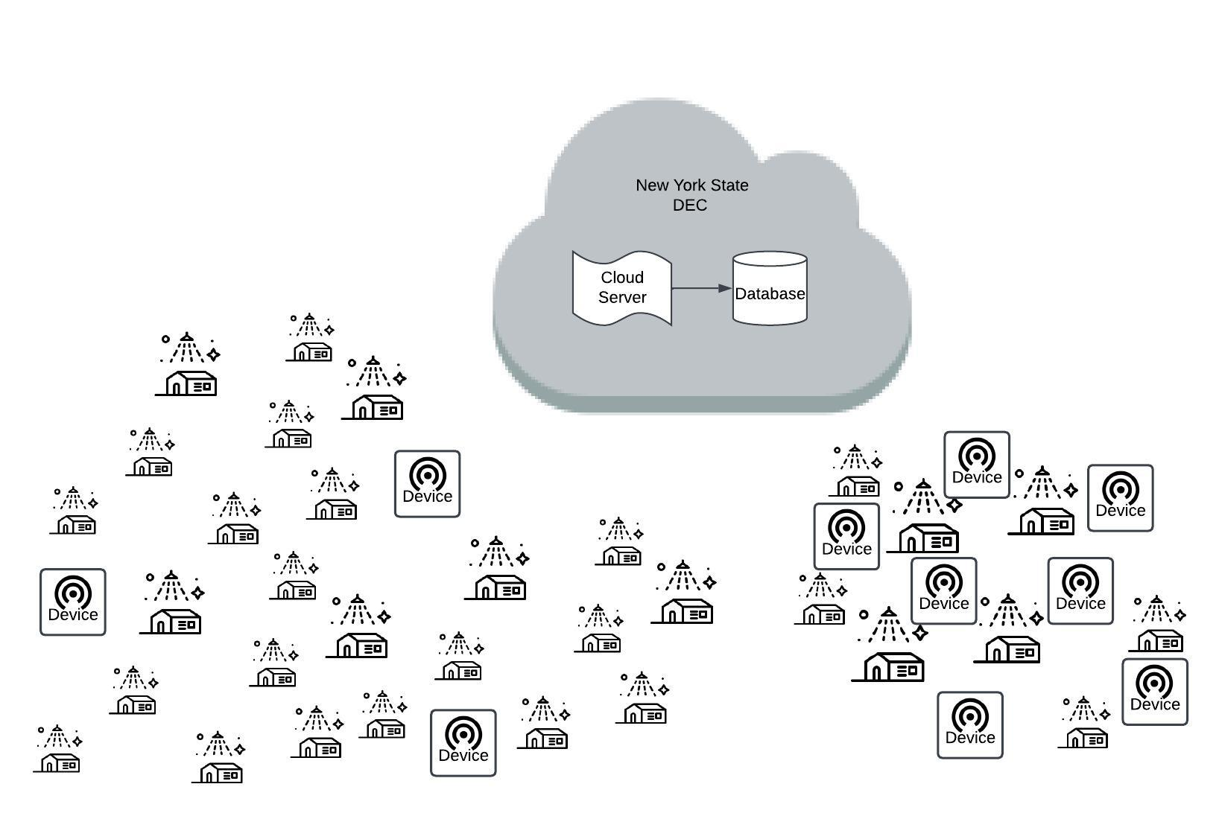
Physical Design
Alternatives: First question before the physical design alternative ...
Distributed by DEC vs Purchased by business/homeowners.

Slide 9
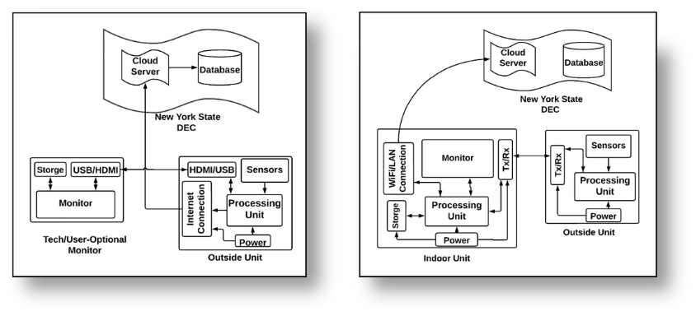
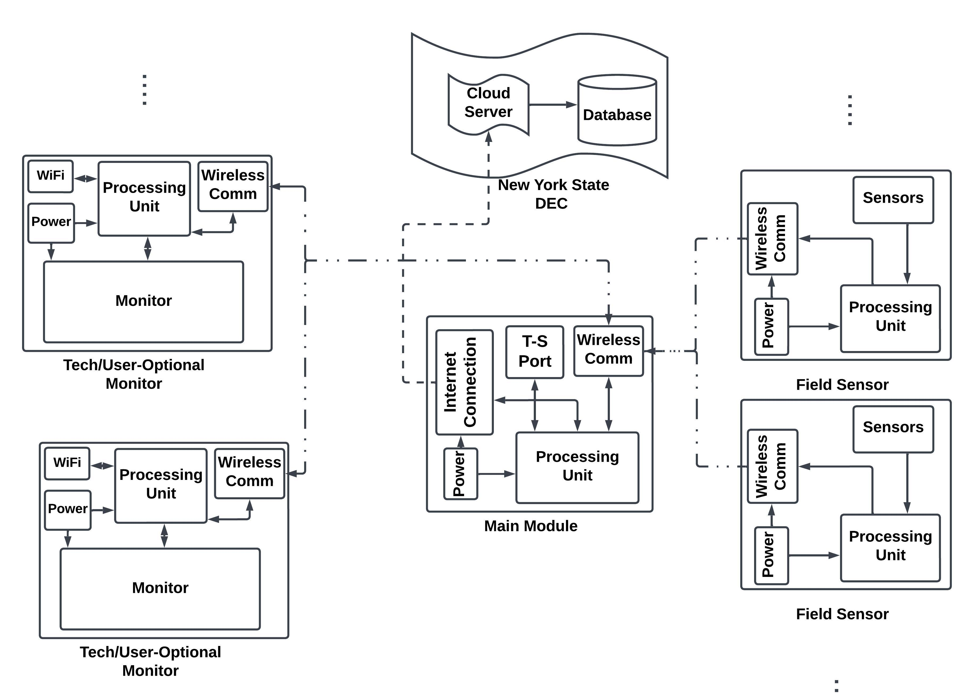

Slide 10
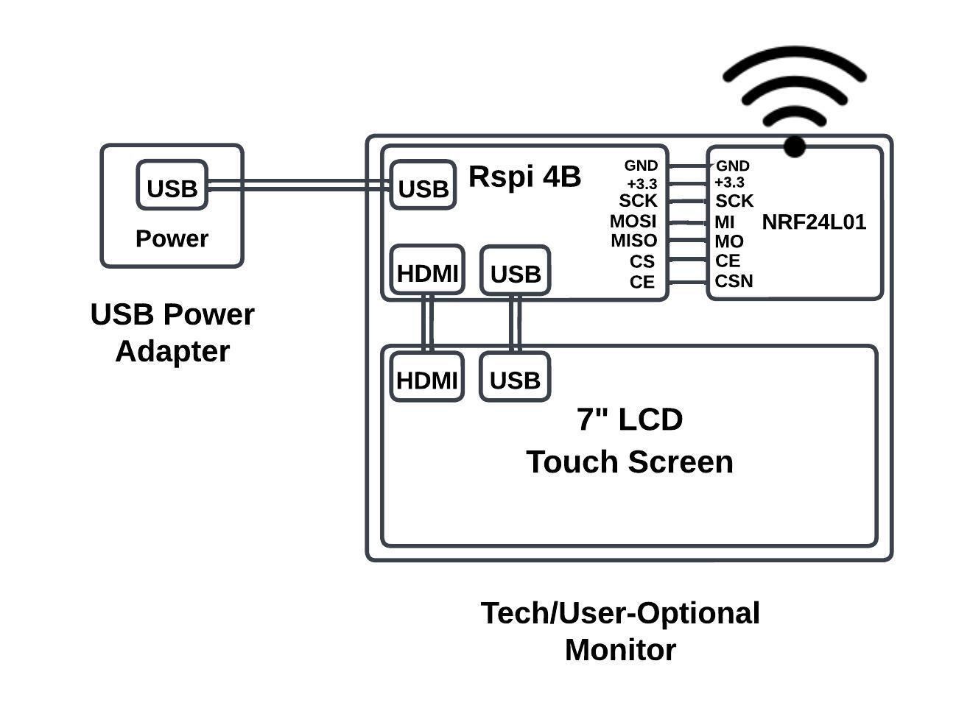
Physical Design
User Interface:
Raspbian Linux (OS)
Python (Portability)
PyQt6 (GUI)

Slide 11
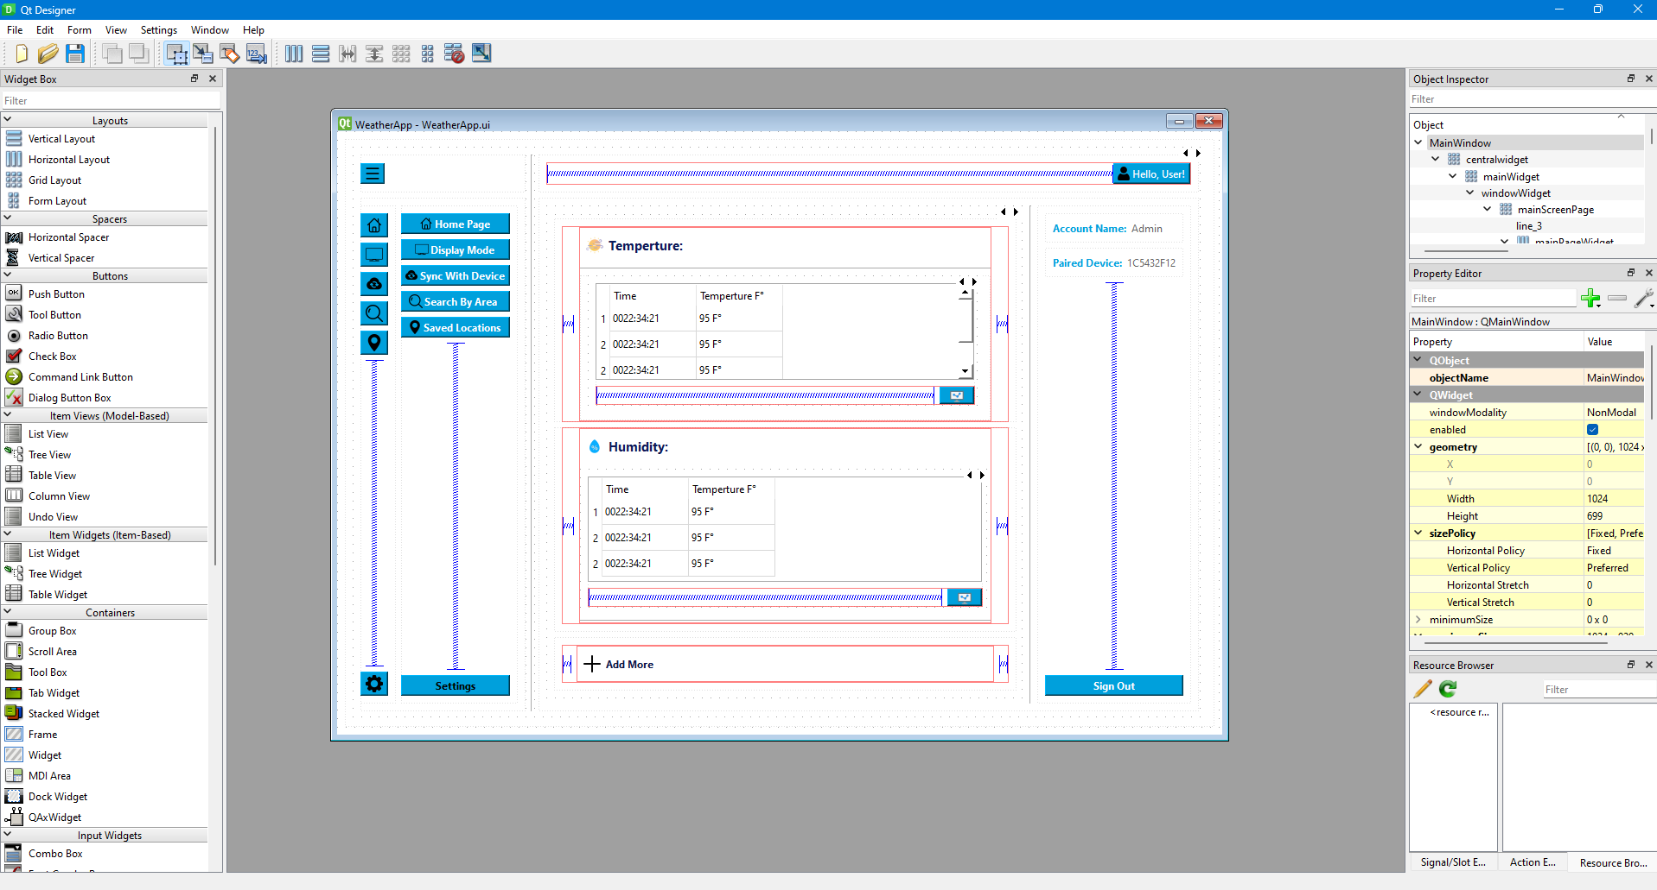
Physical Design

Slide 12
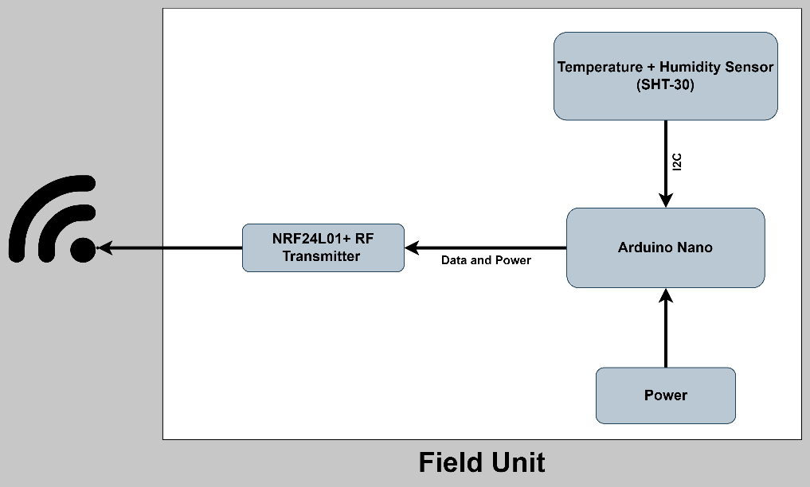
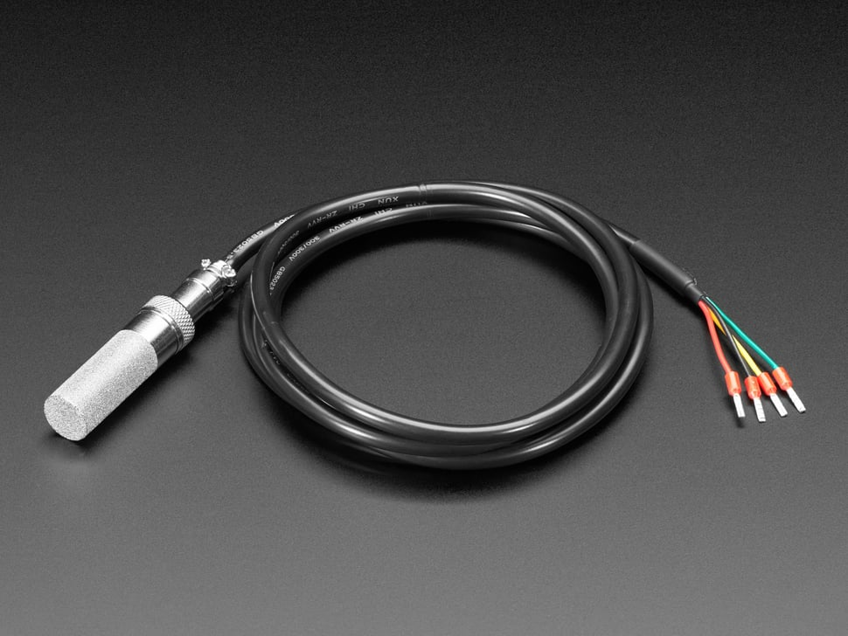
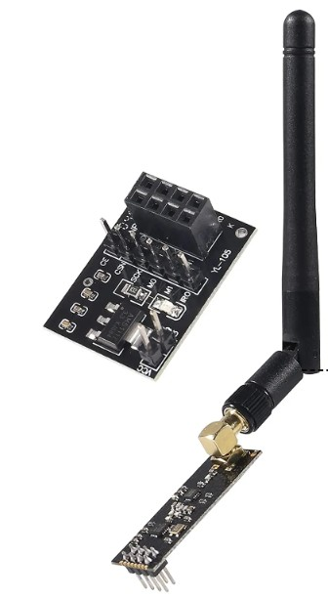
Physical Design
Field Unit:
Obtains data using SHT-30 sensor
Transmit data using RF transceiver

Slide 13
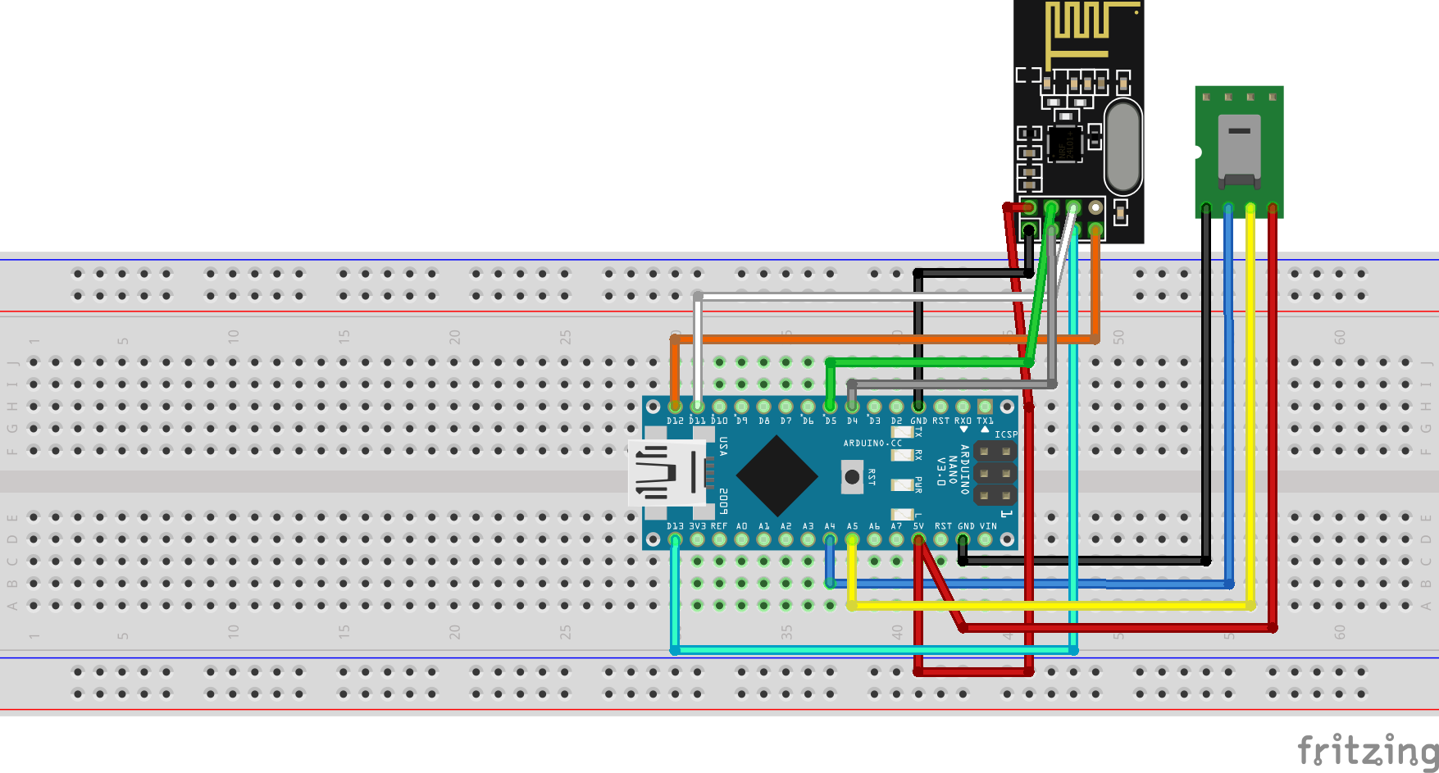
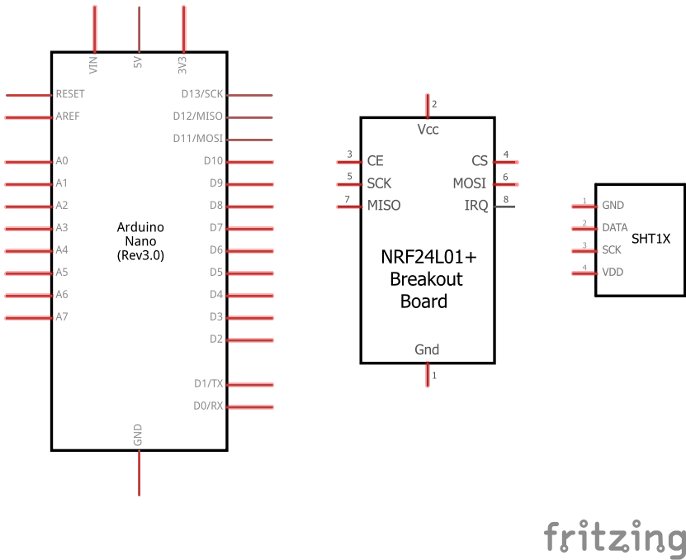
Physical Design
Read temperature and humidity sensors
Store values in data array
Send data package to receiver using device IP
Turn heater on when not transmitting data
Circuit Design and Programming Logic for Sensor Transmission

Slide 14
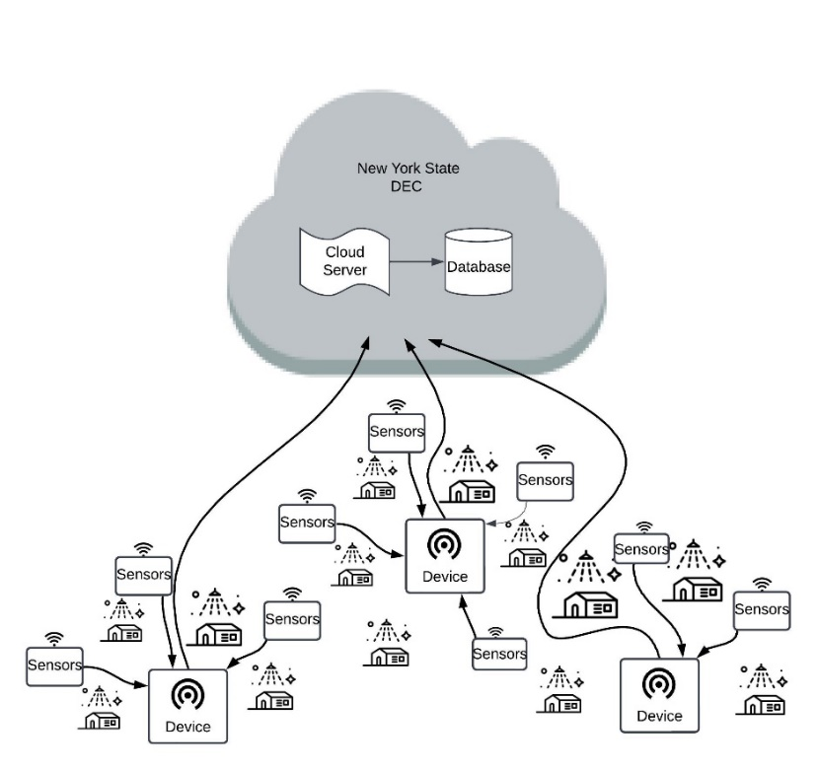
Logical Design:
Components:
Main Module
Sensors
User Interface
NYDEC Server and Database

Slide 15
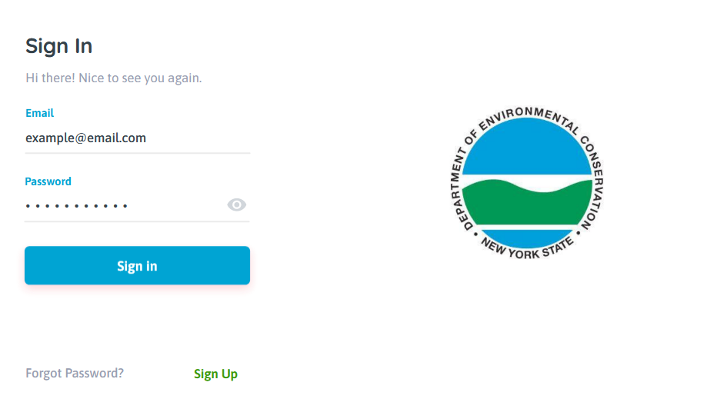
Wireframe Model

Slide 16
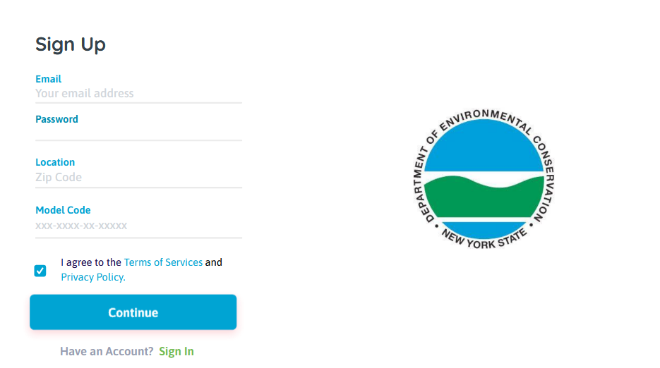
Wireframe Model

Slide 17
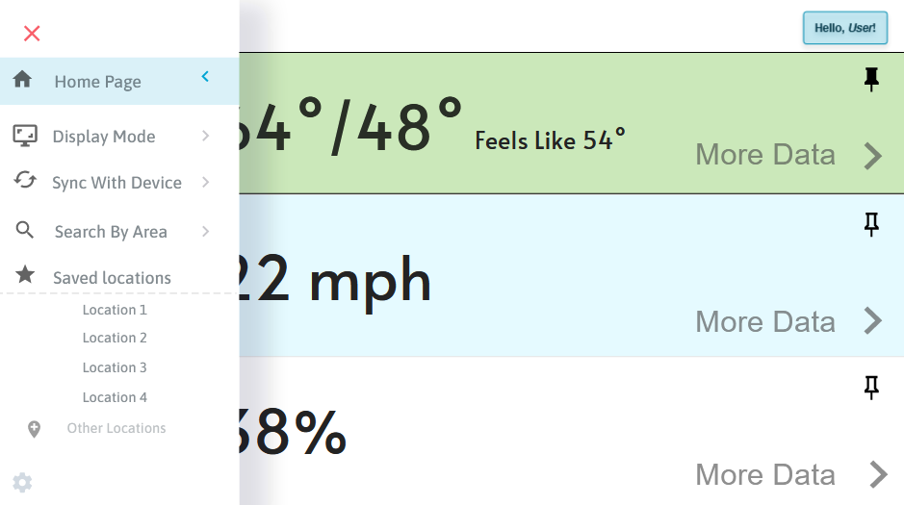
Wireframe Model

Slide 18
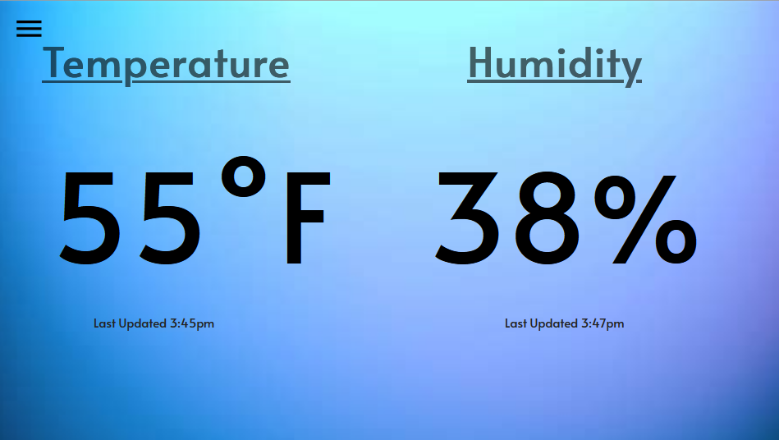
Wireframe Model

Slide 19
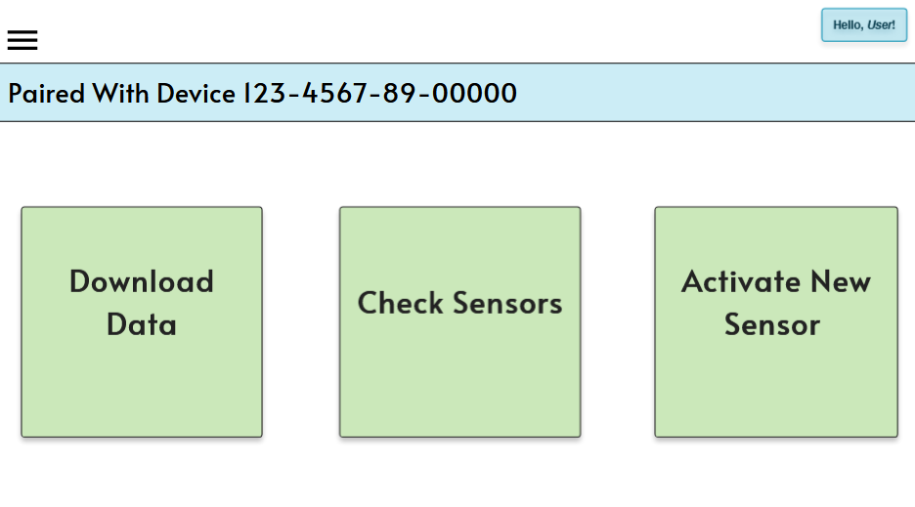
Wireframe Model

Slide 20
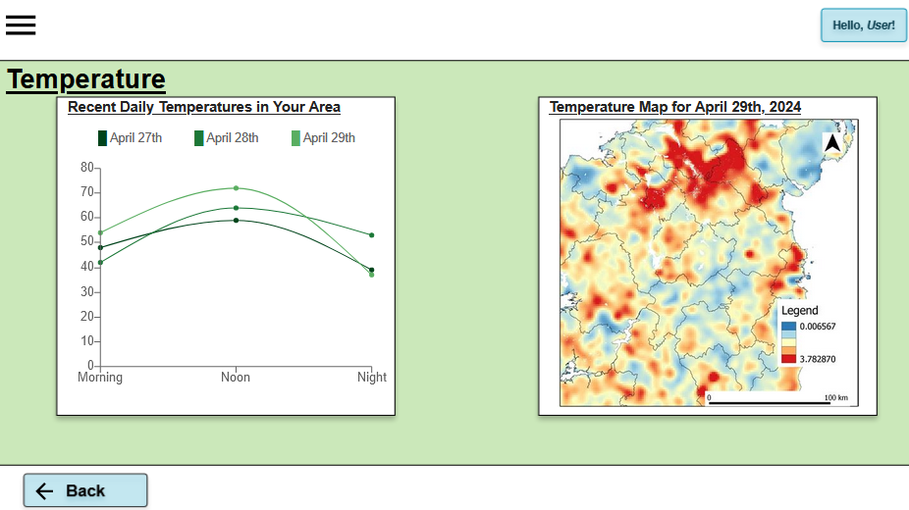
Wireframe Model

Slide 21
System Demonstration
We will now show you a live demo

Slide 22
Conclusions
Why we matter?
Using RF technology combined with an inexpensive processing unit to deliver your weather data to your home or business.
Remotely accessible to DEC researchers and anyone with an internet connection from a mobile device or computer.
Collecting weather data based on locations that DEC researchers need to mitigate the impact of climate change.
System Specs | Speed | Cost | Performance | Range
Arduino Nano | 16Mhz | $24.90 | 19mA | 32KB
SHT-30 Sensors | 2.5ms 12.5ms | $24.95 | 5C 60C 20-80RH | -40C 125C
NRF24L01 | 2.4Ghz | $7.35 | 250kbps 2Mbps | 50FT 200FT
Raspberry Pi | 1.8Ghz | $58.99 | 64-bit quad core | 4GB
Touch Screen | 60Hz | $56.99 | IPS | 1024x600

Slide 23
Recommendations for Future Work
Broader Communication System
Expansive Sensors Network

Slide 24
Individual Contributions
Sarah Scheps
Support Roles: UI
Most Significant Contributions: Documentation and UI Conceptualization
Ahmed Fadlalla
Support Roles: Sensors, Communications
Most Significant Contributions: Device Communication
Katy Cable
Support Roles: Sensors
Most Significant Contributions: Sensor Implementation

Slide 25
Individual Contributions
Irving Becerril
Support Roles: UI
Most Significant Contributions: UI Implementation and Navigation
Quotayba Yousif
Support Roles: UI, Communcation,
Most Significant Contributions: UI, Communication, System Design and Implementation.

Slide 26
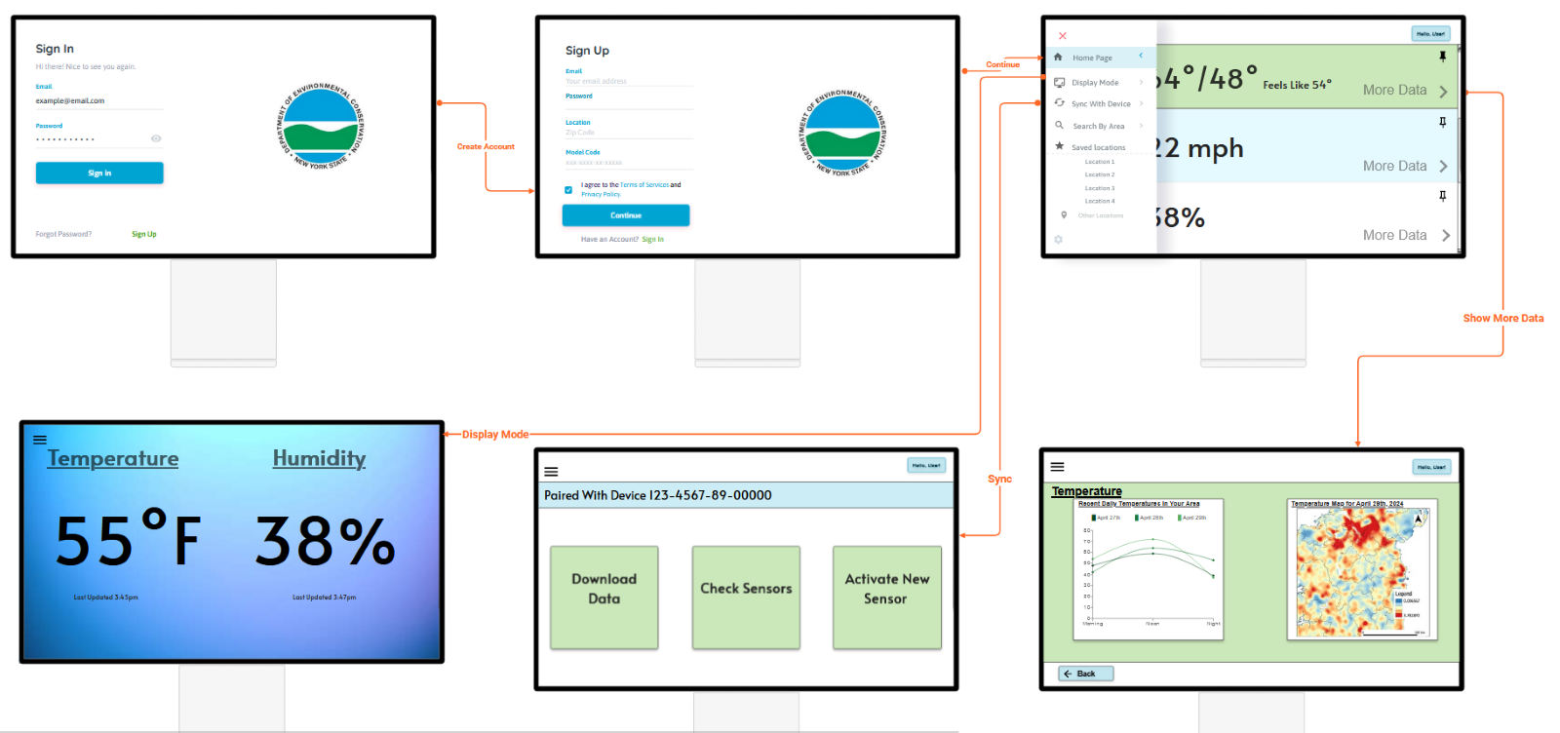
Questions
It’s considered good practice to put your best visualization(s) as your final slide. This way you have an excellent visual(s) up on the screen during the Q&A portion.

Slide 27
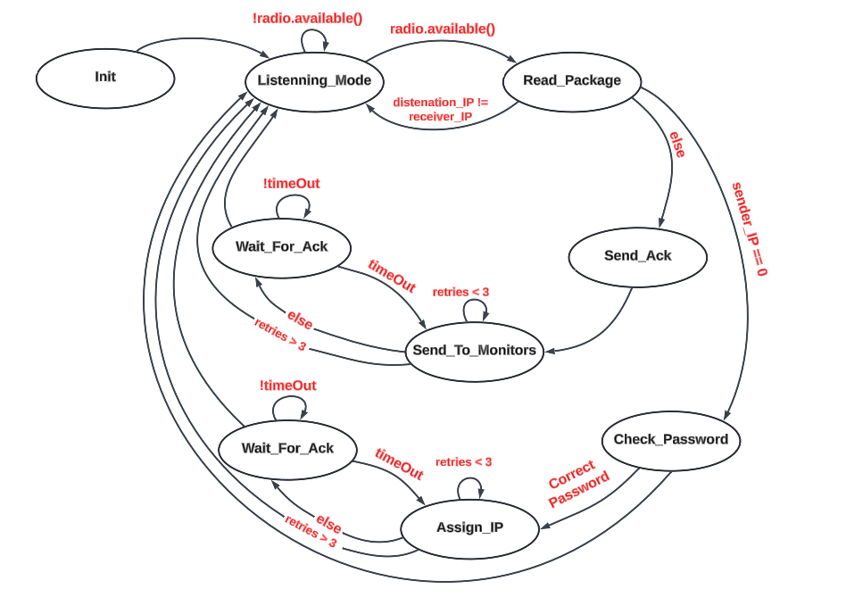
Extra Slides

Slide 28
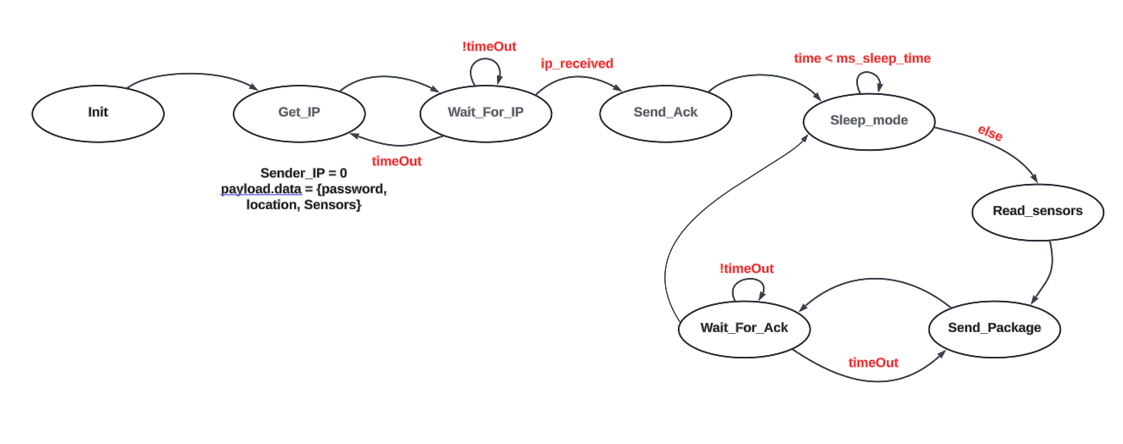
Extra Slides

Slide 29
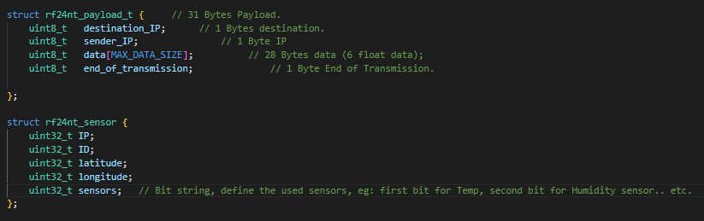
Extra Slides

