Slide 1


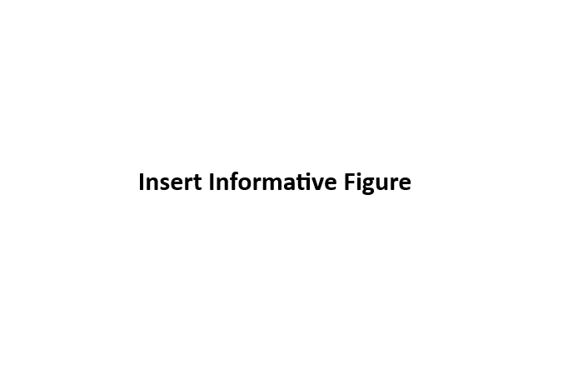
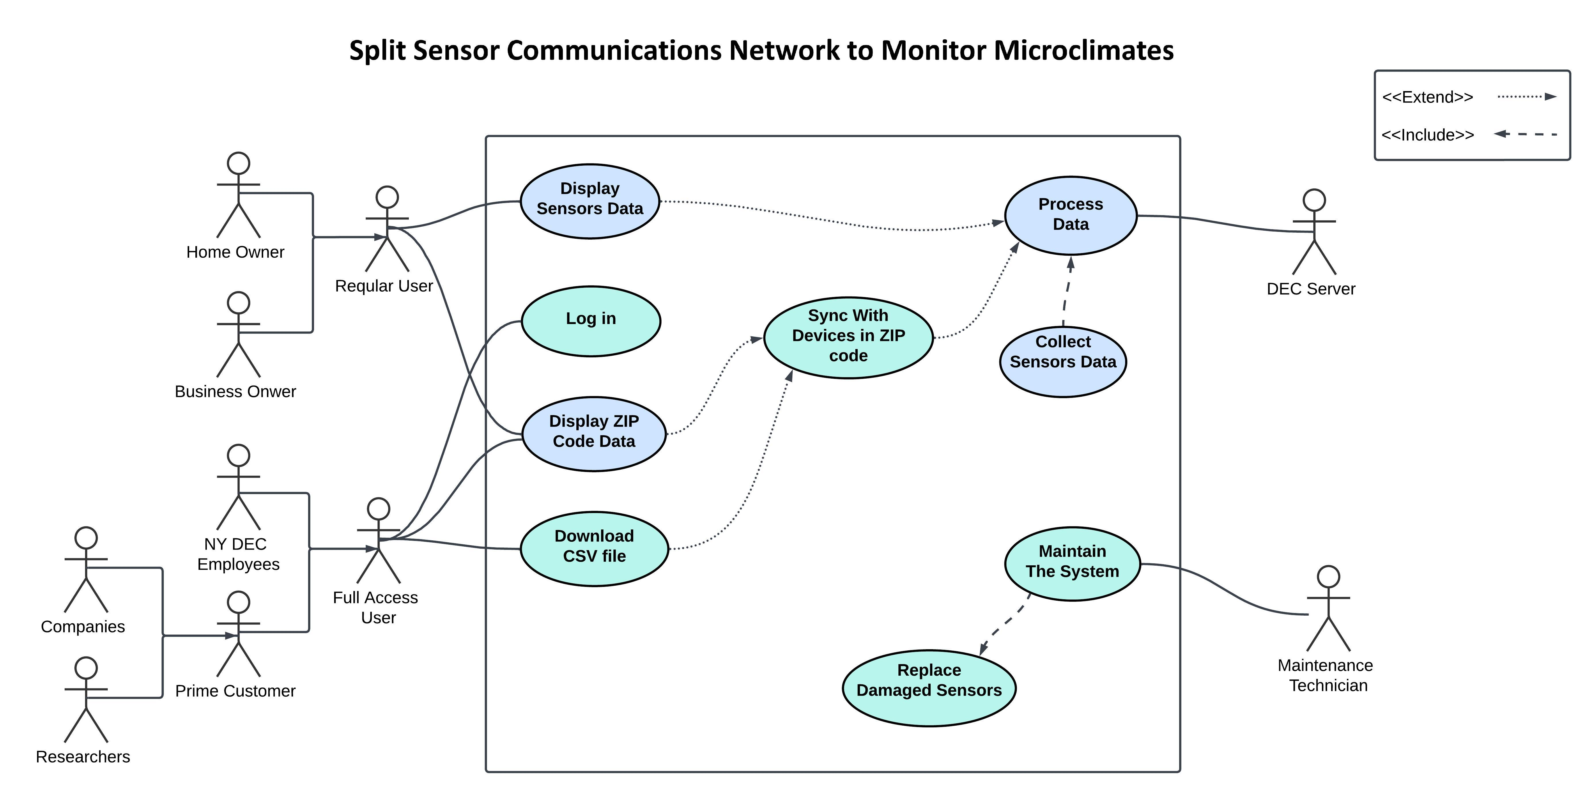
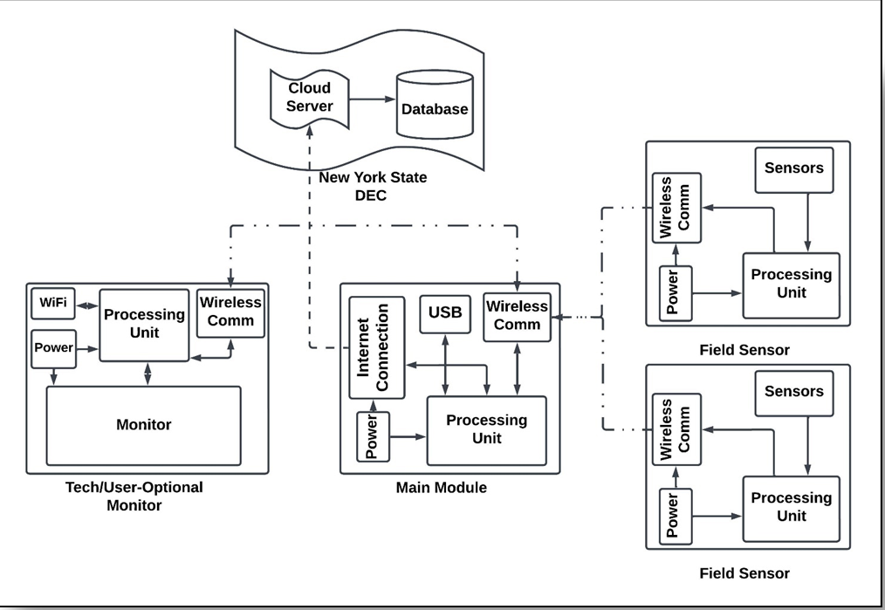
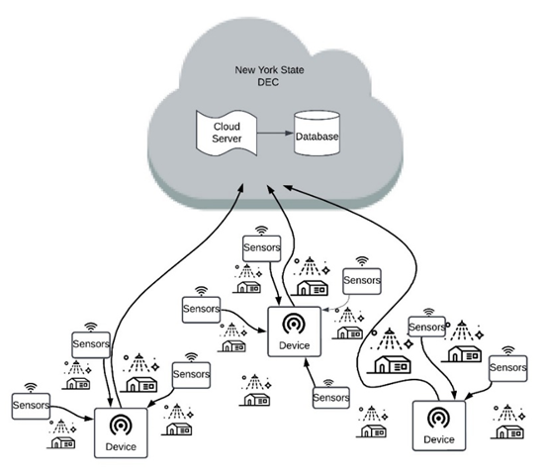
Split Sensor Communications Network to Monitor Microclimates
Quotayba Yousif, Irving Bercerril, Sarah Scheps, Katy Cable, Ahmed Fadlalla Department of Electrical & Computer Engineering, University at Albany
Problem Statement
System Design
System Design
The New York State Department of Environmental Conservation needs a better understanding of the impact of climate change on microclimates within New York State so that they can mitigate adverse effects and take appropriate preventative measures.
Key System Features
To satisfy system requirements, we incorporated the following design specifications:
Item #1: Wireless Communication
Item #2: Remote Data Access
Item #3: Modular Sensors
Item #4: Cloud Storage
Item #5: Graphical User Interface
System Requirements
Data Acquisition: The system must be capable of collecting and processing climate conditions through sensors, enabling users to view and download the data in CSV format.
Accuracy: Testing sensor must adhere to a well-defined and acceptable maximum value of uncertainty (±5%) when compared to other weather data.
Communication: The data acquired must be transmitted to a central unit and to a display via wireless transmission in the form of a comma-separated values file. Transmissions should occur approximately every 10 minutes.
Storage: The system should be able to store and processes data in between transmissions.
Usability: The product should be able to be used by regular consumers without technological experience.
Maintainability: Product should give clear trouble shooting messages and effectively indicate which part of the system is affected. Damaged parts must be easily replaced without the need to replace the whole device.
Reliability: Product must be able to function reliably in various weather conditions and temperatures for long periods of time.
Use Case Diagram: Showing the interaction between the user and the system, in addition to the background actions.
System Design: Showing different module of the system, and the data flow inside and between the different modules.
Bill of Materials
Part | Purpose | Cost
Raspberry Pi | Microprocessor | $58.99
7'' Touch Screen | Display | $56.99
NRF24L01+ | Communication | $12.29
Arduino Nano | Microcontroller | $24.90
Temperature + Humidity Sensor | Data Acquisition | $24.95
Breadboard | Prototyping | $3.50
Assorted Wires | Prototyping | $12.25
TOTAL | TOTAL | $193.87
Network Data flow Diagram: Showing an example on how the sensors and the devices will be distributed

