Slide 1
類神經網路架構實現
2016/04/17 Kabi

Slide 2
計算輸出

Slide 3
網路架構
1
4
2
6
5
3

Slide 4
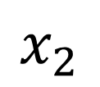
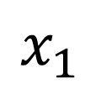
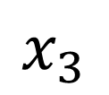
給予輸入(輸入層)
$$x_{1}$$
1
4
$$x_{2}$$
2
6
5
$$x_{3}$$
3

Slide 5






給予權重(輸入層-隱藏層)
$$x_{1}$$
1
$$w_{14}$$
$$w_{15}$$
4
$$w_{24}$$
$$x_{2}$$
2
6
$$w_{25}$$
5
$$w_{34}$$
$$w_{35}$$
$$x_{3}$$
3

Slide 6



計算各節點輸入(隱藏層)
1
$$x_{1}w_{14}+x_{2}w_{24}+{x_{3}w}_{34}$$
$$x_{1}$$
$$w_{14}$$
$$w_{15}$$
4
∑
$$w_{24}$$
$$x_{2}$$
2
6
$$w_{25}$$
5
$$w_{34}$$
∑
$$x_{3}$$
3
$$w_{35}$$
$$x_{1}w_{15}+x_{2}w_{25}+{x_{3}w}_{35}$$

Slide 7
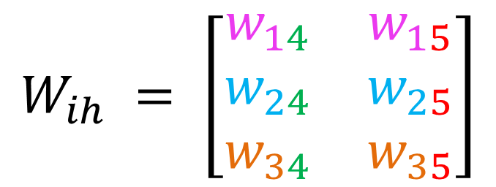
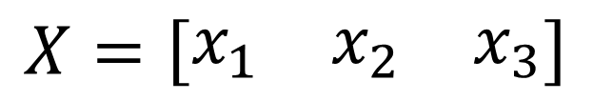
以矩陣呈現
$$X=\left[\begin{matrix}x_{1} & x_{2} & x_{3}\end{matrix}\right]$$
$$W_{ih} = \left[\begin{matrix}w_{14} & w_{15} \\ w_{24} & w_{25} \\ w_{34} & w_{35}\end{matrix}\right]$$
$$I_{h}=XW_{ih}=\left[\begin{matrix}x_{1}w_{14}+x_{2}w_{24}+{x_{3}w}_{34} & x_{1}w_{15}+x_{2}w_{25}+{x_{3}w}_{35}\end{matrix}\right]$$

Slide 8

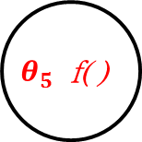
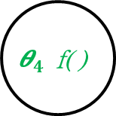

給予閥值(隱藏層)、激活函數
1
$${I_{4}=x}_{1}w_{14}+x_{2}w_{24}+{x_{3}w}_{34}$$
$$x_{1}$$
$$w_{14}$$
$$w_{15}$$
$${\text{θ}}_{4} \text{f}\text{( ) }$$
∑
$$w_{24}$$
$$x_{2}$$
2
6
$$w_{25}$$
$$θ_{5} \text{f}\text{( ) }$$
$$w_{34}$$
∑
$$x_{3}$$
3
$$w_{35}$$
$$I_{5}=x_{1}w_{15}+x_{2}w_{25}+{x_{3}w}_{35}$$

Slide 9

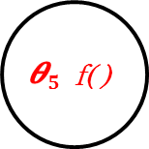

計算各節點輸出(隱藏層)
1
$$O_{4}=f(I_{4}+{\text{θ}}_{4})$$
$$x_{1}$$
$$w_{14}$$
$$w_{15}$$
$${\text{θ}}_{4} \text{f}\text{( ) }$$
∑
$$w_{24}$$
$$x_{2}$$
2
6
$$w_{25}$$
$${\text{θ}}_{5} \text{f}\text{( ) }$$
$$w_{34}$$
∑
$$x_{3}$$
3
$$w_{35}$$
$$O_{5}=f(I_{5}+{\text{θ}}_{5}\text{)}$$

Slide 10
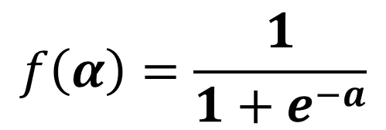
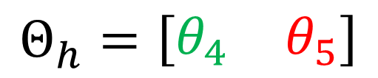
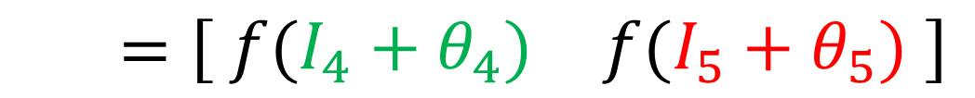
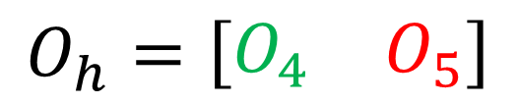
以矩陣呈現
$$f\left(α\right)=\frac{1}{1+e^{−a}}$$
$$Θ_{h}=\left[\begin{matrix}θ_{4} & θ_{5}\end{matrix}\right]$$
$$O_{h}=\left[\begin{matrix}O_{4} & O_{5}\end{matrix}\right]$$
$$=\left[\begin{matrix} f(I_{4}+θ_{4}) & f(I_{5}+θ_{5})\end{matrix} \right]$$

Slide 11


給予權重(隱藏層-輸出層)
1
$$O_{4}=f(I_{4}+{\text{θ}}_{4})$$
$$x_{1}$$
$$w_{14}$$
$$w_{15}$$
$${\text{θ}}_{4} \text{f}\text{( ) }$$
∑
$$w_{46}$$
$$w_{24}$$
$$x_{2}$$
2
6
$$w_{25}$$
$${\text{θ}}_{5} \text{f}\text{( ) }$$
$$w_{56}$$
$$w_{34}$$
∑
$$x_{3}$$
3
$$w_{35}$$
$$O_{5}=f(I_{5}+{\text{θ}}_{5}\text{)}$$

Slide 12

計算各節點輸入(輸出層)
1
$$O_{4}=f(I_{4}+{\text{θ}}_{4})$$
$$x_{1}$$
$$w_{14}$$
$${\text{θ}}_{4} \text{f}\text{( ) }$$
$O_{4}w_{46}$+$O_{5}w_{56}$
$$w_{15}$$
∑
$$w_{46}$$
$$w_{24}$$
$$x_{2}$$
2
6
$$w_{25}$$
$${\text{θ}}_{5} \text{f}\text{( ) }$$
$$w_{56}$$
$$w_{34}$$
∑
$$x_{3}$$
3
$$w_{35}$$
$$O_{5}=f(I_{5}+{\text{θ}}_{5}\text{)}$$

Slide 13
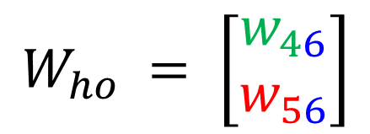


以矩陣呈現
$$O_{h}=\left[\begin{matrix}O_{4} & O_{5}\end{matrix}\right]$$
$$W_{ho} = \left[\begin{matrix}w_{46} \\ w_{56}\end{matrix}\right]$$
$$I_{o}=XW_{ho}=\left[O_{4}w_{46}\text{+}O_{5}w_{56} \right]$$

Slide 14

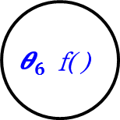
給予閥值(隱藏層)、激活函數
1
$$O_{4}=f(I_{4}+{\text{θ}}_{4})$$
$$x_{1}$$
$$w_{14}$$
$${\text{θ}}_{4} \text{f}\text{( ) }$$
${I_{6}= O}_{4}w_{46}$+$O_{5}w_{56}$
$$w_{15}$$
∑
$$w_{46}$$
$$w_{24}$$
$$x_{2}$$
2
$${\text{θ}}_{6} \text{f}\text{( ) }$$
$$w_{25}$$
$${\text{θ}}_{5} \text{f}\text{( ) }$$
$$w_{56}$$
$$w_{34}$$
∑
$$x_{3}$$
3
$$w_{35}$$
$$O_{5}=f(I_{5}+{\text{θ}}_{5}\text{)}$$

Slide 15

計算各節點輸出(輸出層)
1
$$O_{4}=f(I_{4}+{\text{θ}}_{4})$$
$$x_{1}$$
$$w_{14}$$
$${\text{θ}}_{4} \text{f}\text{( ) }$$
$$O_{6}=f(I_{6}+{\text{θ}}_{6})$$
$$w_{15}$$
∑
$$w_{46}$$
$$w_{24}$$
$$x_{2}$$
2
$${\text{θ}}_{6} \text{f}\text{( ) }$$
$$w_{25}$$
$${\text{θ}}_{5} \text{f}\text{( ) }$$
$$w_{56}$$
$$w_{34}$$
∑
$$x_{3}$$
3
$$w_{35}$$
$$O_{5}=f(I_{5}+{\text{θ}}_{5}\text{)}$$

Slide 16
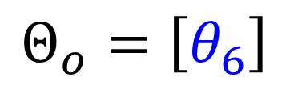
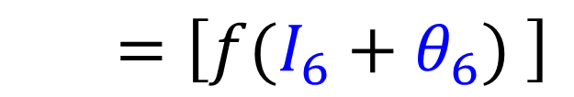
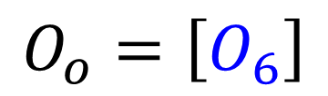
以矩陣呈現
$$f\left(α\right)=\frac{1}{1+e^{−a}}$$
$$Θ_{o}=\left[θ_{6}\right]$$
$$O_{o}=\left[O_{6}\right]$$
$$=\left[f(I_{6}+θ_{6}) \right]$$

Slide 17
倒傳遞

Slide 18
給予輸入(目標值)
1
$$O_{4}=f(I_{4}+{\text{θ}}_{4})$$
T
$$x_{1}$$
$$w_{14}$$
$${\text{θ}}_{4} \text{f}\text{( ) }$$
$$O_{6}=f(I_{6}+{\text{θ}}_{6})$$
$$w_{15}$$
∑
$$w_{46}$$
$$w_{24}$$
$$x_{2}$$
2
$${\text{θ}}_{6} \text{f}\text{( ) }$$
$$w_{25}$$
$${\text{θ}}_{5} \text{f}\text{( ) }$$
$$w_{56}$$
$$w_{34}$$
∑
$$x_{3}$$
3
$$w_{35}$$
$$O_{5}=f(I_{5}+{\text{θ}}_{5}\text{)}$$

Slide 19

計算誤差(整個網路)
1
$$O_{4}=f(I_{4}+{\text{θ}}_{4})$$
T
$$x_{1}$$
$$w_{14}$$
$${\text{θ}}_{4} \text{f}\text{( ) }$$
$$O_{6}=f(I_{6}+{\text{θ}}_{6})$$
$$w_{15}$$
∑
-1
$$w_{46}$$
$$w_{24}$$
$$x_{2}$$
2
$${\text{θ}}_{6} \text{f}\text{( ) }$$
∑
$$w_{25}$$
$$w_{6}=1$$
$${\text{θ}}_{5} \text{f}\text{( ) }$$
$$w_{56}$$
$$w_{34}$$
∑
$$x_{3}$$
3
$$w_{35}$$
$$O_{5}=f(I_{5}+{\text{θ}}_{5}\text{)}$$

Slide 20
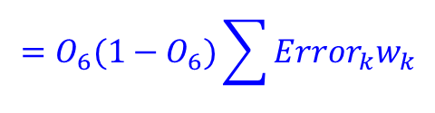

計算誤差項(輸出層)
$$x_{1}$$
1
T
$$w_{14}$$
$$w_{15}$$
$${\text{θ}}_{4} \text{f}\text{( ) }$$
∑
-1
$$w_{46}$$
$$w_{24}$$
$$x_{2}$$
2
$${\text{θ}}_{6} \text{f}\text{( ) }$$
∑
$$w_{25}$$
$$w_{6}=1$$
$${\text{θ}}_{5} \text{f}\text{( ) }$$
$$w_{56}$$
$$w_{34}$$
$$δ_{6}=O_{6}(1−O_{6})(O_{6}−T)$$
∑
$$=O_{6}(1−O_{6})\sum{{Error}_{k}w_{k}}$$
$$x_{3}$$
3
$$w_{35}$$

Slide 21
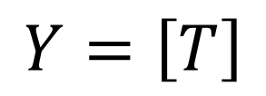
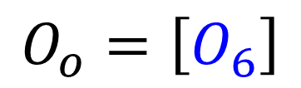
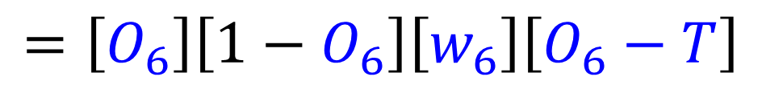
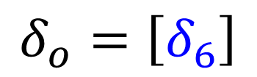
以矩陣呈現
$$O_{o}=\left[O_{6}\right]$$
$$Y=\left[T\right]$$
$$δ_{o}=\left[δ_{6}\right]$$
$$=\left[O_{6}\right]\left[1−O_{6}\right]\left[w_{6}\right]\left[O_{6}−T\right]$$

Slide 22
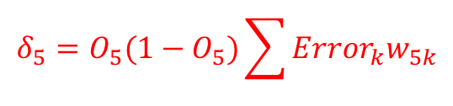
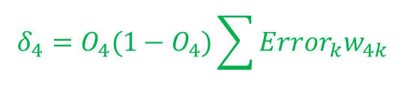
計算誤差項(隱藏層)
$$x_{1}$$
1
$$δ_{4}=O_{4}(1−O_{4})\sum{{Error}_{k}w_{4k}}$$
T
$$w_{14}$$
$$w_{15}$$
$${\text{θ}}_{4} \text{f}\text{( ) }$$
∑
-1
$$w_{46}$$
$$w_{24}$$
$$x_{2}$$
2
$${\text{θ}}_{6} \text{f}\text{( ) }$$
∑
$$w_{25}$$
$$w_{6}=1$$
$${\text{θ}}_{5} \text{f}\text{( ) }$$
$$w_{56}$$
$$w_{34}$$
∑
$$x_{3}$$
3
$$w_{35}$$
$$δ_{5}=O_{5}(1−O_{5})\sum{{Error}_{k}w_{5k}}$$

Slide 23

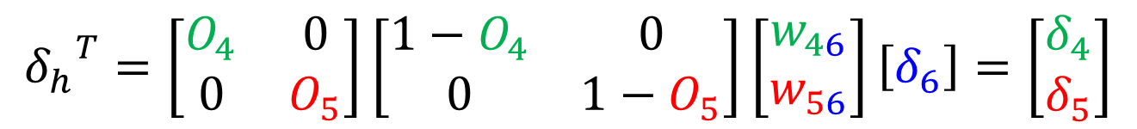
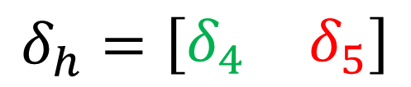

以矩陣呈現
$$W_{ho} = \left[\begin{matrix}w_{46} \\ w_{56}\end{matrix}\right]$$
$$O_{h}=\left[\begin{matrix}O_{4} & O_{5}\end{matrix}\right]$$
$$δ_{o} = \left[δ_{6}\right]$$
$$δ_{h}=\left[\begin{matrix}δ_{4} & δ_{5}\end{matrix}\right]$$
$${δ_{h}}^{T}=\left[\begin{matrix}O_{4} & 0 \\ 0 & O_{5}\end{matrix}\right]\left[\begin{matrix}{1−O}_{4} & 0 \\ 0 & {1−O}_{5}\end{matrix}\right]\left[\begin{matrix}w_{46} \\ w_{56}\end{matrix}\right]\left[δ_{6}\right]=\left[\begin{matrix}δ_{4} \\ δ_{5}\end{matrix}\right]$$

Slide 24


修正門檻值(輸出層)
$$x_{1}$$
1
T
$$w_{14}$$
$$w_{15}$$
$${\text{θ}}_{4} \text{f}\text{( ) }$$
∑
-1
$$w_{46}$$
$$w_{24}$$
$$x_{2}$$
2
$${\text{θ}}_{6} \text{f}\text{( ) }$$
∑
$$w_{25}$$
$$w_{6}=1$$
$${\text{θ}}_{5} \text{f}\text{( ) }$$
$$w_{56}$$
$$w_{34}$$
$${{\text{θ}}_{6}}^{t+1}={{\text{θ}}_{6}}^{t}+Δ{{\text{θ}}_{6}}^{t}$$
∑
$$Δ{{\text{θ}}_{6}}^{t}=η∗δ_{6}$$
$$x_{3}$$
3
$$w_{35}$$

Slide 25
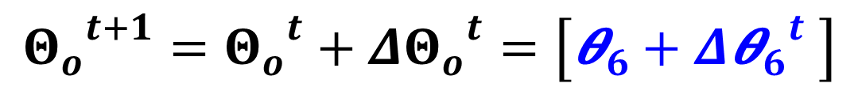
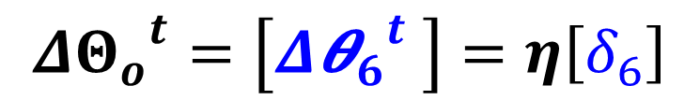
以矩陣呈現
$$Δ{Θ_{o}}^{t}=\left[Δ{{\text{θ}}_{6}}^{t} \right]=η\left[δ_{6}\right]$$
$${Θ_{o}}^{t+1}={Θ_{o}}^{t}+{{ΔΘ}_{o}}^{t}=\left[{\text{θ}}_{6}+Δ{{\text{θ}}_{6}}^{t} \right]$$

Slide 26




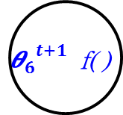
修正門檻值(輸出層)
$${{\text{θ}}_{4}}^{t+1}={{\text{θ}}_{4}}^{t}+Δ{{\text{θ}}_{4}}^{t}$$
$$x_{1}$$
1
$$Δ{{\text{θ}}_{4}}^{t}=η∗δ_{4}$$
T
$$w_{14}$$
$$w_{15}$$
$${\text{θ}}_{4} \text{f}\text{( ) }$$
∑
-1
$$w_{46}$$
$$w_{24}$$
$$x_{2}$$
2
$${{\text{θ}}_{6}}^{t+1} \text{f}\text{( ) }$$
∑
$$w_{25}$$
$$w_{6}=1$$
$${\text{θ}}_{5} \text{f}\text{( ) }$$
$$w_{56}$$
$$w_{34}$$
∑
$$x_{3}$$
3
$$w_{35}$$
$${{\text{θ}}_{5}}^{t+1}={{\text{θ}}_{5}}^{t}+Δ{{\text{θ}}_{5}}^{t}$$
$$Δ{{\text{θ}}_{5}}^{t}=η∗δ_{5}$$

Slide 27
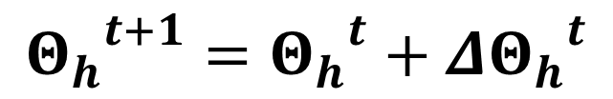
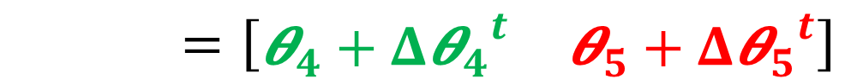
以矩陣呈現
$$Δ{Θ_{h}}^{t}=\left[\begin{matrix}Δ{{\text{θ}}_{4}}^{t} & Δ{{\text{θ}}_{5}}^{t}\end{matrix}\right]=η\left[\begin{matrix}δ_{4} & δ_{5}\end{matrix}\right]$$
$${Θ_{h}}^{t+1}={Θ_{h}}^{t}+{{ΔΘ}_{h}}^{t}$$
$=\left[\begin{matrix}{\text{θ}}_{4} & {\text{θ}}_{5}\end{matrix}\right]+\left[\begin{matrix}Δ{{\text{θ}}_{4}}^{t} & Δ{{\text{θ}}_{5}}^{t}\end{matrix}\right]$
$=\left[\begin{matrix}{\text{θ}}_{4}+Δ{{\text{θ}}_{4}}^{t} & {\text{θ}}_{5}+Δ{{\text{θ}}_{5}}^{t}\end{matrix}\right]$

Slide 28

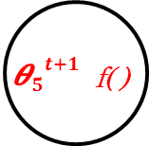

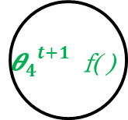


修正門檻值(隱藏層-輸出層)
1
${w_{46}}^{t+1}={w_{46}}^{t}$+${Δw_{46}}^{t}$
T
$$x_{1}$$
$${Δw_{46}}^{t}=η∗O_{4}+δ_{6}$$
$$w_{14}$$
$$w_{15}$$
$${{\text{θ}}_{4}}^{t+1} \text{f}\text{( ) }$$
-1
$$w_{46}$$
$$w_{24}$$
$$x_{2}$$
2
$${{\text{θ}}_{6}}^{t+1} \text{f}\text{( ) }$$
∑
$$w_{25}$$
$$w_{6}=1$$
$${{\text{θ}}_{5}}^{t+1} \text{f}\text{( ) }$$
$$w_{56}$$
$$w_{34}$$
3
$$w_{35}$$
${w_{56}}^{t+1}={w_{56}}^{t}$+${Δw_{56}}^{t}$
$$x_{3}$$
$${Δw_{56}}^{t}=η∗O_{5}+δ_{6}$$

Slide 29
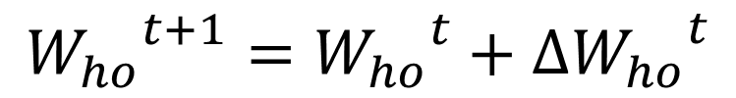
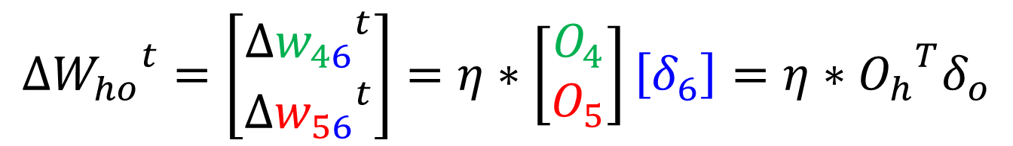
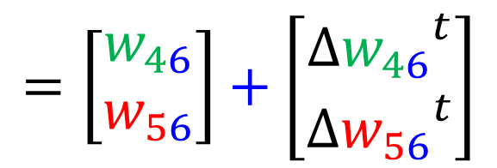
以矩陣呈現
$${ΔW_{ho}}^{t}=\left[\begin{matrix}{{Δw}_{46}}^{t} \\ {{Δw}_{56}}^{t}\end{matrix}\right]=η∗\left[\begin{matrix}O_{4} \\ O_{5}\end{matrix}\right]\left[δ_{6}\right]={{η∗O}_{h}}^{T}δ_{o}$$
$${W_{ho}}^{t+1}={W_{ho}}^{t}+{{ΔW}_{ho}}^{t}$$
$$=\left[\begin{matrix}w_{46} \\ w_{56}\end{matrix}\right]+\left[\begin{matrix}{{Δw}_{46}}^{t} \\ {{Δw}_{56}}^{t}\end{matrix}\right]$$

Slide 30


修正門檻值(隱藏層-輸出層)
${w_{14}}^{t+1}={w_{14}}^{t}$+${Δw_{14}}^{t}$
$$x_{1}$$
1
$${Δw_{14}}^{t}=η∗x_{1}+δ_{4}$$
T
$$w_{14}$$
$$w_{15}$$
$${{\text{θ}}_{4}}^{t+1} \text{f}\text{( ) }$$
-1
$$w_{46}$$
$$w_{24}$$
$$x_{2}$$
2
$${{\text{θ}}_{6}}^{t+1} \text{f}\text{( ) }$$
∑
$$w_{25}$$
$$w_{6}=1$$
$${{\text{θ}}_{5}}^{t+1} \text{f}\text{( ) }$$
$$w_{56}$$
$$w_{34}$$
$$x_{3}$$
3
$$w_{35}$$

Slide 31
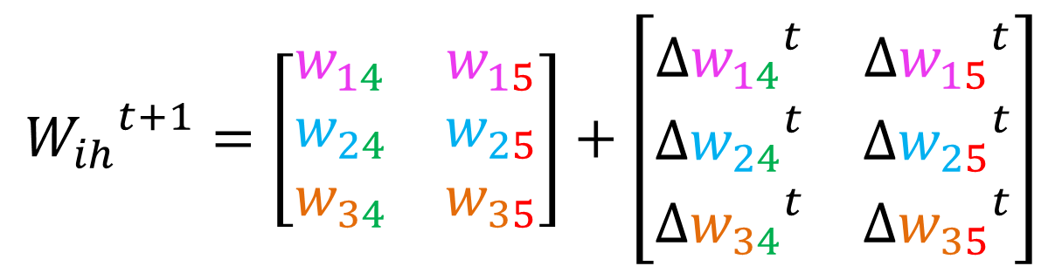
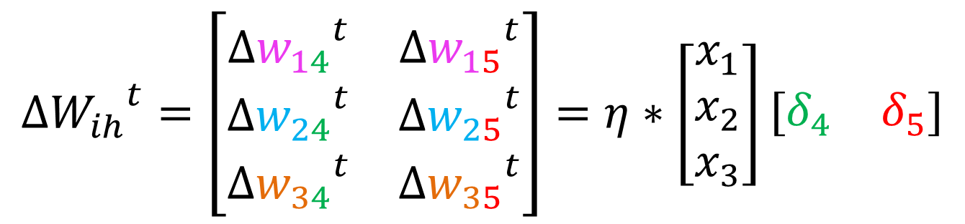
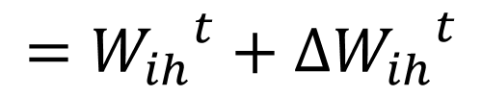

以矩陣呈現
$${ΔW_{ih}}^{t}=\left[\begin{matrix}{Δw_{14}}^{t} & {Δw_{15}}^{t} \\ {Δw_{24}}^{t} & {Δw_{25}}^{t} \\ {Δw_{34}}^{t} & {Δw_{35}}^{t}\end{matrix}\right]=η∗\left[\begin{matrix}x_{1} \\ x_{2} \\ x_{3}\end{matrix}\right]\left[\begin{matrix}δ_{4} & δ_{5}\end{matrix}\right]$$
$$={η∗X}^{T}δ_{h}$$
$${W_{ih}}^{t+1}=\left[\begin{matrix}w_{14} & w_{15} \\ w_{24} & w_{25} \\ w_{34} & w_{35}\end{matrix}\right]+\left[\begin{matrix}{Δw_{14}}^{t} & {Δw_{15}}^{t} \\ {Δw_{24}}^{t} & {Δw_{25}}^{t} \\ {Δw_{34}}^{t} & {Δw_{35}}^{t}\end{matrix}\right]$$
$$={W_{ih}}^{t}+{{ΔW}_{ih}}^{t}$$

Slide 32
以矩陣呈現
$$X=\left[\begin{matrix}x_{1} & x_{2} & x_{3}\end{matrix}\right]$$
$$W_{ih} = \left[\begin{matrix}w_{14} & w_{15} \\ w_{24} & w_{25} \\ w_{34} & w_{35}\end{matrix}\right]$$
$$I_{h}=XW_{ih}=\left[\begin{matrix}x_{1}w_{14}+x_{2}w_{24}+{x_{3}w}_{34} & x_{1}w_{15}+x_{2}w_{25}+{x_{3}w}_{35}\end{matrix}\right]$$

Slide 33
通用資料結構

Slide 34
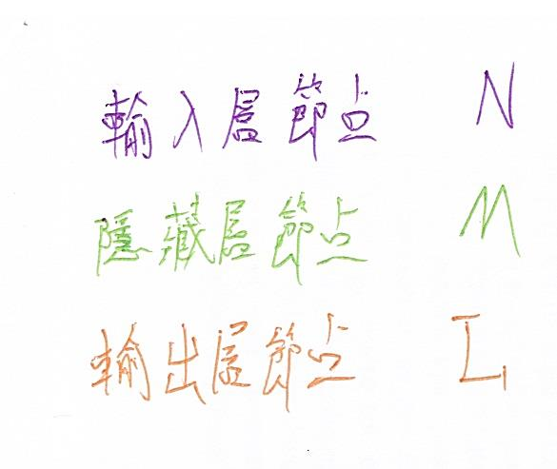
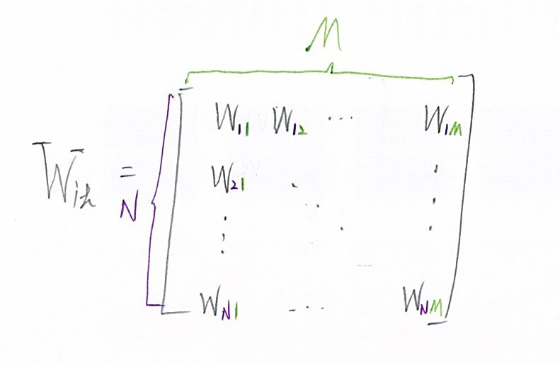
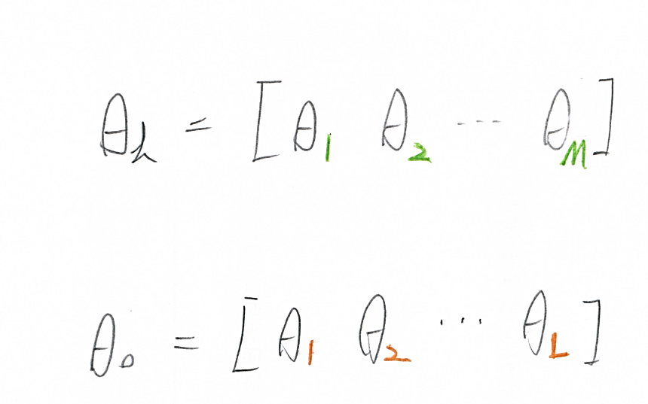
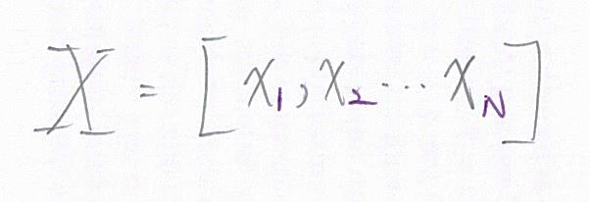
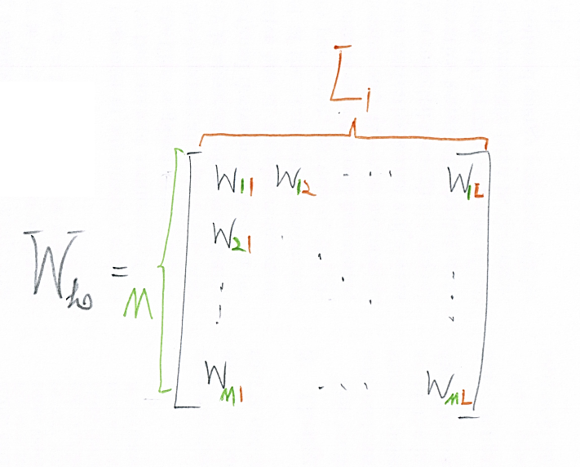
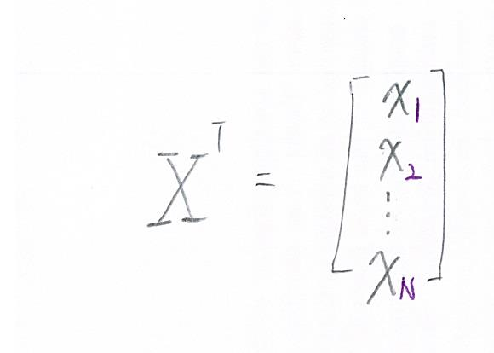
矩陣結構

Slide 35

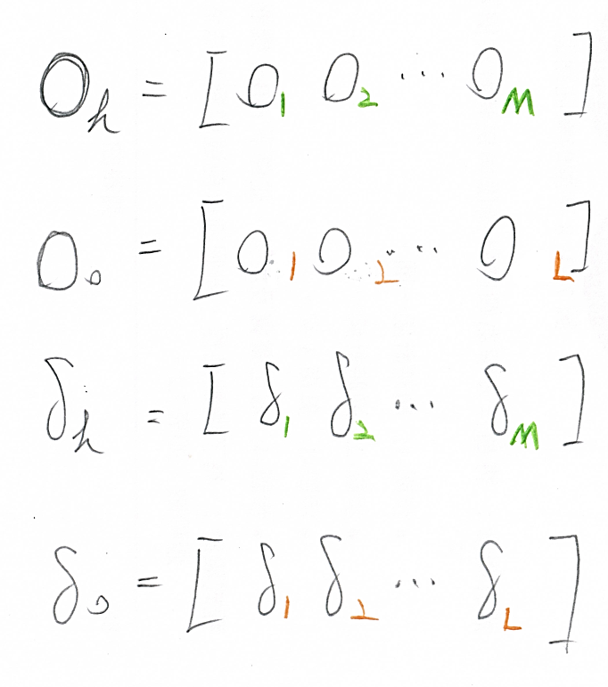




矩陣結構
$$∆$$
$$∆$$
$$∆$$
$$∆$$

Slide 36
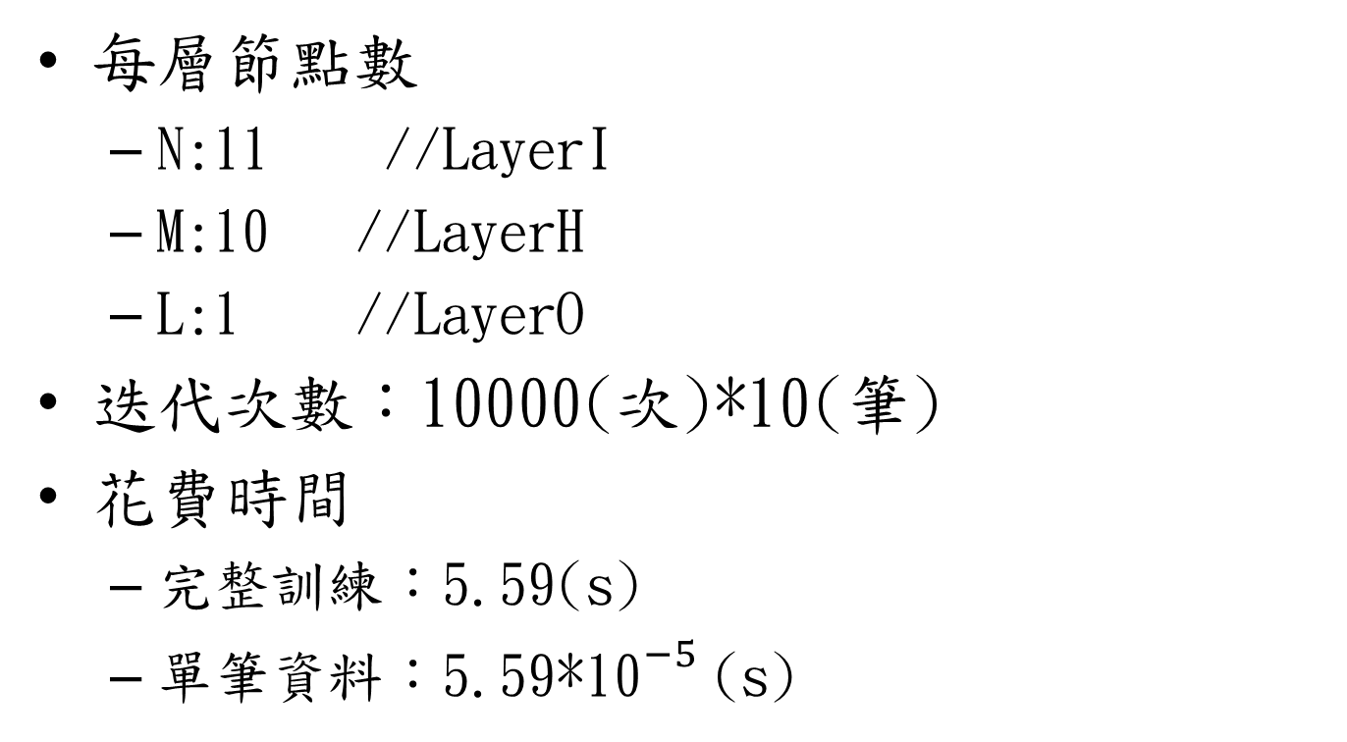
TrainDataSet-1
每層節點數
N:11 //LayerI
M:10 //LayerH
L:1 //LayerO
迭代次數：10000(次)*10(筆)
花費時間
完整訓練：5.59(s)
單筆資料：5.59*${\text{10}}^{−5}$(s)

Slide 37
 | Input |  |  |  |  |  |  |  |  |  |  | Output | ANN_Output | MSE
data-1 | 1 | 0 | 0 | 1 | 0 | 1 | 0 | 1 | 0 | 0 | 0 | 1 | 0.99 | 0.973103
data-2 | 1 | 0 | 0 | 1 | 0 | 1 | 0 | 0 | 1 | 0 | 1 | 0 | 0.02 | 0.000256
data-3 | 1 | 0 | 0 | 1 | 0 | 0 | 1 | 1 | 0 | 0 | 0 | 1 | 0.98 | 0.96542
data-4 | 1 | 0 | 0 | 1 | 0 | 0 | 1 | 0 | 1 | 1 | 0 | 0 | 0.02 | 0.000226
data-5 | 1 | 0 | 0 | 0 | 1 | 1 | 0 | 1 | 0 | 0 | 0 | 1 | 0.99 | 0.97223
data-6 | 1 | 0 | 0 | 0 | 1 | 1 | 0 | 0 | 1 | 0 | 1 | 0 | 0.02 | 0.000324
data-7 | 1 | 0 | 0 | 0 | 1 | 0 | 1 | 1 | 0 | 0 | 0 | 1 | 0.98 | 0.968791
data-8 | 1 | 0 | 0 | 0 | 1 | 0 | 1 | 0 | 1 | 1 | 0 | 0 | 0.02 | 0.000226
data-9 | 0 | 1 | 0 | 1 | 0 | 1 | 0 | 1 | 0 | 0 | 0 | 1 | 0.98 | 0.965269
data-10 | 0 | 1 | 0 | 1 | 0 | 1 | 0 | 0 | 1 | 0 | 1 | 0 | 0.01 | 0.000197

Slide 38
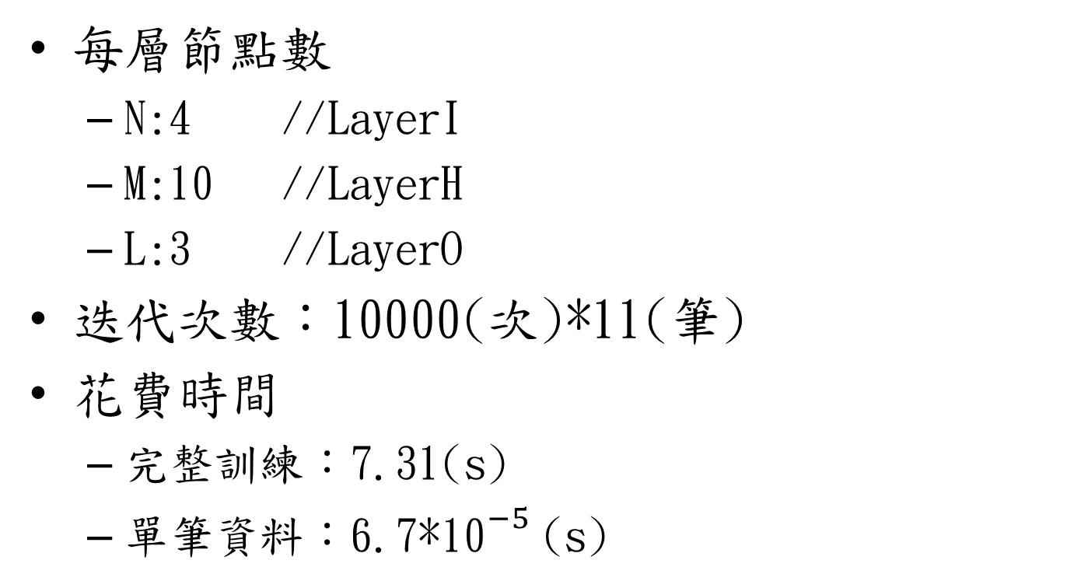
TrainDataSet-2
每層節點數
N:4 //LayerI
M:10 //LayerH
L:3 //LayerO
迭代次數：10000(次)*11(筆)
花費時間
完整訓練：7.31(s)
單筆資料：6.7*${\text{10}}^{−5}$(s)

Slide 39
TrainDataSet-2
 | Input |  |  |  | Output |  |  | ANN_Output |  |  | MSE
 |  |  |  |  | 類別1 | 類別2 | 類別3 | 類別1 | 類別2 | 類別3
data-1 | 4.4 | 3.2 | 1.3 | 0.2 | 0 | 0 | 1 | 0.00 | 0.00 | 0.97 | 0.00
data-2 | 5 | 3.5 | 1.6 | 0.6 | 0 | 0 | 1 | 0.00 | 0.00 | 0.96 | 0.00
data-3 | 5.1 | 3.8 | 1.9 | 0.4 | 0 | 0 | 1 | 0.00 | 0.00 | 0.97 | 0.00
data-4 | 5 | 3.3 | 1.4 | 0.2 | 0 | 0 | 1 | 0.00 | 0.00 | 0.97 | 0.00
data-5 | 7 | 3.2 | 4.7 | 1.4 | 0 | 1 | 0 | 0.06 | 0.00 | 0.01 | 0.33
data-6 | 6 | 2.7 | 5.1 | 1.6 | 0 | 1 | 0 | 0.30 | 0.00 | 0.00 | 0.36
data-7 | 6.7 | 3.1 | 4.7 | 1.5 | 0 | 1 | 0 | 0.04 | 0.00 | 0.01 | 0.33
data-8 | 6.3 | 2.3 | 4.4 | 1.3 | 0 | 1 | 0 | 0.04 | 0.00 | 0.01 | 0.33
data-9 | 6.5 | 3.2 | 5.1 | 2 | 1 | 0 | 0 | 0.85 | 0.00 | 0.00 | 0.01
data-10 | 6.4 | 2.7 | 5.3 | 1.9 | 1 | 0 | 0 | 0.45 | 0.00 | 0.00 | 0.10
data-11 | 5.8 | 2.8 | 5.1 | 2.4 | 1 | 0 | 0 | 0.94 | 0.00 | 0.00 | 0.00

