Slide 1
JS101

Slide 2
Object Oriented Programming (OOP)

Slide 3
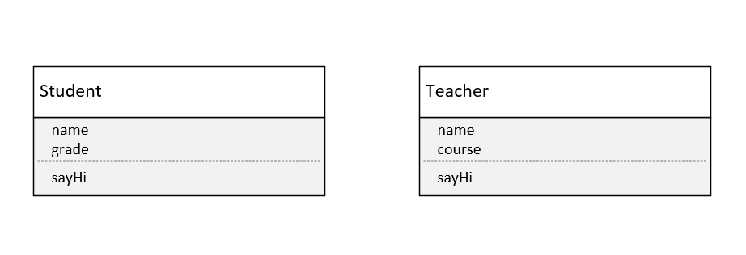

Slide 4
