Slide 1
بسم الله الرحمن الرحیم
Notes:
Introduce yourself
ان شاء الله که وخت خوب و پربرکت خواهیم داشت

Slide 2
JS101 Introduction to Programming with Javascript

Slide 4
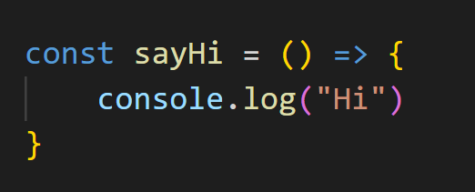
Arrow Function

Slide 5
This
It’s a keyword
Refers to an object
In method, it refers to the object
Alone, it refers to global object
In function, it refers to global object

Slide 6
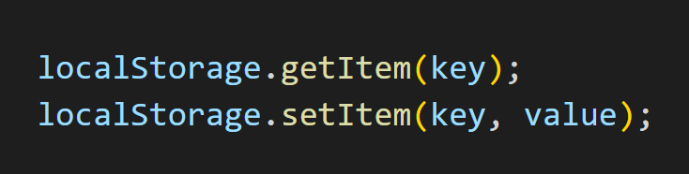
localStorage

