Slide 1
JS101

Slide 2
TODO (continue)

Slide 3
Inline events vs addEventListener

Slide 4
blink
Notes:
stopwatch

Slide 5
element.addEventListener(eventName, event => {})

Slide 6

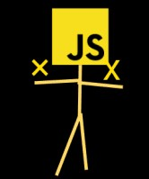
browser
Rendering Engine
JavaScript Engine
Notes:
HTML/CSS: rendering Engine

Slide 7
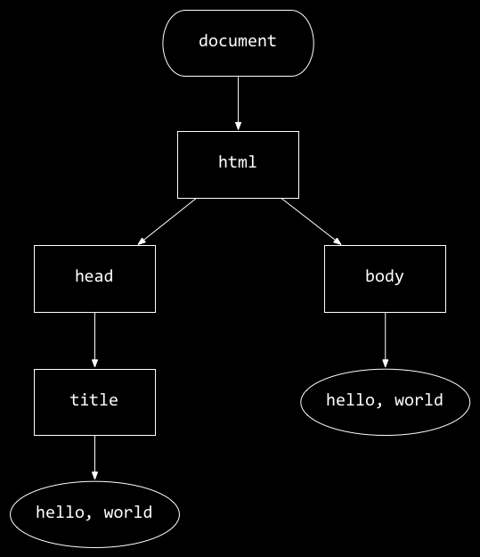
<!DOCTYPE html>
<html lang="en">
<head>
<title>
hello, title
</title>
</head>
<body>
hello, body
</body>
</html>
hello, body
hello, title

Slide 8
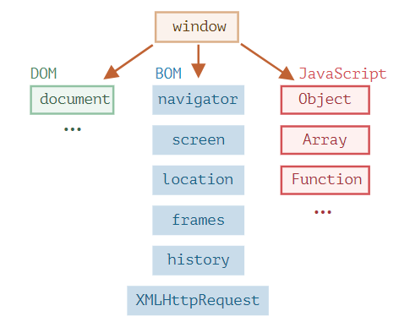
JavaScript Engine
Notes:
The JavaScript specification calls that a host environment.

Slide 9
DOM manipulation
Notes:
Reading value from a node
Creating new node
Modifying existing node
Deleting a node

