Slide 1
JS101

Slide 2
Product development
Idea
Low-fidelity prototype
High-fidelity prototype
Code

Slide 3
Low-fidelity Prototype
Refers to a rough, low-fidelity model of a product or feature, often created with simple materials like paper, cardboard, or sticky notes.
Used to quickly and cheaply test out design ideas and gather feedback.
Can be used to identify usability issues and design flaws before investing more time and resources in creating a higher fidelity prototype.
Typically used in the early stages of product development.

Slide 4
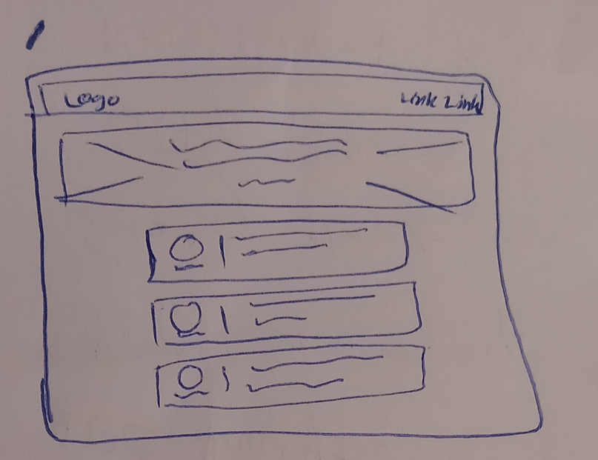
/

Slide 5
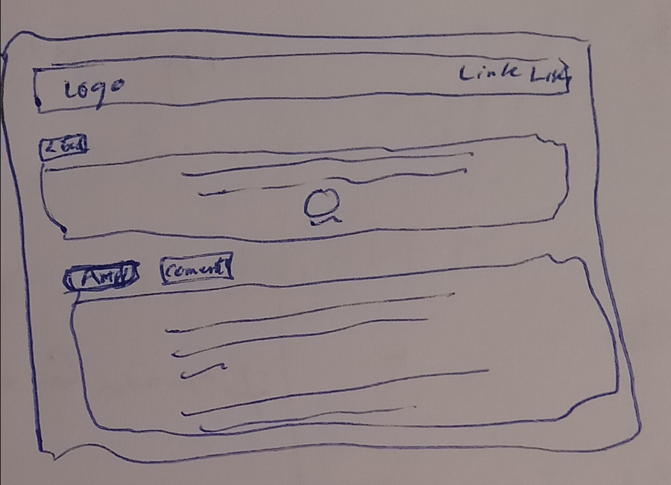
/articles/:id

Slide 6
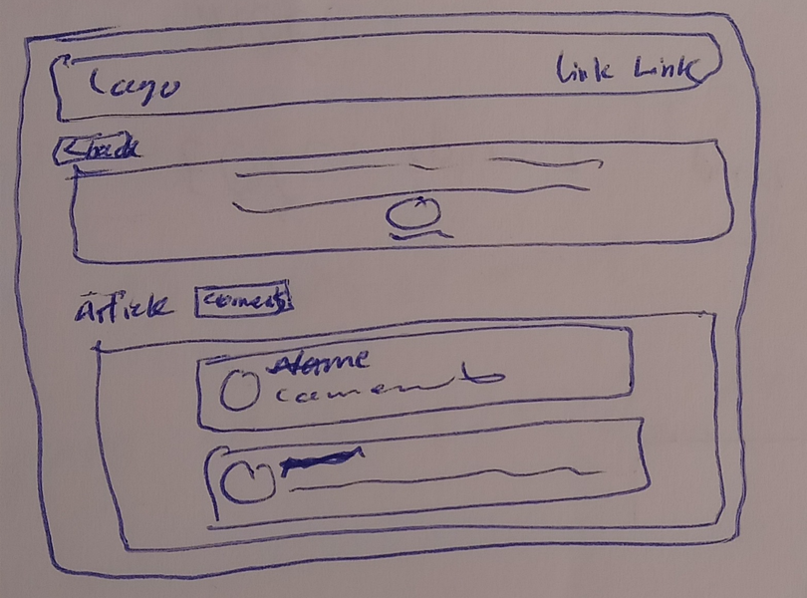
/articles/:id/comments

Slide 7
High-fidelity Prototype
Refers to a more polished, high-fidelity model of a product or feature, often created using digital tools or more advanced materials.
Used to test out more refined design ideas and gather feedback.
Can be used to test out specific interactions or features in greater detail.
Typically used in later stages of product development, after lo-fi prototypes have been tested and refined.

