Slide 1
Lecture 5
Loops

Slide 2
Loop
Loop is a programming construct that enables us to execute a block of code again and again.

Slide 3
While Loop

Slide 4
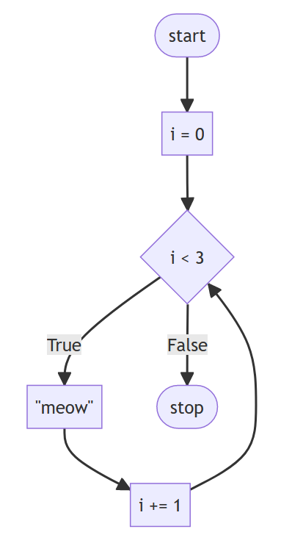
Salam.html

Slide 5
For Loop

Slide 6
5 minute break

Slide 7
Data Types

Slide 8
number
string
boolean
null
undefined
Object
Symbol

Slide 9
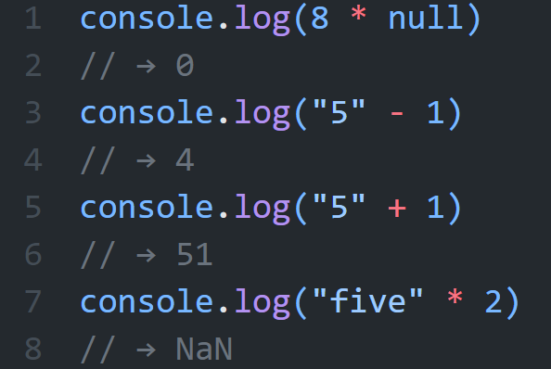
Automatic Type Conversion
Notes:
When an operator is applied to the “wrong” type of value, JavaScript will quietly convert that value to the type it needs, using a set of rules that often aren’t what you want or expect. This is called type coercion

Slide 10
Operators

Slide 11
Operators
Arithmatic:
+, -, *, /, **, %
Assignment:
=
+=, -=, *=
Comparison:
==, !=, ===, !==, >, <, >=, <=
Logical:
|| (OR), && (And)
Unary:
-, !, typeof
Ternary Operator: ?:

Slide 12
Variables

Slide 13
let
const
var

Slide 14
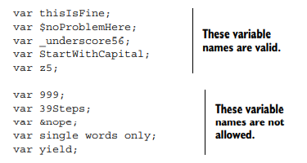
Valid/invalid variable names

Slide 15
Conditionals

Slide 16
If
If-else
switch

Slide 17
Functions

Slide 18
anonymous function
Function expression
Arrow function

