Slide 1
JS101

Slide 2
Browser

Slide 3

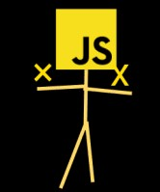
browser
Rendering Engine
JavaScript Engine
Notes:
HTML/CSS: rendering Engine

Slide 4
JavaScript Engine
Browser API
Core JavaScript Language

Slide 5
JavaScript Engine
Browser API
Core JavaScript Language

Slide 6
JavaScript Engine
Source Code
Machine Code
Notes:
Credit: https://web.dev/howbrowserswork/

Slide 7
DOM Tree

Slide 8
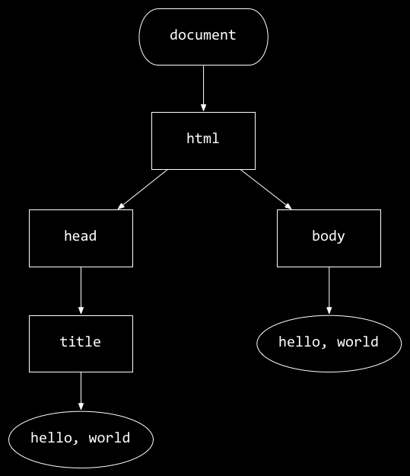
<!DOCTYPE html>
<html lang="en">
<head>
<title>
hello, title
</title>
</head>
<body>
hello, body
</body>
</html>
hello, body
hello, title

Slide 9
hello, body
hello, title
Notes:
Why it’s called tree?

Slide 10
Events

Slide 11
Events
onblur onchange onclick ondrag onfocus onkeyup onload onmousedown onmouseover onmouseup onsubmit ontouchmove onunload

Slide 12
querySelector

Slide 13
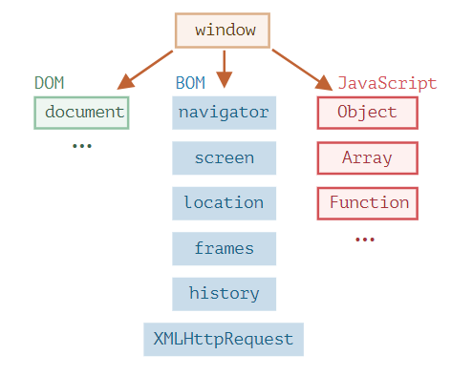
JavaScript Engine
Notes:
The JavaScript specification calls that a host environment.

Slide 14
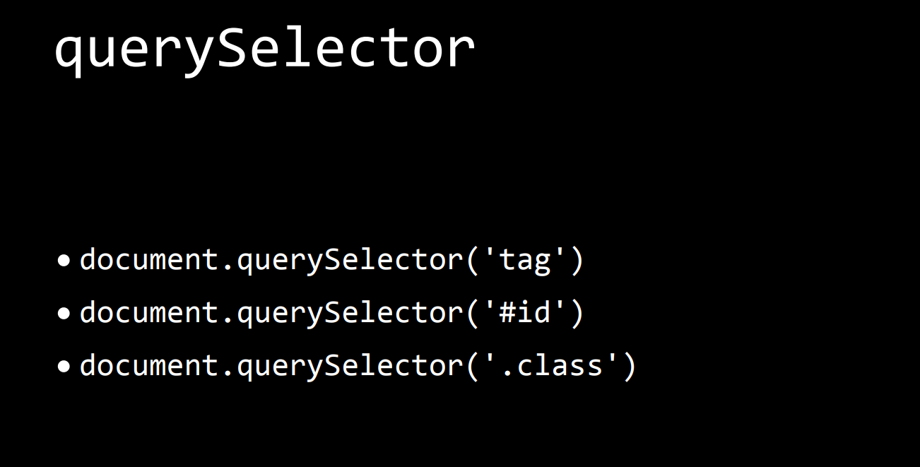

Slide 15
DOM manipulation
Notes:
Reading value from a node
Creating new node
Modifying existing node
Deleting a node

Slide 16
DOM manipulation
Notes:
Reading value from a node
Creating new node
Modifying existing node
Deleting a node

Slide 17
Style
Notes:
Reading value from a node
Creating new node
Modifying existing node
Deleting a node

Slide 18
Examples
Hello0: alert
Hello1: event
goodbye: hello goodbye
Counter: DOMContentLoaded, separate file
Greeting:
RGB1: buttons
RGB2: dropdown
Todo List (optional)
Notes:
React has some key concepts
declarative: we tell the react how our app should look, and the lest should be taken care by react how to do it.
In order to achieve it, react uses some tools.
1. instead of js, it uses an extended version of js, called JSX
2.

