Slide 1
JS101

Slide 2
React Hooks

Slide 3
React Hooks are a set of functions that allow you to use state and other React features in functional components. Here are some key points and examples to help you understand React Hooks:

Slide 4
useState
useState is a hook that allows you to add state to your functional components. You can use it to update state values based on user interactions or other events.

Slide 5
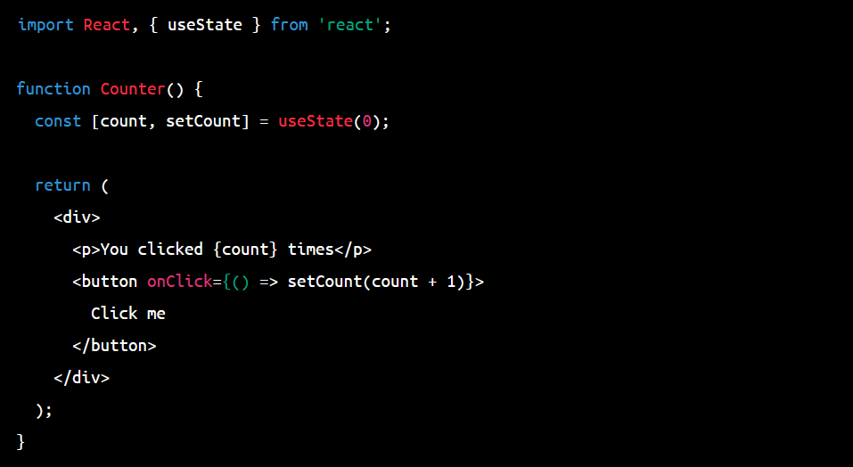

Slide 6
useEffect
useEffect is a hook that allows you to run side effects (such as fetching data from an API or updating the DOM) after rendering your component.

Slide 7
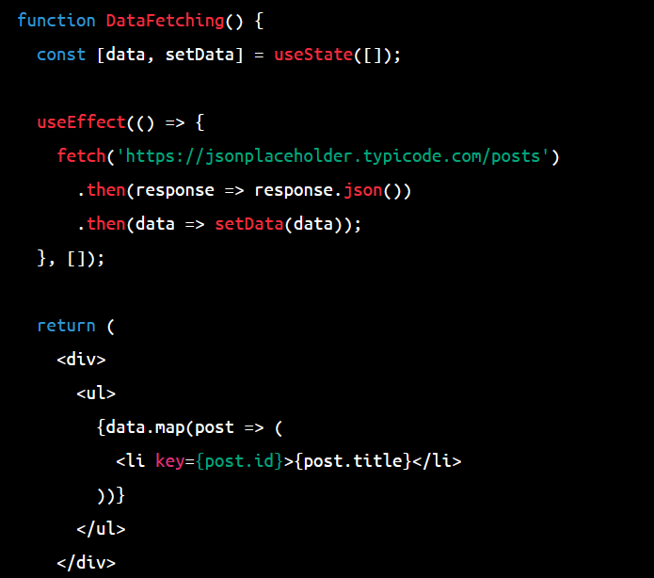

Slide 8
useContext
useContext is a hook that allows you to access values from a Context object without the need to wrap your component in a Context Provider.
It helps to avoid props-drilling

Slide 9
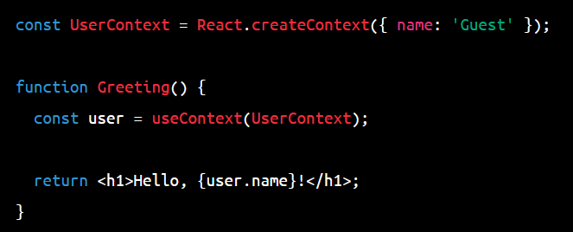

Slide 10
useReducer
useReducer is a hook that allows you to manage state using a reducer function. It's similar to the way state is managed in Redux.

Slide 11
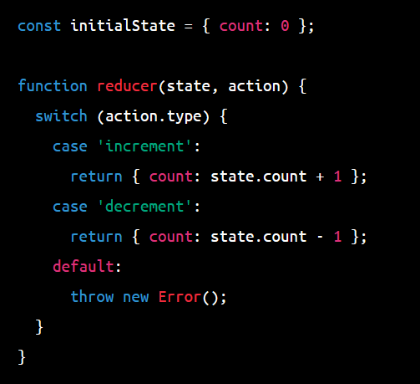

Slide 12
