Slide 1
JS101

Slide 2
Browser

Slide 3

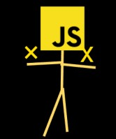
browser
Rendering Engine
JavaScript Engine
Notes:
HTML/CSS: rendering Engine

Slide 4
JavaScript Engine
Browser API
Core JavaScript Language

Slide 5
JavaScript Engine
Source Code
Machine Code
Notes:
Credit: https://web.dev/howbrowserswork/

Slide 6
DOM Tree

Slide 7
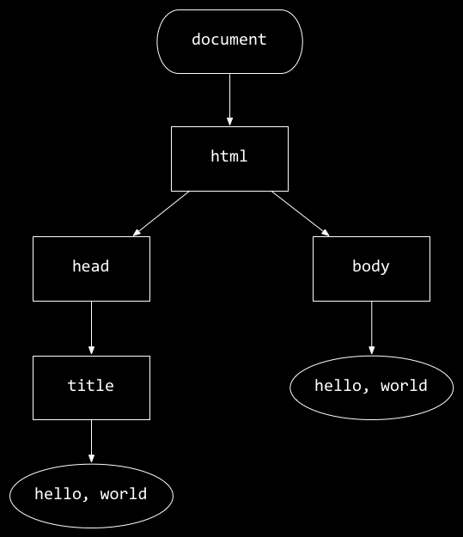
<!DOCTYPE html>
<html lang="en">
<head>
<title>
hello, title
</title>
</head>
<body>
hello, body
</body>
</html>
hello, body
hello, title

Slide 8
hello, body
hello, title

Slide 9
Events

Slide 10
Events
onblur onchange onclick ondrag onfocus onkeyup onload onmousedown onmouseover onmouseup onsubmit ontouchmove onunload

Slide 11
querySelector

Slide 12
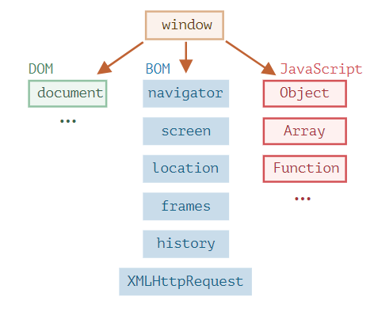
JavaScript Engine
Notes:
The JavaScript specification calls that a host environment.

Slide 13
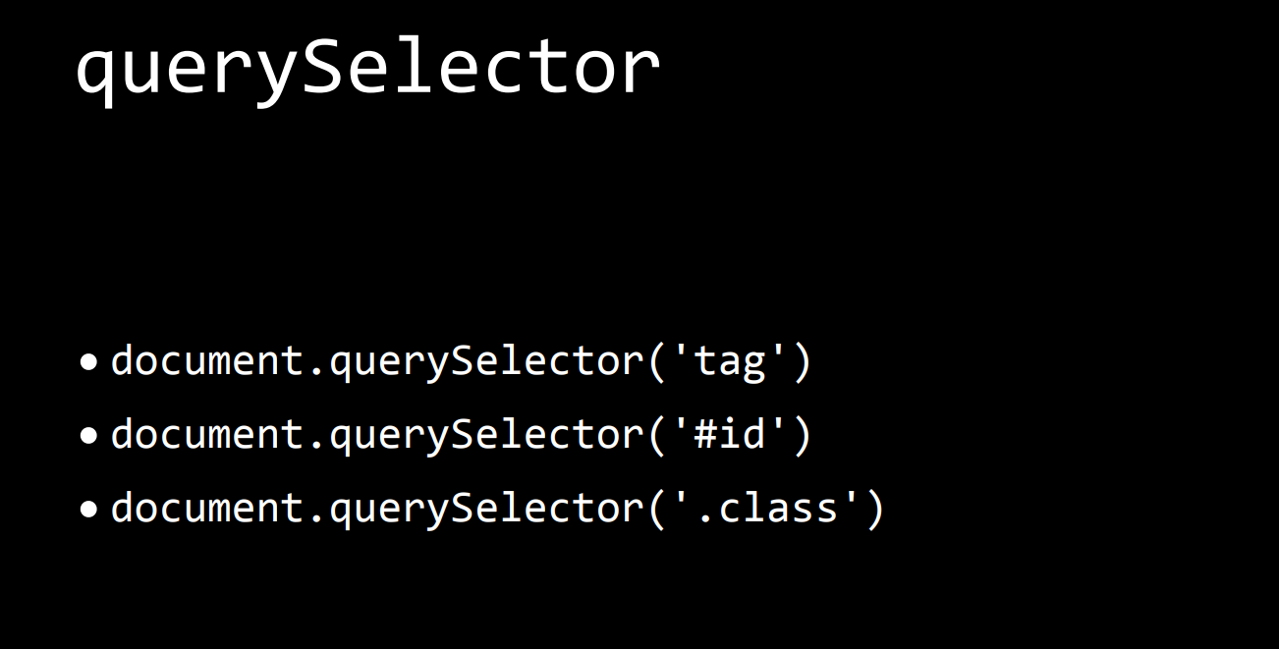

Slide 14
DOM manipulation
Notes:
Reading value from a node
Creating new node
Modifying existing node
Deleting a node

Slide 15
Style
Notes:
Reading value from a node
Creating new node
Modifying existing node
Deleting a node

Slide 16
Examples
Hello0: alert
Hello1: event
goodbye: hello goodbye
Counter: DOMCOntentLoaded, separate file
Greeting:
RGB1: buttons
RGB2: dropdown
Todo List (optional)
Notes:
React has some key concepts
declarative: we tell the react how our app should look, and the lest should be taken care by react how to do it.
In order to achieve it, react uses some tools.
1. instead of js, it uses an extended version of js, called JSX
2.

Slide 17
Objects

Slide 18
Objects
Key-value pairs
methods
Factory Functions
Constructor
Prototype
Notes:
React has some key concepts
declarative: we tell the react how our app should look, and the lest should be taken care by react how to do it.
In order to achieve it, react uses some tools.
1. instead of js, it uses an extended version of js, called JSX
2.

Slide 19
Factory Function

Slide 20
function createPerson (name) {
const obj;
obj.name = name
return obj;
}

Slide 21
const ahmad = createPerson(“Ahmad”)

Slide 22
Constructor Function

Slide 23
function Person (name) {
this.name = name;
}

Slide 24
const person1 = new Person(“Ahmad”)

Slide 25
Prototype

Slide 26
student1
student2
student3
name
name
name
grade
grade
grade
sayHi
sayHi
sayHi

Slide 27
student1
student2
student3
name
name
name
grade
grade
grade
sayHi
sayHi
sayHi

Slide 28
prototype
sayHi
student1
student2
student3
name
name
name
grade
grade
grade
Notes:
if the property can't be found in the object itself, the prototype is searched for the property. If the property still can't be found, then the prototype's prototype is searched,

Slide 29
Null
Object
Prototype
Prototype
Prototype
Student1
Notes:
if the property can't be found in the object itself, the prototype is searched for the property. If the property still can't be found, then the prototype's prototype is searched,

Slide 30
Object Oriented Programming (OOP)

Slide 31
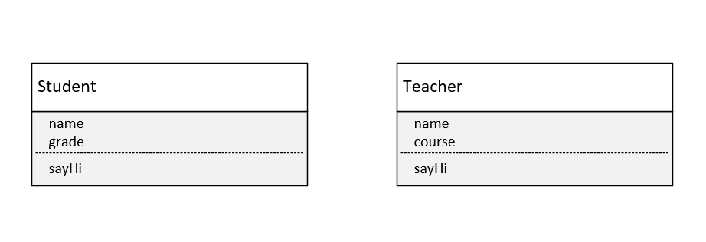

Slide 32
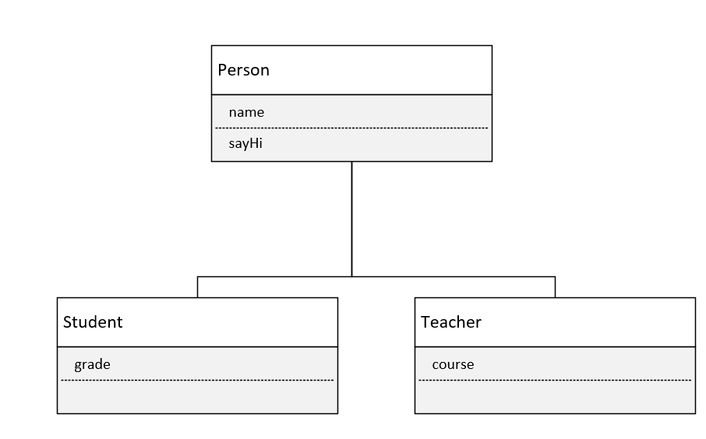

Slide 33
Error Handling

Slide 35
try {
}
catch (error) {
}
Notes:
The try statement allows you to define a block of code to be tested for errors while it is being executed.
The catch statement allows you to define a block of code to be executed, if an error occurs in the try block.

Slide 36
try {
}
catch (error) {
}
finally {
// runs anyway
}
Notes:
The try statement allows you to define a block of code to be tested for errors while it is being executed.
The catch statement allows you to define a block of code to be executed, if an error occurs in the try block.

