Slide 1
Callback functions

Slide 2
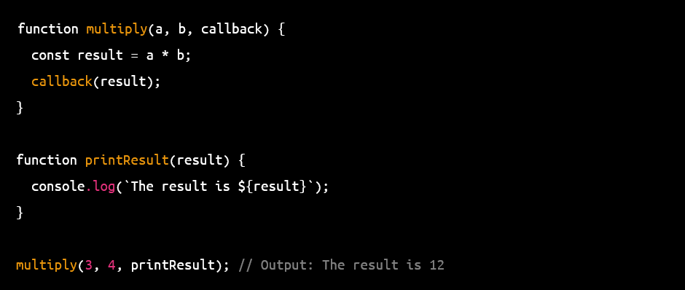
Notes:
In JavaScript, a callback function is a function that is passed as an argument to another function and is called by that function at some point in the future. The callback function is executed when the other function has completed its task.

Slide 3
Array Methods
push() - adds one or more elements to the end of an array and returns the new length of the array.
pop() - removes the last element from an array and returns that element.
shift() - removes the first element from an array and returns that element.
unshift() - adds one or more elements to the beginning of an array and returns the new length of the array.
concat() - joins two or more arrays and returns a new array.
slice() - extracts a section of an array and returns a new array.
splice() - adds or removes elements from an array.
sort() - sorts the elements of an array in place.
reverse() - reverses the order of the elements in an array in place.

Slide 4
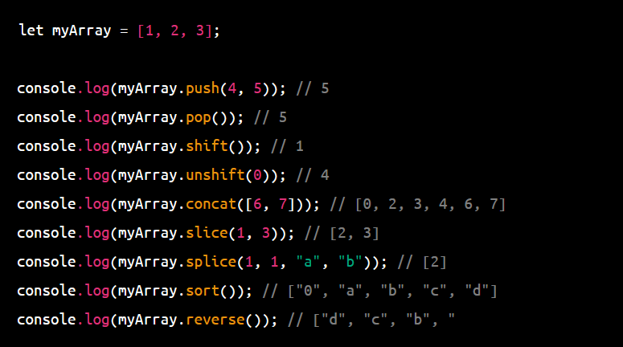

Slide 5
Array methods Continued
join() - joins all elements of an array into a string.
indexOf() - returns the first index at which a given element can be found in the array.
lastIndexOf() - returns the last index at which a given element can be found in the array.
includes() - determines whether an array includes a certain element.
forEach() - executes a provided function once for each array element.
map() - creates a new array with the results of calling a provided function on every element in the array.
filter() - creates a new array with all elements that pass the test implemented by the provided function.
reduce() - applies a function against an accumulator and each element in the array to reduce it to a single value.

Slide 6
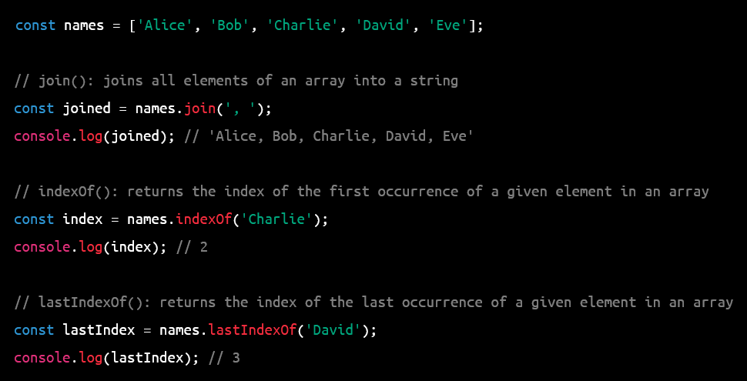

Slide 7
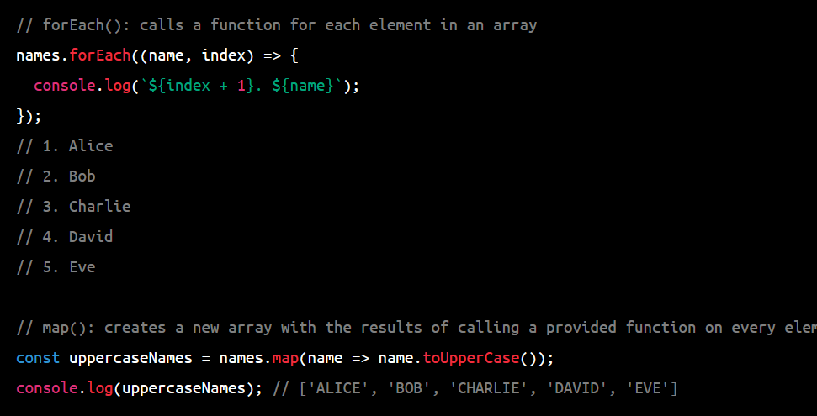

Slide 8
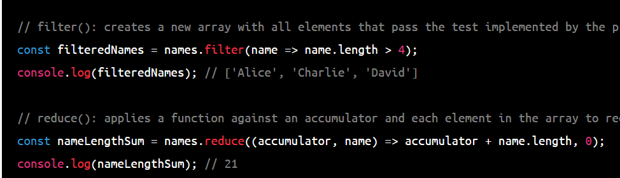

Slide 9
Object methods
Object.assign() - copies the values of all enumerable properties from one or more source objects to a target object.
Object.keys() - returns an array of all the enumerable property names of an object.
Object.create() - creates a new object with the specified prototype object and properties.
Object.defineProperty() - defines a new property directly on an object or modifies an existing property's attributes.
Object.getOwnPropertyDescriptor() - returns an object describing the attributes of a specified property.
Object.getPrototypeOf() - returns the prototype of an object.
Object.is() - determines whether two values are the same value.
Object.hasOwnProperty() - returns a boolean indicating whether the specified object has a property with the specified name.

Slide 10
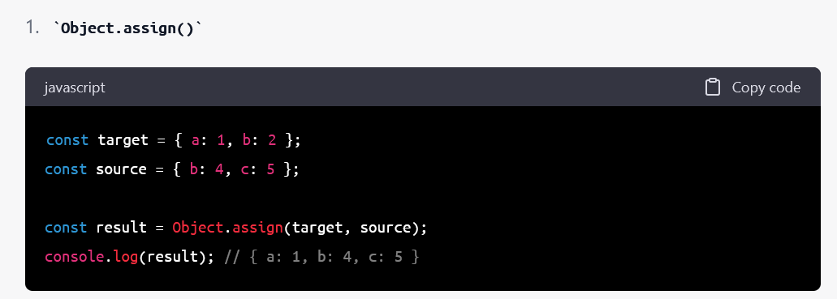
Notes:
In this example, Object.assign() is used to copy the values of all enumerable properties from the source object to the target object. The result is a new object that contains all the properties of both objects, with any matching properties from the source object overwriting those in the target object.

Slide 11
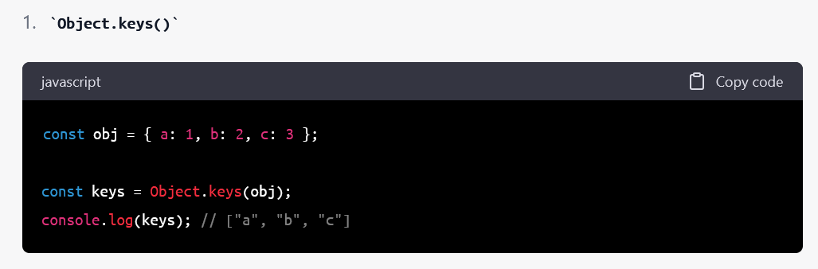
Notes:
In this example, Object.keys() is used to return an array of all the enumerable property names of the obj object. The resulting array contains the strings "a", "b", and "c", which are the keys of the obj object.

Slide 12
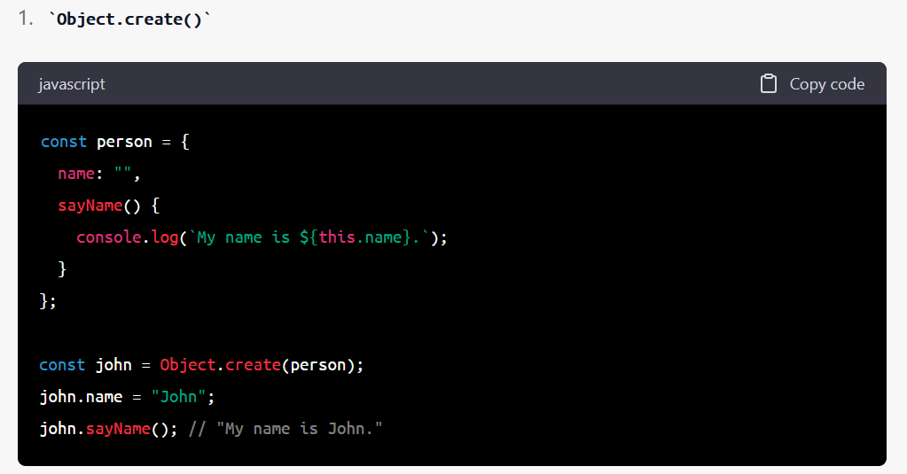
Notes:
In this example, Object.create() is used to create a new object john with person as its prototype object. john inherits the name property and sayName() method from the person object. The john object is then assigned a name property with the value "John", and the sayName() method is called on john, resulting in the output "My name is John.".

Slide 13
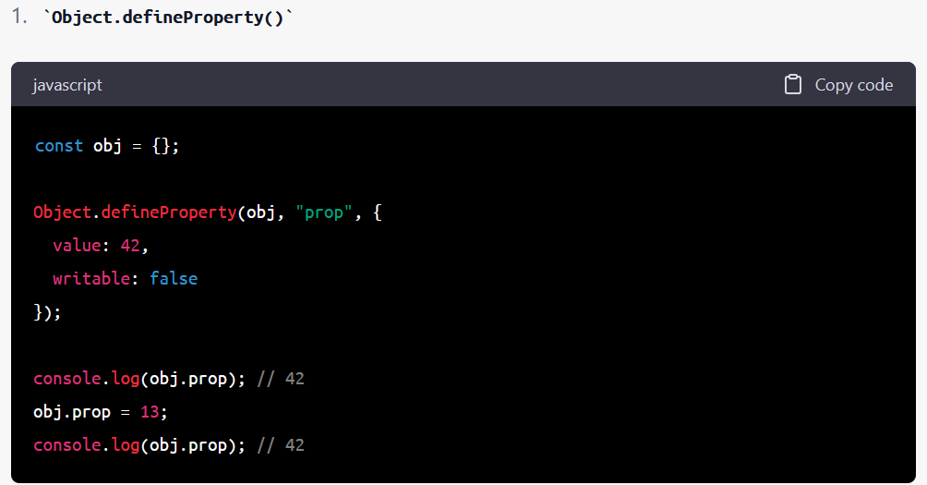
Notes:
In this example, Object.defineProperty() is used to define a new property prop directly on the obj object. The value of prop is set to 42, and the writable attribute is set to false, which means that the property cannot be reassigned a new value. When the obj.prop property is accessed and when an attempt is made to reassign a value to it, the output is always 42.

Slide 14
DOM methods
getElementById() - retrieves an element from the document based on its ID attribute.
getElementsByTagName() - retrieves a list of elements with the specified tag name.
getElementsByClassName() - retrieves a list of elements with the specified class name.
querySelector() - retrieves the first element in the document that matches a specified CSS selector.
querySelectorAll() - retrieves a list of all elements in the document that match a specified CSS selector.
createElement() - creates a new element node.
createTextNode() - creates a new text node.
appendChild() - appends a child node to an element.
removeChild() - removes a child node from an element.
replaceChild() - replaces one child node of an element with another.
setAttribute() - sets the value of an attribute on an element.
getAttribute() - retrieves the value of an attribute on an element.
addEventListener() - registers an event handler function for a specified event on an element.
removeEventListener() - removes an event handler function for a specified event on an element.
style - property used to set or retrieve the inline style of an element.

Slide 15
DOM methods
parentNode - retrieves the parent node of an element.
childNodes - retrieves a list of child nodes of an element.
nextSibling - retrieves the next sibling node of an element.
previousSibling - retrieves the previous sibling node of an element.
firstChild - retrieves the first child node of an element.
lastChild - retrieves the last child node of an element.
innerHTML - property used to set or retrieve the HTML content of an element.
textContent - property used to set or retrieve the text content of an element.
classList - property used to set or retrieve the classes of an element as a DOMTokenList object.
dataset - property used to set or retrieve data attributes of an element as a DOMStringMap object.

