Slide 1
JS101

Slide 2
Single Page Applications
SPA

Slide 3
Error Handling

Slide 4
IIFE

Slide 5
Closure
-

Slide 6
{ let x = 1; } console.log(x)

Slide 7

{ }

Slide 8

{ }
X = 1

Slide 9

{ }

Slide 10
{ }

Slide 11
{ let x = 1; function printNumber(){ console.log(x) } } printNumber() // 1

Slide 12

{ }

Slide 13

{ }
X = 1

Slide 14
{ }
X = 1
printNumber()

Slide 15
{ }
X = 1
printNumber()

Slide 16

{ }
X = 1
printNumber()

Slide 17
{ }
X = 1
printNumber()

Slide 18
{ }
X = 1
printNumber()

Slide 19
function(){ // Do something let x = 0; return increment(){ x++; } }()

Slide 20
IIFE
Immediately Invoked Functional Expression

Slide 21
(function(){ // Do something })()

Slide 22
Modules

Slide 23
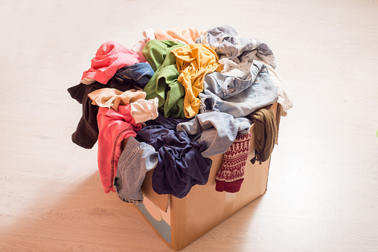

Slide 24
