Slide 1
JS101

Slide 2
0 1
Notes:
Computer only understands zeros and ones

Slide 3
JS Engine
Source Code →
→ machine Code
Notes:
- JavaScript Engine converts Source code to machine readable code

Slide 4


Notes:
In web, a client requests a page from the server.
We can run algorithms on client-side, which has the following benefits:
Less load on server
More interactive
(think about other benefits yourself)

Slide 5
algorithm
Notes:
Algorithm is step-by-step instruction to so something
Algorithm can be correct, incorrect, efficient or inefficient.

Slide 6
1 Pick up dictionary
2 Open to middle of dictionary
3 Look at page
4 If word is on page
5 Read the Definition
6 Else if word is earlier in dictionary
7 Open to middle of left half of dictionary
8 Go back to line 3
9 Else if word is later in dictionary
10 Open to middle of right half of dictionary
11 Go back to line 3
12 Else
13 Quit
Notes:
Pseudocode is the representation of algorithm in a human language (Farsi, Pashto, English).
We can implement an algorithm in javascript

Slide 7
Variable
Stores a Value
Notes:
Variable is a container that stores a value

Slide 8


Slide 9
Primitive types
Object Type
string.
number.
bigint.
boolean.
undefined.
symbol.
null
Object
Array
Function
Notes:
Primitive types are immutable
Even function and array are objects

Slide 10
Function
Perform an Action

Slide 11

Notes:
Function can be treated as a value in javascript

Slide 12
Conditionals
Make Decision

Slide 13
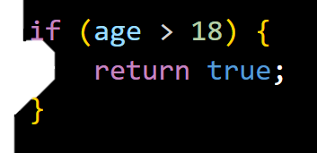

Slide 14
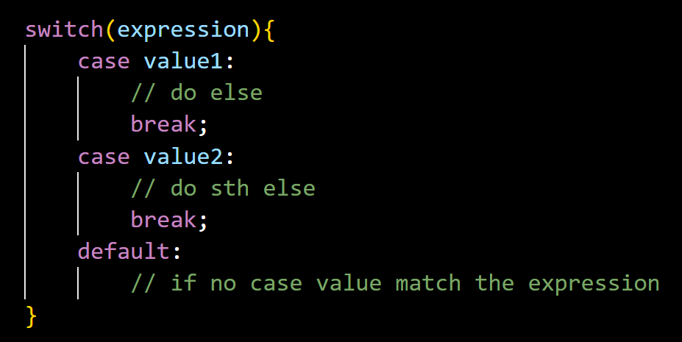

Slide 15
Loops
Do Something Again and Again

Slide 16
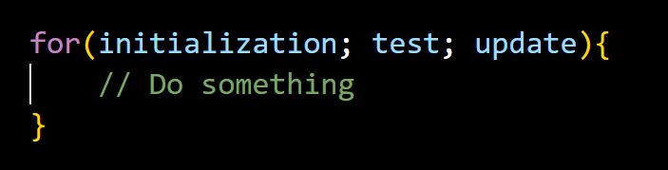

Slide 17
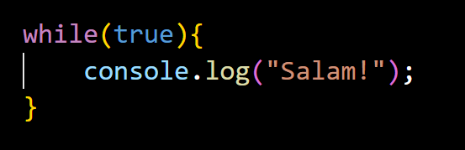
Notes:
- Infinite loop

Slide 18
Objects
Have Properties and Can do Something (methods)

Slide 19
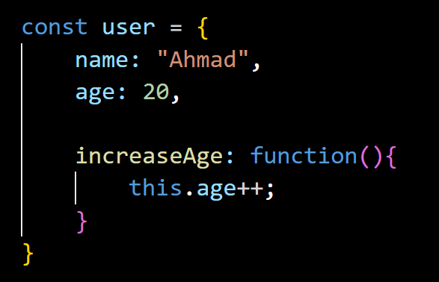

Slide 20
Primitives are Immutable
They don’t change, but new values are created

Slide 21
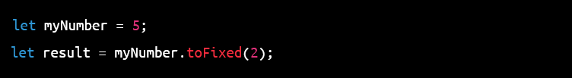
Wrapper Objects
In JavaScript, number is a primitive data type, but it also has a corresponding object wrapper called Number.
When you attempt to call a method on a primitive number value, JavaScript will automatically wrap the value with the Number object to access its methods. This is known as "boxing" or "wrapping".

Slide 22
Wrapper objects
However, it's worth noting that in most cases, you don't need to create wrapper objects explicitly, as JavaScript will automatically create them when you try to access a property or method on a primitive value.

Slide 23
Number Methods
toString() - converts a number to a string.
toFixed() - formats a number to a specified number of decimal places.
toPrecision() - formats a number to a specified length.
toExponential() - returns a string representing the number in exponential notation.
valueOf() - returns the primitive value of a Number object.
isNaN() - checks whether a value is NaN (Not a Number).
isFinite() - checks whether a value is finite (i.e., not NaN, Infinity or -Infinity).
parseInt() - parses a string argument and returns an integer.
parseFloat() - parses a string argument and returns a floating point number.

Slide 24
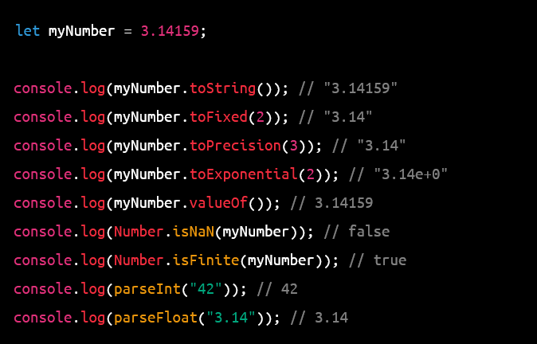

Slide 25
String Methods
charAt() - returns the character at a specified index.
charCodeAt() - returns the Unicode value of the character at a specified index.
concat() - joins two or more strings.
indexOf() - returns the index of the first occurrence of a specified value in a string.
lastIndexOf() - returns the index of the last occurrence of a specified value in a string.
slice() - extracts a section of a string and returns a new string.
substring() - extracts a section of a string between two specified indices and returns a new string.
replace() - replaces a specified value with another value in a string.
toUpperCase() - converts a string to uppercase.
toLowerCase() - converts a string to lowercase.
trim() - removes whitespace from both ends of a string.
split() - splits a string into an array of substrings based on a specified separator.

Slide 26
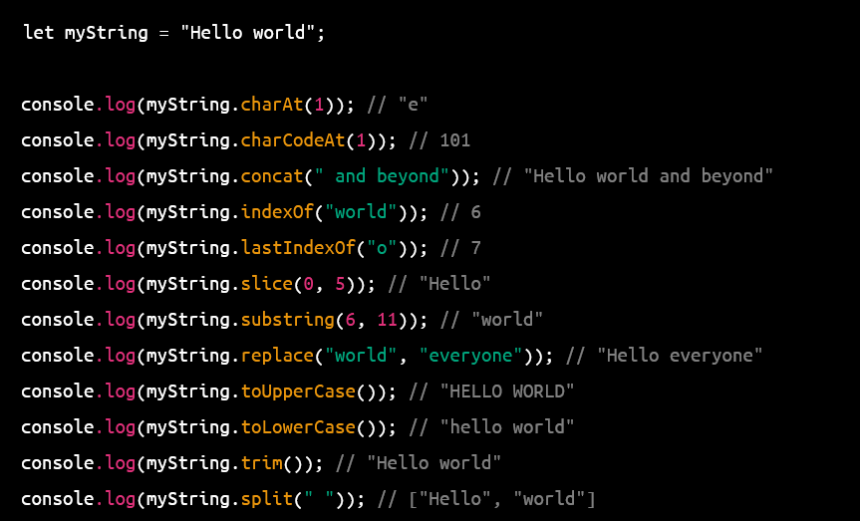

Slide 27
Array Methods
push() - adds one or more elements to the end of an array and returns the new length of the array.
pop() - removes the last element from an array and returns that element.
shift() - removes the first element from an array and returns that element.
unshift() - adds one or more elements to the beginning of an array and returns the new length of the array.
concat() - joins two or more arrays and returns a new array.
slice() - extracts a section of an array and returns a new array.
splice() - adds or removes elements from an array.
sort() - sorts the elements of an array in place.
reverse() - reverses the order of the elements in an array in place.

Slide 28
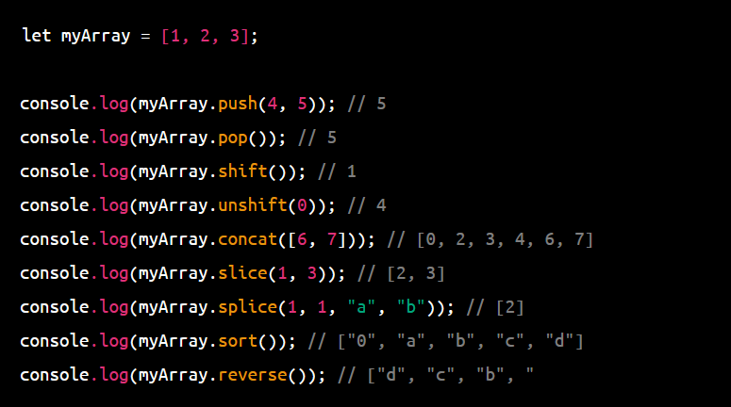

Slide 29
Array methods Continued
join() - joins all elements of an array into a string.
indexOf() - returns the first index at which a given element can be found in the array.
lastIndexOf() - returns the last index at which a given element can be found in the array.
includes() - determines whether an array includes a certain element.
forEach() - executes a provided function once for each array element.
map() - creates a new array with the results of calling a provided function on every element in the array.
filter() - creates a new array with all elements that pass the test implemented by the provided function.
reduce() - applies a function against an accumulator and each element in the array to reduce it to a single value.

Slide 30
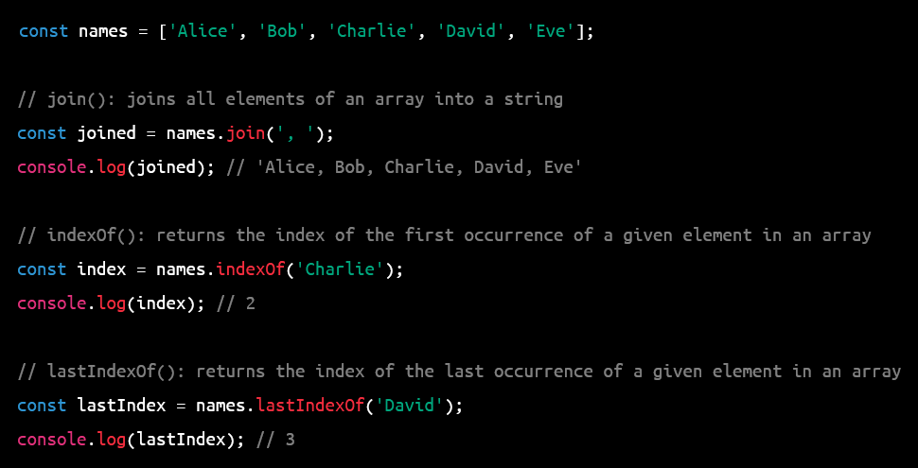

Slide 31
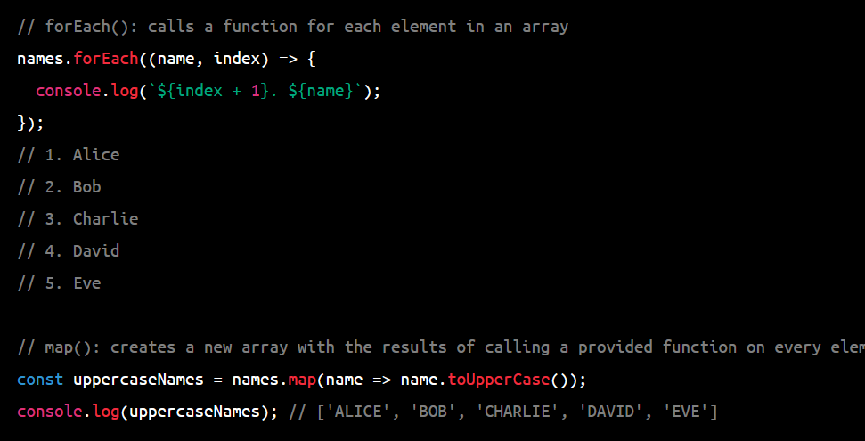

Slide 32
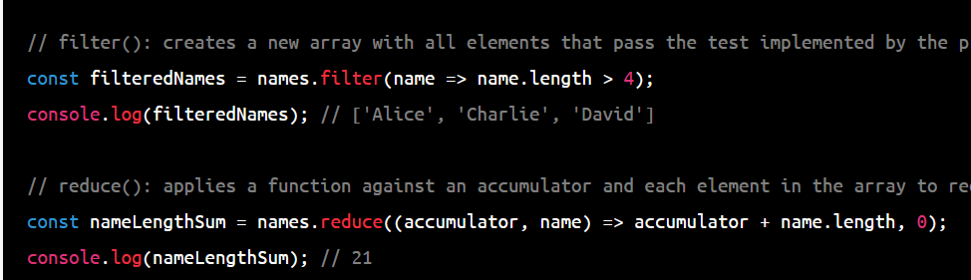

Slide 33
Object methods
Object.assign() - copies the values of all enumerable properties from one or more source objects to a target object.
Object.keys() - returns an array of all the enumerable property names of an object.
Object.create() - creates a new object with the specified prototype object and properties.
Object.defineProperty() - defines a new property directly on an object or modifies an existing property's attributes.
Object.getOwnPropertyDescriptor() - returns an object describing the attributes of a specified property.
Object.getPrototypeOf() - returns the prototype of an object.
Object.is() - determines whether two values are the same value.
Object.hasOwnProperty() - returns a boolean indicating whether the specified object has a property with the specified name.

Slide 34
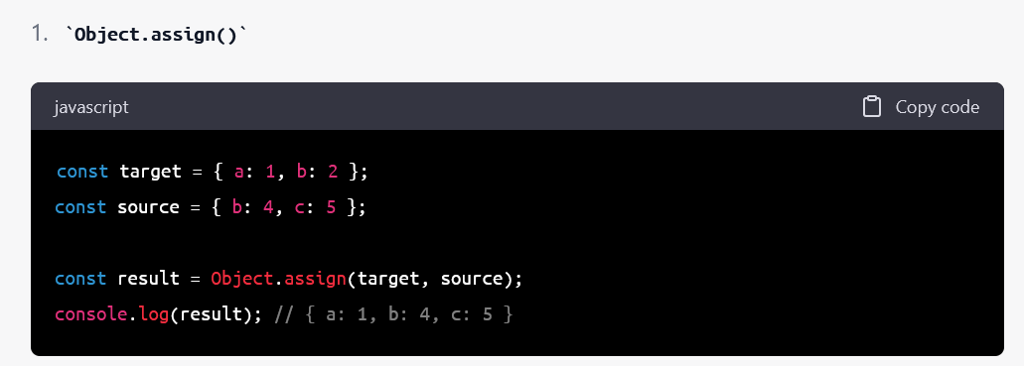
Notes:
In this example, Object.assign() is used to copy the values of all enumerable properties from the source object to the target object. The result is a new object that contains all the properties of both objects, with any matching properties from the source object overwriting those in the target object.

Slide 35
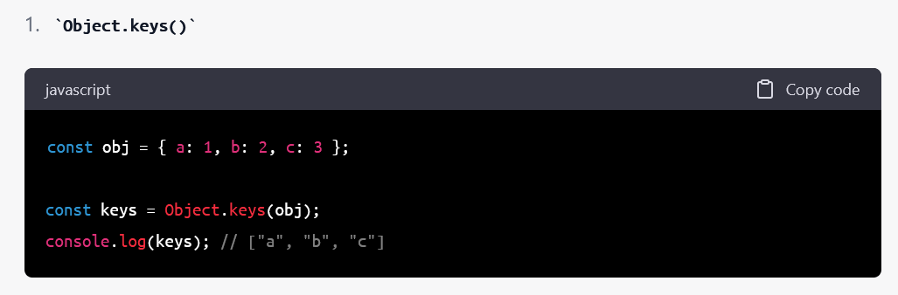
Notes:
In this example, Object.keys() is used to return an array of all the enumerable property names of the obj object. The resulting array contains the strings "a", "b", and "c", which are the keys of the obj object.

Slide 36
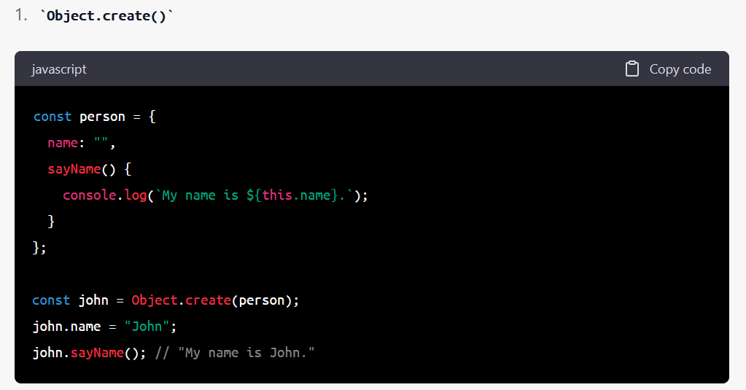
Notes:
In this example, Object.create() is used to create a new object john with person as its prototype object. john inherits the name property and sayName() method from the person object. The john object is then assigned a name property with the value "John", and the sayName() method is called on john, resulting in the output "My name is John.".

Slide 37
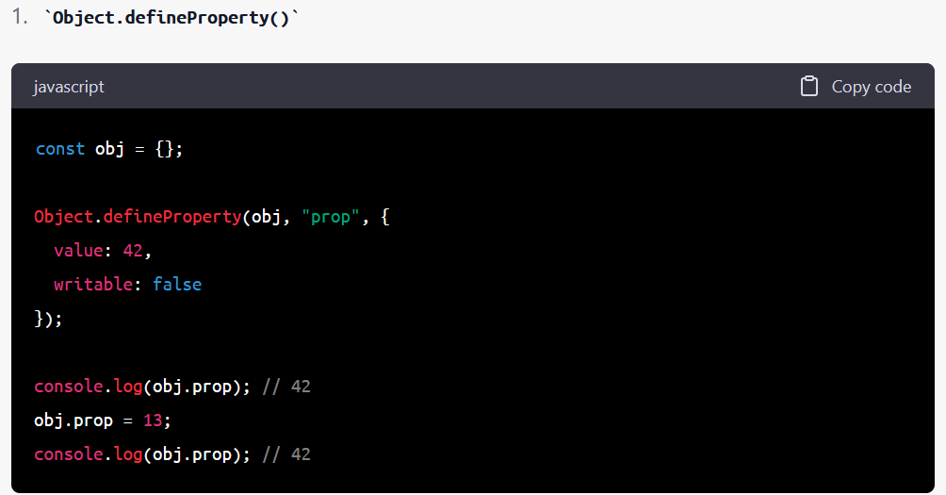
Notes:
In this example, Object.defineProperty() is used to define a new property prop directly on the obj object. The value of prop is set to 42, and the writable attribute is set to false, which means that the property cannot be reassigned a new value. When the obj.prop property is accessed and when an attempt is made to reassign a value to it, the output is always 42.

Slide 38
DOM methods
getElementById() - retrieves an element from the document based on its ID attribute.
getElementsByTagName() - retrieves a list of elements with the specified tag name.
getElementsByClassName() - retrieves a list of elements with the specified class name.
querySelector() - retrieves the first element in the document that matches a specified CSS selector.
querySelectorAll() - retrieves a list of all elements in the document that match a specified CSS selector.
createElement() - creates a new element node.
createTextNode() - creates a new text node.
appendChild() - appends a child node to an element.
removeChild() - removes a child node from an element.
replaceChild() - replaces one child node of an element with another.
setAttribute() - sets the value of an attribute on an element.
getAttribute() - retrieves the value of an attribute on an element.
addEventListener() - registers an event handler function for a specified event on an element.
removeEventListener() - removes an event handler function for a specified event on an element.
style - property used to set or retrieve the inline style of an element.

Slide 39
DOM methods
parentNode - retrieves the parent node of an element.
childNodes - retrieves a list of child nodes of an element.
nextSibling - retrieves the next sibling node of an element.
previousSibling - retrieves the previous sibling node of an element.
firstChild - retrieves the first child node of an element.
lastChild - retrieves the last child node of an element.
innerHTML - property used to set or retrieve the HTML content of an element.
textContent - property used to set or retrieve the text content of an element.
classList - property used to set or retrieve the classes of an element as a DOMTokenList object.
dataset - property used to set or retrieve data attributes of an element as a DOMStringMap object.

