Slide 1
Garbage Collector
-

Slide 2
Scope Chain
-

Slide 3
Closure
-

Slide 4
{ let x = 1; } console.log(x)

Slide 5

{ }

Slide 6

{ }
X = 1

Slide 7

{ }

Slide 8
{ }

Slide 9
{ let x = 1; function printNumber(){ console.log(x) } } printNumber() // 1

Slide 10

{ }

Slide 11

{ }
X = 1

Slide 12
{ }
X = 1
printNumber()

Slide 13
{ }
X = 1
printNumber()

Slide 14

{ }
X = 1
printNumber()

Slide 15
{ }
X = 1
printNumber()

Slide 16
{ }
X = 1
printNumber()

Slide 17
function(){ // Do something let x = 0; return increment(){ x++; } }()

Slide 18
IIFE
Immediately Invoked Functional Expression

Slide 19
(function(){ // Do something })()

Slide 20
Modules

Slide 21
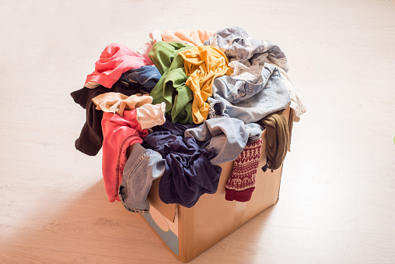

Slide 22
