Slide 1
JS101

Slide 2
Form validation

Slide 3
Client-side validation
Before sending data to server, we can check it’s validity and provide quick feedback to user.
Server-side validation is still required, because client-side validation can be easily bypassed.
There are two options of client-side validation in the browser:
Built-in form validation
JavaScript validation

Slide 4
Built-in Validation
Performant, but not customizable

Slide 5
Build-in validation
required
minlenght and maxlenght
Min and max
Type
Pattern: regular expression

Slide 6
:valid

Slide 7
:invalid

Slide 8
document.querySelector(“form”)

Slide 9
document.forms

Slide 10
document.forms[0]

Slide 11
form.elements[index] form.elements[name] form.elements[id]
Notes:
HTMLFormControlsCollection type

Slide 12
Element.validity
badInput
customError
patternMismatch
rangeOverflow
rangeUnderflow
stepMismatch
tooLong
tooShort
typeMismatch
valid
valueMissing
Notes:
HTMLFormControlsCollection type

Slide 13
form.reset()

Slide 14
form.submit()

Slide 15
value.trim()

Slide 16
Map
A Map is a collection of key-value pairs in JavaScript.
The keys in a Map are used to identify and retrieve the associated values.
Unlike Objects in JavaScript, Maps allow any type of value to be used as a key, including objects, functions, and other complex data types.
Keys in a Map must be unique, but values can be duplicated.
Maps are iterable, which means you can loop over the keys or values.
Maps maintain the order of keys, which is useful when you need to retrieve the keys in a specific order.

Slide 17
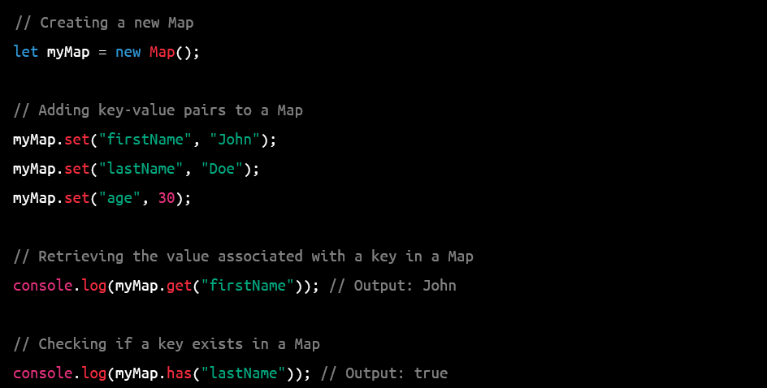

Slide 18
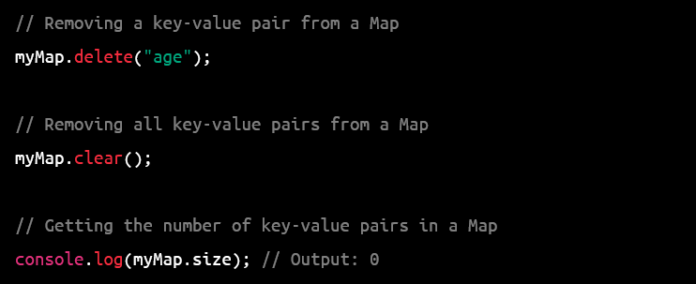

Slide 19
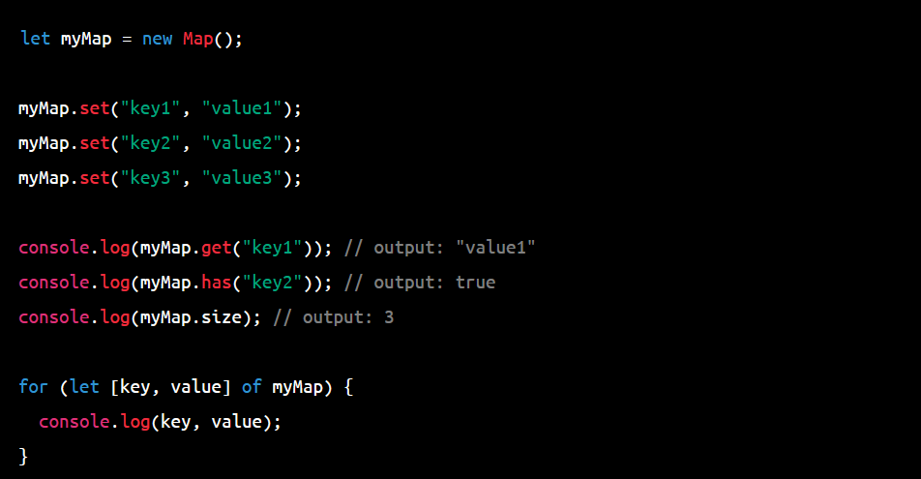

Slide 20
Set
A Set is a collection of unique values, where each value can only occur once. It's useful when you need to store a list of items without duplicates. Sets are also iterable, which means that you can loop over the values.

Slide 21
