Slide 1
JS101

Slide 2
JS101

Slide 3
Objects

Slide 4
Objects
Key-value pairs
methods
Factory Functions
Constructor
Prototype
Notes:
React has some key concepts
declarative: we tell the react how our app should look, and the lest should be taken care by react how to do it.
In order to achieve it, react uses some tools.
1. instead of js, it uses an extended version of js, called JSX
2.

Slide 5
Factory Function

Slide 6
function createPerson (name) {
const obj;
obj.name = name
return obj;
}

Slide 7
const ahmad = createPerson(“Ahmad”)

Slide 8
Constructor Function

Slide 9
function Person (name) {
this.name = name;
}

Slide 10
const person1 = new Person(“Ahmad”)

Slide 11
Prototype

Slide 12
student1
student2
student3
name
name
name
grade
grade
grade
sayHi
sayHi
sayHi

Slide 13
student1
student2
student3
name
name
name
grade
grade
grade
sayHi
sayHi
sayHi

Slide 14
prototype
sayHi
student1
student2
student3
name
name
name
grade
grade
grade
Notes:
if the property can't be found in the object itself, the prototype is searched for the property. If the property still can't be found, then the prototype's prototype is searched,

Slide 15
Null
Object
Prototype
Prototype
Prototype
Student1
Notes:
if the property can't be found in the object itself, the prototype is searched for the property. If the property still can't be found, then the prototype's prototype is searched,

Slide 16
Object Oriented Programming (OOP)

Slide 17
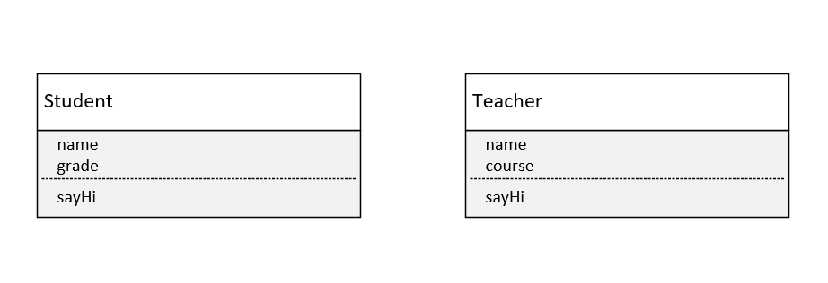

Slide 18
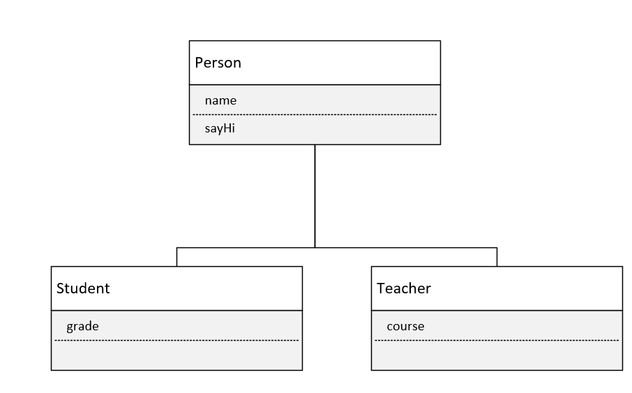

Slide 19
Error Handling

Slide 21
try {
}
catch (error) {
}
Notes:
The try statement allows you to define a block of code to be tested for errors while it is being executed.
The catch statement allows you to define a block of code to be executed, if an error occurs in the try block.

Slide 22
try {
}
catch (error) {
}
finally {
// runs anyway
}
Notes:
The try statement allows you to define a block of code to be tested for errors while it is being executed.
The catch statement allows you to define a block of code to be executed, if an error occurs in the try block.

