Slide 1
Public Infrastructure Information
Retrieval System
https://github.com/sarthak-23081/Public-Infrastructure-Final/tree/main
Group Members:
Sarthak Kaner (MT23081)
Prerna Tyagi (MT23131)
Aman Gupta (MT23016)
Sakshi Singh (MT23135)
Mayank SIngh Thakur(MT23123)
Rashi Khandelwal(MT23072)

Slide 2
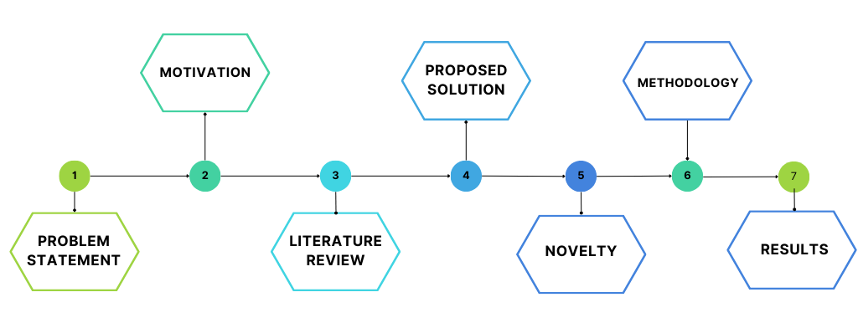
Outline

Slide 3
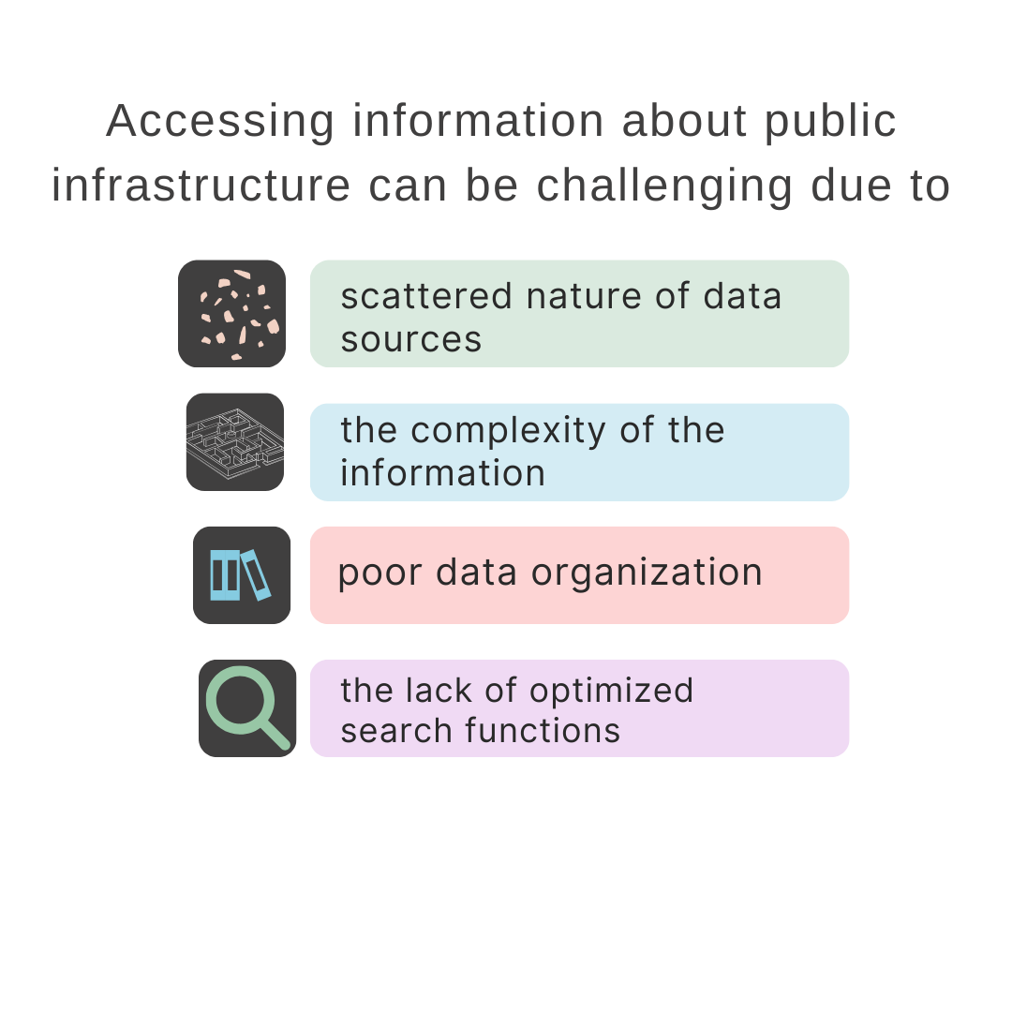
Problem Statement

Slide 4

Motivation
How can I get the details of government hospitals in south delhi ?
Is there any metro station in this region ?
How can I contact a particular school ?
What is the IFSC code of any particular branch ?

Slide 5
Literature Review
We read several papers for this project, some of which have been briefed here:
Effective Retrieval Of Related Documents Based On Spelling Correction To Improve Information Retrieval System
Due to the presence of vast amount of documents present on the web, this paper talks about information retrieval method which uses a combination of vector space modeling and language statistical model to improve the retrieval of related documents.
An Effective Retrieval Approach for Documents related to Past Civil Engineering Projects
The paper proposes an advanced document retrieval solution within the PROBIM project to efficiently manage and retrieve digital documents in civil engineering projects and tender responses, addressing challenges such as semantic search and usability for non-computer science users.

Slide 6
Literature Review
3.) Hindi Chatbot for Supporting Maternal and Child Health Related Queries in Rural India
This paper uses different techniques such as DTP (Dynamic Time Pruning), SPC (Sentence Pair Classification), and COS (Cosine similarity) to assess sentence similarity and retrieve relevant information. It utilizes FAQ-based model and is implemented using a healthcare database in Hindi.
4.) Text Pre-Processing Methods on Cross Language Information Retrieval
This paper highlights the significance of text pre-processing in CLIR systems and provides insights into the impact of different pre-processing techniques on the effectiveness of CLIR models for languages like Tamil and Malayalam. It uses Tokenization, Noise Removal, stop word Removal, Stemming and Term weighting with TF-IDF for text preprocessing.

Slide 7
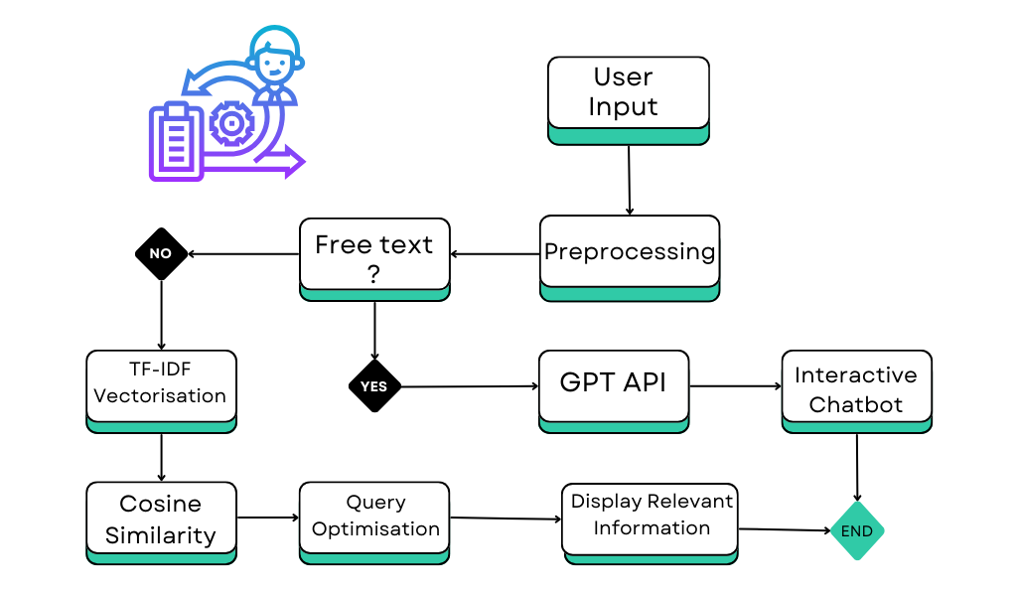
Methodology

Slide 8
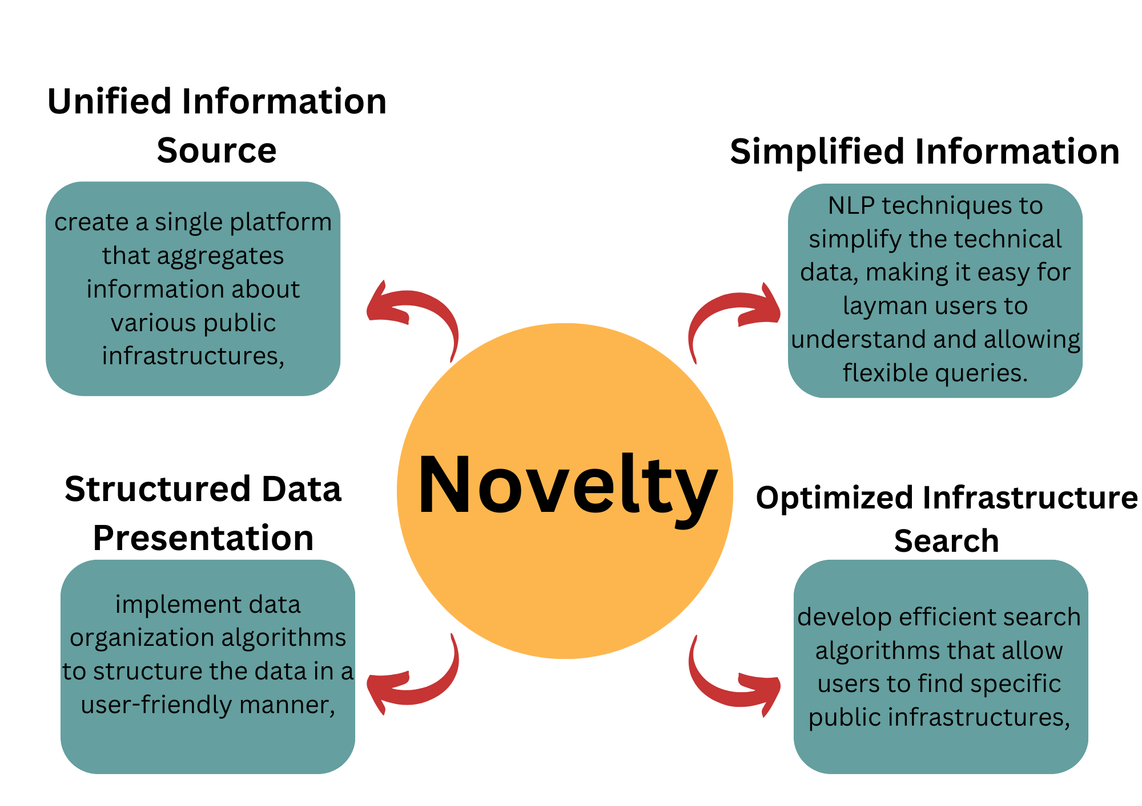
Novelty

Slide 9
Proposed Solution
Data Collection: We have collected comprehensive public infrastructure data for three cities, ensuring a wide range of information is available for retrieval.
TF-IDF: We employ Term Frequency-Inverse Document Frequency (TF-IDF) to weigh the importance of different words in the user’s query, improving the accuracy of the search results.
Similarity Search: Our system uses similarity search algorithms to find the most relevant data based on the user’s query.
Spell Correction: Our system includes a fuzzy module for spell correction, ensuring that minor spelling errors in the user’s query do not hinder the retrieval of relevant data.
User Interface: We have developed an intuitive UI that allows users to easily input their queries and retrieve the relevant data.
Chatbot: We have integrated a chatbot into our system to provide an interactive and engaging user experience.

Slide 10
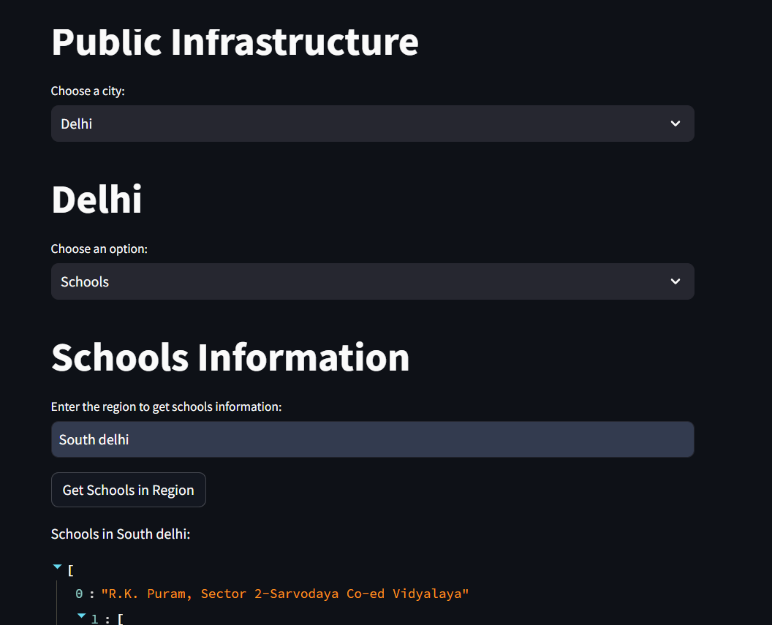
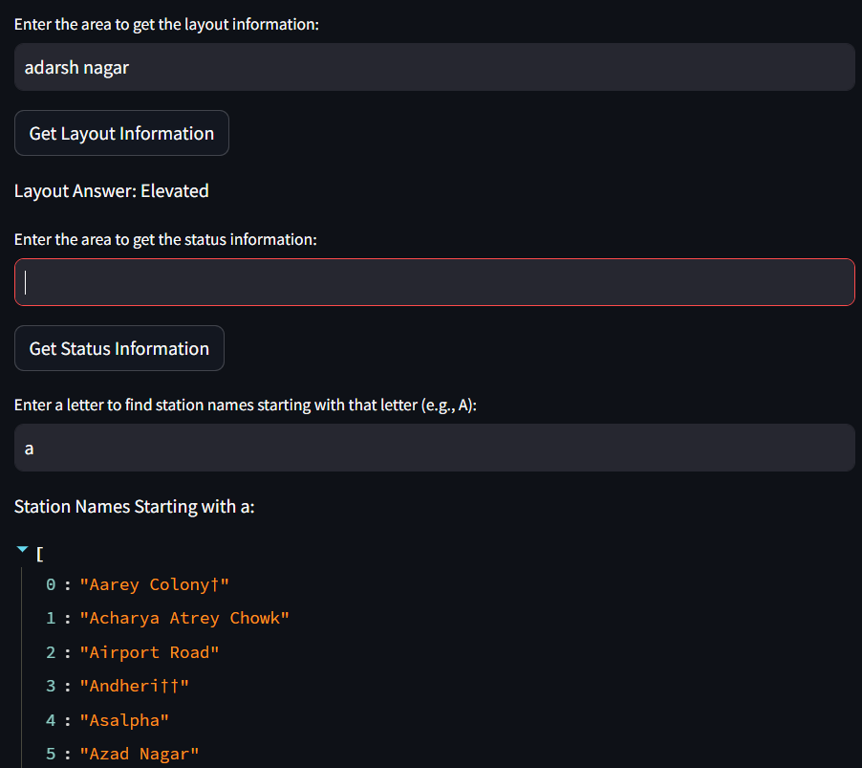
System Prototype
Sample output
Landing Page

Slide 11
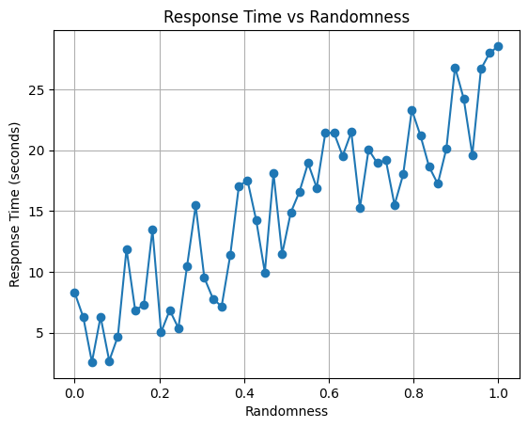
Evaluation

Slide 12
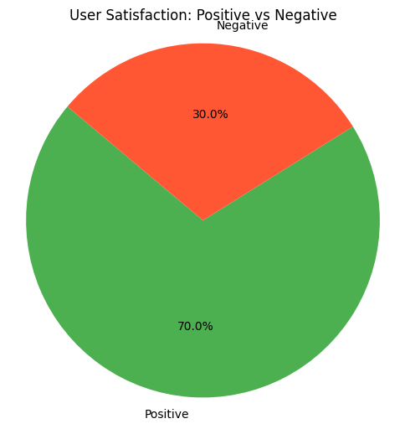
Evaluation

Slide 13
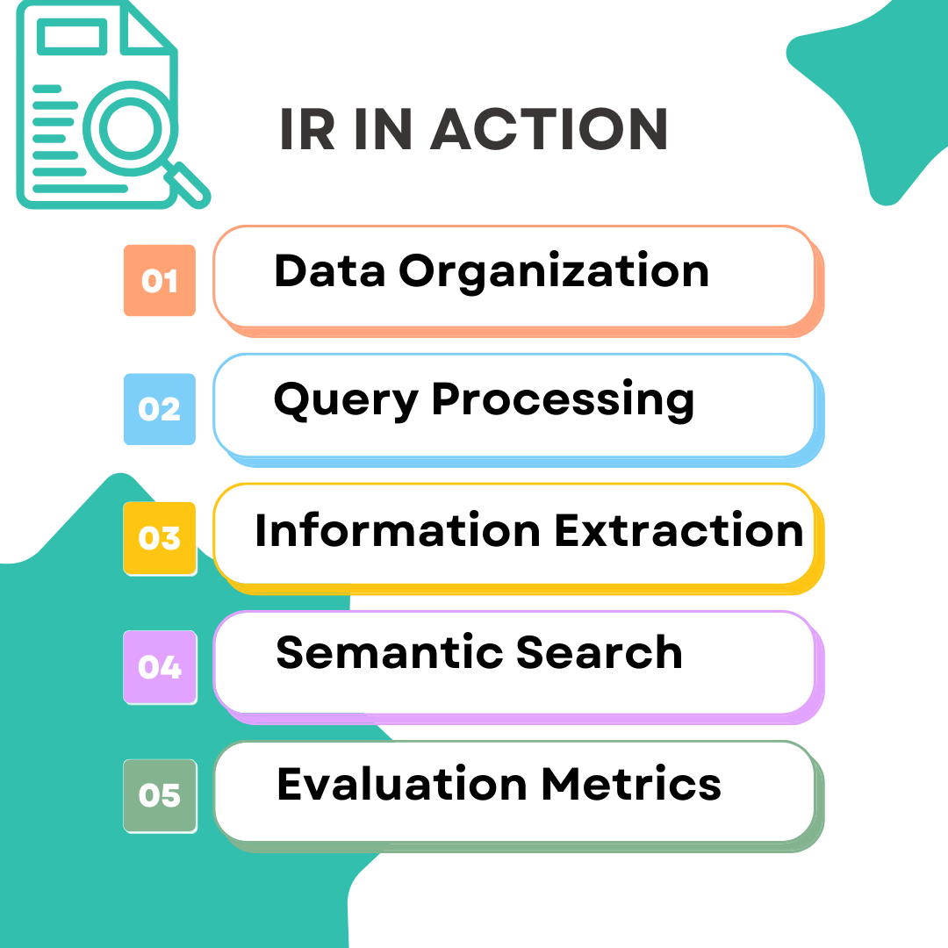
How our project uses IR ?

Slide 14
References
M. Houtinezhad and H. R. Ghaffary, "Effective retrieval of related documents based on spelling correction to improve information retrieval system," 2018 3rd Conference on Swarm Intelligence and Evolutionary Computation (CSIEC), Bam, Iran, 2018, pp. 1-6, doi: 10.1109/CSIEC.2018.8405418.
C. Esposito and O. Tamburis, "An Effective Retrieval Approach for Documents Related to Past Civil Engineering Projects," 2019 IEEE 28th International Conference on Enabling Technologies: Infrastructure for Collaborative Enterprises (WETICE), Napoli, Italy, 2019, pp. 295-300, doi: 10.1109/WETICE.2019.00068.
Ritwik Mishra, Simranjeet Singh, Jasmeet Kaur, Pushpendra Singh, and Rajiv Shah. 2023. Hindi Chatbot for Supporting Maternal and Child Health Related Queries in Rural India. In Proceedings of the 5th Clinical Natural Language Processing Workshop, pages 69–77, Toronto, Canada. Association for Computational Linguistics.
S. V. S and P. R, "Text Pre-Processing Methods on Cross Language Information Retrieval," 2022 International Conference on Connected Systems & Intelligence (CSI), Trivandrum, India, 2022, pp. 1-5, doi: 10.1109/CSI54720.2022.9923952. keywords: {Information retrieval;Feature extraction;Tokenization;Task analysis;Text pre-processing;CLIR;stemming;Tamil;Malayalam},

Slide 15


