Slide 1

Advanced Database Systems
Assignment 4
A Critique of ANSI SQL Isolation Levels
16CS30044: Sarthak Chakraborty

Slide 2
1.
INTRODUCTION
Isolation Levels specified in ANSI/ISO SQL-92

Slide 3
Introduction to Isolation
Isolation guards against inconsistent database state due to concurrent transactions
Phenomena: Operation subsequences that may lead to anomaly [Defined in ANSI/ISO SQL-92 Specifications]
Dirty Read: Reading a data item that never existed
Non-repeatable Read: Rereading data item shows inconsistent values
Phantom: Rereading data based on <search condition> returns different set of item

Slide 4

Dirty Read
Transaction T1 modifies a data item. Another transaction T2 then reads that data item before T1 performs a COMMIT or ROLLBACK. If T1 then performs a ROLLBACK, T2 has read a data item that was never committed and so never really existed.
write1(x)
. . .
read2(x)
. . .
( a1 and c2 in any order)
P1
write1(x)
. . .
read2(x)
. . .
((c1 or a1) and (c2 or a2)
in any order)
Statement does not insist that T1 aborts
A1
ACTUAL
ANOMALY !!
Loose Interpretation

Slide 5
Non-Repeatable Read
Transaction T1 reads a data item. Another transaction T2 then modifies or deletes that data item and commits. If T1 then attempts to reread the data item, it receives a modified value or discovers that the data item has been deleted.
read1(x)
write2(x)
commit2
read1(x)
commit1
P2
read1(x)
. . .
write2(x)
. . .
((c1 or a1) and (c2 or a2)
in any order)
A2

Slide 6
Phantom
Transaction T1 reads a set of data items satisfying some <search condition>. Transaction T2 then creates data items that satisfy T1’s <search condition> and commits. If T1 then repeats its read with the same <search condition>, it gets a set of data items different from the first read.
read1(P)
write2(y inP)
commit2
read1(P)
commit1
A2
P3
read1(P)
. . .
write2(y in P)
. . .
((c1 or a1) and (c2 or a2)
in any order)

Slide 7
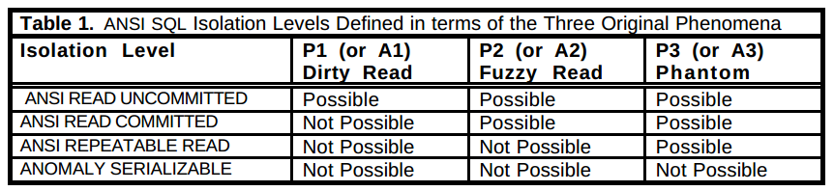
Isolation Levels in ANSI/ISO SQL-92
Execution subsequences that disallow the three phenomena are not fully serializable !

Slide 8
2.
ANALYSIS
Analysis of ANSI SQL Isolation Levels

Slide 9
Dirty Write - A New Phenomena
Transaction T1 modifies a data item. Another transaction T2 then further modifies that data item before T1 performs a COMMIT or ROLLBACK. If T1 or T2 then performs a ROLLBACK, it is unclear what the correct data value should be.
P0
write1(x)
. . .
write2(x)
. . .
((c1 or a1) and (c2 or a2)
in any order)
Violates Database Consistency
Only ANSI SERIALIZABLE isolation level excludes this anomalous behaviour
Notes:
Without protection from P0, the system can’t
undo updates by restoring before images. (NEW SLIDE??)

Slide 10
REMARK
ANSI SQL isolation should be modified to require P0 for all isolation levels

Slide 11
Phenomena or Anomaly: Which is Correct?
read1[x=50] -> write1[x=10] -> read2[x=10] -> read2[y=50] -> commit2 -> read1[y=50] -> write1[y=90] -> commit1
T1 transfering 40 from x to y, maintaining x+y=100, but T2 reads inconsistent state where x+y=60
A1 not violated No transaction aborts
A2 not violated No rereading
A3 not violated No relevant predicate change
P1 VIOLATED !!

Slide 12
Phenomena or Anomaly: Which is Correct?
read1[x=50] -> read2[x=50] -> write2[x=10] -> read2[y=50] -> write2[y=90] -> commit2 -> read1[y=90] -> commit1
P2 VIOLATED !!
read1[P] -> write2[insert y in P] -> read2[z] -> write2[z] -> commit2 -> read1[z] -> commit1
P3 VIOLATED !!

Slide 13
REMARK
Strict interpretations A1, A2, and A3 have unintended weaknesses. The correct interpretations are the Loose ones. We assume in what follows that ANSI meant to define P1, P2, and P3.

Slide 14
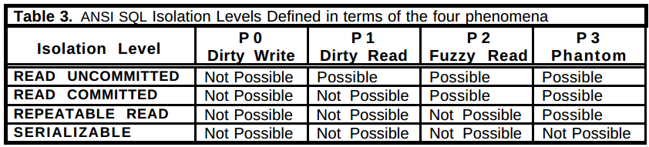
Isolation Levels with Four Phenomena

Slide 15
3.
CURSOR STABILITY
Other Isolation Levels

Slide 16
Lost Update Anomaly
The lost update anomaly occurs when transaction T1 reads a data item and then T2 updates the data item (possibly based on a previous read), then T1 (based on its earlier read value) updates the data item and commits.
P4
read1[x=100], read2[x=100], write2[x=120], commit2, write1[x=130], commit1
Update of x=120 lost
Possible at READ COMMITTED level
Forbidding P0 and P1 allows the history
Forbidding P2 precludes P4
read1(x)
. . .
write2(x)
. . .
write1(x)
. . .
commit1

Slide 17
Cursor Stability
Fetch data from a cursor
Lock the current data item of the cursor
Lock is held till cursor moves or is closed, possibly by commit
To update a row, hold write lock until transaction commits, even after the cursor moves on
REPEATABLE READ >>
CURSOR STABILITY >>
READ COMMITTED
Widely Implemented

Slide 18
4.
SNAPSHOT ISOLATION
Other Isolation Levels

Slide 19
Snapshot Isolation
Transaction reads from the snapshot of the data
Read is never blocked for a transaction running in Snapshot Isolation
Updates by concurrent transaction are not visible to each other
T1 can commit if there is no other concurrent transaction T2 wrote data item that T1 also wrote and committed. Otherwise T1 aborts. FIRST COMMITTER WINS
Type of multiversion concurrency control

Slide 20
Data Item Constraint Violation Anomaly
Read Skew
Suppose transaction T1 reads x, and then a second transaction T2 updates x and y to new values and commits. If now T1 reads y, it may see an inconsistent state, and therefore produce an inconsistent state as output.
A5A
read1(x) . . write2(x) . . write2(y) . . commit2 . . read1(y) . . (c1 or a1)

Slide 21
Data Item Constraint Violation Anomaly
Write Skew
Suppose T1 reads x and y, which are consistent with some constraint, and then a T2 reads x and y, writes x, and commits. Then T1 writes y. If there were a constraint between x and y, it might be violated.
A5B
read1(x) . . read2(y) . . write1(y) . . write2(x) . . (c1 and c2 can occur)

Slide 22
Snapshot Isolation
First-committer-wins prevents Dirty Writes (P0)
Timestamp mechanism in SI prevents dirty reads (P1)
Transaction cannot see updates of other transactions, prevents A2
A5A not possible in SI but possible in READ COMMITTED
A5B can occur in SI. Forbidding P2 also forbids A5B. Thus P2 occurs in SI which does not occur in REPEATABLE READ
SI does not experience A3 since transaction updates are not seen by others, but REPEATABLE READ can experience A3
Snapshot Isolation histories prohibit histories with anomaly A3, but allow A5B, while REPEATABLE READ does the opposite.

Slide 23
Snapshot Isolation
REPEATABLE READ >> << SNAPSHOT ISOLATION >> READ COMMITTED
Snapshot Isolation histories preclude anomalies A1, A2 and A3. Therefore, in the anomaly interpretation of ANOMALY SERIALIZABLE
SNAPSHOT ISOLATION >> ANOMALY SERIALIZABLE

Slide 24
5.
CONCLUSION
Summary of the Analysis

Slide 25
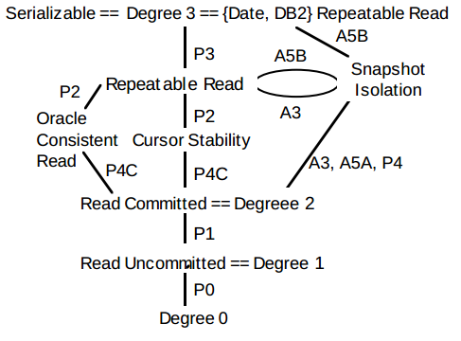
Conclusion

Slide 26
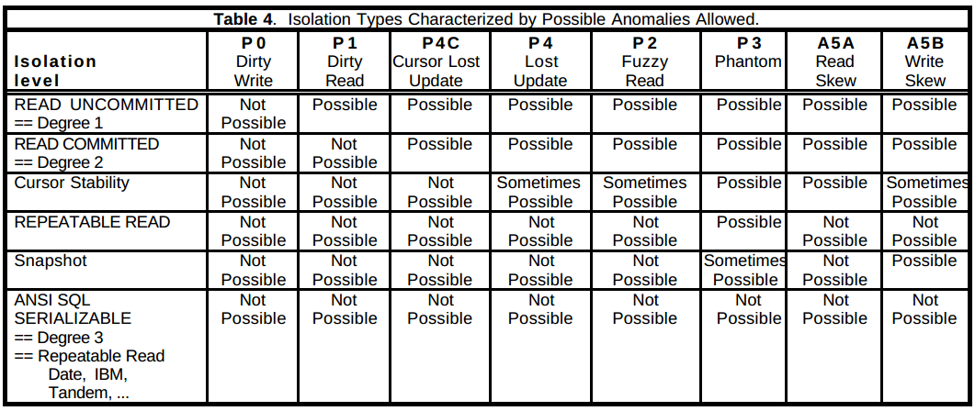
Conclusion

Slide 27
Thank You!

