Slide 1

GENERATING COUNTERSPEECH AGAINST ONLINE HATESPEECH
GROUP NUMBER 14
Hitesh Atluri
Sarthak Gupta
Sravya Mareedu
Sai Tharun Reddy
Akhil Shashi
Satya Pradeep Chandra
Monisha Ramu

Slide 2
INTRODUCTION
Social media has brought about unprecedented levels of global communication, but it has also given rise to hate speech and false information. Therefore, it has become crucial to combat hate speech in order to sustain a vibrant online community.
Combating hate speech using computational methods is a promising strategy, and the T5 language model is a versatile tool for creating counter-narratives to hate speech.
When trained on a dataset of hate speech and its corresponding counter speech, the T5 model can automatically generate new counter-narratives, making it easier to respond to hate speech.
Python, a popular programming language for machine learning and NLP tasks, is the ideal choice for implementing a system that generates counter-narratives using the T5 model.

Slide 3
CONAN DATASET
The CONAN dataset is a valuable resource for researchers and practitioners interested in creating machine learning models for producing counter-speech against online hate speech.
The collection includes over 11,000 distinct counter-narratives, each tagged with the category of hate speech it addresses.
Benefits of using the CONAN dataset include a substantial number of carefully selected, diversified, and high-quality counter-narratives written by over 100 trained experts from 3 different NGOs using nichesourcing.
The dataset also includes a broad range of hate speech scenarios and counter-narrative types.

Slide 4
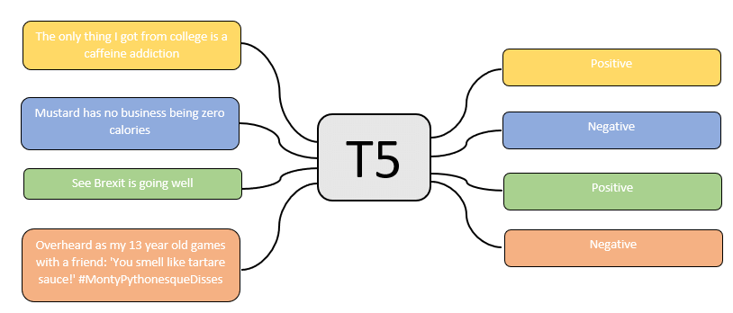
Methodology
T5 (Text- to-Text Transfer Transformer) methodology is an advanced NLP model created by Google that utilizes a text-to-text transfer learning approach. It has the capability to perform a multitude of NLP tasks and is highly adaptable, as it can be trained on different types of datasets.
Furthermore, T5 has a large-scale architecture that allows it to acquire a profound understanding of language and context.

Slide 5
Why T5 Model?
Versatility : It is flexible and can perform wide range of NLP tasks.
Large- Scale : It was trained with massive amount of data which made it to develop a deep understanding of language and context.
High - Quality Responses : It is a powerful language model that can generate high quality responses to hate speech.
Rapid Prototyping: Transfer Learning It allows developers to quickly test and refine their ideas, which can be helpful in generating counter speech responses.
Open - Source: It allows developers to modify and customize its code to build applications tailored to their specific needs.

Slide 6
DATA PREPROCESSING
INPUT DATA
LOWER CASE CONVERSION
REMOVING UNWANTED CHARACTERS/ SYMBOLS
T5 TOKENIZER
MODEL TRAINING
âJuice (Jews) are worse that Nukes.â
âjuice (jews) are worse that nukes.â
juice (jews) are worse that nukes.
tensor( [[ 22008, 19, 734, 20, 47, 416, 90, 274, 68, 118, 596, 4]] )

Slide 7
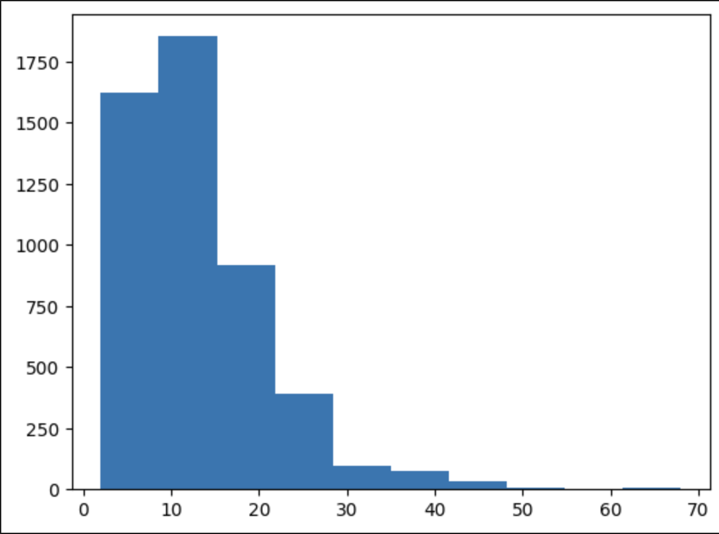
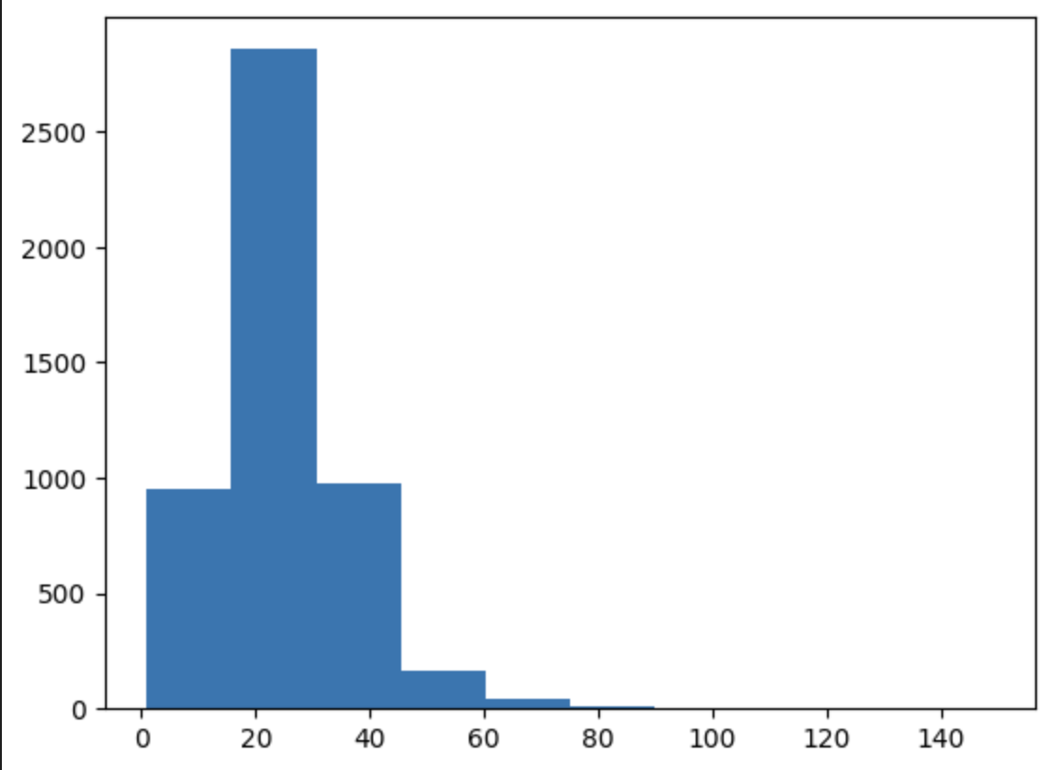
Exploratory Data Analysis
To decide the max length of the input and output tokenizer, we plotted histograms of hate_speech and counter_speech input data to understand how much padding and truncation is required
Max_source_token_length = 30 and Max_target_token_length = 60

Slide 8
MODEL PIPELINE AND TRAINING
TRAINING: 4000
T-5 LARGE MODEL
4500
COUNTER SPEECH GENERATOR MODULE
INPUT DATA
ENCODING
FLATTEN
VALIDATION: 500
TEST
500
jews
Id: 734 Label: 25 Attention Mask:1
[734, 25, 1]

Slide 9
Model Training Hyperparameters
→ Total Data Points = 5000
Training split = 4000 (80%)
Validation split = 500 (10%)
Test split = 500 (10%)
→ Batch Size = 20 so that our model can converge to global minima faster than by keeping batch size smaller.
→ Number of Epochs = 20 so that our model has enough epochs to get trained
→ Learning Rate = 0.0001
→ Optimiser = Adam
→ Number of workers = 12

Slide 10
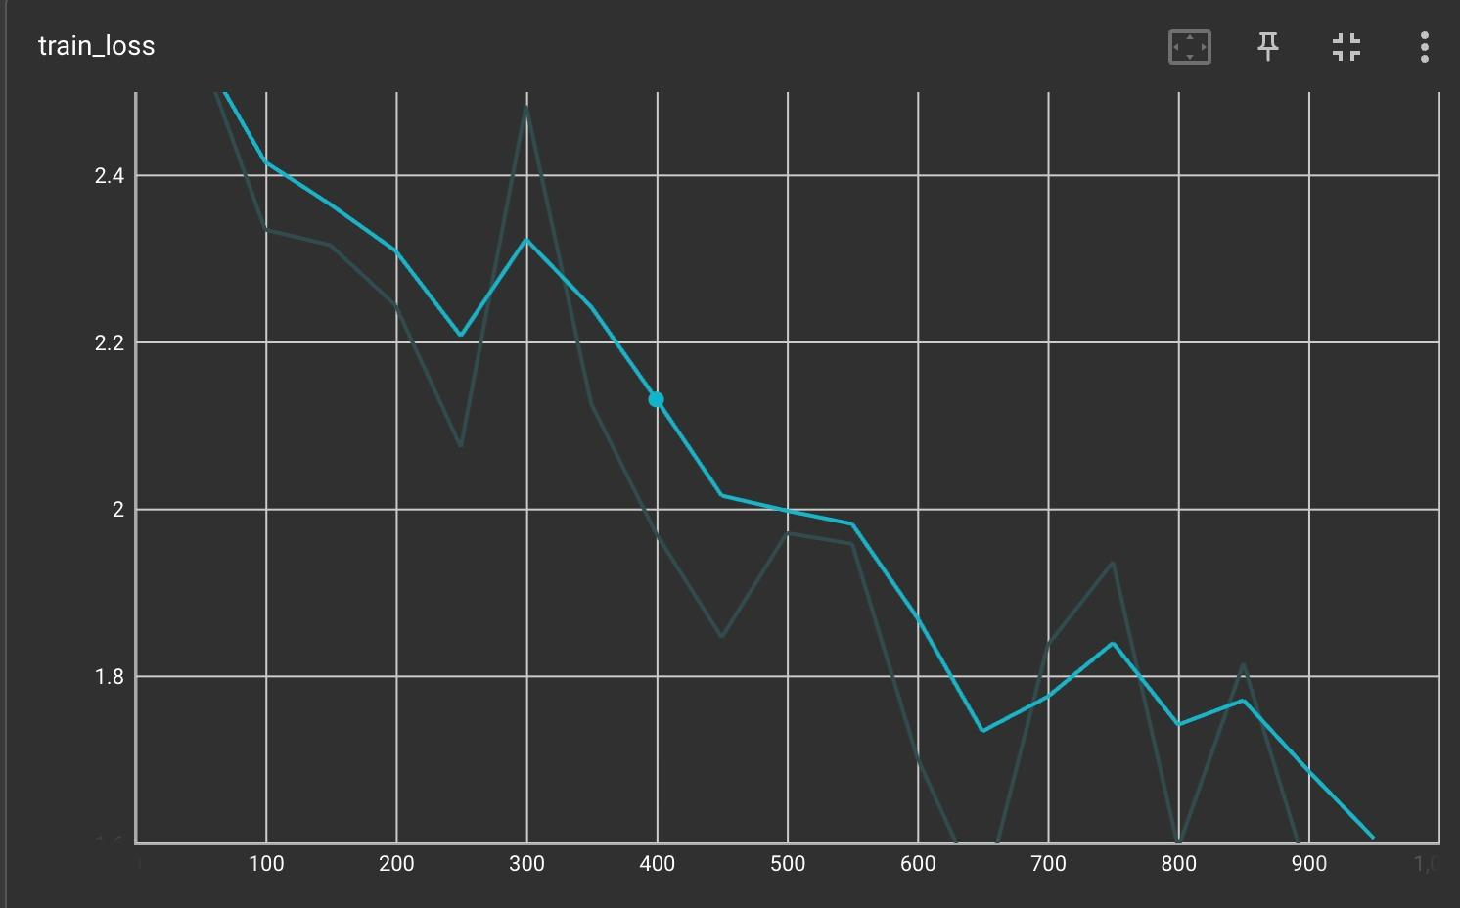
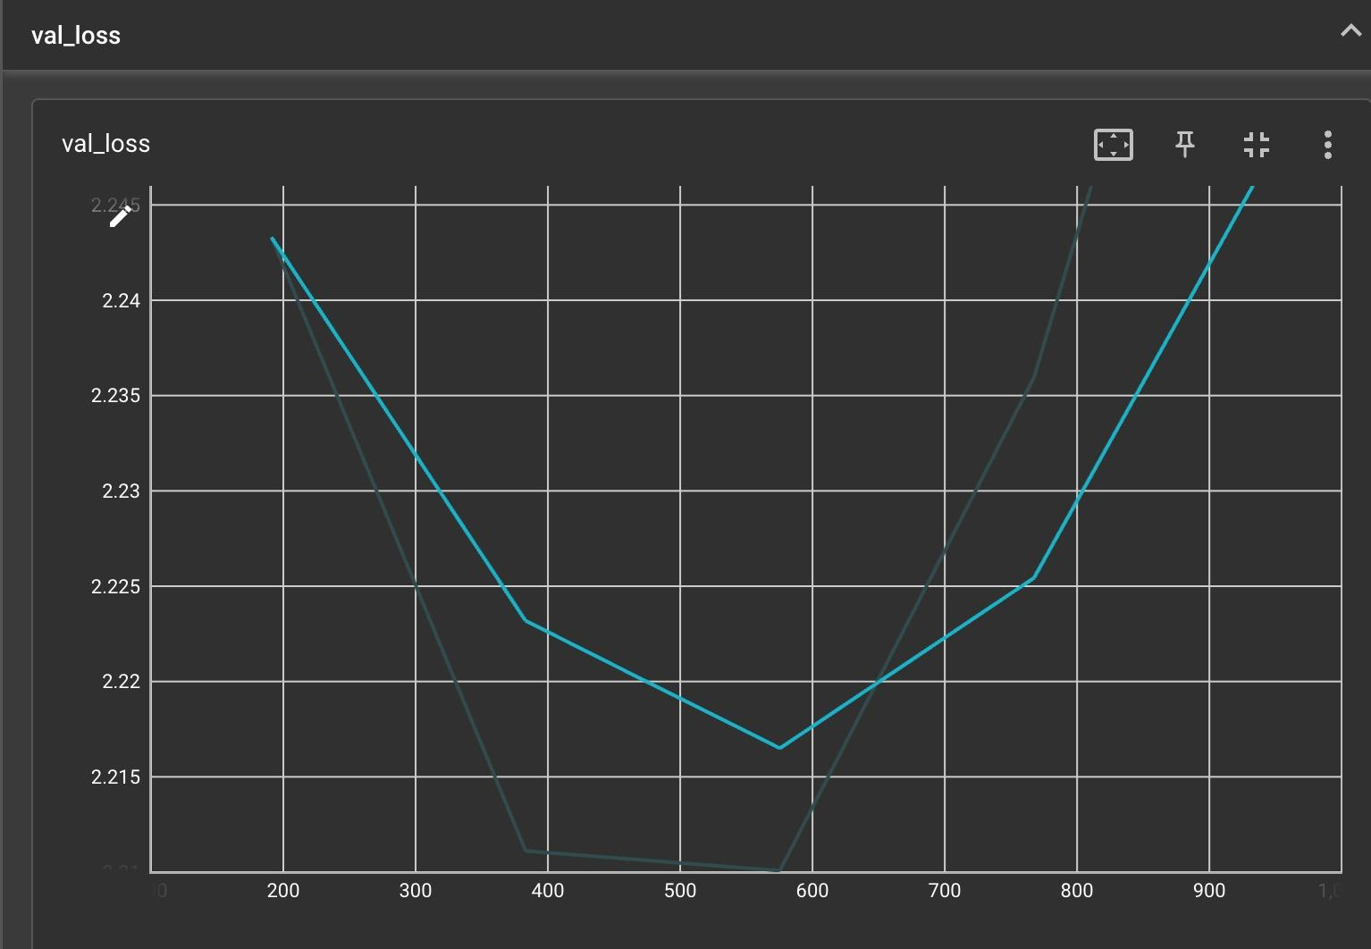
Train/ Val Loss Graph
We see that via the Validation loss that the best model checkpoint is picked well before 5 epochs.
Throughout the model training, the training loss keeps diminishing but the validation loss first decreases and then starts rising up showing that model starts overfitting after 5 epochs.

Slide 11
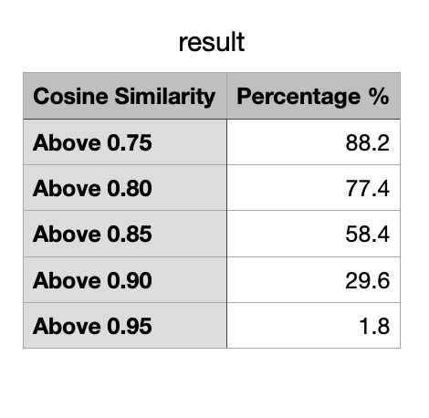
Analysis Results
Out of 500 data points on the test set, we used “Cosine similarity” as a metric to measure semantic similarity between given counter speech and generated model output counter speech using the spaCy package.
We achieve cosine similarity above 0.75 for almost 90% of the test set.
Here is the distribution →

Slide 12
Results
HATE SPEECH | EXPECTED COUNTER SPEECH | GENERATED COUNTER SPEECH | COSINE SIMILARITY
women are a burden to society and should not be allowed to vote. | the decision on who has the right to vote is based on the law. if you do not want to allow people to have the right to vote because of their gender, then you have a problem. | women are citizens and have the right to vote. they should be allowed to exercise their rights, not discriminated against because of who they were born into. | 0.92
gay men are a burden to society. | the way you phrase the statement could be the epitome of some homophobic assumptions. to be honest, so much hatred and violence spewed from the way you thought. | gay men are not a burden to society. they are just people who want to live their life as they wish, and that is what makes them human beings. | 0.90
we should have never let women into the workplace. it's against their right. | there are many cases of domestic violence, where women do not want to have such a lifestyle. this, instead, is against their rights. | women have the right to work, and it is against their rights not only in the workplace but also in life. | 0.93

Slide 13
HATE SPEECH | EXPECTED COUNTER SPEECH | GENERATED COUNTER SPEECH | COSINE SIMILARITY
the blacks should be expelled from the u.s., only white people should remain because they are superior. | the u.s. is full of many different cultures and races, which i consider a lot more equal and human than what you propose. | the u.s is a country of people, not of race. we are all human being with rights and freedoms. | 0.90
if only men were the ones to choose their partners, we'd all be so much happier. women's opinion shouldn't be taken into account. | that is the most important thing: the choice to have a relationship with someone is freely to take for each person, regardless of gender. | i think it is important to remember that women are human beings with rights. they have the right of choice and should be respected for who they want to be with. | 0.91
mentally disabled folks are criminals. | there are a variety of intellectual and creative disabilities, and they are not crimes. how can you say otherwise? | i don't think it is true that all mentally disabled people are criminals. they just need to be treated with respect and dignity, not as criminals. | 0.91
afro-americans are inferior citizens who are born to be oppressed. | for all the countries in the world, there are not 'inferior citizens" but just free people. to claim that afro-americans are born to be the "oppressed" is just wrong. | afro-americans are not born to be oppressed. they are born to have the same rights as any other citizen. | 0.90
all muslims are terrorists | the overwhelming majority of muslims are peaceful people who just take their faith seriously. | i don't think that is true. the vast majority of muslims are peaceful people who have helped to build our country and society. | 0.92

Slide 14
Further Improvements
Explore Jaccard similarity, Levenshtein distance, word2Vec and gloVe word embedding as alternative metrics to cosine similarity to measure similarity between given output and generated output.
Use a better tokenizer
Remove outliers using data processing
Train using larger model and more training data

Slide 15
References
https://arxiv.org/pdf/1910.03270.pdf
https://ojs.aaai.org/index.php/AAAI/article/view/17745
https://arxiv.org/pdf/1809.04444.pdf
https://aclanthology.org/2020.acl-main.110.pdf
https://epjdatascience.springeropen.com/articles/10.1140/epjds/s13688-021-00314-6

