Slide 1
Investigating the Effects of Multimodal Explanations Using Multiple In-Vehicle Displays for Takeover Request in Conditionally Automated Driving
Authors: Sangwon Lee, Jeonguk Hong, Gyewon Jeon, Jeongmin Jo, Sanghyeok Boo, Hwiseong Kim, Seoyoon Jung, Jieun Park, Inheon Choi, Sangyeon Kim
- Sarthak Raj

Slide 2
OVERVIEW
This study investigated the effects of multimodal explanations using multiple IVDs for TORs in Conditionally Automated Driving (CAD). A driving simulator experiment was conducted with participants to compare the effects of four different TOR designs:
Visual-only: A visual TOR displayed on the in-vehicle display(IVD).
Auditory-only: An auditory TOR played through the speakers.
Visual-auditory: A visual TOR displayed on the IVD and an auditory TOR played through the speakers.
Multimodal with multiple IVDs: A visual TOR displayed on the IVD and a complementary visual explanation displayed on the center information display (CID). The CID explanation provided more detailed information about the reason for the TOR, such as the type of obstacle detected or the road condition that exceeded the system's capabilities.
Notes:
TOR ( Takeover Requests) CAD: Level 3 automation is known as “conditional automation.” The car can control both its speed and steering at the same time, and can monitor its surroundings, so it is able to drive on its own under certain conditions. Example: example of conditional automation is Audi's AI traffic jam pilot
Conditionally Automated Driving (CAD)

Slide 3
CONTRIBUTION
Using multiple modalities (visual and auditory) and multiple IVDs is more effective than using a single modality or IVD alone.
The specific type of explanation that is provided has an impact on takeover performance.
Explanations that are clear, concise, and informative are more effective than explanations that are vague or confusing.
Using multimodal explanations and multiple IVDs can be an effective way to improve takeover performance in conditionally automated driving.
This is important because it can help to ensure that drivers are able to safely regain control of their vehicle when needed.

Slide 4
PARTICIPANTS
There were total 82 participants for the experiment
In which 45 male and 37 female were present
The mean age of all the participants was 25.1
Notes:
32 participants got the license within a year.
14 were holding the license for more than a year but less than 3 years.
And the remaining had their license for more than 3 years.

Slide 5
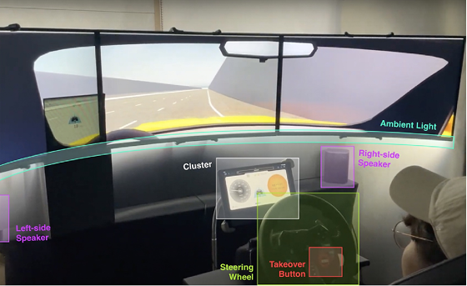
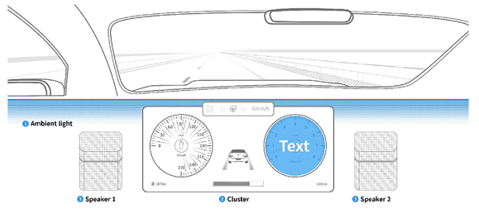
EXPERIMENTAL SETUP

Slide 6
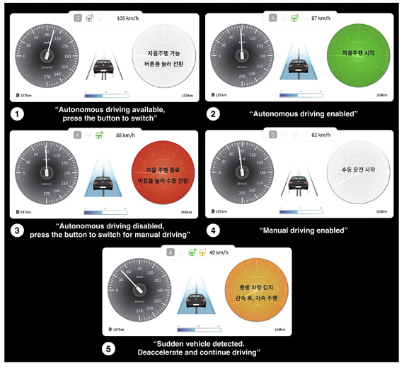
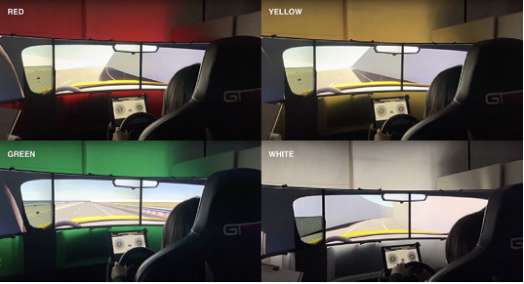
EXPERIMENTAL SETUP

Slide 7
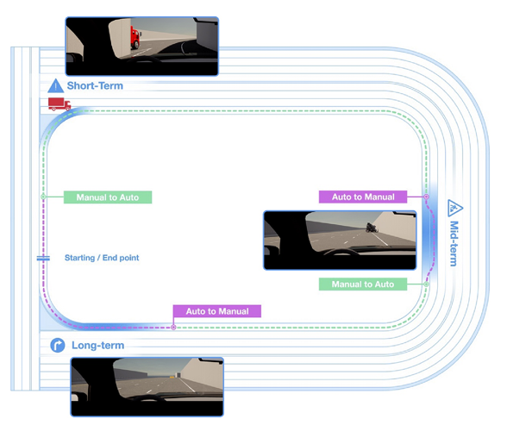
SIMULATION (Driving Map)
Notes:
Participant starts manual driving on a straight road.
Vehicle informs of highway entrance and issues TOR to switch to automated driving.
Vehicle enters highway entrance on a curved section.
Red truck narrowly misses the participant's vehicle, and vehicle performs automated emergency braking.
Vehicle resumes automated driving and goes on along a straight highway road.
Vehicle issues TOR to switch to manual driving due to construction site ahead.
Participant follows detour around the construction site.
Vehicle informs of safe situation and issues TOR to switch back to automated driving.
Vehicle continues automatically driving for a while.
Vehicle informs of highway exit and issues TOR to switch back to manual driving.
Participant successfully gets off the highway and driving session is finished.

Slide 8
STATISTICAL DATA: Takeover Response Time Findings
Initial Takeover (Manual to Automated)
Sound significantly reduced takeover response time (0.666s vs. 1.272s).
Mid-term Takeover (Automated to Manual)
Text with a coloured background (-0.155s) and sound (-0.253s) reduced response time.
Interaction effect between sound and ambient light.
Second Mid-term Takeover (Manual to Automated)
Text with a colored background improved response time (0.801s vs. 0.391s).
Long-term Takeover (Automated to Manual)
Text with a colored background (-0.242s) and sound (-0.228s) reduced response time.
Notes:
Drivers were faster to respond to takeover requests when they were accompanied by an auditory alert (M = 0.666 seconds) than when they were only accompanied by a visual alert (M = 1.272 seconds)
Drivers were faster to respond to takeover requests when they were accompanied by text on the cluster with a coloured background (M = -0.155 seconds) than when there was no text or background color (M = 0.142 seconds).
Drivers were also faster to respond to takeover requests when they were accompanied by an auditory alert (M = -0.253 seconds) than when there was only a visual alert (M = 0.210 seconds).
Drivers were faster to respond to takeover requests when they were accompanied by text on the cluster with a colored background (M = 0.801 seconds) than when there was no text or background color (M = 0.391 seconds).
Drivers were faster to respond to takeover requests when they were accompanied by text on the cluster with a colored background (M = -0.242 seconds) than when there was no text or background color (M = 0.226 seconds).
Overall Study Findings:
Multimodal explanations and in-vehicle display enhance takeover performance.
Text on the cluster with a colored background and auditory alerts expedite responses.

Slide 9
RESULTS
The results of the study showed that the multimodal TOR with multiple IVDs was the most effective in terms of driver takeover performance and perceived workload.
Participants who received the multimodal TOR had shorter takeover times, fewer errors, and reported feeling less stressed than participants who received the other TOR designs.
The multimodal TOR with multiple IVDs was particularly effective in complex driving scenarios, such as when the obstacle was unexpected or when the driver was distracted.
Notes:
TOR ( Takeover Requests)
Conditionally Automated Driving (CAD)
non-driving related tasks (NDRTs)

Slide 10
LIMITATION
Limitation 1: Participant driving skill and experience were not considered, potentially impacting takeover responses, especially for novice drivers.
Limitation 2: The study overlooked the influence of non-driving related tasks (NDRTs), which can distract drivers and impede their response to takeover requests.
Limitation 3: The experimental task design, which lacked a clear signal for response, may have led to faster responses, affecting the results.
Limitation 4: The study's findings on multimodal explanations' effect on driver trust may be influenced by factors like study simplicity, limited duration, and trust measurement.
Notes:
In summary, the study offers valuable insights into multimodal explanations and multiple IVDs' impact on takeover performance in conditionally automated driving, it's essential to consider the highlighted limitations in result interpretation and future study designs.
non-driving related tasks (NDRTs)

Slide 11
FUTURE STUDY
Future studies might include driving experience metrics (e.g., years or miles driven) to explore their impact on takeover performance.
Future studies can assess NDRTs' impact on takeovers by having participants engage in various distracting tasks in driving simulators, helping identify the most distracting types and develop mitigation strategies.
Future studies could improve ecological validity by having participants respond to takeovers at specific times or at the start of messages, enhancing generalizability to real-world driving scenarios.
Future studies may delve into explanation effects on trust in more complex automated driving situations, employing dynamic trust measures that assess trust in individual situations.
Notes:
TOR ( Takeover Requests)
Conditionally Automated Driving (CAD)
non-driving related tasks (NDRTs)

Slide 12
CONCLUSION
The findings of the study suggest that multimodal explanations using multiple IVDs can be an effective way to improve the safety and efficiency of TORs in CAD.
Future research should focus on developing more sophisticated multimodal explanations that can tailor the information provided to the specific situation and driver needs.
Notes:
TOR ( Takeover Requests)
Conditionally Automated Driving (CAD)
non-driving related tasks (NDRTs)

Slide 13
REFERENCES
Forster, Y., Naujoks, F., & Neukum, A. (2017). Increasing anthropomorphism and trust in automated driving functions by adding speech output. IEEE Intelligent Vehicles Symposium (IV), 2017, 365–372. https://doi.org/10.1109/IVS.2017.7995746
Ha, T., Kim, S., Seo, D., & Lee, S. (2020). Effects of explanation types and perceived risk on trust in autonomous vehicles. Transportation Research Part F: Traffic Psychology and Behaviour, 73. https://doi.org/10.1016/j.trf.2020.06.021
Bazilinskyy, P., Petermeijer, S. M., Petrovych, V., Dodou, D., & de Winter, J. C. F. (2018). Take-over requests in highly automated driving: A crowdsourcing survey on auditory, vibrotactile, and visual displays. Transportation Research Part F: Traffic Psychology and Behaviour, 56, 82–98. https://doi.org/10.1016/j.trf.2018.04.001
Choi, J. K., & Ji, Y. G. (2015). Investigating the Importance of Trust on Adopting an Autonomous Vehicle. International Journal of Human-Computer Interaction, 31(10), 692–702. https://doi.org/10.1080/10447318.2015.1070549

Slide 14
Thank You

