Slide 1





Mc Donald’s Menu Nutritional Analysis
Welcome to the McDonald's Menu Nutritional Analysis project! This initiative explores the comprehensive nutritional composition of McDonald's menu items, aiming to identify patterns and trends within the data. This project is a personal endeavor, conducted independently, and all information was acquired through thorough research.
Objective-
The primary goal of this project is to delve into the nutritional aspects of McDonald's menu items. The analysis covers the distribution of macronutrients, micronutrients, overall calorie content, and the relationships between these components. To provide a more quantitative understanding, a multiple linear regression analysis was conducted to quantify correlations, offering a nuanced perspective on the nutritional dynamics of the menu.

Slide 2


Information about McDonald’s
McDonald's started as a small drive-in restaurant in 1940 by Richard and Maurice McDonald in San Bernardino, California. They introduced the "Speedee Service System" in 1948, pioneering the modern fast-food model. Ray Kroc joined in 1954, opening the first franchise in 1955 and leading the company's nationwide expansion.
McDonald's saw rapid growth, with Kroc buying the company in 1961. Iconic elements like the Golden Arches and Ronald McDonald were introduced, and the first international locations opened in the 1960s. By the 1980s and 1990s, McDonald's had become a global presence with thousands of locations worldwide.
Since the 2000s, McDonald's has added healthier menu options like salads and fruit, provided nutritional information, and introduced all-day breakfast. They focus on sustainability, sourcing cage-free eggs and sustainable beef. Innovations include plant-based burgers, catering to health-conscious and environmentally aware consumers, reflecting changing dietary preferences and transparency.

Slide 3
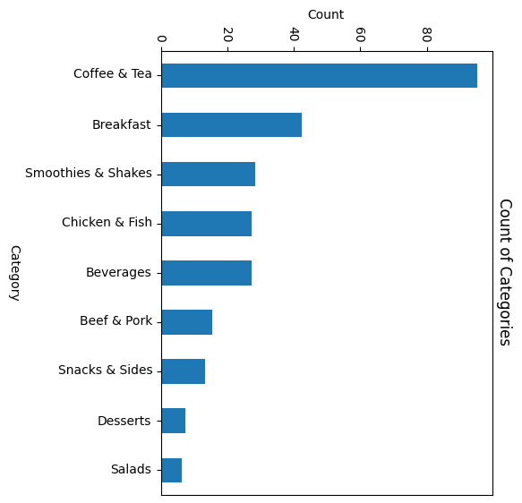
Menu
Categories-
Coffee and Tea
Breakfast
Smoothies and Shakes
Chicken and Fish
Beverages
Beef and Pork
Snacks and Sides
Desserts
Salads
…More info

Slide 4
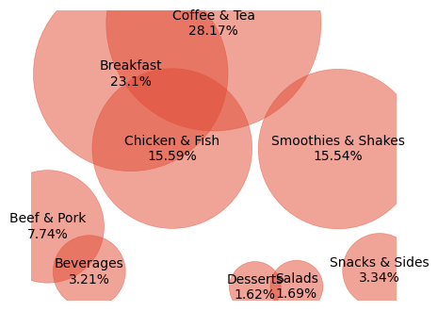
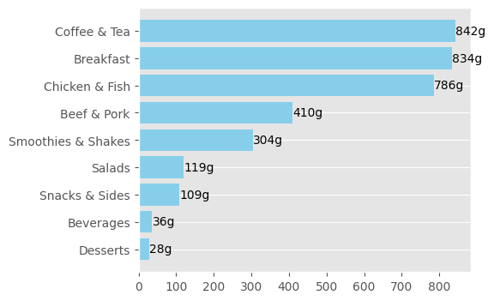
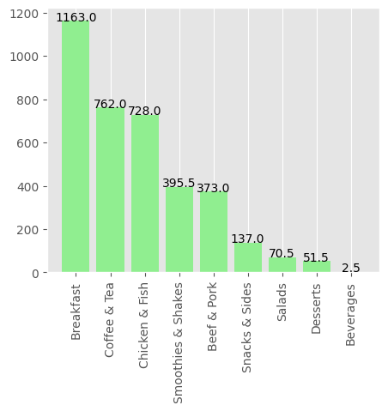
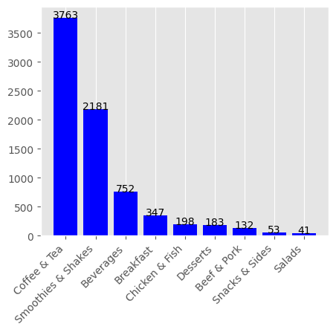
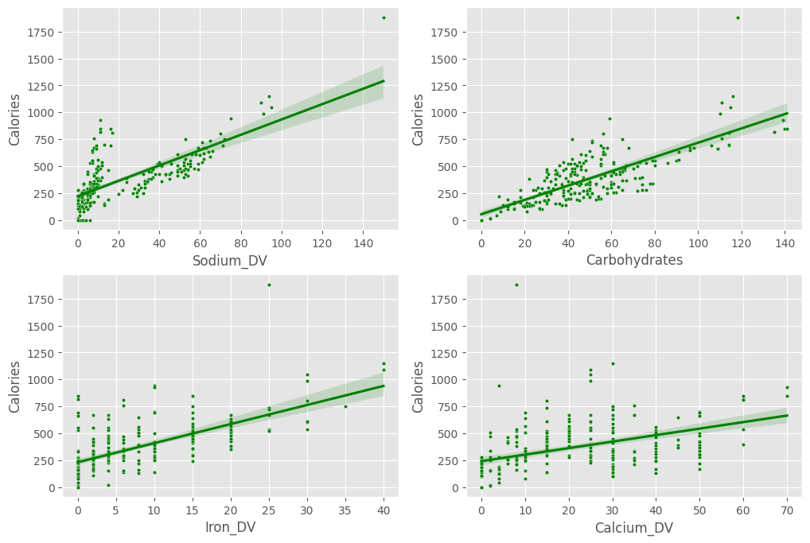
Calories
Protein
Fats
Sugars
Sugars
Others…

Slide 5
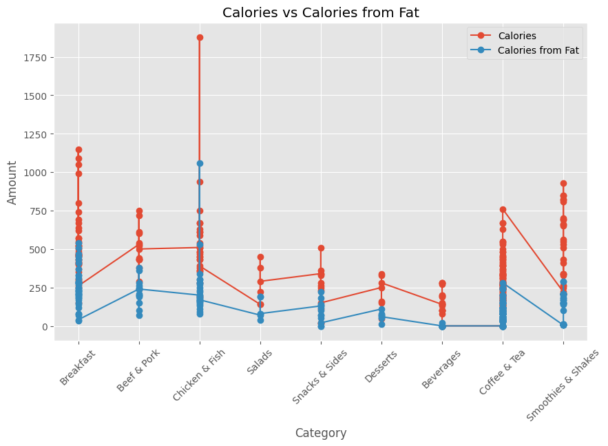
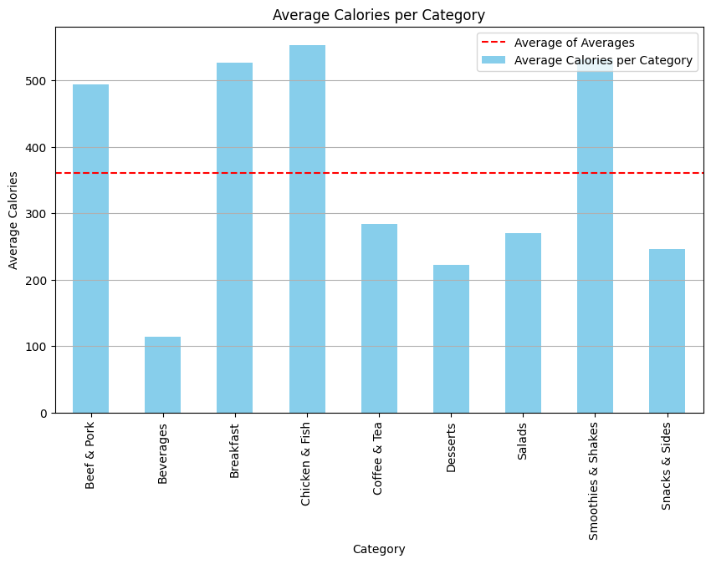
Calories Analysis
Category | Item with Highest Calorie | Calories
Coffee and Tea | Frappé Chocolate Chip (Large) | 760
Breakfast | Big Breakfast (Large Biscuit) | 800
Smoothies & Shakes | McFlurry with M&M’s Candies (Medium) | 930
Chicken & Fish | Chicken McNuggets (20 piece) | 940
Beverages | Coca-Cola Classic (Large) | 280
Beef & Pork | Double Quarter Pounder with Cheese | 750
Snacks & Sides | Large French Fries | 510
Desserts | Hot Caramel Sundae | 340
Salads | Premium Southwest Salad with Crispy Chicken | 450

Slide 6
Protein Analysis
Category | Item with most Protein | Protein
Coffee & Tea | Hot Chocolate with Nonfat Milk (Large) | 19
Breakfast | Steak, Egg & Cheese Bagel | 33
Chicken & Fish | Chicken McNuggets (20 piece) | 44
Beef & Pork | Double Quarter Pounder with Cheese | 48
Smoothies & Shakes | McFlurry with Reese's Peanut Butter Cups (Medium) | 21
Salads | Premium Bacon Ranch Salad with Grilled Chicken | 29
Snacks & Sides | Chipotle BBQ Snack Wrap (Grilled Chicken) | 16
Beverages | Fat Free Chocolate Milk Jug | 9
Desserts | Hot Fudge Sundae | 8

Slide 7
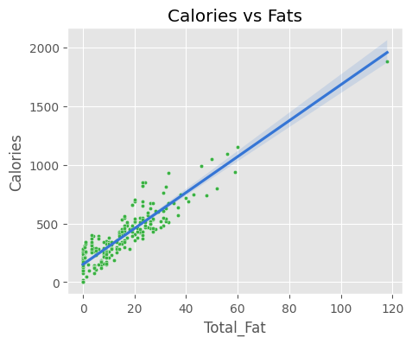
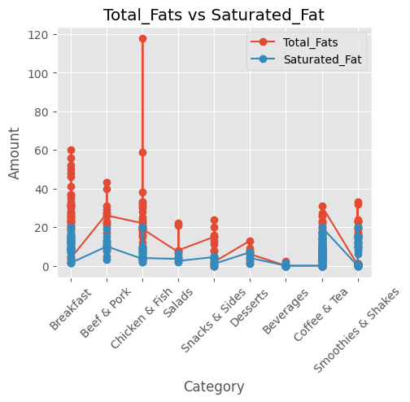
Fats Analysis
Category | Item with most Fats | Fats
Coffee & Tea | Frappé Chocolate Chip (Large) | 31
Breakfast | Big Breakfast (Large Biscuit) | 52
Chicken & Fish | Chicken McNuggets (20 piece) | 59
Beef & Pork | Double Quarter Pounder with Cheese | 43
Smoothies & Shakes | McFlurry with M&M’s Candies (Medium) | 33
Salads | Premium Southwest Salad with Crispy Chicken | 22
Snacks & Sides | Large French Fries | 24
Beverages | 1% Low Fat Milk Jug | 2.5
Desserts | Baked Apple Pie | 13

Slide 8
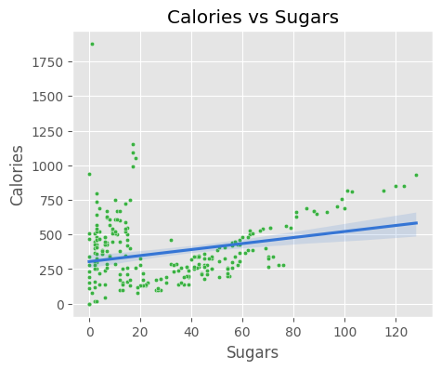
Sugar Analysis
Category | Item with most Sugar | Sugars
Coffee & Tea | Frappé Chocolate Chip (Large) | 99
Breakfast | Cinnamon Melts | 32
Chicken & Fish | Bacon Clubhouse Crispy Chicken Sandwich | 16
Beef & Pork | Bacon Clubhouse Burger | 14
Smoothies & Shakes | McFlurry with M&M’s Candies (Medium) | 128
Salads | Premium Southwest Salad with Crispy Chicken | 12
Snacks & Sides | Fruit 'n Yogurt Parfait | 23
Beverages | Coca-Cola Classic (Large) | 76
Desserts | Hot Fudge Sundae | 48

Slide 9
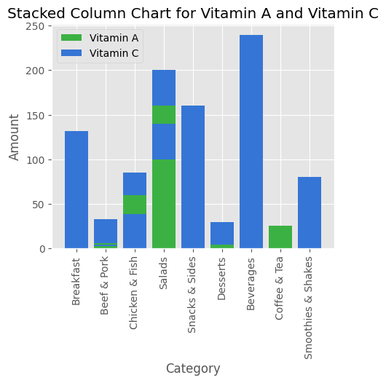

Others

Slide 10

Thankyou for stopping by
For more details, checkout the Jupyter notebooks available on my git hub repository-

