Slide 1




Figure 1 a
Mesenchymal
Epithelial
Luminal
p=0.00003
Basal
p=0.008
p=0.0007
ZR-75-1
MDA-MB-231
MDA-MB-468
HCC1937
p=0.02
MCF7
p=0.2
97 kD
E-cadherin
57 kD
Vimentin
E-cadherin/Vimentin ratio

Slide 2
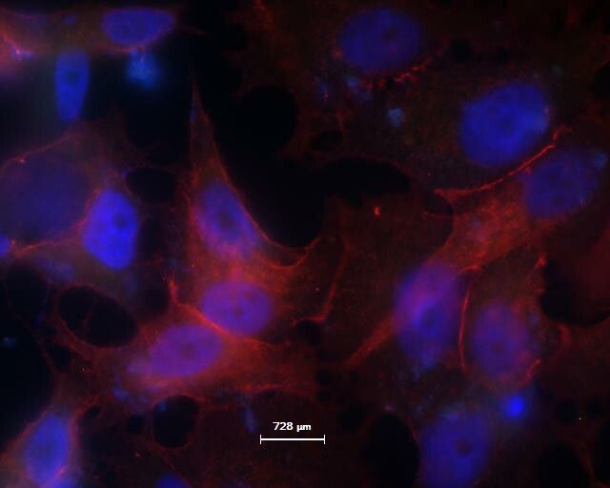
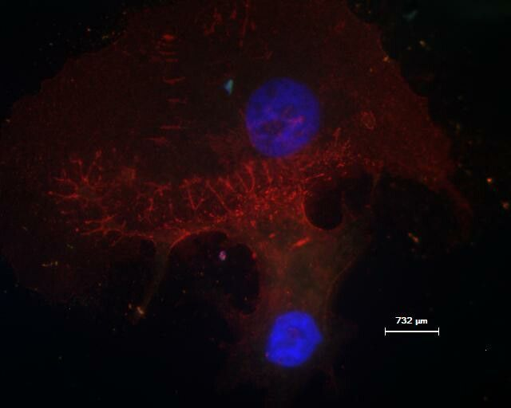
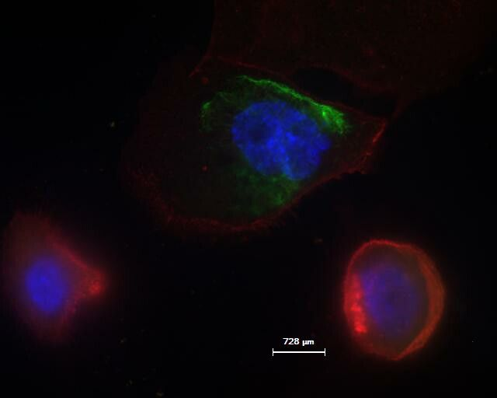
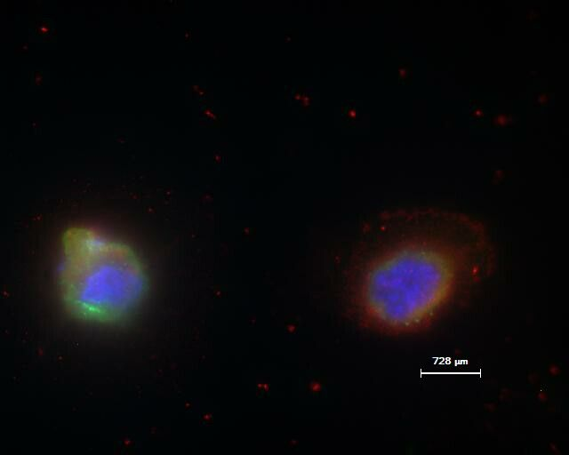
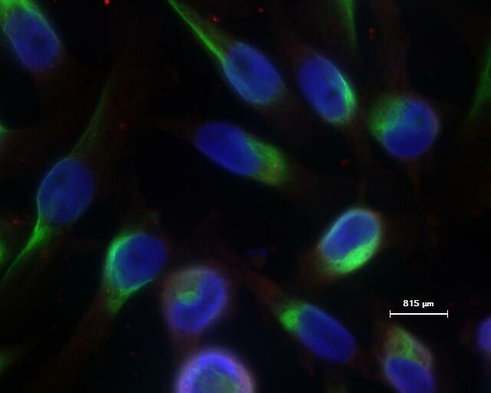
Figure 1 b
MCF7
E-cadherin
Vimentin
ZR-75-1
E-cadherin
Vimentin
HCC1937
E-cadherin
Vimentin
MDA-MB-468
E-cadherin
Vimentin
MDA-MB-231
E-cadherin
Vimentin

Slide 3
Figure 1 c
*
*
*
*
*
*
*p<0.05
(No significant difference between luminal & epithelial score, basal & mesenchymal score)

