Slide 1
CSN-503 Project
SECURE FILE TRANSFER APPLICATION
Deepak Sahu (20535011)
Pranav Mehta (20535020)
Sarthak Sharma (20535025)
Shivam (20535026)
Shweta (20535027)
Taj Mohammad (20535030)
Karthi Kannan M (20535037)

Slide 2
Overview
This application performs the functionality of transferring file from source to destination in encrypted format using AES Symmetric encryption technique. The connection between source and destination is established using socket programming implemented in C language and file transfer takes place through sockets.

Slide 3
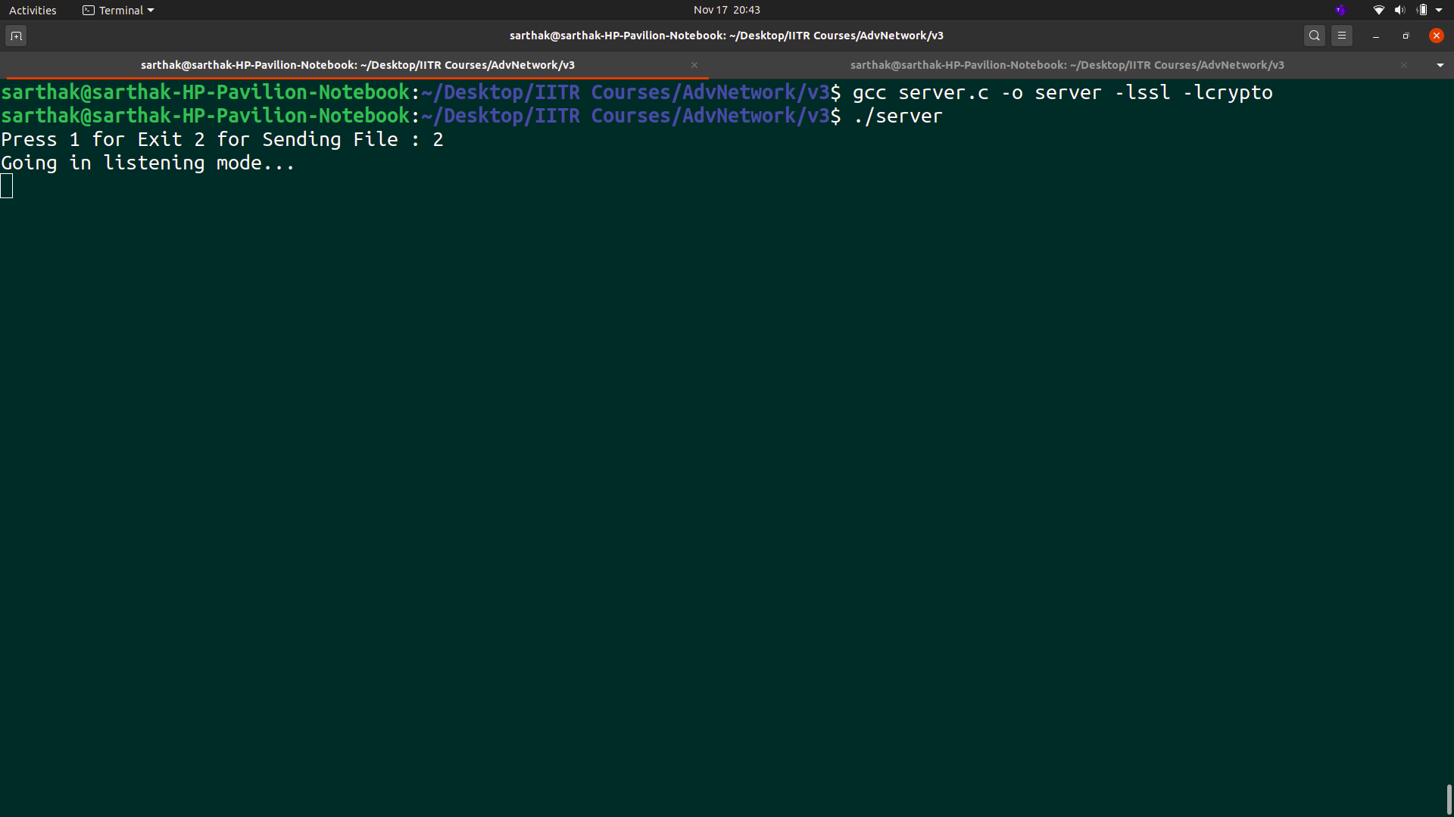
Application Walkthrough

Slide 4
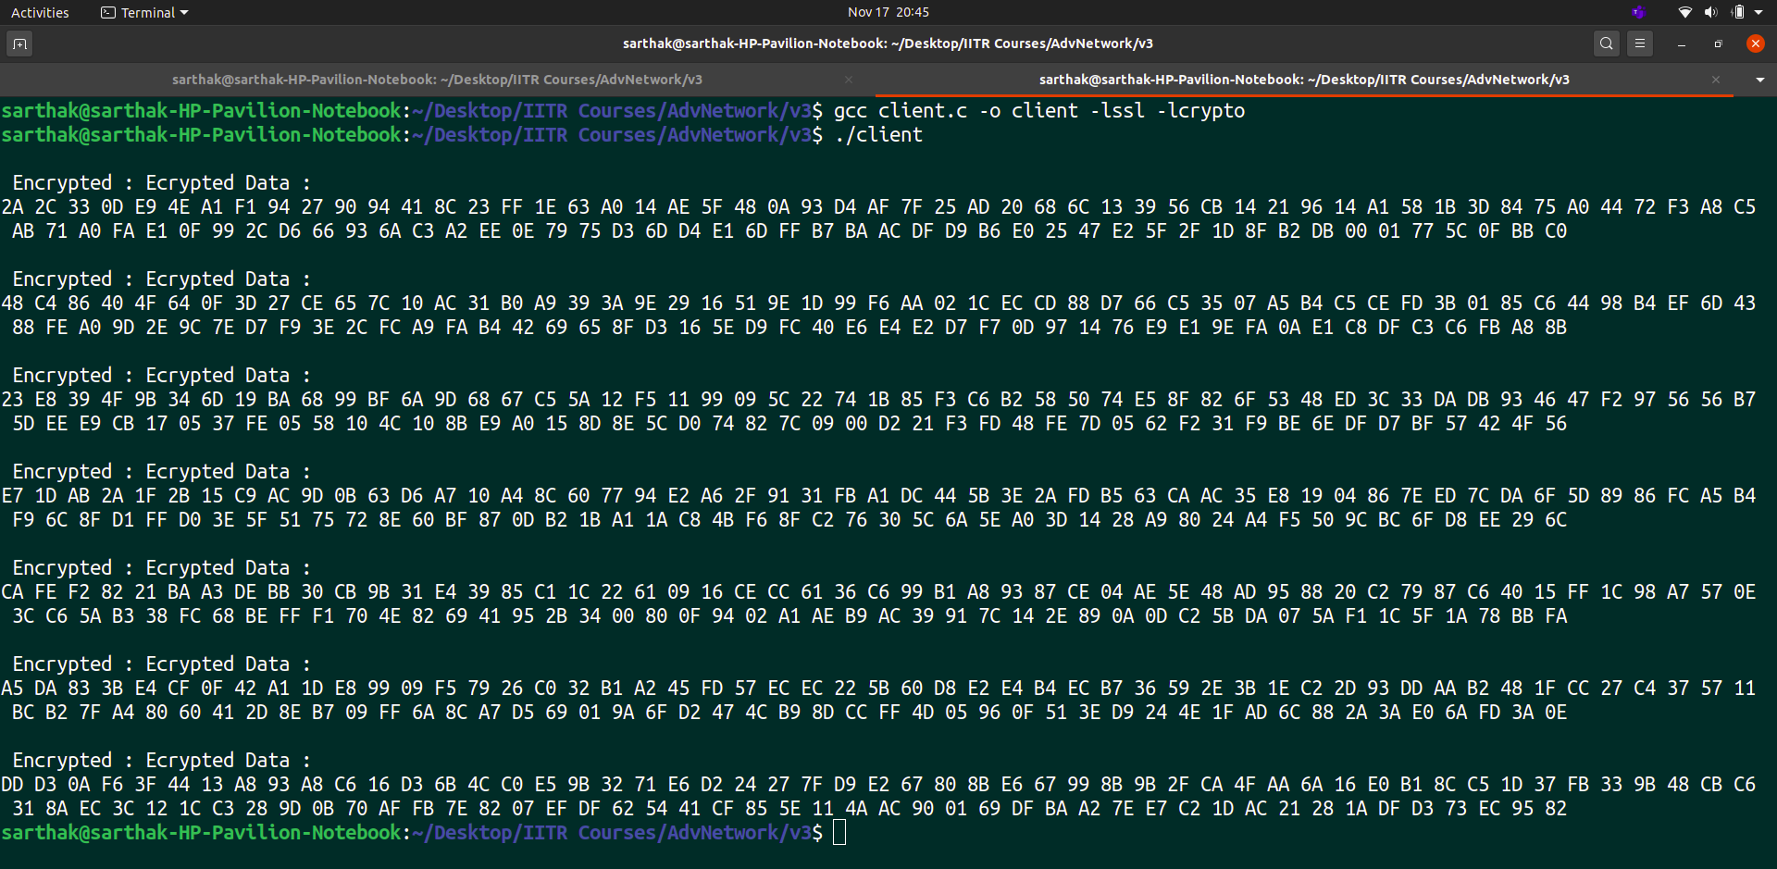
Application Walkthrough
jjj

Slide 5
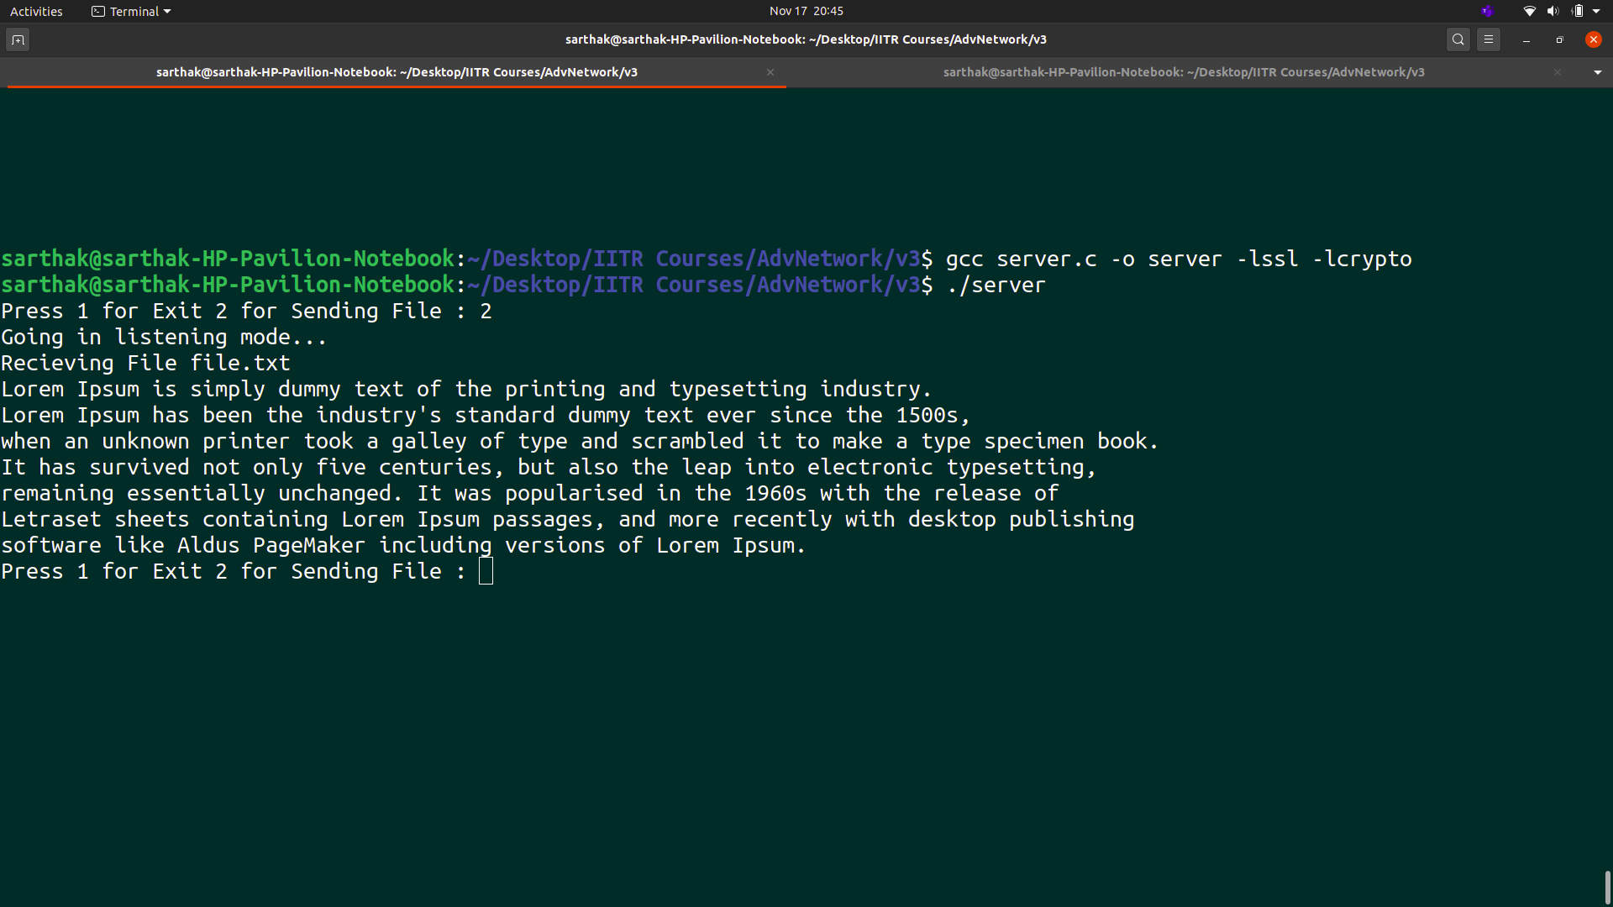
Application Walkthrough

Slide 6
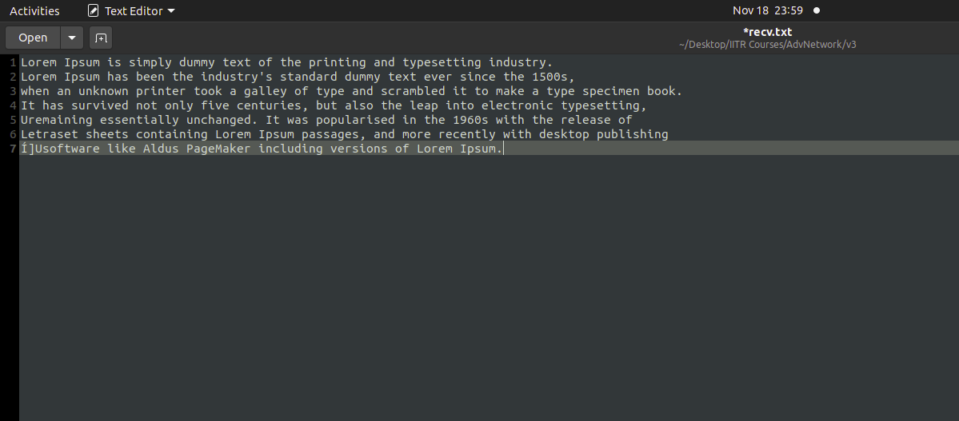
Application Walkthrough

Slide 7
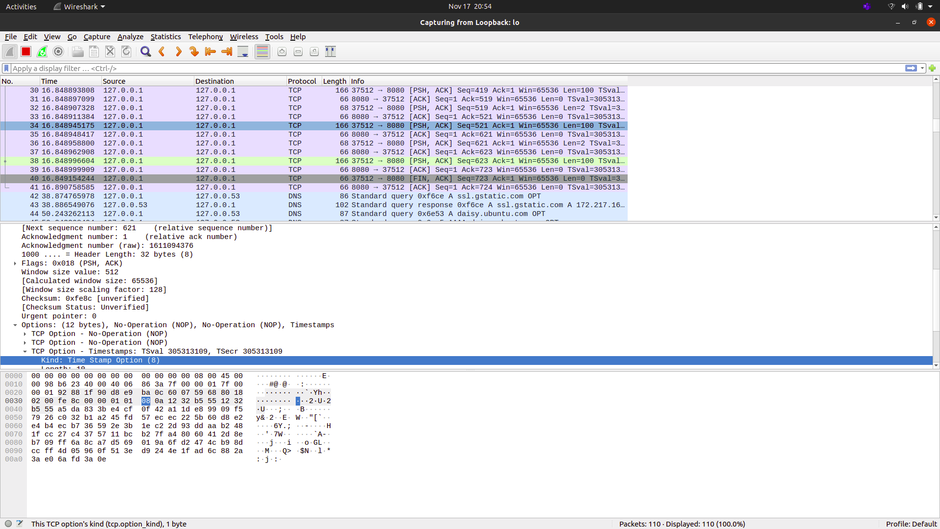
Application Walkthrough

Slide 8
Connection Establishment - Server Side
There are 4 stages involved in connection establishment on Server Side
Socket Creation :
Syntax : int sockfd = socket(domain, type, protocol)
Creates an endpoint for communication and returns a file descriptor that refers to that endpoint. The file descriptor returned by a successful call will be the lowest-numbered file descriptor not currently open for the process.
Binding :
Syntax : int bind(int sockfd, const struct sockaddr *addr, socklen_t addrlen)
bind() assigns the address specified by addr to the socket referred to by the file descriptor sockfd. addrlen specifies the size, in bytes, of the address structure pointed
to by addr

Slide 9
Connection Establishment - Server Side
3. Listening :
Syntax : int listen(int sockfd, int backlog)
Marks the socket referred to by sockfd as a passive socket, that is, as a socket that will be used to accept incoming connection requests. The backlog argument defines the maximum length to which the queue of pending connections for sockfd may grow.
4. Accept :
Syntax : int new_socket= accept(int sockfd, struct sockaddr *addr, socklen_t *addrlen)
It extracts the first connection request on the queue of pending connections for the listening socket, sockfd, creates a new connected socket. The original socket sockfd is unaffected by this call.

Slide 10
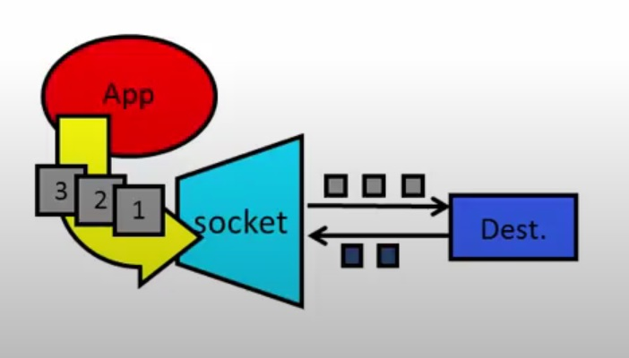
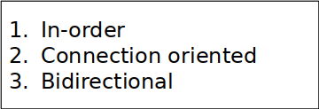
Socket Programming Client Side
Socket - Interface between application and network.
Two types of Sockets
TCP
UDP
TCP socket used for reliable delivery.

Slide 11

STAGES OF CLIENT SIDE
2 Stages involved:
Socket creation - int sockfd = socket(domain, type, protocol)
sockfd: Socket descriptor, an integer (like a file-handle)
domain: Integer, communication domain e.g., AF_INET, AF_INET6
type: Communication type
protocol: Protocol value for Internet Protocol(IP), which is 0.
Connect - The connect() function connects the socket referred to by the file descriptor sockfd to the address specified by addr. Server’s address and port is specified in addr.
Int connect(int sockfd, const struct sockaddr *addr, socklen_t addrlen)

Slide 12
Sending file as a string
Sending File ( Client Side )
Sends the file “file.txt” to a connected Socket object.
Function used :-
send(sock1 , msg_from_client , strlen(msg_from_client) , 0 );
fp=fopen("file.txt","r");
send(sock1,enc_out,sizeof(enc_out)
Here,
sock1 : Socket Descriptor.
Msg_from_client : data
strlen(msg_from_client) : length of data to be send.

Slide 13
File Receiving ( Server Side )
Receiving file from client side:
read( sock , msg, 1024);
Opening file to receive data named as “recv.txt”
fp=fopen("recv.txt","w");
Receiving encrypted data
recv(sock,enc_out,100,0);

Slide 14
Diffie Hellman
Diffie hellman is a key exchange algorithm which enables 2 entities over a network to securely produce and share keys.
The keys finally generated at the end of the computation are same on both the systems and hence the key so generated can be used for any symmetric encryption algorithm.
In Diffie hellman we need to calculate a prime number followed by a primitive root (generator) of that prime number, this could be done at one of the server, then following some mathematical computations the resultant private key is obtained as explained in the figure below:

Slide 15
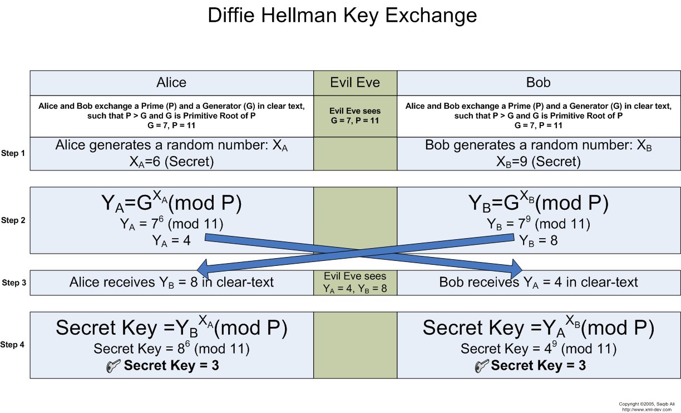

Slide 16
How is Diffie Hellman relevant here?
In our project Diffie Hellman is being used so as to encrypt the key being sent for AES.
The individual units of keys (of the AES) are being cyphered by using diffie hellman. This provides us with added security by providing us with an option to securely send the aes key online (which is usually sent offline to keep things safe from man in the middle attack).

Slide 17
AES (Advanced Encryption standard )
Established by the U.S. National Institute of Standards and Technology (NIST) in 2001.
it's a Symmetric key block cipher.
AES is stronger than DES in term of security and faster than the DES in term of performance.
AES comprises three block cipher :AES-128,AES-192,AES-256.
AES-128: 10 rounds and key size will be of 128 bit.
AES-192: 12 rounds and key size will be of 192 bit.
AES-256: 14 rounds and key size will we of 256 bit.
it is extremely efficient in 128-bit form, AES also uses keys of 192 and 256 bits for more secure encryption purposes.

Slide 18
AES-128 bit Encryption:
AES key for Encryption and Decryption
const static unsigned char aes_key[]={0x00,0x11,0x22,0x33,0x44,0x55,0x66,0x77,0x88,0x99,0xAA,0xBB,0xCC,0xDD,0xEE,0xFF};
AES-128 bit CBC Encryption
AES_KEY enc_key, dec_key;
AES_set_encrypt_key(aes_key, sizeof(aes_key)*8, &enc_key);
AES_cbc_encrypt(aes_input, enc_out, sizeof(aes_input), &enc_key, iv, AES_ENCRYPT);
print_data("\n Encrypted",enc_out, sizeof(enc_out));

Slide 19
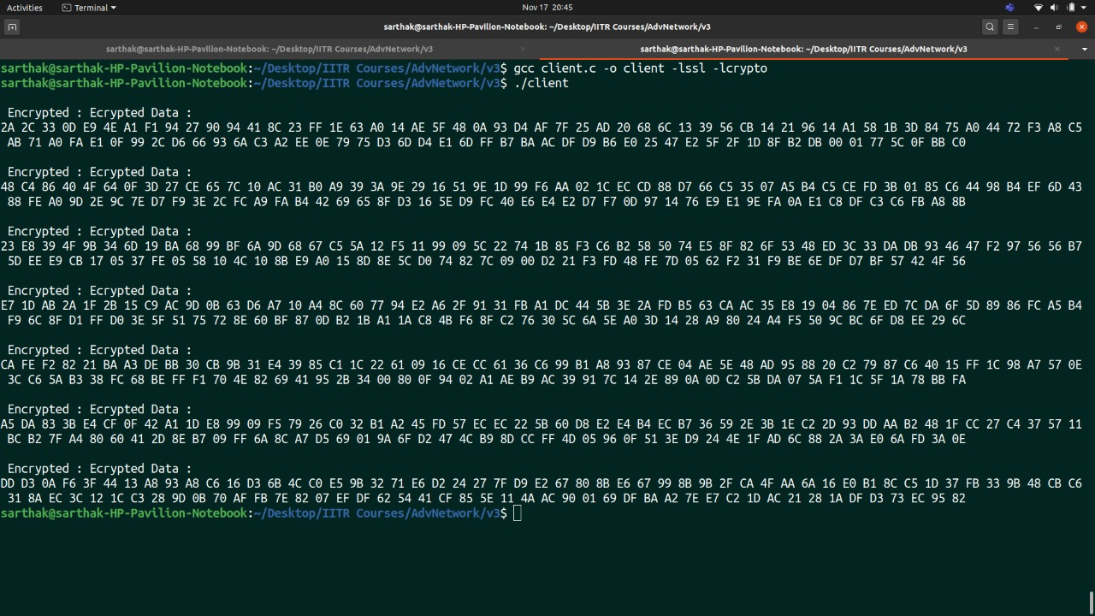
Cipher Text:

Slide 20
AES DECRYPTION
The decryption in aes involves : add round key
Followed by n-1 rounds of: reverse shift rows and reverse sub bytes, add round key and finally reverse mix columns.
The reverse operations are also called inverse operations for the functionality that they offer.
The last round involves - reverse shift rows, reverse sub bytes, add round key.
This is finally followed by add round key operation.

Slide 21
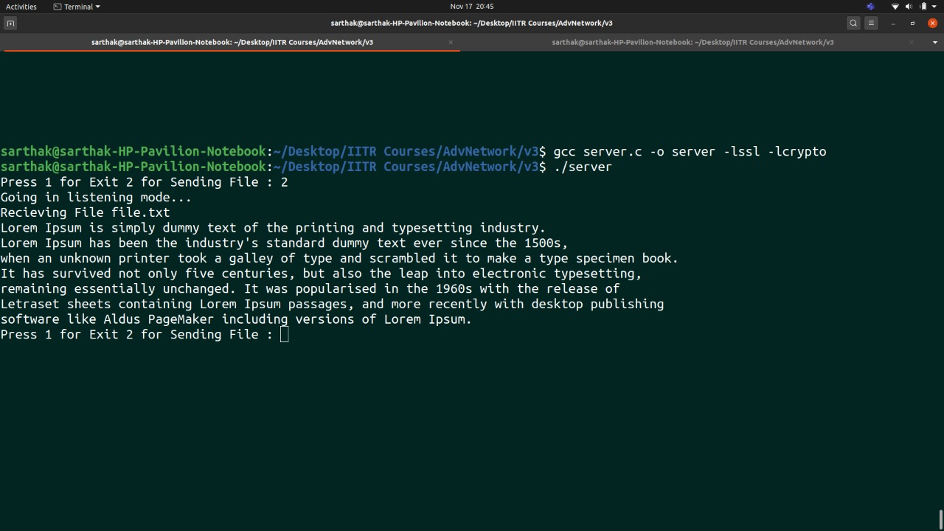
AES-128 bit Decryption:
AES_set_decrypt_key(aes_key, sizeof(aes_key)*8, &dec_key); // Size of key is in bits
AES_cbc_encrypt(enc_out, dec_out, b, &dec_key, iv, AES_DECRYPT);

Slide 22
Wireshark
Wireshark is a network packet analyzer. A network packet analyzer presents captured packet data in as much detail as possible.
Wireshark is available for free, is open source, and is one of the best packet analyzers
Captured network data can be browsed via a GUI
Data display can be refined using a display filter
Wireless connections can also be filtered as long as they traverse the monitored Ethernet
Available for UNIX and Windows.

Slide 23
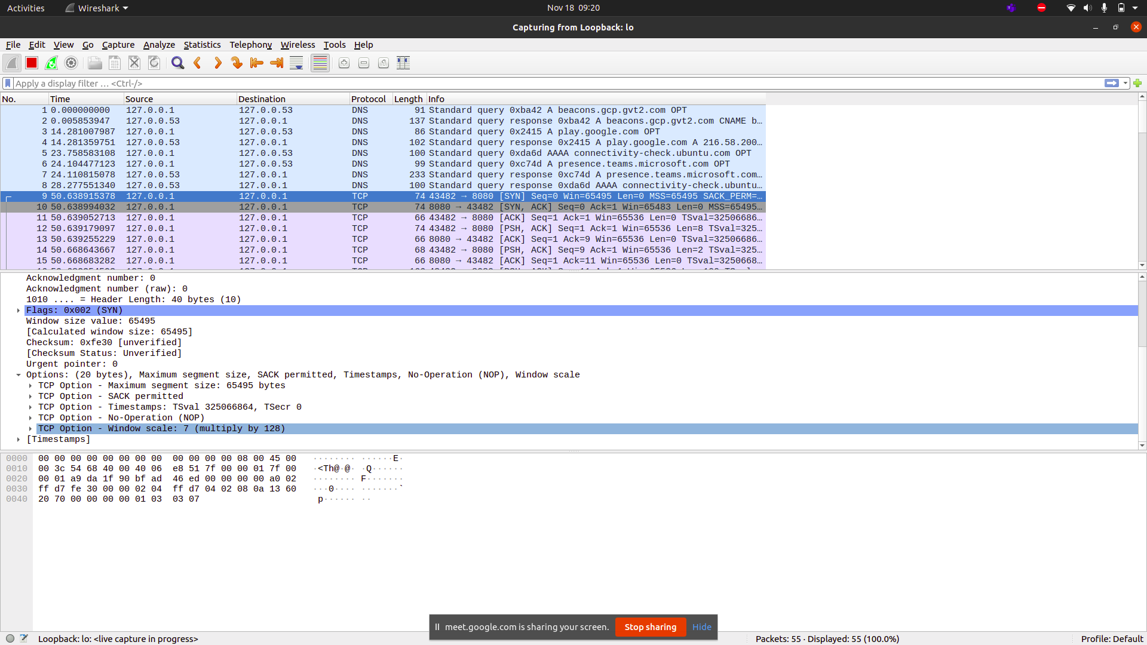
TCP Connection Establishment

Slide 24
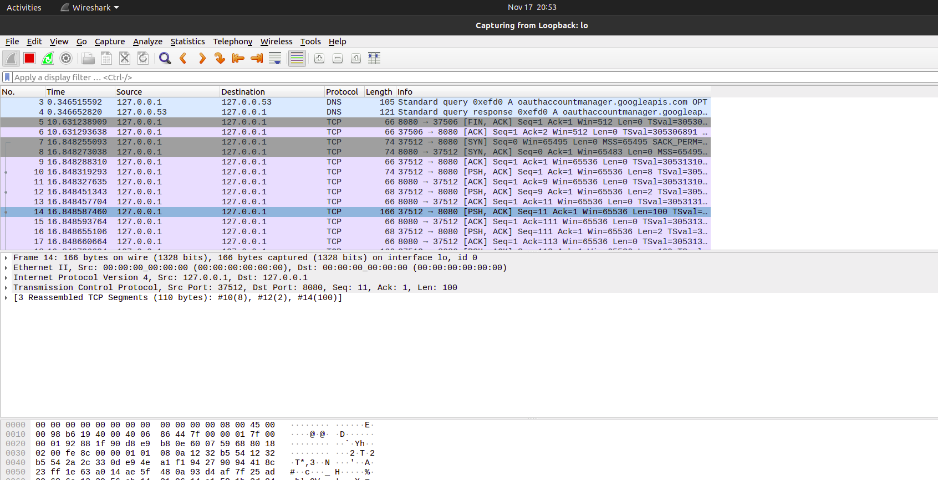
Encrypted Data Transfer

Slide 25
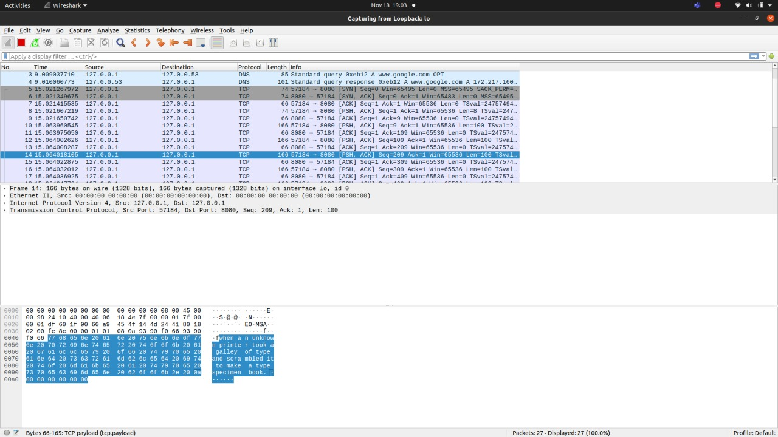
Plain Data Transfer

Slide 26
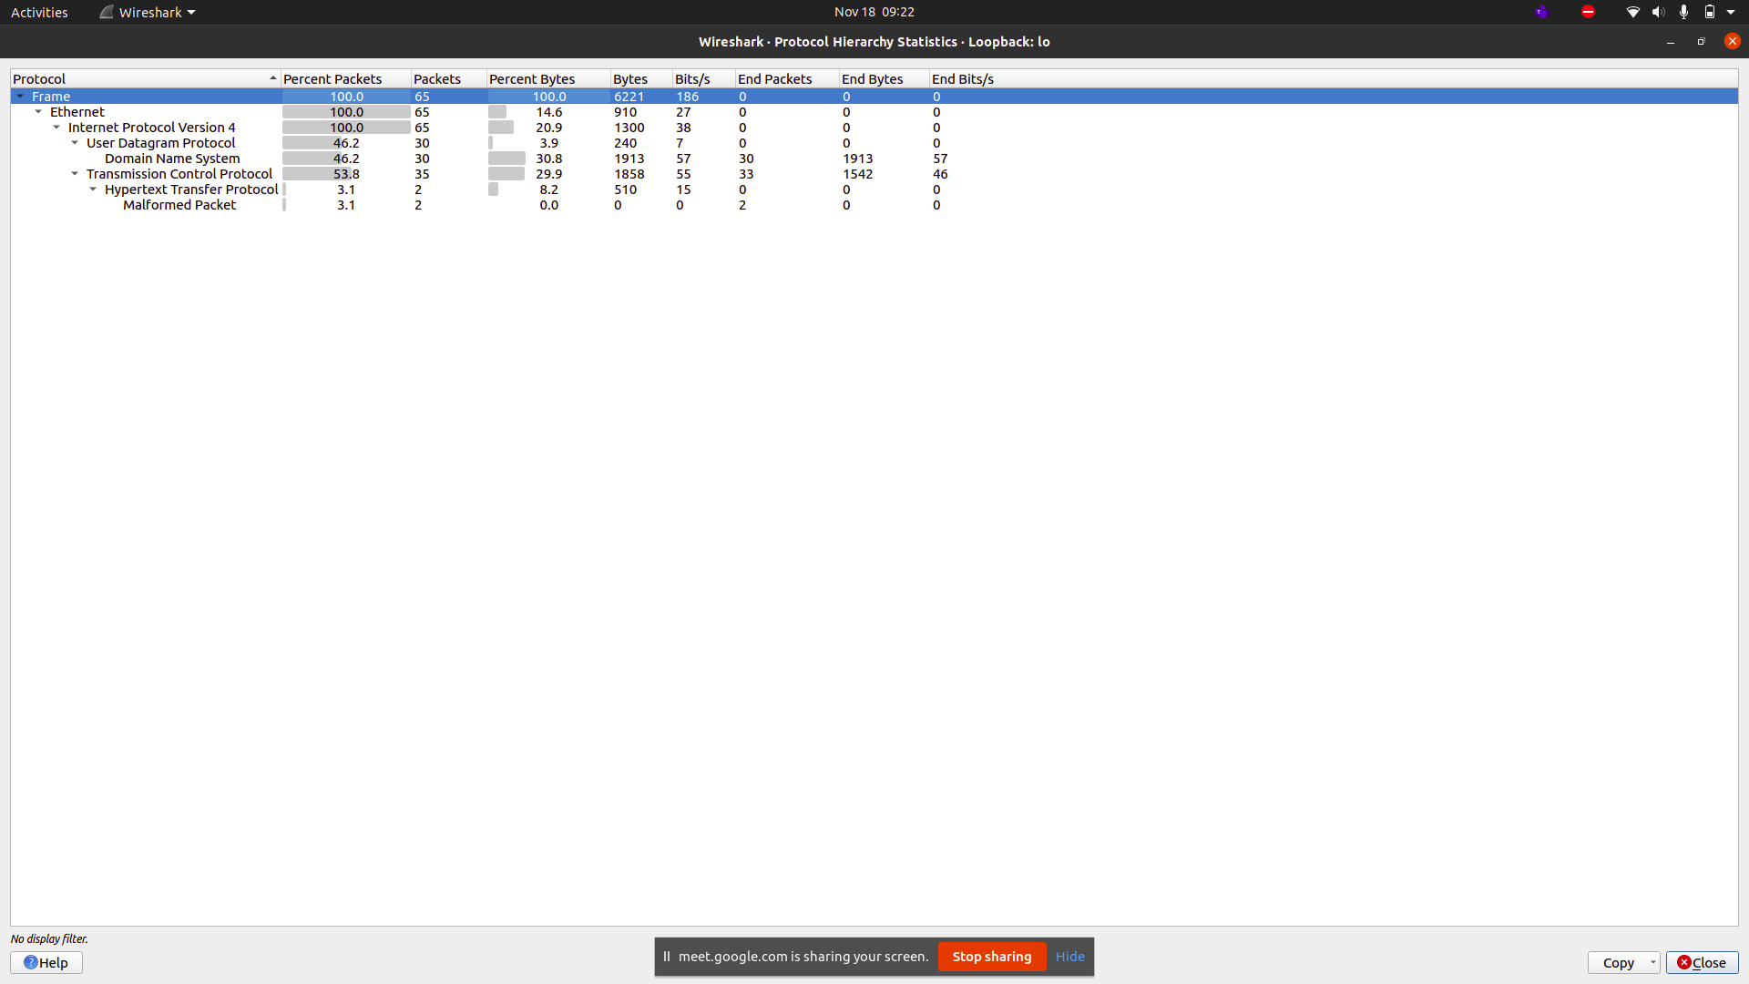
Protocol Hierarchy

Slide 27
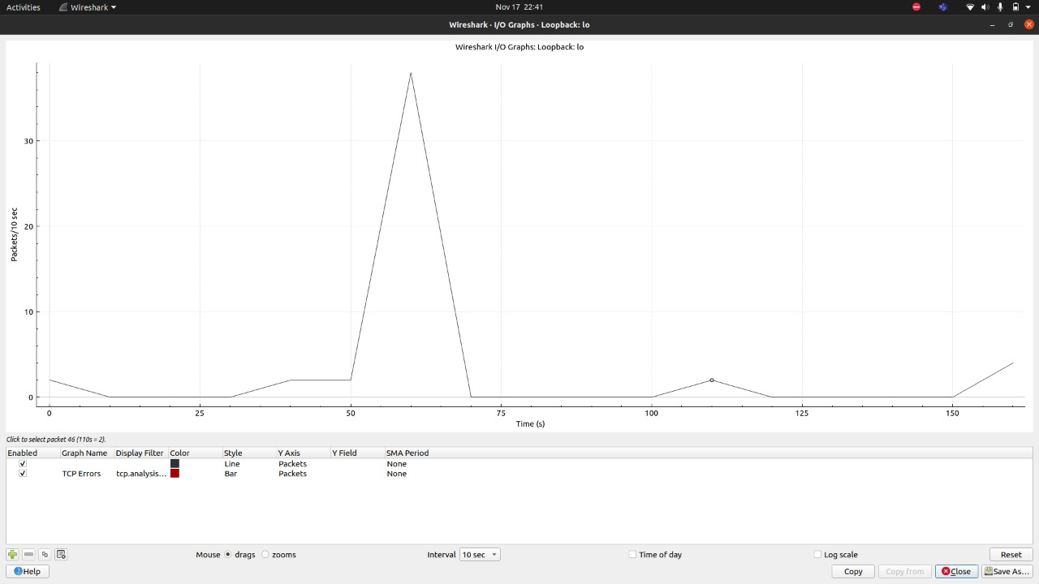
I/O Graphs

Slide 29
Thank You!

