Slide 1


July 2024
Intro To Machine Learning
Group 12
Summer Term - Academic Project for STA S380
PRESENTER OR SPEAKER NAME
Albert
Twinkle
Sarthak
Gaurav

Slide 2

Problem Statement
July 2024
A cab service startup seeks to understand Uber's pricing strategy to offer more cost-effective rides.

Slide 3
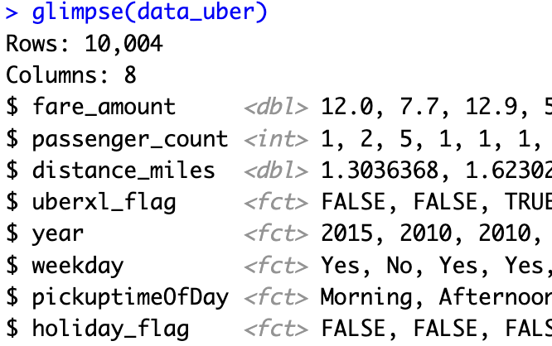
Data Understanding

Slide 4
Dropping NULLs and duplicates
Data
Pre-Processing
Column renaming, splitting, selection and typecasting
Detecting and treating anomalies in data, for instance, abnormal values for latitude or longitude

Slide 5









Feature Engineering
Location based features
Time based features
Miscellaneous features
MAP route distance using Google API
Zip codes using reverse geocoding
Pickup time of day categorized as Morning, Afternoon, Evening & Night
Weekday flag denoting if the pickup day is a weekday or weekend
Holiday Flag denoting if the pickup day is a holiday
UberXL flag denoting if the cab is a uber or not based on passenger count

Slide 6
Models Implemented
Model
Linear Model
Trees
Multiple linear regression
Stepwise Selection
Regression Tree
Boosting
Bagging & Random Forest
BART
Notes:
We used a CV split of 80% training, 20% test data and used the same random seed to make results replicable.

Slide 7
Model Comparison
Models
Training RMSE
Test RMSE
Strengths/Weaknesses
1
Linear Regression/ Best Subset
6.001 / 6.001
4.722069 / 4.725299
Error value is very high for the given range of fare_amount.
MSE doesn’t reduce while using multiple variables
2
Single Regression Tree
4.266952
4.511213
Captures categorical variable effects better
Overfitting
Predictions are not much better than linear
3
Random Forest/Bagging
3.01833
3.33614
Low RMSE
Overfitting
Harder to interpret
4
Boosting - XGBoost / GBM
4.276331
/
4.436574
3.920847
/
4.374432
Regularization properties reduce overfitting
Parallel processing in XGB enabling faster training
Produced better results than GBM (Test RMSE: 4.374432)
5
BART
4.276946
5.083321
Better for complex, non-linear relationships and interactions
Overfitting
Computationally Intensive

Slide 8
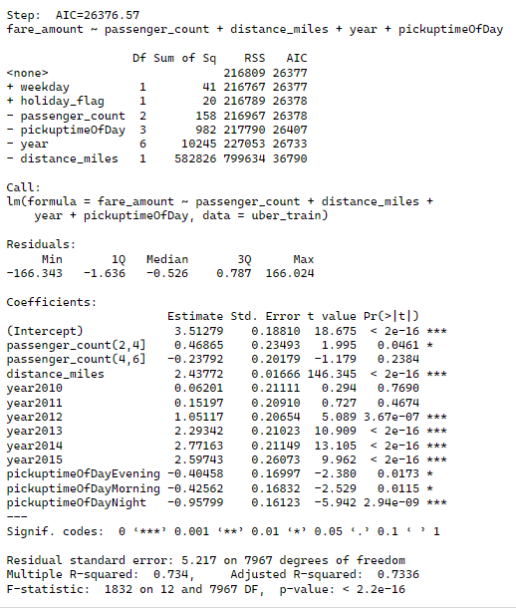
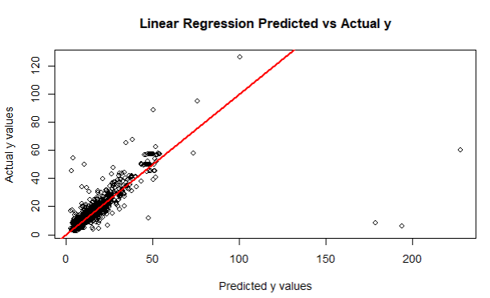
Linear Regression Graphs

Slide 9
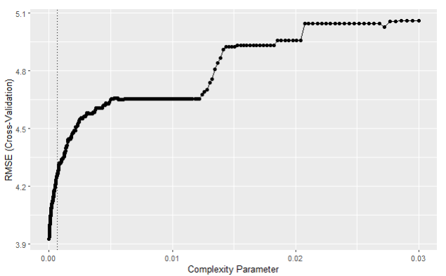
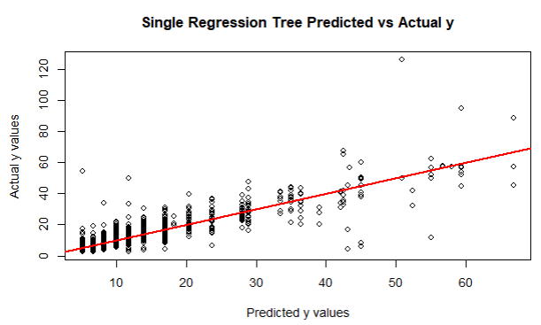
Single Regression Tree Graphs

Slide 10
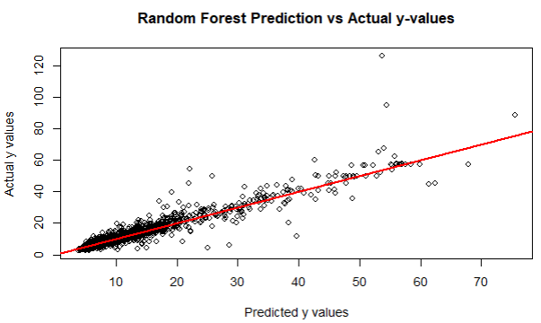
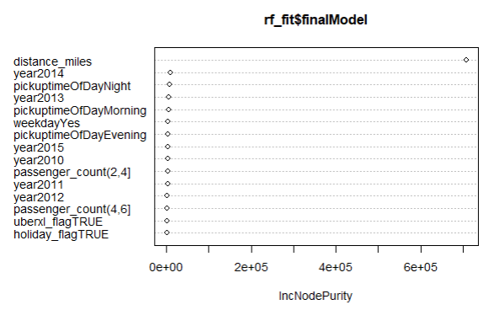
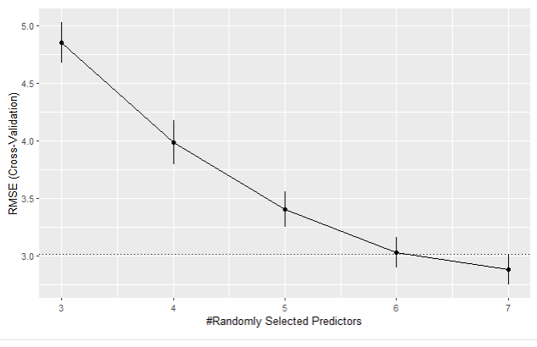
Random Forest/Bagging Graphs

Slide 11
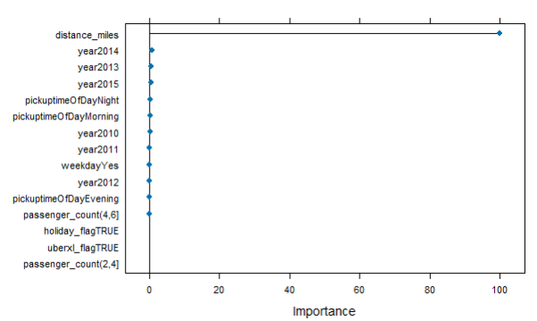
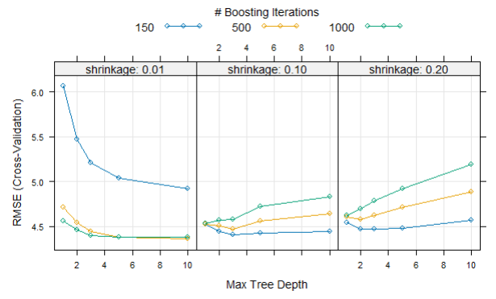
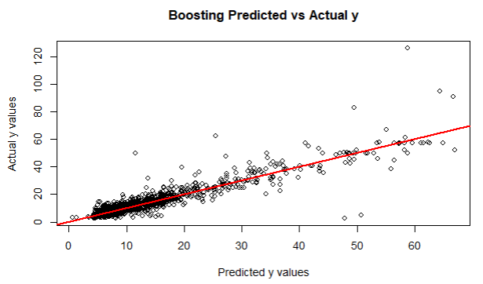
Boosting Graphs

Slide 12
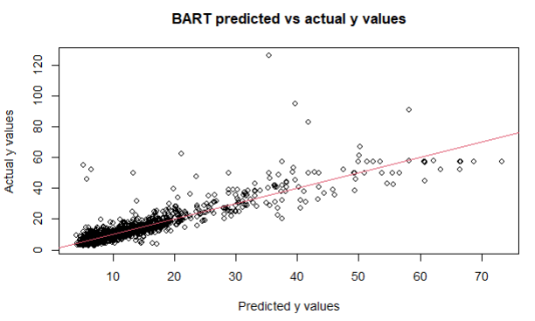
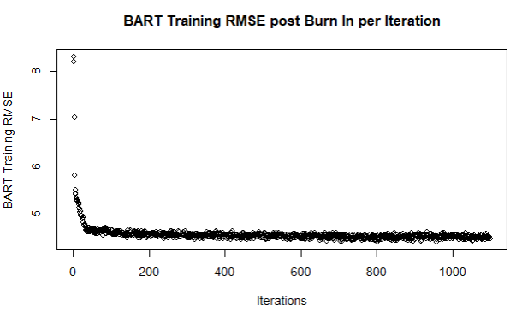
BART Graphs

Slide 13
Conclusion
July 2024
The distance driven by the Uber is by far the most important predictor.
Random Forests(Boosting) does the best job purely based on RMSE
Linear Regression remains the most interpretable
Notes:
Recommendations Challenges :
Location features - zip code, county, area code
No. of data points
Distributed data points from multiple states
SEC classifica

