Slide 1
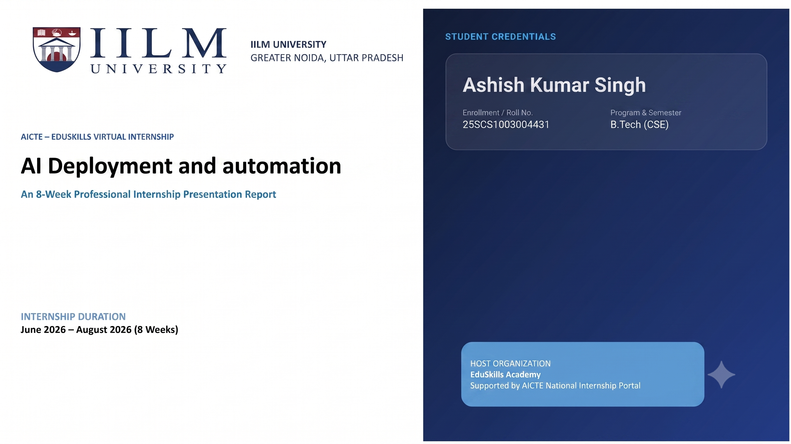
STUDENT CREDENTIALS
STUDENT CREDENTIALS
GOLDMAN SACHS – FORAGE JOB SIMULATION
Internal Audit
Job Simulation
Sarthak Shubham
Roll No.: 25SCS1003002959
B.Tech (Computer Science & Engineering) • 2025–2029
An Academic Internship / Job Simulation Presentation
COMPLETION PERIOD
IILM University, Greater Noida, U.P.
September 2026
Goldman Sachs
Internal Audit Job Simulation

Slide 2

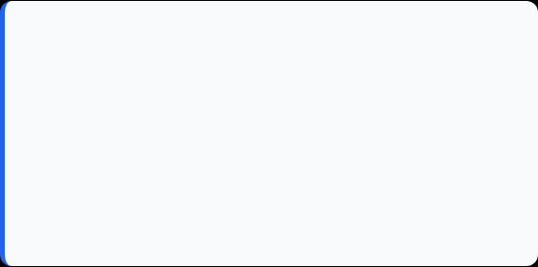
Candidate & Program Overview
Candidate Details
Simulation Profile
Student Name: Sarthak Shubham
Roll Number: 25SCS1003002959
Degree: B.Tech (Computer Science & Engineering)
Academic Batch: 2025–2029
University: IILM University, Greater Noida, U.P.
Program: Goldman Sachs – Internal Audit Job Simulation
Platform: Forage
Domain: Internal Audit, Risk & Financial Operations
Completion Period: September 2026
Credential: Certificate of Completion

Slide 3


Organization & Simulation Profile
Goldman Sachs
Forage Job Simulation
The simulation places the learner in the context of a leading global investment bank and introduces the role internal auditors play in supporting financial stability, risk management and sound business processes.
Forage provides a risk-free environment to experience realistic work tasks. The program combines guided learning with practical exercises, allowing students to apply professional reasoning without claiming employment at Goldman Sachs.
• Focus on curiosity, collaboration and client impact
• Exposure to accounting and financial operations
• Practical tasks rather than only theoretical study
• Emphasis on risk awareness and control thinking

Slide 4

Problem Statement & Industry Context
The Industry Challenge
Simulation Scope
Large financial institutions operate through complex processes and controls. Weak controls can create financial, operational, regulatory and reputational risks. Internal audit helps identify such weaknesses and provides independent insight into whether controls are working as intended.
The job simulation translates this challenge into realistic audit scenarios. The learner reviews observations, identifies risks and control gaps, considers business and client impact, and recommends practical improvements.

Slide 5








Core Learning Objectives
Build a Risk Mindset
Understand Internal Audit
Assess Control Weaknesses
Recommend Improvements
Recognize risks before they become larger business problems.
Learn how audit supports controls, governance and financial stability.
Connect audit observations with process gaps and their consequences.
Propose practical actions that reduce risk and improve outcomes.

Slide 6





Methods, Evidence & Analytical Skills
Risk Assessment
Control Analysis
Scenario Analysis
Recommendation
Probability + impact thinking to prioritize risks.
Identify where a process or control can fail.
Interpret audit observations in a banking context.
Suggest specific, practical control improvements.
Work products: Personal Finance Risk Assessment (Excel) + Internal Audit Scenario Responses (Word)

Slide 7
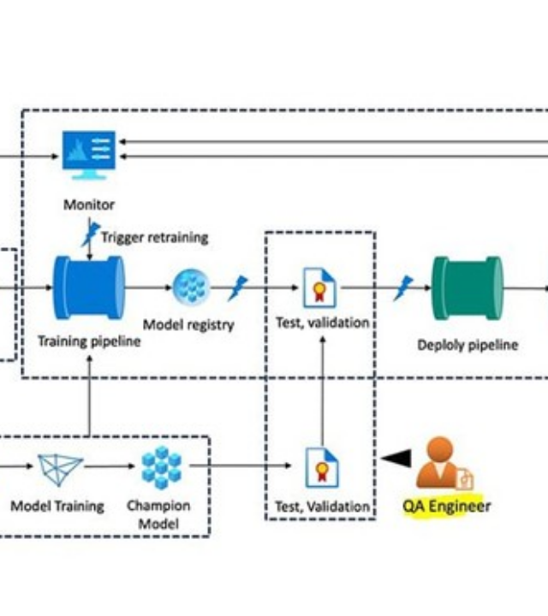
Internal Audit Risk-Assessment Workflow
1
Understand the process
What is the process supposed to achieve?
2
Identify the risk
What could go wrong and why?
3
Assess impact
Who or what could be affected?
4
Evaluate the control
Is the existing control sufficient?
5
Recommend action
What practical change can reduce the risk?

Slide 8
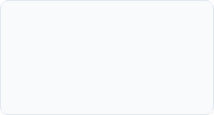
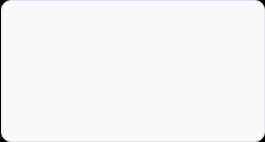
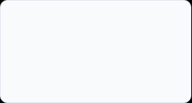
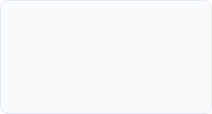
Task Timeline & Activities
Task 1
Task 2
Foundations of Internal Audit
Risk Assessment in Global Banking & Markets
Learned audit fundamentals and applied risk management to a personal-finance exercise.
Reviewed three audit scenarios and identified risks, control gaps and improvement actions.

Slide 9
Task 2 – Global Banking & Markets Scenarios
01
02
03
Trade Execution
Credit Risk / NPLs
AML Transaction Monitoring
Execution delays created financial and operational impact. The response considered both Technology Audit and Business Audit perspectives.
Strengthen ongoing credit monitoring and periodic borrower reassessment to identify deterioration earlier.
Low reporting of identified suspicious transactions indicated an escalation/control gap requiring stronger review and automation.

Slide 10
Key Work Completed & Demonstrated Skills
Personal Risk Assessment
Built a structured risk assessment for managing personal finances as a student, using probability, impact, risk rating and controls.
Trade Execution Analysis
Linked slow execution to financial loss, operational discrepancies and client experience, while recognizing the technology/business audit overlap.
Credit Risk Analysis
Recommended stronger post-approval monitoring and periodic reassessment to catch early warning signs before loans become non-performing.
AML Control Improvement
Identified the gap between suspicious-transaction detection and reporting and proposed mandatory review plus automated escalation.
Professional Documentation
Converted observations into concise, evidence-based explanations and actionable recommendations.

Slide 11

Certification & Official Verification
Verification Item | Details
Program | Goldman Sachs – Internal Audit Job Simulation
Platform | Forage
Participant | Sarthak Shubham
Completion | Certificate of Completion — September 10, 2026
Practical Tasks | Foundations of Internal Audit; Risk Assessment in Global Banking & Markets
Credential evidence is reproduced on the following slide.

Slide 12
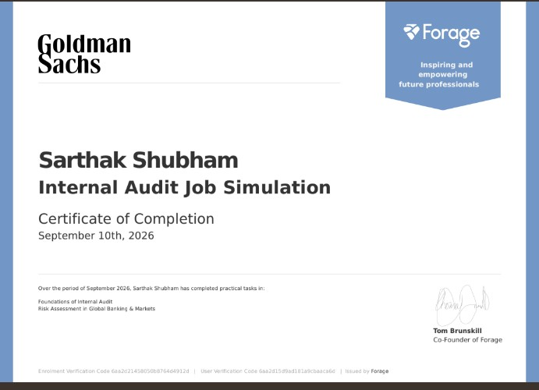
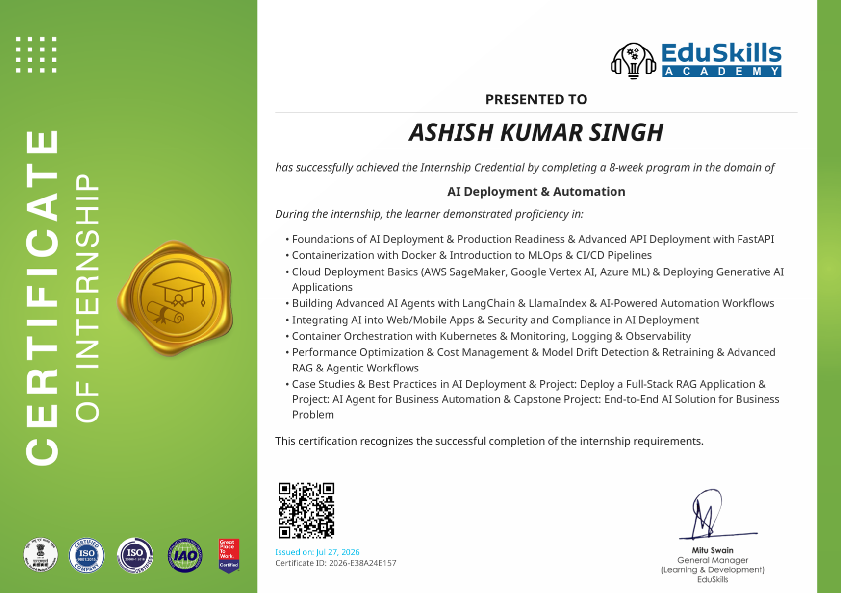
Certificate of Completion

Slide 13
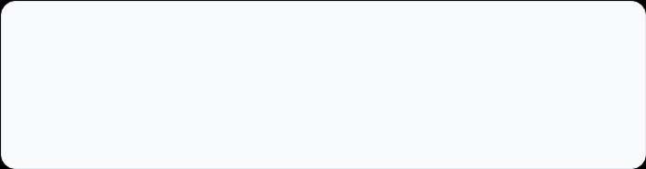
Thank You!
Sarthak Shubham
School of Computer Science & Engineering
Roll No: 25SCS1003002959
IILM University, Greater Noida, U.P.

