Slide 1
DATA ANALYSIS PROJECT
Spotify Churn
Analysis & Prediction
Understanding why listeners leave — and how data can help improve retention.
Kaggle dataset | Python • Pandas • Matplotlib • Scikit-learn
Project presentation • 2026

Slide 2
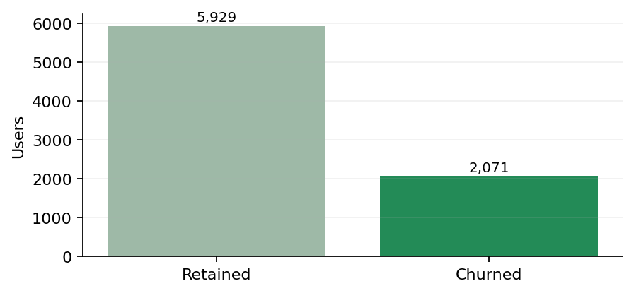
1. Dataset & first look
A basic quality check and a look at the churn split.
records • 12 columns
missing values
duplicate rows
labelled as churned
8,000
0
0
25.9%
Churn distribution
What the dataset tells us
The target column is is_churned. The remaining columns describe users, subscriptions and listening behaviour.
Class balance
Retained: 5,929 Churned: 2,071
Available fields:
user id, gender, age, country, subscription type,
listening time, songs played per day, skip rate, device
type, ads listened per week, offline listening, is churned
2/6

Slide 3
2. Analysis workflow
The project follows a simple, repeatable machine-learning process.
01
Inspect
Check data types, missing values, duplicates and target balance.
02
Explore
Study feature distributions and compare churn across user groups.
03
Prepare
Separate inputs and targets, encode categories, then split train and test data.
04
Train
Use Logistic Regression for churn; Linear Regression for listening-time prediction.
05
Evaluate
Check classification scores and regression errors on unseen test records.
Note: Logistic Regression is used for classification, even though “regression” appears in its name.
3/6

Slide 4
3. Model results
The scores show that accuracy alone can give a misleading impression.
Logistic Regression — churn classification
Linear Regression — listening-time prediction
Accuracy
74.12%
Precision / Recall / F1
0.00 / 0.00 / 0.00
MAE 73.57 RMSE 84.56
Test-set confusion matrix
R² −0.0056
Actual retained
Predicted retained
1,186
Predicted churned
0
A slightly negative R² means the model performs a little worse than always predicting the average listening time.
Actual churned
Predicted retained
414
Predicted churned
0
The model predicted every test user as retained. It therefore missed every churn case; 74.1% accuracy is just the majority-class result.
Overall, neither model is ready for practical use. The evaluation helps identify what needs to improve.
ROC-AUC: 0.4966 • close to random ranking
4/6

Slide 5
4. Findings & next steps
What the current results mean, and how the project could be improved.
What we learned
What to try next
• About 25.9% of users in this dataset are labelled as churned.
• The class imbalance makes accuracy alone misleading.
• The current Logistic Regression setup does not identify churners.
• Listening-time prediction has almost no explanatory power.
• Review label encoding, feature selection and the train/test split.
• Use stratified splitting, class weights and threshold tuning.
• Compare with decision trees, random forests and boosting.
• Track recall, F1 and PR-AUC; validate on fresh user data.
Conclusion: churn analysis can guide retention work, but dependable predictions need stronger signals and careful validation.
5/6

Slide 6
5. Use of AI Tools
AI supported our workflow, while the project decisions remained with our team.
How AI supported us
Our team's role
Understanding technical concepts used in the project.
Reviewing AI-assisted suggestions and the resulting code.
Organising the data-analysis workflow and presentation.
Using our understanding to interpret model results.
Improving and debugging the Python code.
Evaluating performance and drawing the final conclusions.
AI tools served as supporting resources; the analysis, interpretation and conclusions were reviewed and owned by our team.
6/6

