Slide 1
GUJRAT
BY:- SARTHAK DEWANGAN

Slide 2
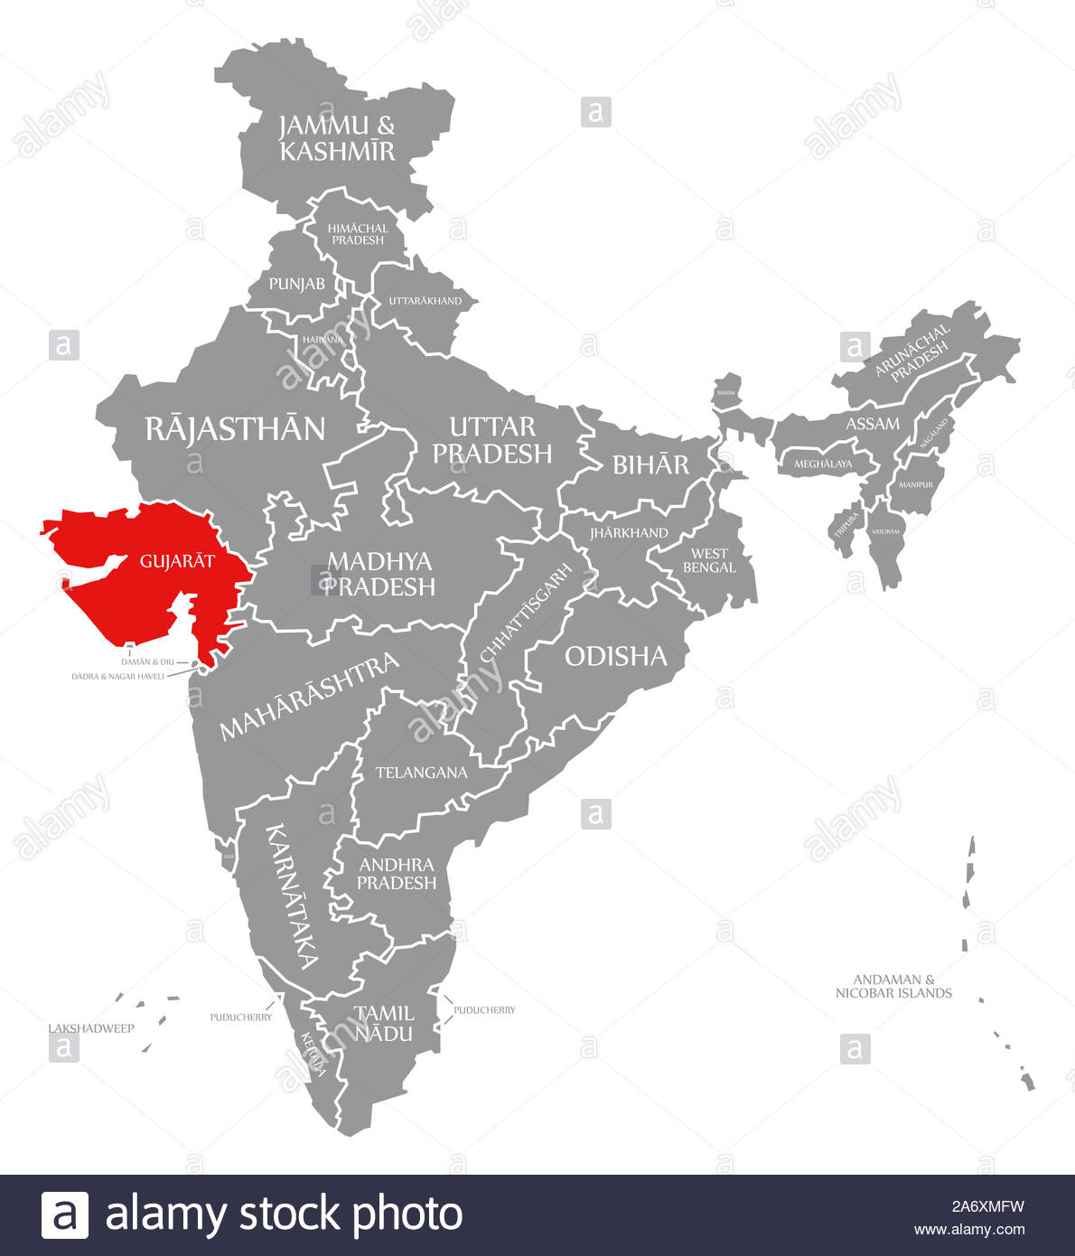

Slide 3
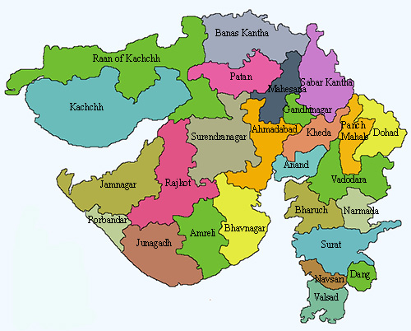

Slide 4
*Area : 196077 sq.km. *Population : 60383628 *Capital : Gandhinagar *Language : Guajarati *Currency : Indian Rupee *Climate : Wet in the southern districts and desertic in the north-west region *Winter : November to February (12-29degree Celsius) *Summer : March to May (29-41degree Celsius) *Monsoon : June to October (27-35degree Celsius)
FAST FACTS ABOUT GUJRAT

Slide 5
The history of Gujarat encompasses the Indus Valley civilization . The Dravidian tribes were the original inhabits of the region . The ancient history of Gujarat was enriched by their commercial activities . The history of Gujarat saw an Aryan invasion followed by the brief period of Greek rule . There were a succession of Hindu kingdoms including the era of the guptas and culminating in the region of the Solankis . The 9th century history of Gujarat saw the emergence of the Muslims in the political arena of the state . The Mughals established and consolidated their rule from Delhi The rule of the Mughals lasted for two centuries before it was ended by the Marathas in the 18th century .
HISTORY

Slide 6
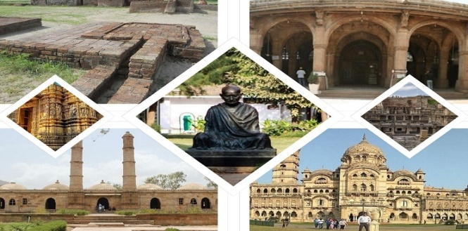
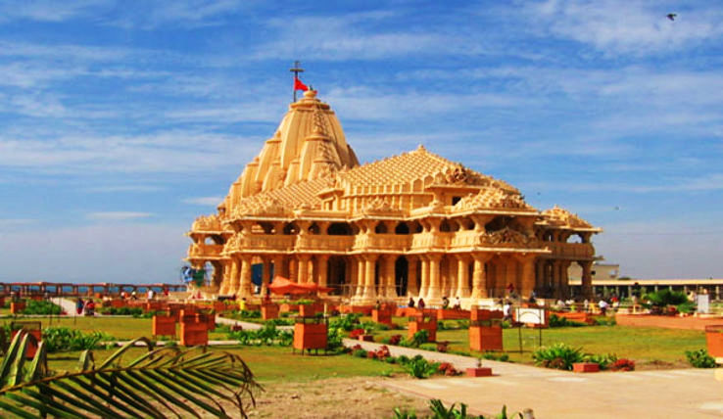
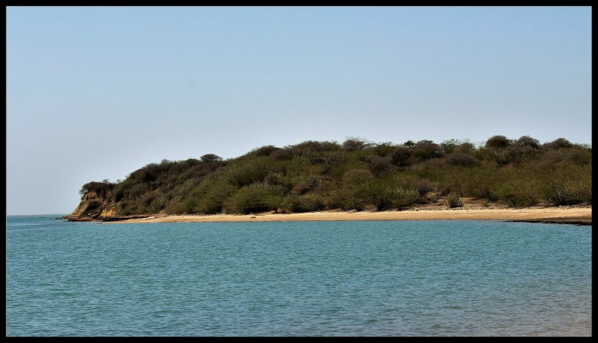
Heritage *champaner *Indus civilization sites like Lothal and Dholavera *Ancient Buddhist sites Spiritual *Jyotirlingas at Somnath Temple *Dwarkadhish Temple *Dwarka *Pavagadh *Mount Girnar at Junagadh Reactional and Eco *Nal Sarovar *Gandhinagar *Dunny Point
CITIES FAMOUS FOR

Slide 7
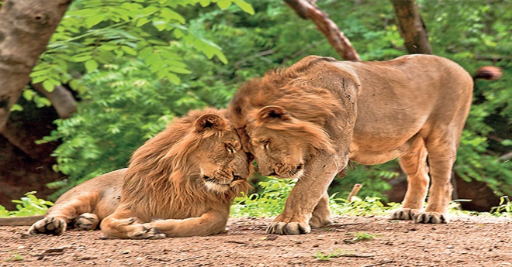

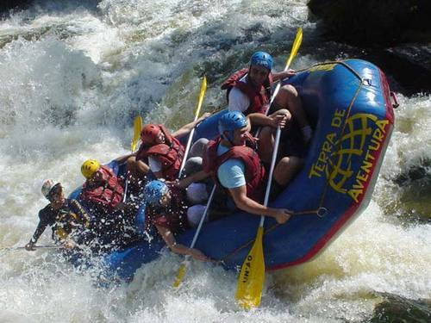
Nature *Asiatic Lions in Gir Forests *Wild Ass in Rann of Kutchh *Dugong is found in Okha *Indian bustards in bird reserves Health *Ahmedabad *Nadiad *Karamsad *Vadodara *Gandhinagar *Mehsana Adventure *Aero Sports - Saputara , Pavagadh , Jungadh *Watersports – Ahmedpur Mandavi , Dwarka , Tithal , Chorwad

Slide 8
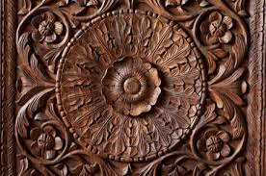
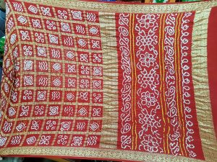
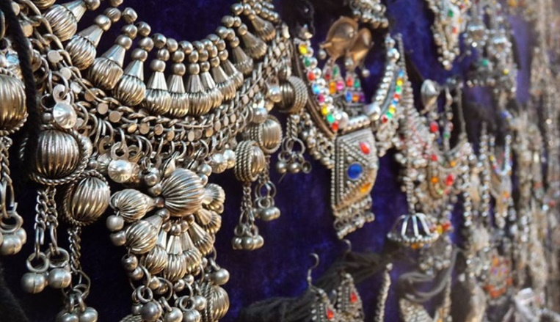
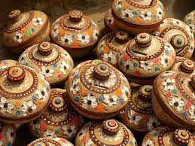
Gujarat is blessed with rich and vibrant tradition of Handicrafts . It is widely differing in its proportion of its patterns to the element of wonderful exquisite Artifacts in various forms. It stand unique with diverse and crafts – a mixed combination with aesthetic appeal . *Needlework *Pottery *Tie and dye – Bandhani *Woodwork *Beadwork *Textile culture *Patola *Zari *Temple culture *Jewellery *Furnishings
TRADITION , CULTURE AND LIFESTYLE

Slide 9
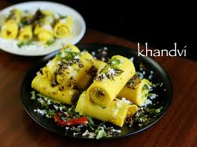
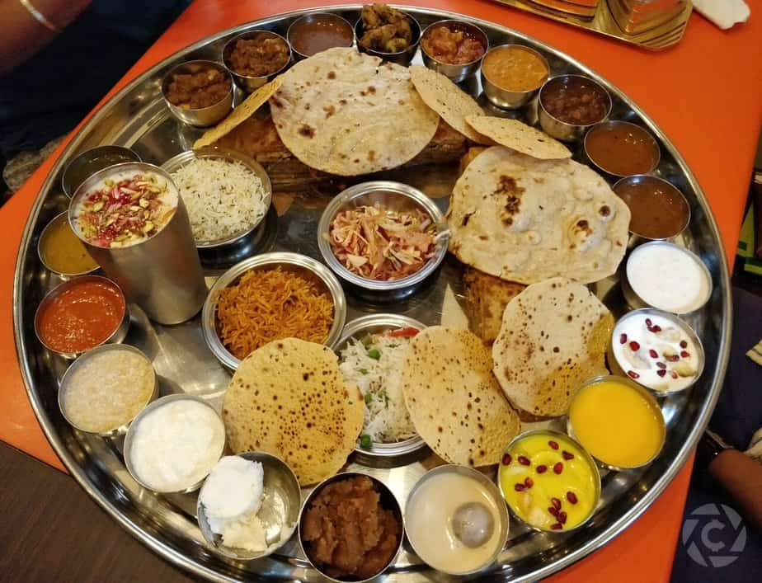
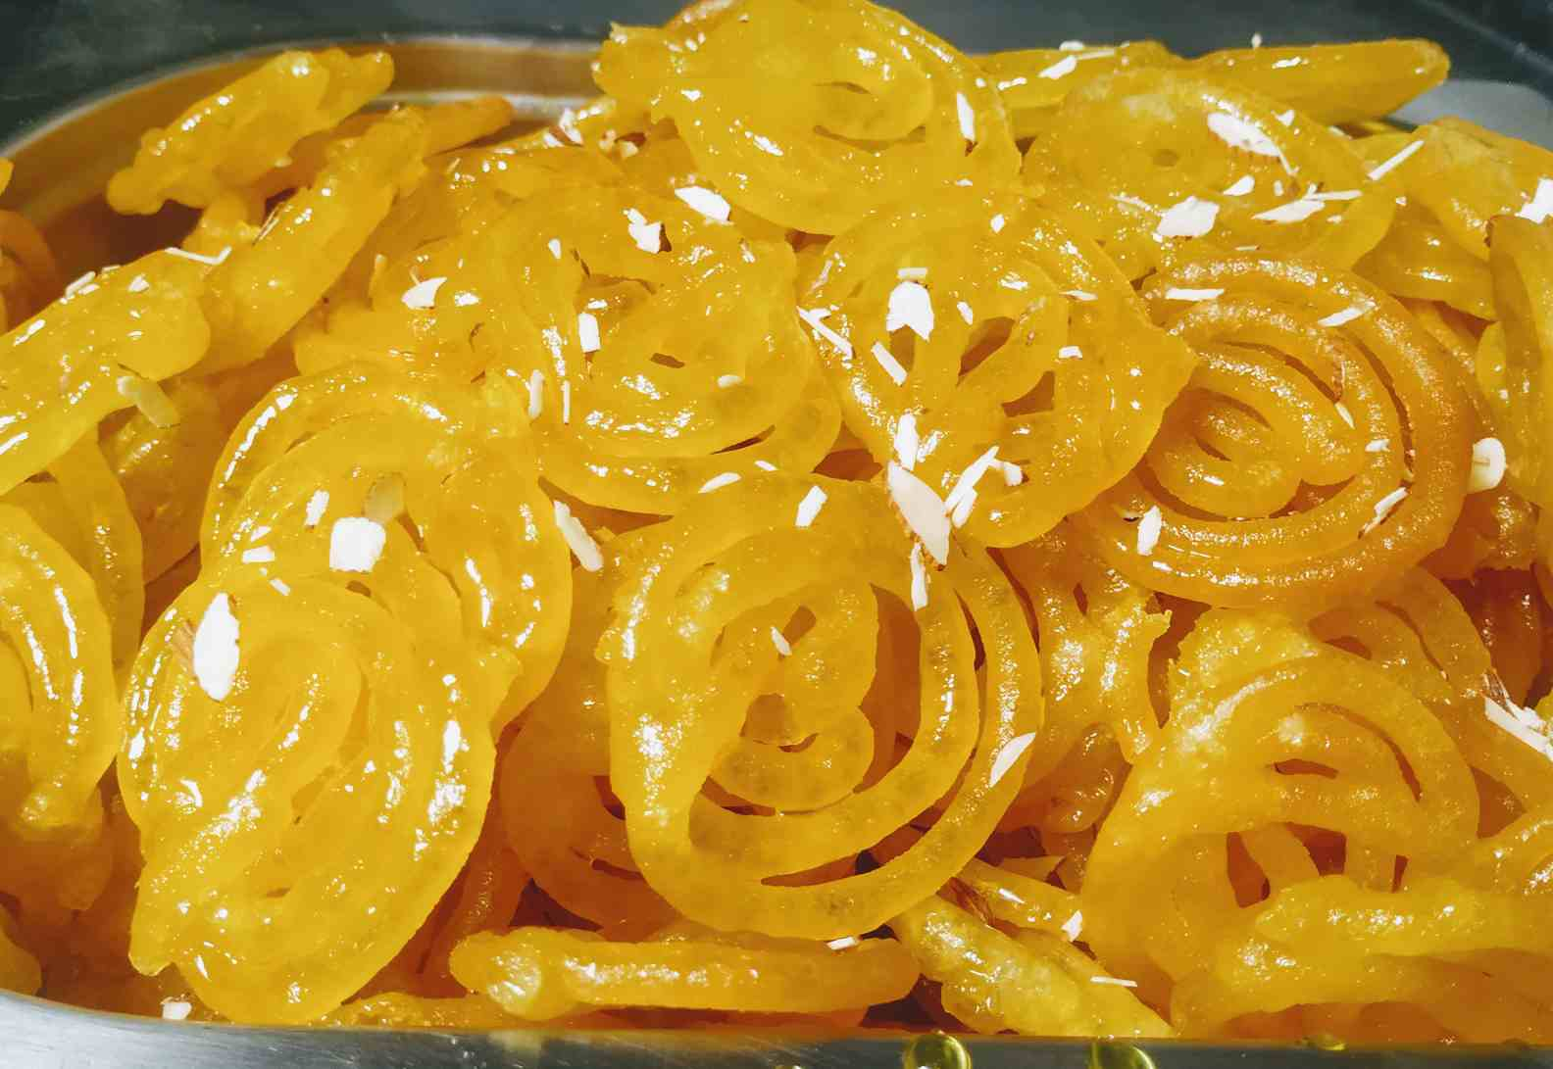
As Gujarat stands as “HEARTH OF INDIA” , Multiculturalism is traced in Gujarat . Originally known as Gujars , Guajarati's are influenced by the waves from the past that inherit values of arts, culture and tradition. For costumes , traditional outfits like chania choli by women and kedia dress is worn by men in rural areas or during cultural festivals . A traditional “GUJRATI THALI” consisting of dal , roti and vegetables apart from salads , farsan and sweet dish followed by chaas , forms the morning meal . A variety of Cuisine sub- ordinates like pickles , chutney , papad ,yoghurt , etc serve as fillings on main menu .

Slide 10
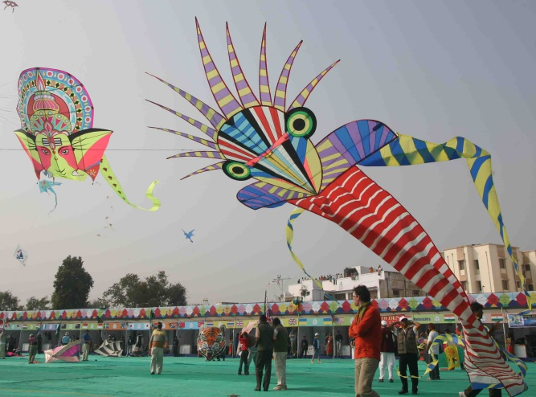
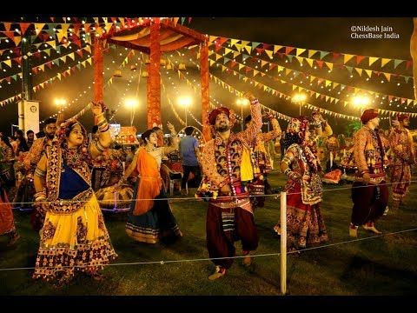
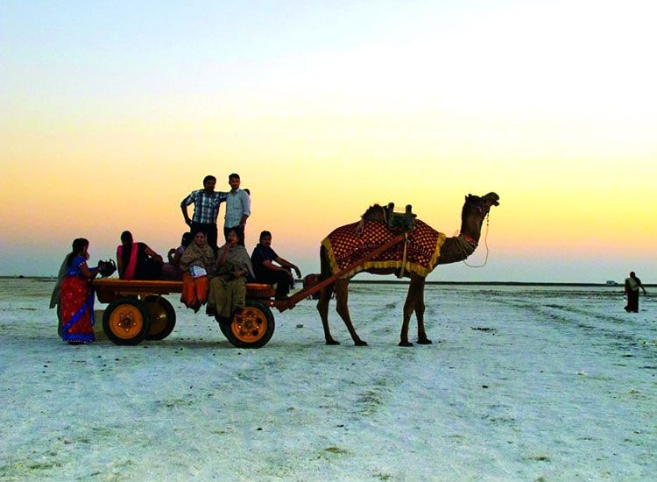
Kite Festival(Makar Sankranti , January) Global Garba(October – November) Rann Utsav(November – December)
FAIRS AND FESTIVALS

Slide 11
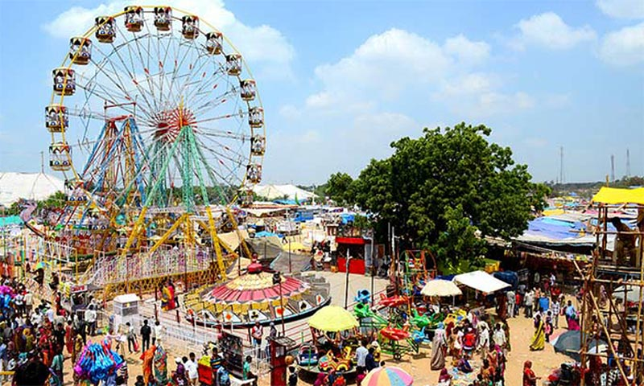
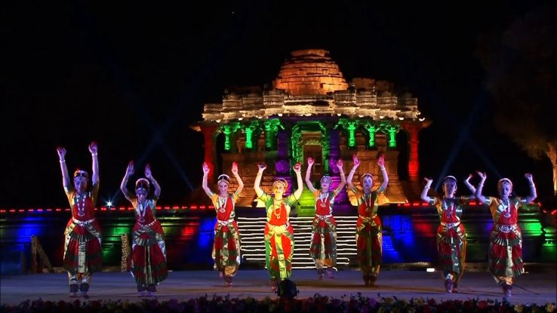
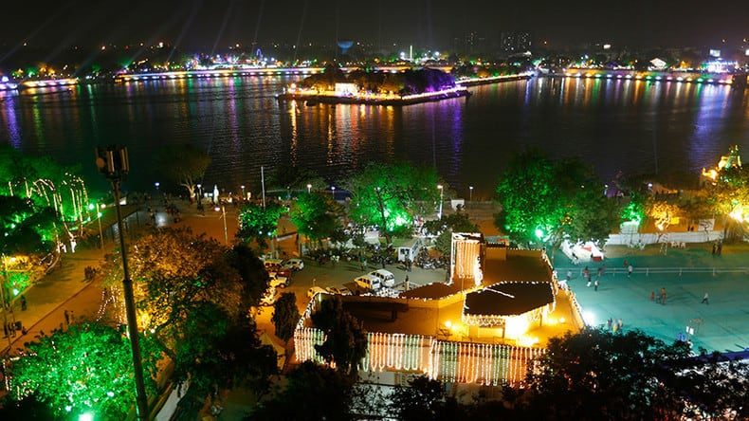
Tarnetar Fair(August) Modhera Dance Festival (3rd week January) Kankaria Carnival (25-31 December)

Slide 12
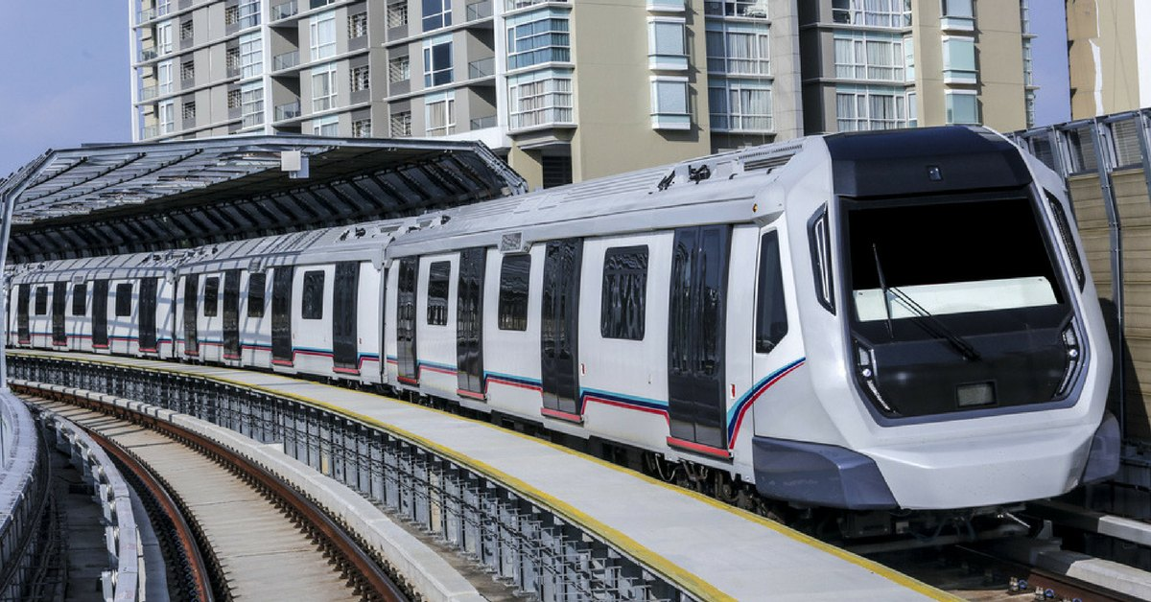
Eight Tourism Hubs have been created for convenience of tourists visiting Gujarat : *Ahmedabad Metro *Ahmedabad Rural (north gujarat) *Surat( south gujarat) *Vadodra(central gujarat) *Rajkot *Junagadh *Jamnagar(saurashtra) *Bhuj(kutch) These hubs are well equipped with the modern infrastructure, facilities and services in the areas of commerce , communication , connectivity , hospitality , transportation , medical facilities.

Slide 13
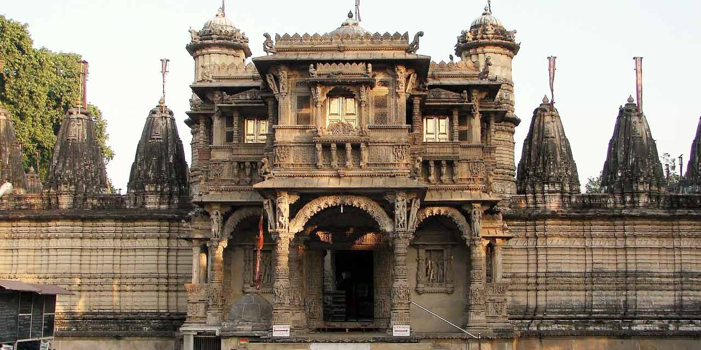
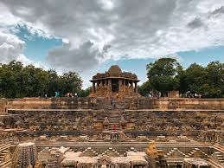
Founded in the 15th century, Ahmedabad is the largest city in the state of Gujarat . The city is a vibrant business district and raising Centre of education , information technology and scientific industries . Divided in two – the old city and the new city; Ahmedabad enjoys a thriving cultural tradition , being the centre of Gujarati cultural activities . Popular celebrations and observances include Uttarayan - an annual kite – flying day on 14 January and the nine nights of navaratri – celebrated with people performing Garba – the folks dance of Gujarat – at venues across the city.
AHEMDABAD
HATHEE SINGH JAIN TEMPLE
MODHERA SUN TEMPLE

Slide 14
Religious Sites *Hathee - singh Jain Temple *Swaminarayan Temple *Akshardham Forests & Natural Ecosystem *Sundarvan *Indora Nature Park Heritage Monuments *Jhulta Minara Others *Ravivar (Sunday) Market *Vishala
AHMEDABAD METROPOLITAN

